Slide 1
Employee Attrition Prediction: From Data to Deployment
Ashmitha Maduri

Slide 2
Agenda
Introduction
Problem Definition
Path to Predictive Insights
- Data Collection + Data Cleaning
- Data Visualization + Data Analysis
- Feature Engineering
- Model Building
- Model Deployment
4. Conclusion

Slide 3


Introduction
Employee attrition, the departure of employees from an organization, poses a critical challenge for businesses globally.
Its implications extend beyond talent loss to encompass productivity setbacks and financial implications.
This project focuses on addressing this challenge through various stages, including data collection, preprocessing, and model deployment.
By utilizing advanced techniques, the aim is to help organizations identify potential attrition cases and implement proactive strategies for employee retention.

Slide 4
Problem Definition
The challenge of employee attrition is impacting businesses across industries. The departure of valuable talent leads to increased costs and reduced productivity.
To address this, a robust machine learning model is needed to predict attrition accurately, enabling proactive retention strategies.
By solving this problem, organizations can optimize workforce management, reduce attrition rates, and achieve sustainable growth in a competitive landscape.

Slide 5
Navigating Employee Attrition: Unveiling the Path to Predictive Insights
Data Collection + Cleaning
1
Acquiring relevant data from Kaggle
Identifying and Handling missing values if any; by performing statistical analysis
Data Visualization +Analysis
2
Analysing various departments employees are from, their salaries, satisfaction levels and retention rates
Analysing correlation between different features
Checking the skewness of the distributions
Feature Engineering
3
Encoding the categorical features into numeric using Label Encoder.
Scaling the features using MinMax Scaler
Model Building
4
The model training involved using various algorithms and hyperparameter tuning. The algorithms used include
Model Deployment
5
I utilized the Spyder IDE within the Anaconda environment for model development and experimentation.
To deploy the model and create a user-friendly interface, I leveraged Streamlit, a powerful Python library for building interactive web applications.
Logistic Regression,
XG Boost,
Random Forest,
Ada Boost,
Gradient Boost,
Support Vector Machine, and
Decision Tree Classifier.
These algorithms were tuned using Grid Search CV to optimize their performance.

Slide 6
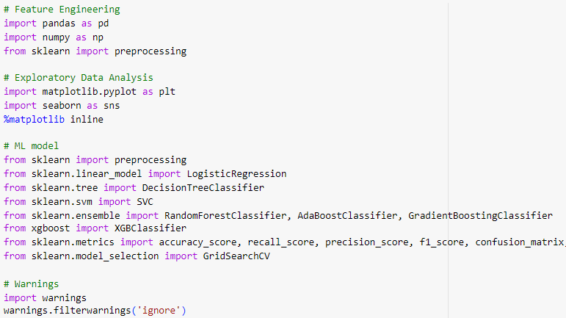
Data Collection + Data Cleaning
Dataset - https://www.kaggle.com/datasets/giripujar/hr-analytics?resource=download
Importing the Libraries

Slide 7
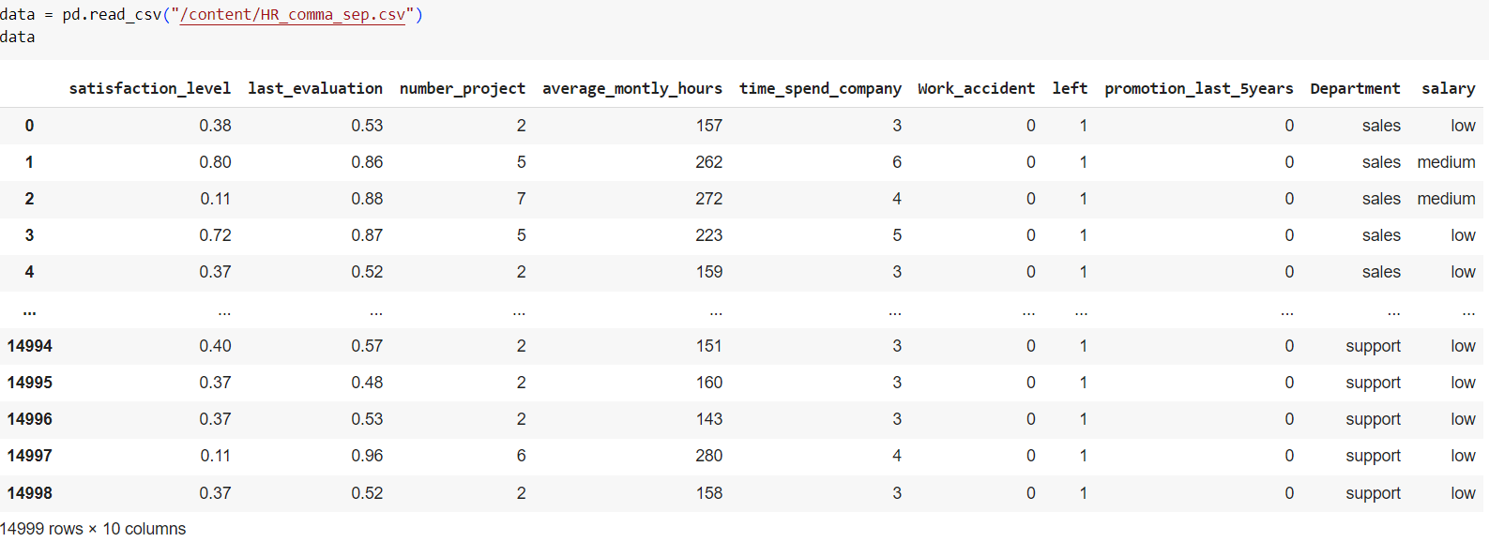
Loading the Data

Slide 8
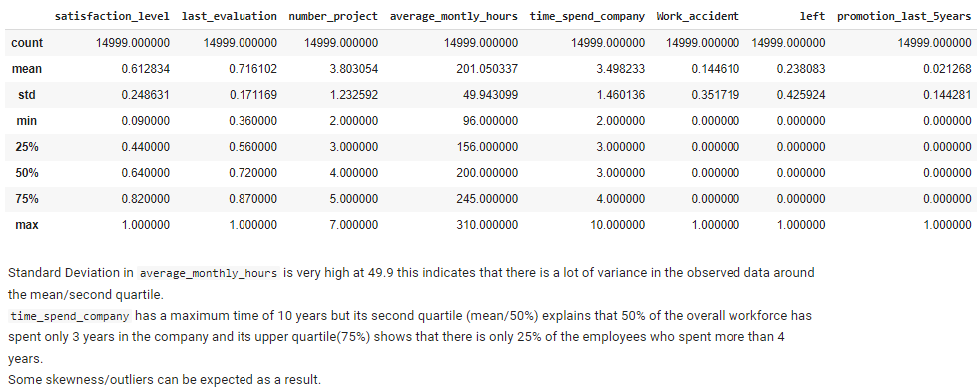
Statistical Analysis

Slide 9

Data Visualization + Data Analysis
(EDA)
This Photo by Unknown Author is licensed under CC BY-SA-NC

Slide 10
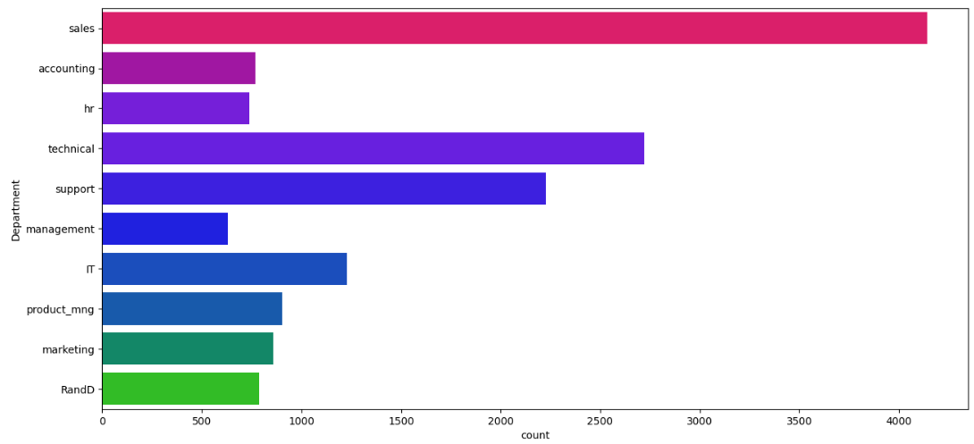
Distribution of the Departments

Slide 11
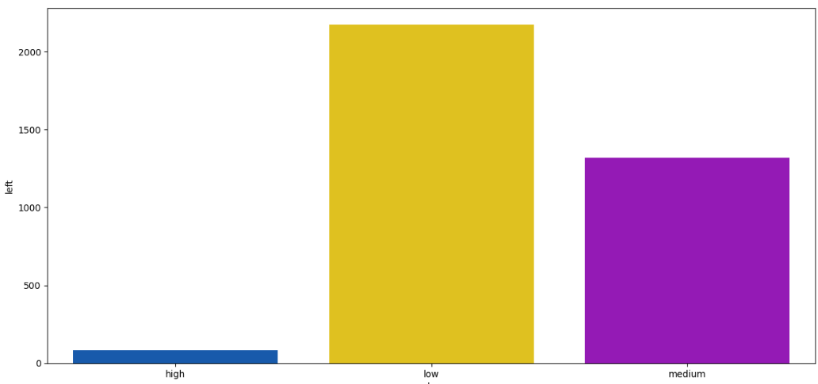
Salary Distribution : The low to medium range salaried employees tend to leave the company more frequently in comparison with high salaried ones; this could be because the strategic level employees (high salaried) are settled and content with the company unlike (low/medium) salaried ones and therefore this factor could behave as an outlier further.

Slide 12
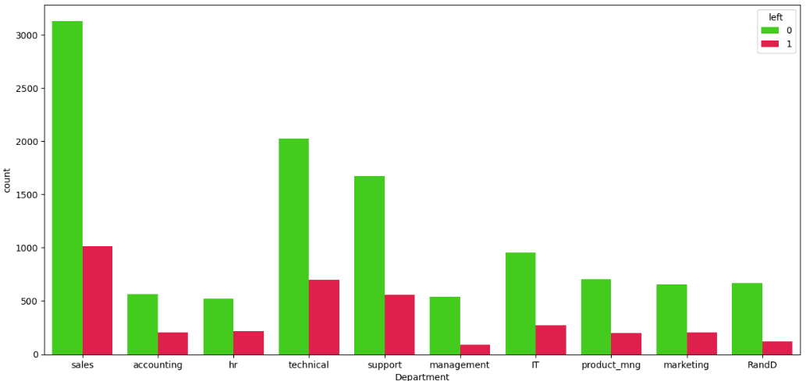
Department wise Attrition : Out of the total employees who left the company (3571) those who left from Sales, Technical and Support Departments sum up to more than 75% this could be because they are from the functional level of the organisation.

Slide 13
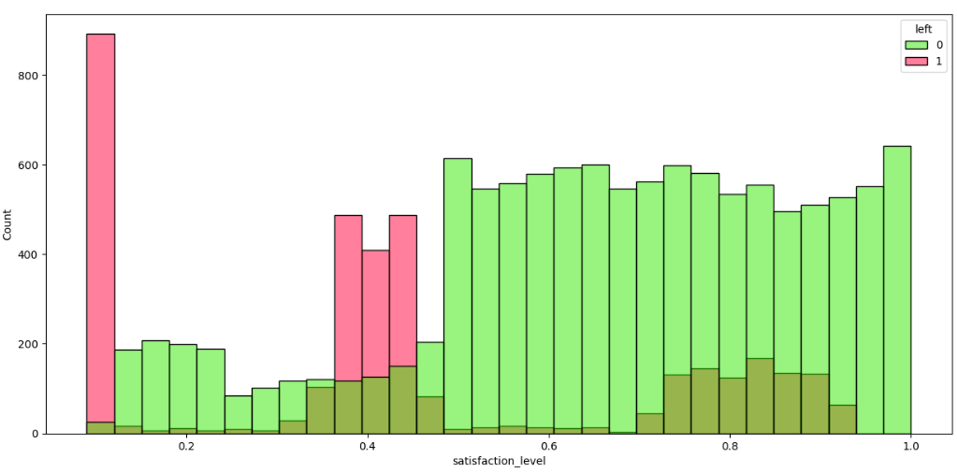
Analysing Satisfaction levels : It is evident that employees who left the company were not really satisfied and employees who were satisfied didn't leave.

Slide 14
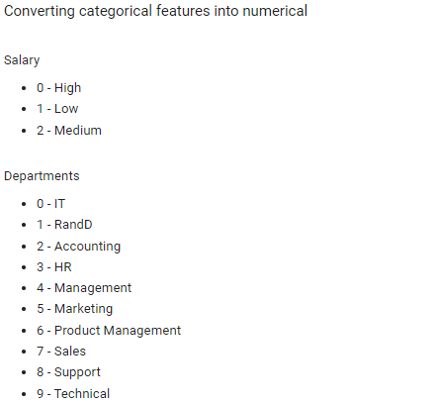
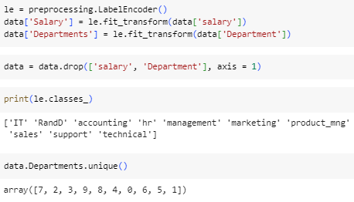
Feature Engineering Converting categorical features into numerical 1. `Salary` 2. `Departments`

Slide 15
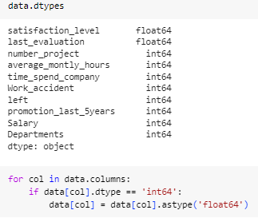
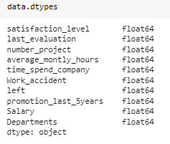
Ensuring all the columns have the same data type

Slide 16
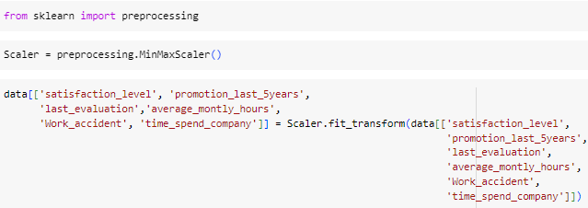
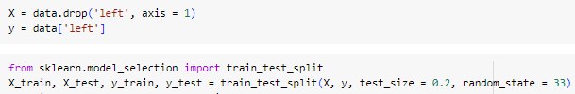
Scaling + Splitting

Slide 17

MODEL BUILDING

Slide 18
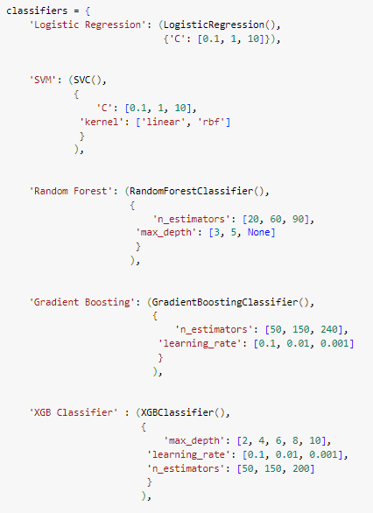
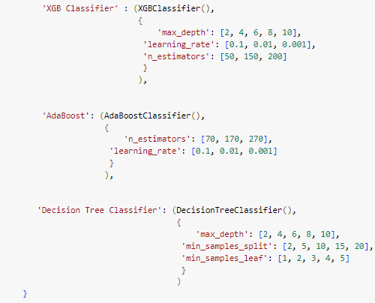
Training the ML Model

Slide 19
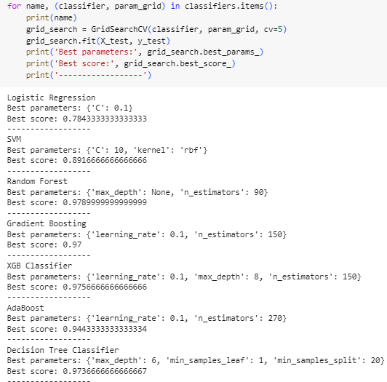
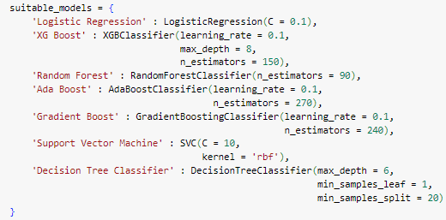
Conducting GridSearchCV on each classifier to identify the optimal model with the best hyperparameters

Slide 20
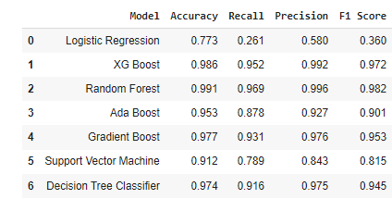
Evaluating the Models
`Accuracy`: Random Forest produced the best test accuracy with its score at 99.1%
`Recall`: Random Forest is the strongest by far with a score of 96.6%. XG Boost is second.
`Precision`: Random Forest is a clear winner followed by XG Boost, respectively.
`F1 Score`: Random Forest is the best amongst all.

Slide 21
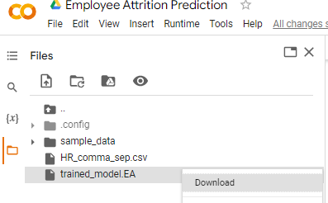
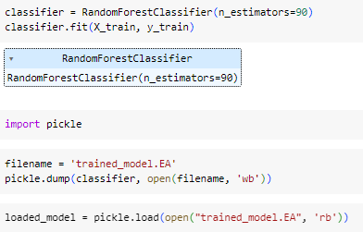
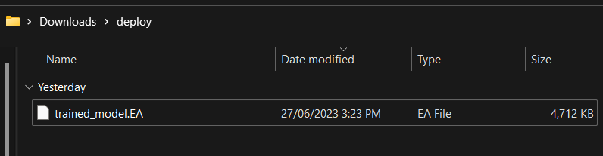




Saving + Downloading the Best Model

Slide 22
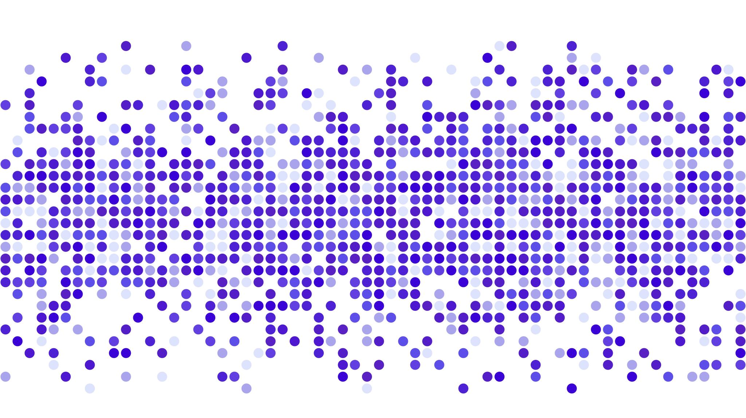

MODEL DEPLOYMENT

Slide 23
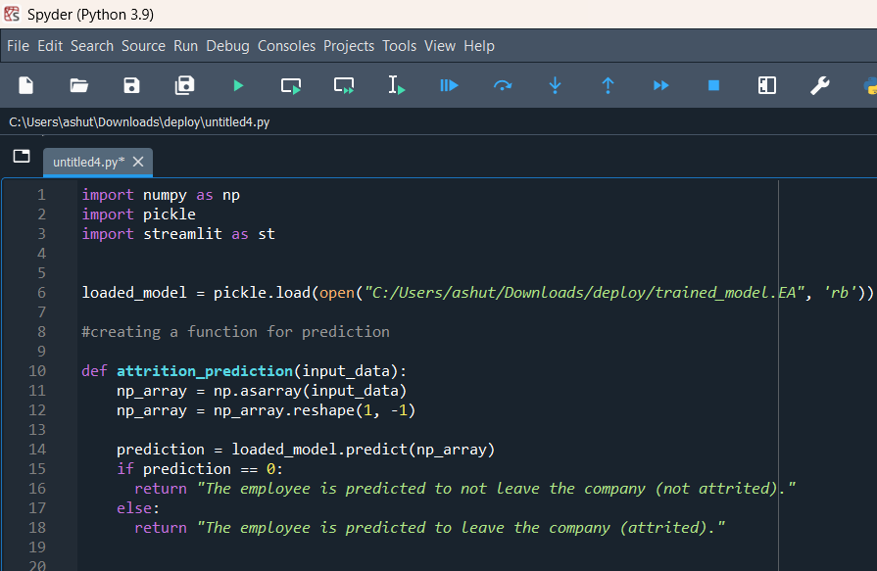
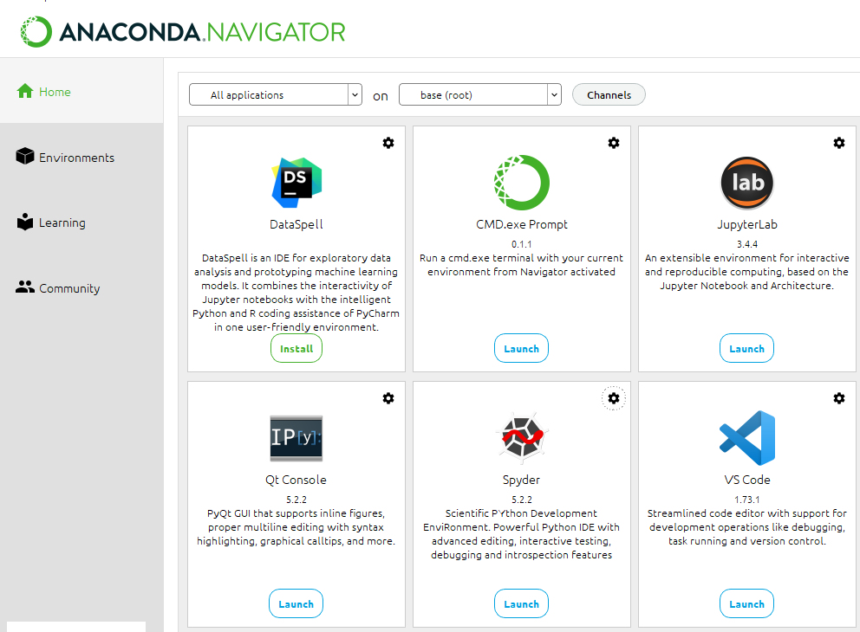




Deploying the Model using Streamlit

Slide 24
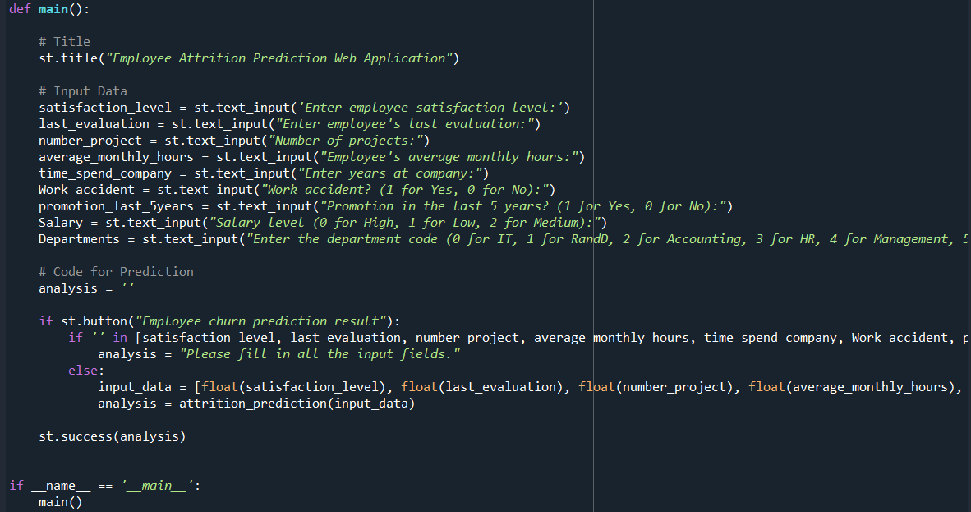
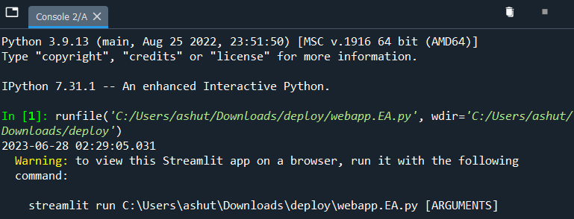


Slide 25
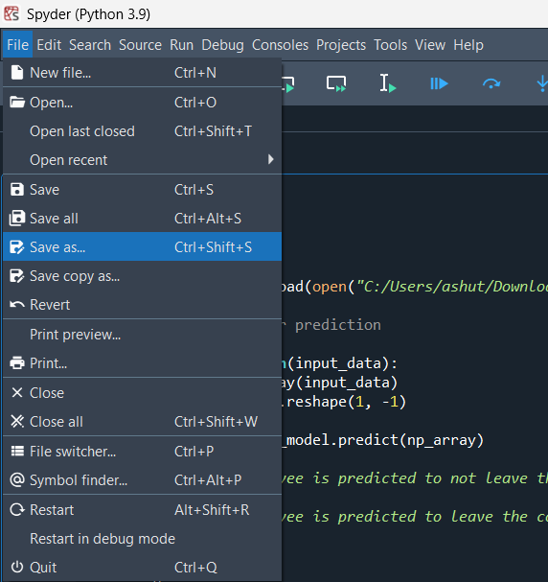
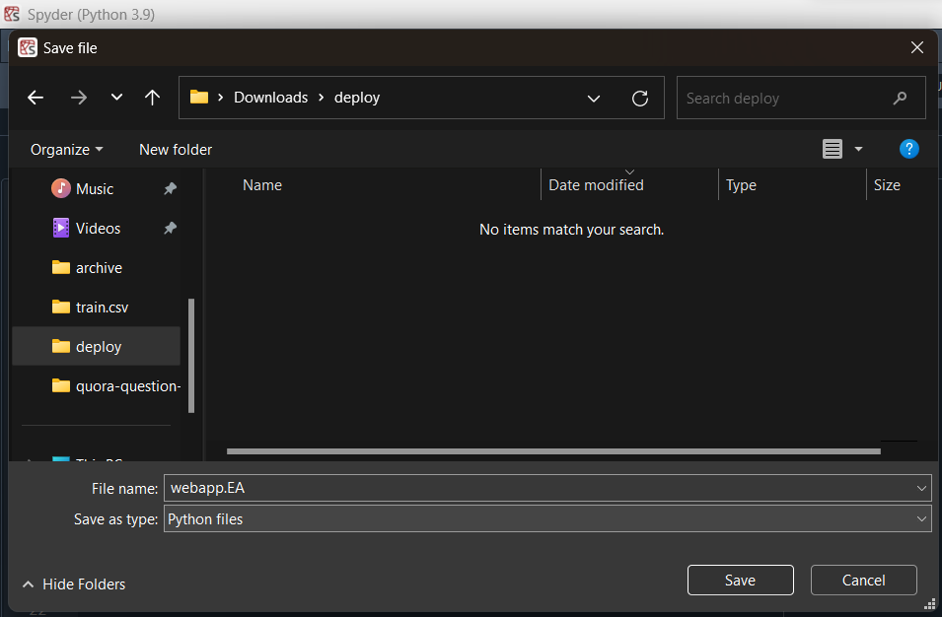



Saving the file

Slide 26
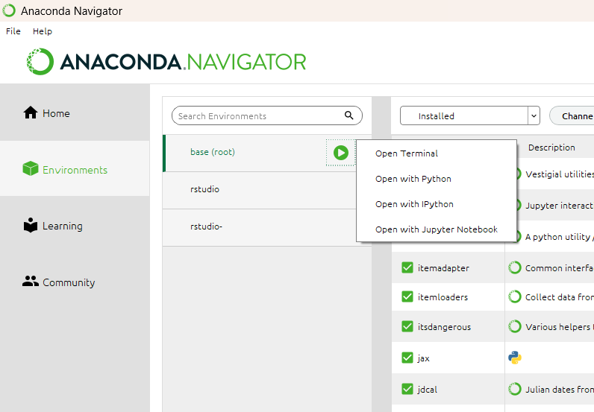
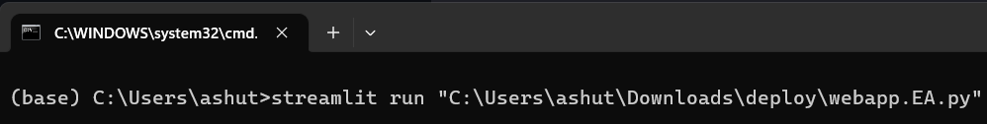
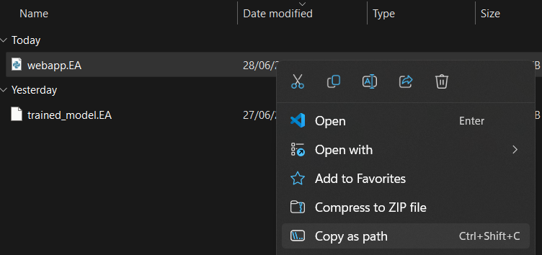





Opening the Terminal for Deployment

Slide 27
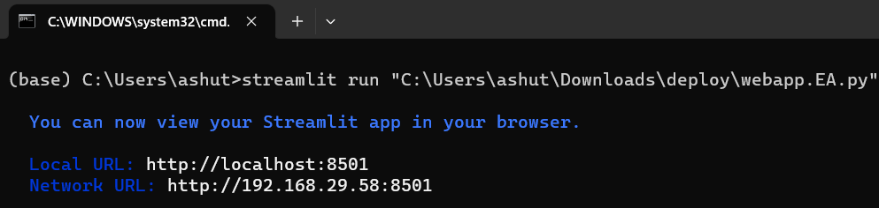




Viewing the Web Application

Slide 28
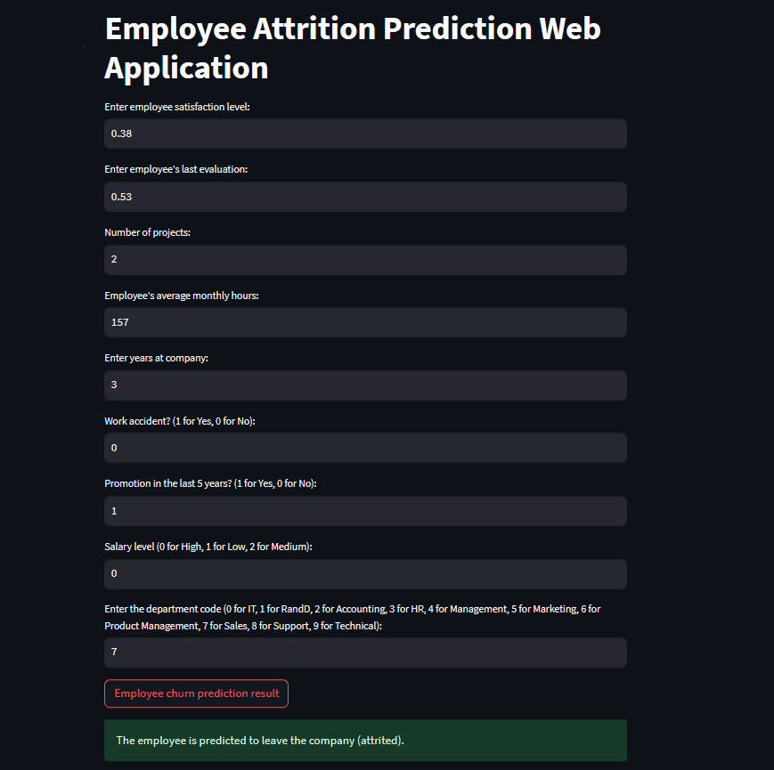


Filling the inputs
Clicking on this to view the result
Here’s the result

Slide 29

Conclusion
The developed employee attrition prediction model holds significant value for businesses and organizations in mitigating employee turnover and its associated costs.
By using this model, organizations can proactively identify employees who are at a higher risk of leaving and implement targeted retention strategies.
The insights provided by the model can assist decision-makers in making informed human resource management decisions, such as improving employee satisfaction, providing appropriate incentives, or addressing issues within specific departments.
Overall, the model can help organizations optimize their workforce management practices, reduce attrition rates, enhance productivity, and create a more stable and engaged workforce.
This Photo by Unknown Author is licensed under CC BY-NC-ND

