Slide 1
Introduction to R

Slide 2
Unit Overview
This is an applied, interactive unit. Lectures will introduce new methods and we will apply these methods using software in class. Please bring your laptop to every class.
This year based on feedback from faculty and the Head of School, we have overhauled the unit and will be teaching more modern, advanced methods that will enable you to analyse many types of data using state of the art approaches. Broadly, the topics are:
Mixed effects models (multilevel models) and extensions on them
These models extend regression models to deal with repeated measures and combined with regression methods taught from 3rd year, are suitable for answering the majority of research questions in honours.
Working with real world data, in preparation for working with your own data for your thesis.
Graphing and plotting data and dealing with missing data

Slide 3
Unit Assessments
Assessment (MCQ) (10%) [Week 7]
Online Moodle quiz. You will be given a dataset in advance & conduct analyses, then use the results to answer multiple choice questions.
Essay (2500 words) (35%) [Week 8]
Same format as the honours thesis proposal
In place of the (typically brief) data analysis plan, write a comprehensive plan (eg, data management plans, cleaning, descriptives, missing data, and analysis)
Research Workbook (1500 words) (20%) [Week 12]
A log book of exercises associated with each lecture. Turned in end of semester but strongly encourage completing each piece after the relevant lecture
Exam (90 minutes) (35%) [date TBD]
Focused on the conceptual aspects of the unit.
Multiple choice questions

Slide 4
Introduction to R

Slide 5
Background
R is…
A programming language and environment for statistical computing
Completely controlled by written code
Open source, meaning that anyone can inspect how R is written, good for science as it is possible to verify any aspect of an analysis conducted in R
Available free of cost
Written and maintained by a community of thousands of developers
When you install R, it’s like a new phone
Some built in features
Most the features / use come from other apps (called ‘packages’ in R)
>16,000 R packages freely available, which give R its amazing flexibility

Slide 6
Background
R is mostly a functional language (ie based on using functions)
Functions take this general form: functionName(x) = y
In that example, functions take input, x, process it, and return some output, y. In R inputs are called the function arguments.
After the name of a function, R always uses parentheses ( ) and all the arguments go inside parentheses
Here is a real example in R: sum( c(1, 2, 3) )
This is actually two different functions: sum() and c(). The c() functions combines a set of numbers into a vector. The sum() function adds up all the numbers in a vector.
By default, R returns the output of a function to the console. However, we can save function output to use later

Slide 7
Background
Often, we store output from functions, either to use in another step or so that we can examine it repeatedly without re-running the function. R stores/saves output using the arrow operator: <-
x <- sum(c(1, 2, 3))
This code saves the sum of the numbers 1, 2, 3 into an object named “x”. We choose the name, here we chose “x” but any name would do. Note if you already have an object named “x” in your workspace, this will overwrite it.
As with many programming languages, R is case sensitive
Sum() is not the same function as sum()
“DepSymptoms” is not the same variable as “depsymptoms”
If code seems to be correct but R is saying it cannot find a function or variable, there is a good chance the capitalization is incorrect
R can have multiple datasets open simultaneously
This means for every command, you typically have to specify both the variable(s) you want to use and the name of the dataset to use

Slide 8
Installing/Setting up R & RStudio [~ 30 minutes]
If you had trouble with install/setup, go to the link below with the install instructions and raise your hand for assistance.
https://jwiley.github.io/MonashHonoursStatistics/IntroR.html

Slide 9
Try out R
[Note, if you still do not have RStudio and R working on your own laptop, follow along with a classmate]
Download
Download the worksheet from here if you have not already:
https://jwiley.github.io/MonashHonoursStatistics/IntroR.html

Slide 10
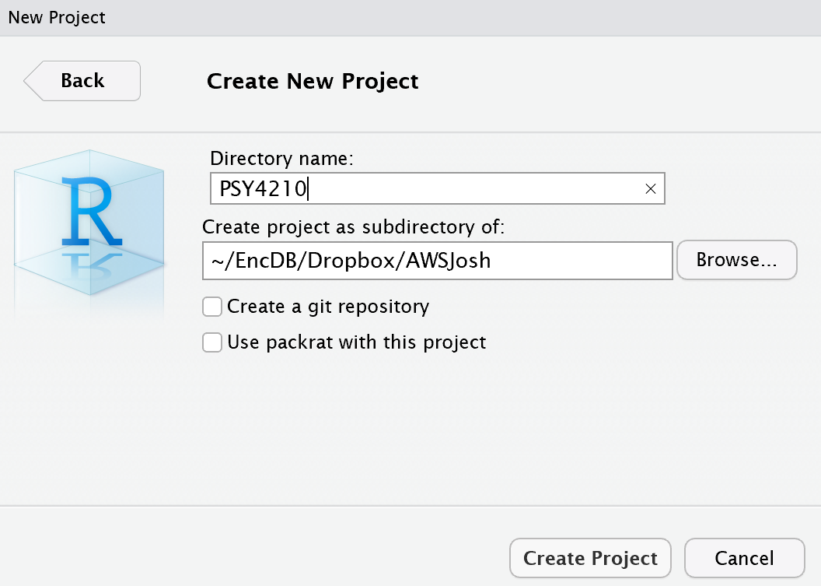

Slide 11
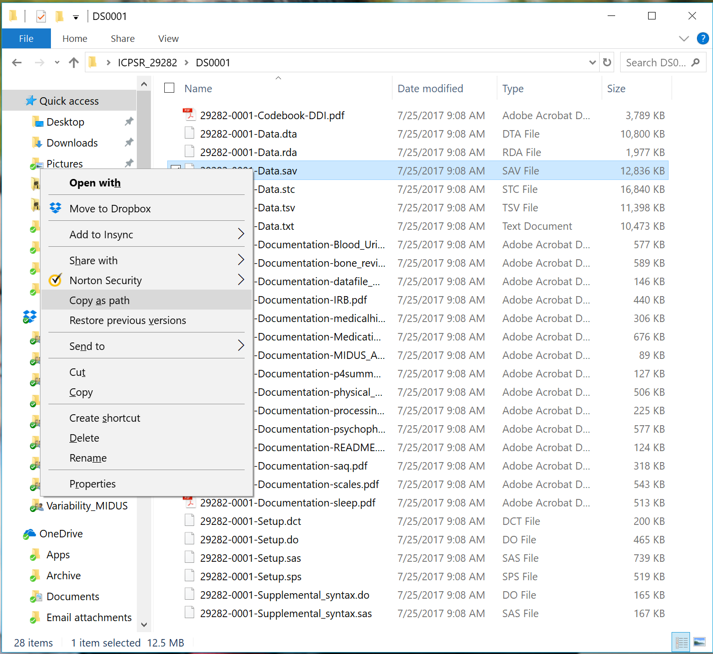
Windows: Copy File Path
To bring up the “Copy as path” option, find the file, hold down Shift and (while holding shift) right click ➔ then choose “Copy as path”
For a video demo, see: https://youtu.be/S8-qrQlgqLo

Slide 12
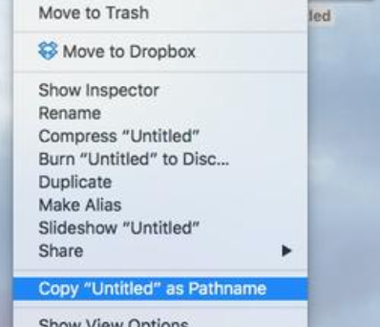
Mac: Copy File Path
To copy the file path on Mac, right-click (two-finger click on trackpads) on the file or folder in the Mac Finder ➔ with the right click menu up, hold down the “option” key to toggle the menu ➔ choose “Copy [filename] as pathname”
For a video demo, see:
https://youtu.be/zan41ihxbY8

Slide 13
With the original SPSS dataset open, bring up the SPSS syntax editor,
Paste (Ctrl + V on Windows; Cmd + V on Mac) the path to the original data file into the editor. It might look something like:
"C:\Users\jwile\Desktop\ICPSR_29282\DS0001\29282-0001-Data.sav"
"/Users/jwile/Desktop/ICPSR_29282/DS0001/29282-0001-Data.sav"
Paste the SPSS syntax from the bottom of the slide
Edit the file name in the OUTFILE from the example syntax, to use the path and filename for your computer, be sure to change the filename itself (e.g., by adding “_reduced.sav” or something like that.
"C:\Users\jwile\Desktop\ICPSR_29282\DS0001\29282-0001-Data_reduced.sav"
"/Users/jwile/Desktop/ICPSR_29282/DS0001/29282-0001-Data_reduced.sav"

