Slide 1
Procurement Management

Slide 2
Introduction
Why is it Important?
Ensures uninterrupted operations.
Reduces costs, improves efficiency, and mitigates risks.
Provides Flexibility
To allow client organizations to focus on core business

Slide 3
Introduction
Procurement management is the process of identifying, acquiring, and managing the resources, goods, or services needed for a project.
It involves planning, negotiating, purchasing, and overseeing suppliers to ensure the procurement process is efficient, cost-effective, and aligns with organizational goals.
Effective procurement management ensures that resources are delivered on time, within budget, and meet the required quality standards.

Slide 4
Procurement Planning
Procurement planning involves determining which project needs can be met through external products or services. It includes:
Whether to procure: Deciding if outsourcing is necessary.
How to procure: Selecting the method for acquisition (e.g., contracts, bids).
What to procure: Identifying the specific goods or services required.
How much to procure: Determining the quantity based on project scope and budget.
When to procure: Scheduling procurement to align with project timelines.
Where to procure: Identifying suppliers or vendors that best meet quality, cost, and delivery needs.
Managing procurement risks: Evaluating and mitigating potential issues with vendors or supply chains.

Slide 5
Key Steps in Procurement Management
1. Needs Assessment
2. Market Research
3. Supplier Selection
4. Purchase Order Creation
5. Delivery and Inspection
6. Payment and Record Keeping

Slide 6
Procurement Management Processes
Procurement Planning: Determining what goods or services are needed and when to procure them.
Solicitation Planning: Documenting product or service requirements and identifying potential vendors.
Solicitation: Requesting quotations, bids, proposals, or offers from suppliers.
Source Selection: Evaluating responses and selecting the most suitable vendor.
Contract Administration: Managing the vendor relationship, ensuring performance, and addressing issues.
Contract Close-Out: Finalizing all contract obligations, completing payments, and settling terms.

Slide 7
Procurement Planning Tools and Techniques
Make-or-Buy Analysis: Evaluating whether to produce goods/services internally or purchase them from external suppliers.
Market Research: Gathering information about suppliers, market trends, and prices to make informed procurement decisions.
Cost Estimating: Estimating the cost of goods, services, or projects to ensure alignment with budget and financial goals.

Slide 8
Make-or Buy Example
• Assume you can lease an item you need for a project for $150/day. To purchase the item, the investment cost is $1,000, and the daily cost would be another $50/day.
How long will it take for the lease cost to be the same as the purchase cost?
If you need the item for 12 days, should you lease it or purchase it?

Slide 9
Make-or Buy Solution
Set up an equation so the "make" is equal to the "buy" • In this example, use the following equation. Let d be the number of days to use the item.
$150d = $1,000+ $50d
Solve for d as follows:
- Subtract $50d from the right side of the equation to get $100d = $1,000
Divide both sides of the equation by $100
d = 10 days
• The lease cost is the same as the purchase cost at 10 days If you need the item for 12 days, it would be more economical to purchase it

Slide 10
Types of Contracts
Fixed-price or lump-sum: involve a fixed total price for a well-defined product or service
Cost-reimbursable: involve payment to the seller for direct and indirect costs
Time and material contracts: hybrid of both fixed price and cost-reimbursable, often used by consultants, where the buyer pays for the time and materials used.
Unit price contracts: require the buyer to pay the seller a predetermined amount per unit of service

Slide 11
Cost Reimbursable Contracts
Cost Plus Incentive Fee (CPIF): The buyer reimburses the seller for allowable performance costs and adds a predetermined fee. The seller can also earn an incentive bonus based on meeting or exceeding certain performance targets.
Cost Plus Fixed Fee (CPFF): The buyer reimburses the seller for allowable costs and pays a fixed fee, usually calculated as a percentage of the estimated project costs. The fee does not change regardless of project performance.
Cost Plus Percentage of Costs (CPPC): The buyer reimburses the seller for allowable performance costs, with an additional payment as a percentage of the total costs incurred. The seller's fee increases as the project costs rise.

Slide 12
Statement of Work (SOW)
A statement of work is a description of the work required for the procurement
Many contracts, or mutually binding agreements, include SOWS
A well-written SOW provides bidders with a clear understanding of the buyer's expectations, helping them submit accurate proposals and reducing misunderstandings.

Slide 13
Statement of Work (SOW)
In software projects, the Statement of Work (SOW) is a key part of the procurement process:
Defines Scope and Requirements: Outlines software features, functionalities, and performance expectations.
Guides Vendor Selection: Helps vendors submit accurate proposals, enabling informed selection.
Serves as Contractual Agreement: Becomes part of the contract, setting terms for deliverables, timelines, and payments.
Tracks Deliverables and Performance: Establishes milestones to monitor progress and ensure project success.

Slide 14
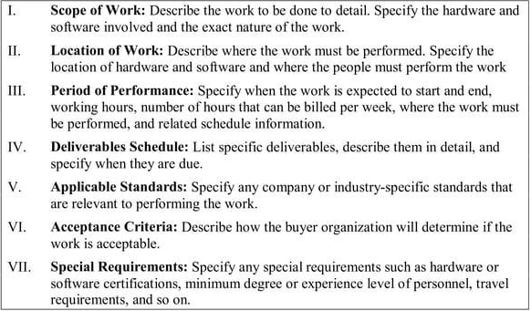
Statement of Work Template

Slide 15
Solicitation Planning
Solicitation planning involves preparing several documents
Request for Proposals: used to solicit proposals from prospective sellers
Requests for Quotes: used to solicit quotes for well-defined procurements
Invitations for bid or negotiation and initial contractor responses are also part of solicitation planning

Slide 16
Source Selection
Source selection involves
Evaluating Bidders' Proposals
Formal Evaluation Procedures
Choosing the Best Proposal
Negotiating the Contract
Awarding the Contract

Slide 17
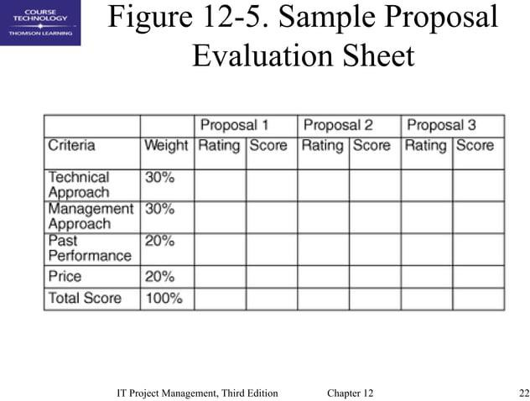
Sample Proposal Evaluation Sheet

Slide 18
Key Considerations in Selecting Suppliers and Writing Contracts:
Check Supplier Stability: Ensure financial reliability and long-term commitment.
Beware of Reputable Suppliers: Even well-known suppliers can fail if not managed properly.
Clear Contracts: Write detailed contracts outlining expectations and penalties.
Effective Management: Monitor contracts to ensure supplier performance.
Learn from Failures: Poor planning and lack of leadership can lead to supplier issues.

Slide 19
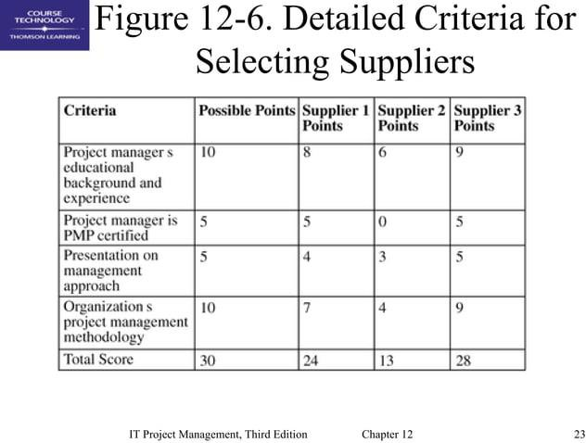
Detailed Criteria for Selecting Suppliers

Slide 20
Contract Administration
Contracts are legal agreements, so legal professionals should be involved.
Ensures the seller performance meets contractual requirements.
Many project managers ignore contractual issues, which can result in serious problems

Slide 21
Suggestions on Change Control for Contracts
Review and Approval: Changes must be reviewed, approved, and documented by the same people who approved the original plan.
Impact Analysis: Evaluate how the change will affect scope, time, cost, and quality.
Documentation: All changes and important communications should be documented in writing.

Slide 22
Latest Trends in Procurement Management
Digital Transformation (AI, blockchain).
Sustainability and green procurement.
Data-driven decisions (analytics for suppliers).
Resilient supply chains (diverse suppliers).
Collaborative procurement (platforms like Coupa).
Risk management using predictive analytics.
Compliance and ethical sourcing.
AI-powered negotiations.

Slide 23
Benefits of Effective Procurement
Cost savings
Improved product quality
Stronger supplier relationships
Risk mitigation
Compliance with regulations

Slide 24
Challenges in Procurement Management
Supplier risks (reliance on one supplier).
Compliance issues (regional regulations).
Cost overruns (unexpected expenses).

Slide 25
Conclusion
Ensures operational efficiency and strategic growth.
Embrace technology and sustainability for a competitive edge.
“Let’s rethink procurement to shape a sustainable and efficient future.”

