Slide 1
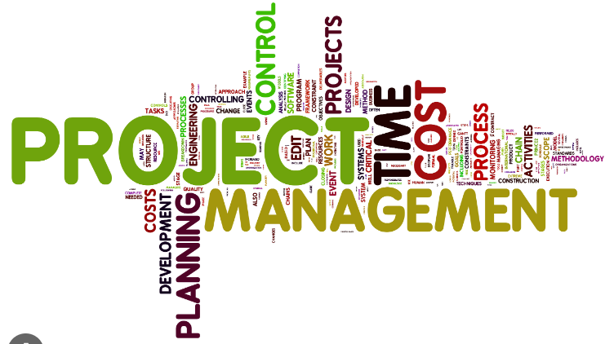
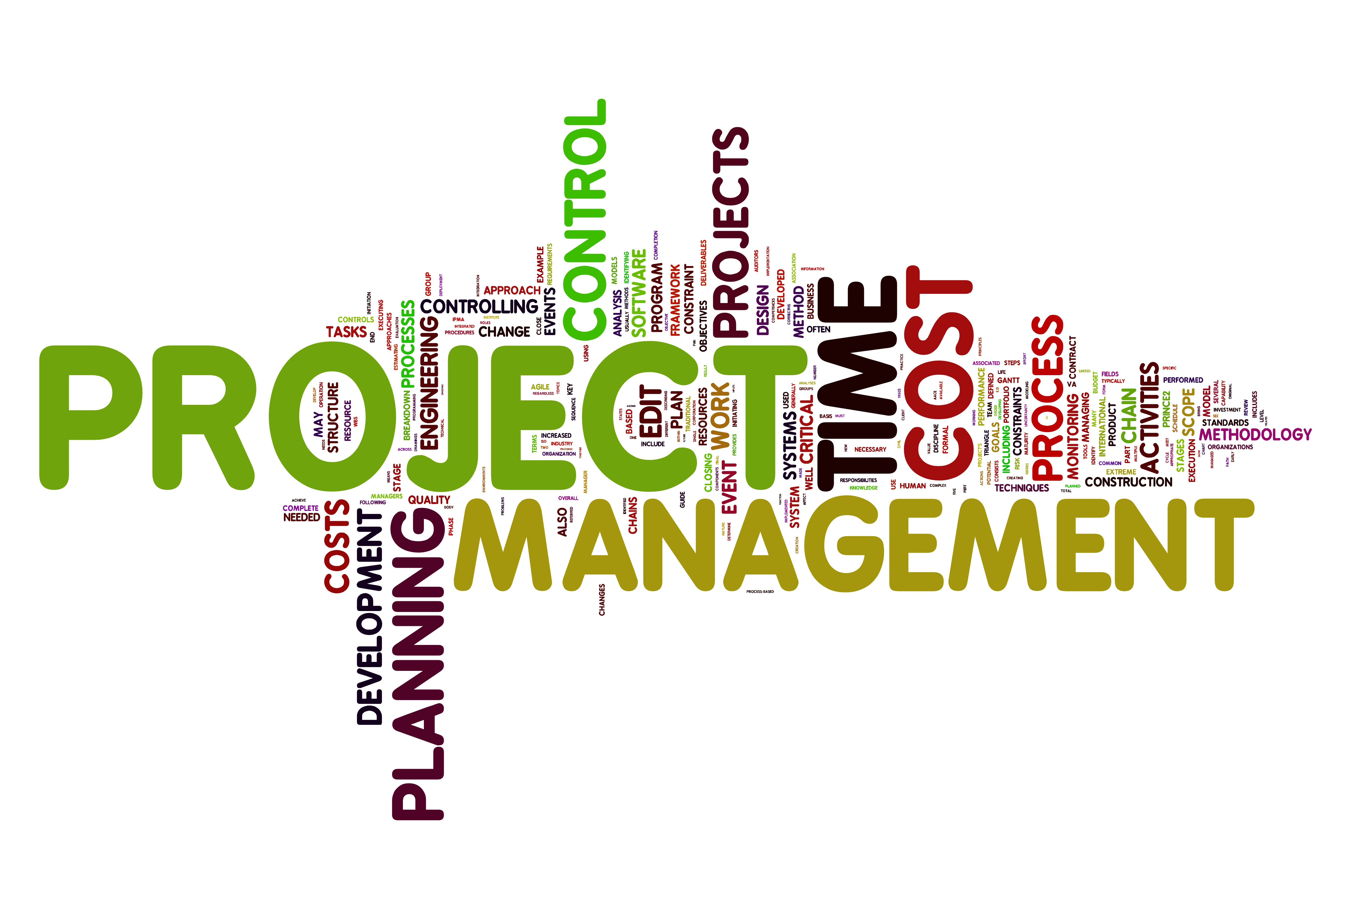
Software Project Management
Lecture 2
Sarah Mazhar

Slide 2
Advantages of Project Management Techniques
• Better control of financial, physical, and human resources
• Improved customer relations
• Shorter development times
• Lower costs and improved productivity
• Higher quality and increased reliability
• Higher profit margins
• Better internal coordination
• Positive impact on meeting strategic goals
• Higher worker morale

Slide 3
Reminder
A project is “a temporary endeavor undertaken to create a unique product, service, or result.”
Operations, on the other hand, is work done in organizations to sustain the business. It focuses on the ongoing production of goods and services.
Projects are different from operations in that they end when their objectives have been reached or the project has been terminated.

Slide 4
It is important to note that people focusing on operations and projects must work together for a smooth transition.
For example, in software development, DevOps is a fairly new term used to describe a culture of collaboration between software development and operations teams to build, test, and release reliable software more quickly.

Slide 5


Examples of IT Projects
Projects can be large or small and involve one person or thousands of people.
They can be done in one day or take years to complete.
As described earlier, IT projects involve using hardware, software, and networks to create a product, service, or result.

Slide 6
Examples of IT Projects
• A large network of healthcare providers updates its information systems and procedures to reduce hospital-acquired diseases. (These infections are usually acquired after hospitalization and manifest 48 hours after admission to the hospital)
• A team of students creates a smartphone application and sells it online.
• A company develops a driverless car.
• A college upgrades its technology infrastructure to provide wireless Internet access across the whole campus as well as online access to all academic and student service information.
• A company implements a new system to increase sales force productivity and customer relationship management that will work on various laptops, smartphones, and tablets.

Slide 7
Examples of IT Project
• A television network implements a system to allow viewers to vote for contestants and provide other feedback on programs via social media sites.
• A government group develops a system to track child immunizations.
• A large group of volunteers from organizations throughout the world develops standards for environmentally friendly or green IT.
• A global bank acquires other financial institutions and needs to consolidate systems and procedures.
• Government regulations require monitoring of pollutants in air and water.
• A multinational firm decides to consolidate its information systems into an integrated enterprise resource management approach.

Slide 8
Gartner, Inc., a prestigious consulting firm, identified the top 10 strategic technologies for 2018. A few of these technologies include the following:
Artificial Intelligence (AI) Foundation: Creating systems that learn, adapt, and potentially act autonomously can enhance decision making and improve the customer experience.
Intelligent Things: AI is driving advances for new intelligent things, including autonomous vehicles, robots, and drones as well as Internet of Things like thermostats, lights, and home appliances.
Cloud to the Edge: Edge computing pushes data handling to the edge of the network, closer to the source of the data. Instead of sending data to the cloud server or central data center for processing, the device connects through a local gateway device, allowing faster analytics and reduced network pressure.
Immersive Experience: Virtual, augmented, and mixed reality are changing the way that people perceive and interact with the digital world. “The virtual reality (VR) and augmented reality (AR) market is currently adolescent and fragmented. Interest is high, resulting in many novelty VR applications that deliver little real business value outside of advanced entertainment, such as video games and 360-degree spherical videos. To drive real tangible business benefit, enterprises must examine specific real-life scenarios where VR and AR can be applied to make employees more productive and enhance the design, training and visualization processes.
As you can see, a wide variety of projects use information technologies, and organizations rely on them for success.

Slide 9


