Slide 1
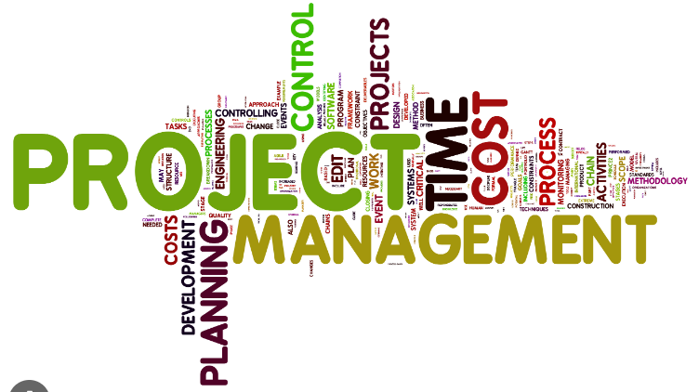
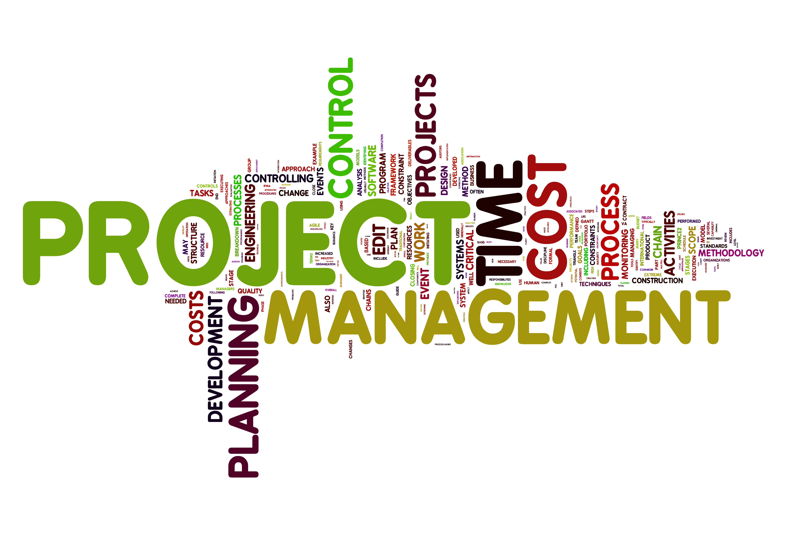
Software Project Management
Lecture 5
Sarah Mazhar

Slide 2
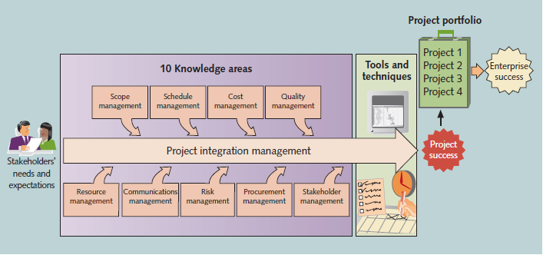

Slide 3
Project Management Knowledge Areas
Knowledge Areas describe the key competencies that project managers must develop.
1. Project scope management involves defining and managing all the work required to complete the project successfully.
2. Project schedule management (formerly called project time management) includes estimating how long it will take to complete the work, developing an acceptable project schedule, and ensuring timely completion of the project.
3. Project cost management consists of preparing and managing the budget for the project.
4. Project quality management ensures that the project will satisfy the stated or implied needs for which it was undertaken.
5. Project resource management is concerned with making effective use of the people and physical resources involved with the project.
6. Project communications management involves generating, collecting, disseminating, and storing project information.
7. Project risk management includes identifying, analyzing, and responding to risks related to the project.

Slide 4
8. Project procurement management involves acquiring or procuring goods and services for a project from outside the performing organization.
9. Project stakeholder management includes identifying and analyzing stakeholder needs while managing and controlling their engagement throughout the life of the project.
10. Project integration management is an overarching function that affects and is affected by all of the other knowledge areas.
Project managers must have knowledge and skills in all 10 of these areas according to the Project Management Institute (PMI)'s Project Management Body of Knowledge (PMBOK) Guide, 7th Edition.

Slide 5
Process Groups
There are five process groups in software project management, according to the Project Management Institute's (PMI) Project Management Body of Knowledge (PMBOK) Guide, 7th Edition:
Initiating: This process group is responsible for defining the project and authorizing its start.
Planning: This process group is responsible for developing the project plan, which outlines how the project will be executed, monitored, and controlled.
Executing: This process group is responsible for carrying out the project plan and delivering the project's products and services.
Monitoring and controlling: This process group is responsible for tracking the project's progress and making necessary adjustments to the project plan.
Closing: This process group is responsible for formally completing the project and delivering the project's products and services to the customer.
The five process groups are not sequential. They can be performed iteratively and concurrently, depending on the needs of the project. The PMBOK Guide is a widely used reference for software project managers, and the five process groups are considered to be the foundation of software project management.

Slide 6
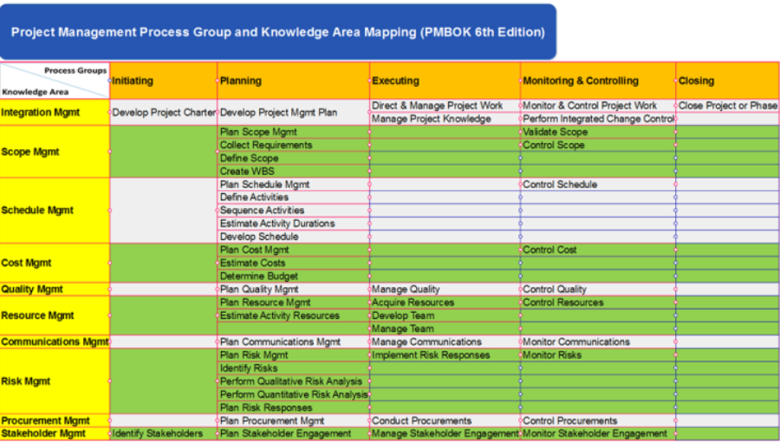

Slide 7
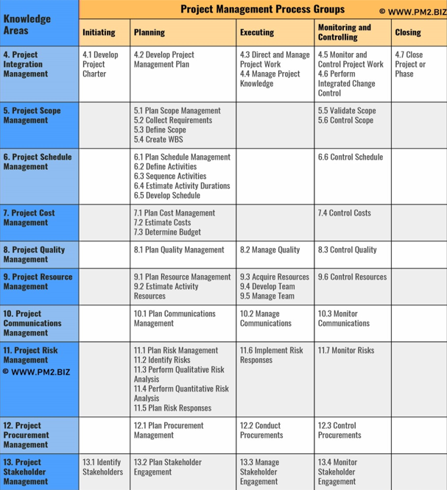

Slide 8
Project Management Tools and Techniques
Thomas Carlyle, a famous historian and author, stated, “Man is a tool-using animal. Without tools he is nothing, with tools he is all.”
Project management tools and techniques assist project managers and their teams in carrying out work in all 10 knowledge areas.
For example, some popular time-management tools and techniques include Gantt charts, project network diagrams, and critical path analysis.

Slide 9
A survey of 753 project and program managers was conducted to rate several project management tools. Respondents rated tools on a scale of 1–5 (low to high) based on the extent of their use and the potential of the tools to help improve project success.
“Super tools” were defined as those that had high use and high potential for improving project success.

Slide 10
The PMBOK® Guide – Sixth Edition now lists tools and techniques based on their purpose, as follows:
• Data gathering: benchmarking, brainstorming, check sheets, checklists, focus groups, interviews, market research, questionnaires and surveys, and statistical sampling
• Data analysis: alternatives analysis, assessment of other risk parameters, assumption and constraint analysis, cost of quality, cost-benefit analysis, decision tree analysis, document analysis, earned value analysis, and several other tools fit in this category

Slide 11
Data representation: affinity diagrams, cause-and-effect diagrams, control charts, flow charts, hierarchical charts, histograms, logical data models, matrix diagrams, matrix-based charts, mind mapping, probability and impact matrix, scatter diagrams, stakeholder engagement assessment matrix, stakeholder mapping/representation, and text-oriented formats
• Decision making: multi-criteria decision analysis and voting
• Communication: feedback and presentations
• Interpersonal and team skills: active listening, communication styles assessment, conflict management, cultural awareness, decision making, emotional intelligence, facilitation, influencing, leadership, meeting management, motivation, negotiation, networking, nominal group, observation/conversation, political awareness, team building
• Ungrouped: several other tools fit in this category

Slide 12
A process is a series of actions directed toward a particular result.
Project management process groups progress from initiating activities to planning activities, executing activities, monitoring and controlling activities, and closing activities.
A project can have different combinations of phases. One project might have concept, development, implementation, and close-out phases, and another might have initial, intermediate, and final phases.
But all projects and all project phases need to include all five process groups

Slide 13
Initiation Processes
Initiating processes include defining and authorizing a project or project phase. Initiating processes take place during each phase of a project.
For example, in the close-out phase, initiating processes are used to ensure that the project team completes all the work, that someone documents lessons learned, and that the customer accepts the work.

Slide 14
Planning Processes
Planning processes include devising and maintaining a workable scheme to ensure that the project addresses the organization’s needs. Projects include several plans, such as the scope management plan, schedule management plan, cost management plan, and procurement management plan.
These plans define each knowledge area as it relates to the project at a particular point in time.

Slide 15
Planning Processes (continued)
For example, a project team must develop a plan to define the work needed for the project, to schedule activities related to that work, to estimate costs for performing the work, and to decide what resources to procure to accomplish the work. To account for changing conditions on the project and in the organization, project teams often revise plans during each phase of the project life cycle.
The project management plan, which is described in Chapter 4, coordinates and encompasses information from all other plans.

Slide 16
Monitoring and controlling processes
Monitoring and controlling processes include regularly measuring and monitoring progress to ensure that the project team meets the project objectives.
The project manager and staff monitor and measure progress against the plans and take corrective action when necessary.
A common monitoring and controlling process is reporting performance, where project stakeholders can identify any necessary changes that may be required to keep the project on track.

Slide 17
Closing processes
Closing processes include formalizing acceptance of the project or project phase and ending it efficiently. Administrative activities are often involved in this process group, such as archiving project files, documenting lessons learned, and receiving formal acceptance of the delivered work as part of the phase or project.

Slide 18
Essential Information w.r.t. Process Groups
The process groups are not mutually exclusive.
For example, project managers must perform monitoring and controlling processes throughout the project’s life span. That is, monitoring and controlling processes occur concurrently throughout a project with initiating, planning, executing, and closing processes. Initiating and planning processes can occur concurrently with executing processes, and so on for each process group

Slide 19
The level of activity and length of each process group varies for every project.
Normally, executing tasks require the most resources and time, followed by planning tasks.
Initiating and closing tasks are usually the shortest (at the beginning and end of a project or phase, respectively), and they require the least resources and time.
However, every project is unique, so exceptions are possible.

Slide 20
You can apply the process groups for each major phase or iteration of a project, or you can apply the process groups to an entire project.
The first example of the JWD Consulting case study applies the process groups to the entire project. The second example shows how you can use a more agile approach to manage the same project; several process groups are repeated for each iteration of the project.

Slide 21
Many people ask for guidelines on how much time to spend in each process group.
In his book Alpha Project Managers: What the Top 2 percent Know That Everyone Else Does Not, Andy Crowe collected data from 860 project managers in various companies and industries in the United States.
He found that the best—the alpha—project managers spent more time on every process group, except executing, than their counterparts as shown in Figure. Notice that the alpha project managers spent almost twice as much time on planning (21 percent versus 11 percent) as other project managers. Spending more time on planning should lead to less time spent on execution, which should reduce the time and money spent on projects. The best project managers know and practice this important concept—do a good job of planning

Slide 22
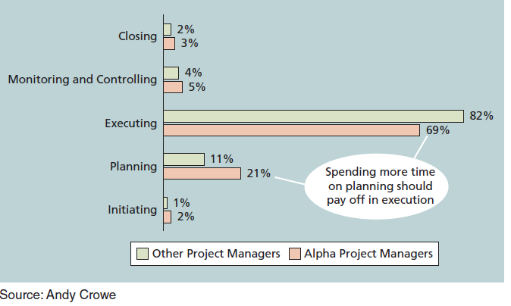
Percentage of time spent on each process group

Slide 23
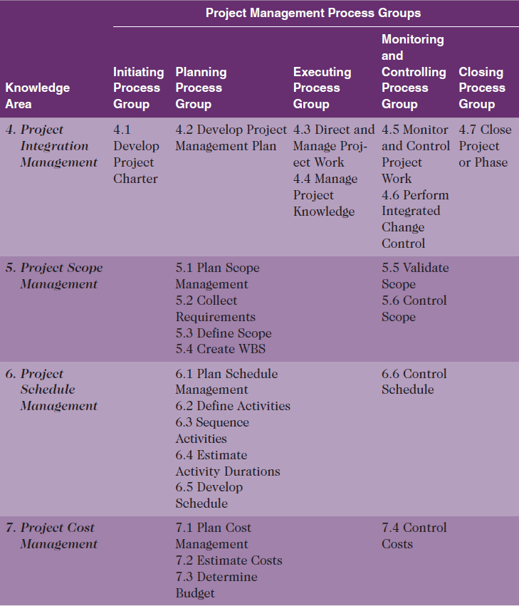

Slide 24
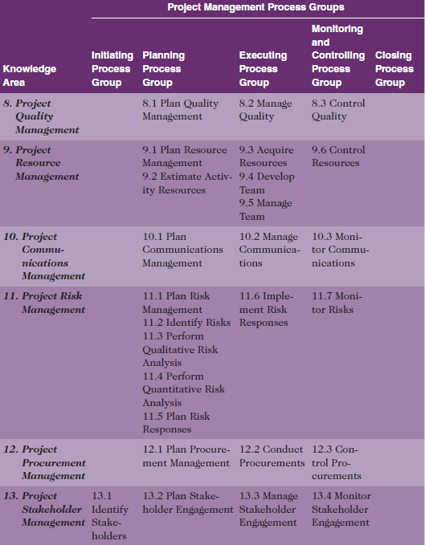

Slide 25


