Slide 1

TRIPPY Your Journey, Our Passion
Quad Coders - 106
TONY KURIAN – 248740
VIVEK KUMAR P V – 248784
ASHNA SHAMSUDEEN – 249416
SHYMA PAUL – 249387

Slide 2
CONTENTS
00 PROBLEM STATEMENT
01 WEEKLY UPDATES
02 TECHNOLOGY USED
03 API ENDPOINTS
04 WIREFRAME
05 DATABASE DESIGN
06 KEY FEATURES

Slide 3
PROBLEM STATEMENT
Develop a comprehensive solution to get the best airline route possible. When travelers are searching for routes between two destinations, the system should provide solutions with the minimum travel duration and the least amount of inconvenience caused by layovers and connecting flights. The system is expected to provide the optimum response within 30ms.

Slide 4
WEEK-1
Analysed the problem statement.​
Brainstormed our ideas.​
Installed required applications.​
Collected JSON file of airport , airline and route details.
Fetched airport ,airline and route details and saved data in the designed database using APIs

Slide 5
WEEK-2
Developed APIs for fetching airline and airport using the IATA code.​
Developed an API to list best recommendations.​
Added filters for accepting multiple class and airline types.​
Designed flight recommendations for round trip & multi city.​
Developed an API for airport autocomplete search.

Slide 6
WEEK-3
Developed an APIs to get detailed itinerary information.
Started front-end and designed the wireframe.
Wireframe designed using Miro.
Started front-end coding
Used React as Front-end library.
Pushed the code to GitHub

Slide 7








Technologies Used
Python
JAVA
MYSQL
MongoDB
React
Bootstrap
Spring Boot
Fast API
Fast API

Slide 8
APIs (Python)
http://127.0.0./:8900/autoc
http://127.0.0./:8900/autoc/recommended_flights
http://127.0.0./:8900/autoc/recomended_flights/round
http://127.0.0./:8900/autoc /flight

Slide 9
APIs (Java)
http://localhost:8100/api/airline
http://localhost:8100/api/airline/getbyiata/{iataCode}
http://localhost:8100/api/airport
http://localhost:8100/api/airport/getbyiata/{iataCode}
http://localhost:8100/api/airport /suggest
http://localhost:8100/api/airline /routes

Slide 10
APIs (Java)
http://localhost:8100/api/airline /routes/filter
http://localhost:8100/api/airline /routes/search
http://localhost:8100/api/airline /routes/getdetaileditinerary
http://localhost:8100/api/airline /routes/multicity
http://localhost:8100/api/airline /routes/onewayround

Slide 11
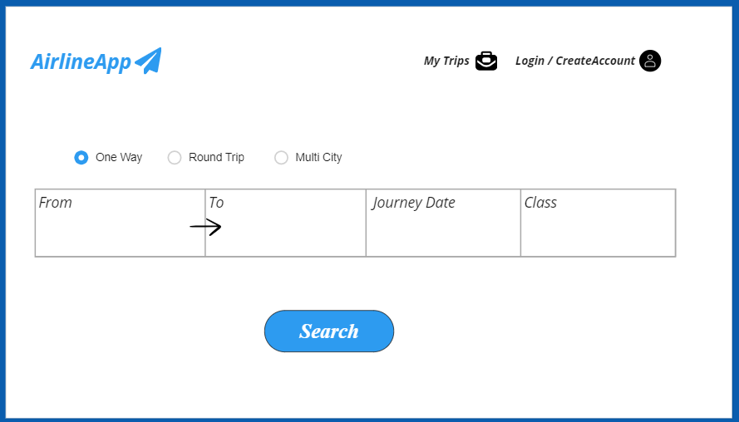
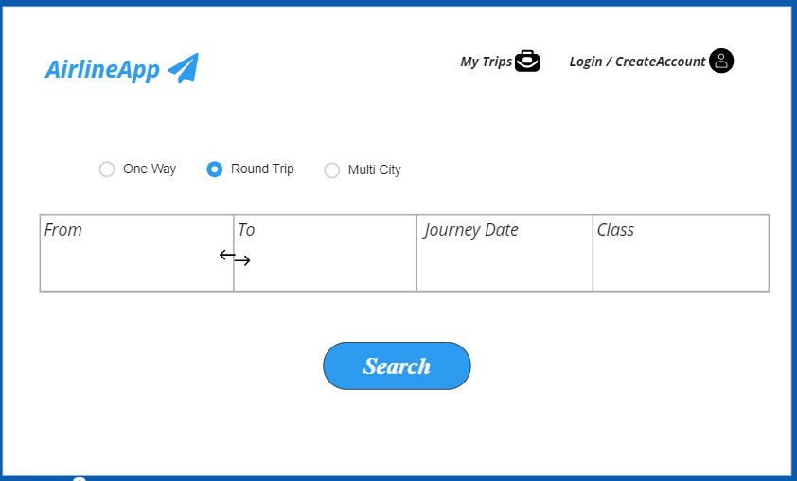
WIREFRAME DESIGN

Slide 12
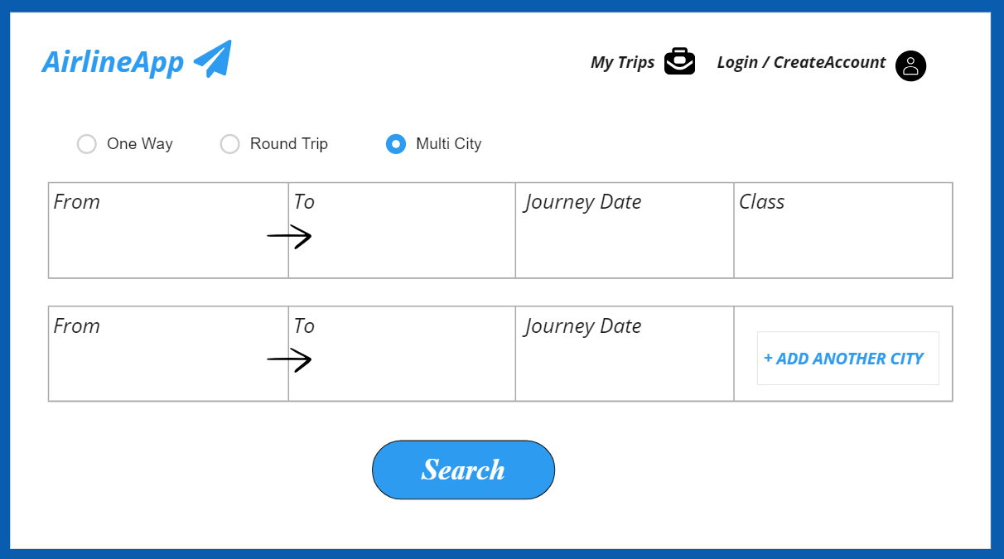
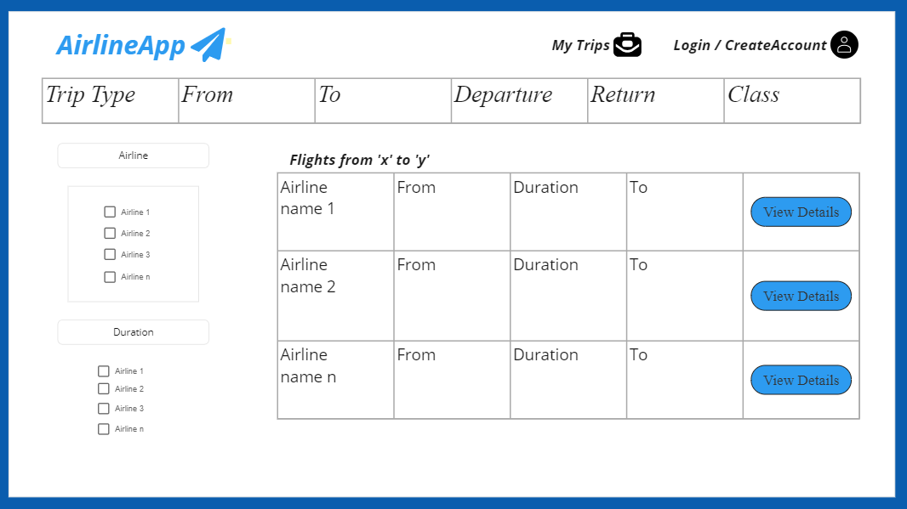
WIREFRAME DESIGN (Cont..)

Slide 13
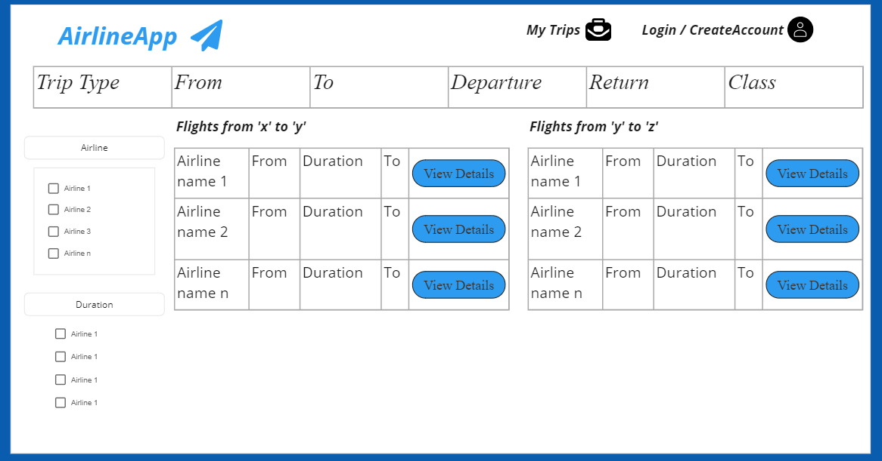
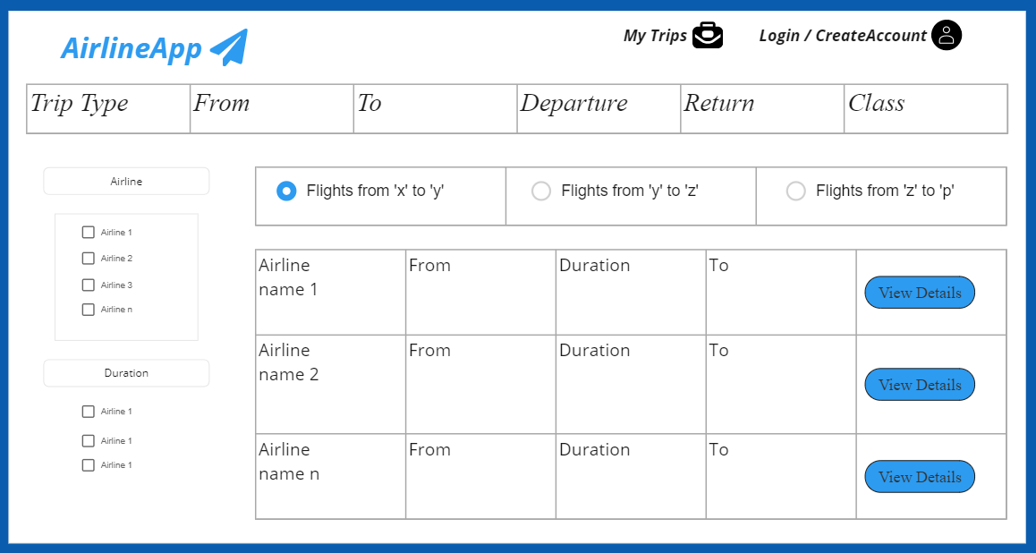
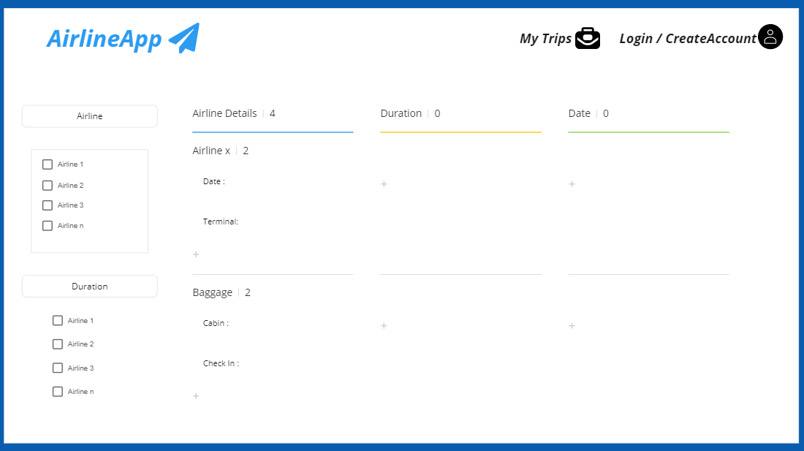
WIREFRAME DESIGN (Cont..)

Slide 14
Database Design
AIRLINE
id | int
code | String
is_lowcost | boolean
logo | String
name | String

Slide 15
Database Design
AIRPORT
id | int
iata_code | String
airport_name | String
country | String
latitude | double
longitude | double
city | String
state | String
icao | String
created_on | LocalDateTime
updated_on | LocalDateTime
direct_flights | int

Slide 16
Database Design
ROUTE
id | int
iata_from | String
iata_to | String
air_line_iata | String
day1 | boolean
day2 | boolean
day3 | boolean
day4 | boolean
day5 | boolean
day6 | boolean
day7 | boolean
max_duration | LocalDateTime
min_duration | LocalDateTime
airport_via | String
class_first | boolean
class_economy | boolean
class_buisiness | boolean
created_on | LocalDateTime
updated_on | LocalDateTime

Slide 17
Key Features
Solved the problem in two ways, using Python as well as Java.
Fulfilled all requirements, including the multi-city requirement
Improved the UI design and front end by adding more functions.
The system will respond in the best possible way in the shortest period .
The system will sort the obtained flight information according to travel duration.
All the available flights in the system can be viewed.

Slide 18
THANK YOU!

