Slide 1
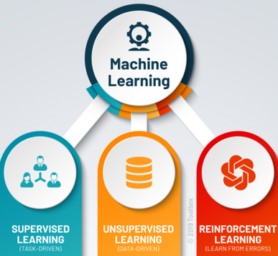
Web Data Mining - RLMCA301
Module 2 : Supervised and unsupervised Learning

Slide 2
Syllabus: Supervised Learning - Basic Concepts - Decision Tree Induction - Classifier Evaluation - Rule Induction - Classification based on Associations - Support Vector Machines - Linear SVM - Separable Case -Non Separable Case - Unsupervised Learning - Basic Concepts - K-Means Clustering - Representation of Clusters - Hierarchical Clustering
Meera Rose Mathew
Assistant Professor
Amal Jyothi College of Engineering
Kanjirapally

Slide 3
What is Machine Learning?
What is a Model?
What is Supervised Learning? Example
What is Unsupervised Learning? Example
What is Reinforcement Learning? Example

Slide 4
Supervised Learning
Also called classification or inductive learning in machine learning.
This type of learning is analogous to human learning from past experiences to gain new knowledge in order to improve our ability to perform real-world tasks.
Computers do not have “experiences”, machine learning learns from data, which are collected in the past and represent past experiences in some real-world applications.

Slide 5
Basic Concepts
A data set used in the learning task consists of a set of data records, which are described by a set of attributes A = {A₁, A₂, …, A_{|A|} }, where |A| denotes the number of attributes or the size of the set A.
The data set also has a special target attribute C, which is called the class attribute.
We consider C separately from attributes in A due to its special status, i.e., we assume that C is not in A.
The class attribute C has a set of discrete values, i.e., C = {c₁, c₂, …, c_{|C|}}, where |C| is the number of classes and |C| >=2. A class value is also called a class label.
A data set for learning is simply a relational table. Each data record describes a piece of “past experience”.

Slide 6
In the machine learning and data mining literature, a data record is also called an example, an instance, a case or a vector.
A data set basically consists of a set of examples or instances.
Given a data set D, the objective of learning is to produce a classification/prediction function to relate values of attributes in A and classes in C.
The function can be used to predict the class values/labels of the future data. The function is also called a classification model, a predictive mod- el or simply a classifier.
The function/model can be in any form, e.g., a decision tree, a set of rules, a Bayesian model or a hyperplane.

Slide 7
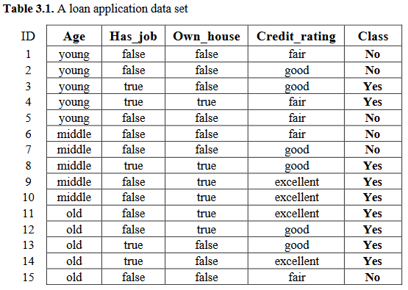

Slide 8
Example 1: Table 3.1 shows a small loan application data set. It has four attributes.
The first attribute is Age, which has three possible values, young, middle and old.
The second attribute is Has_Job, which indicates whether an applicant has a job. Its possible values are true (has a job) and false (does not have a job).
The third attribute is Own_house, which shows whether an applicant owns a house.
The fourth attribute is Credit_rating, which has three possible values, fair, good and excellent.
The last column is the Class attribute, which shows whether each loan application was approved (denoted by Yes) or not (denoted by No) in the past.

Slide 9
We want to learn a classification model from this data set that can be used to classify future loan applications.
That is, when a new customer comes into the bank to apply for a loan, after inputting his/her age, whether he/she has a job, whether he/she owns a house, and his/her credit rating, the classification model should predict whether his/her loan application should be approved.
Our learning task is called supervised learning because the class labels (e.g., Yes and No values of the class attribute in Table 3.1) are provided in the data.
The data set used for learning is called the training data (or the training set).
After a model is learned or built from the training data by a learning algorithm, it is evaluated using a set of test data (or unseen data) to assess the model accuracy.

Slide 10

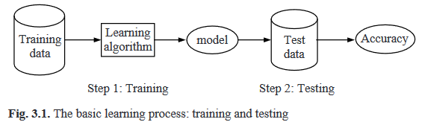
The accuracy of a classification model on a test set is defined as:
A correct classification means that the learned model predicts the same class as the original class of the test case.
Basic Learning Process: Training and Testing

Slide 11
In step 1, a learning algorithm uses the training data to generate a classification model. This step is also called the training step or training phase.
In step 2, the learned model is tested using the test set to obtain the classification accuracy. This step is called the testing step or testing phase.
If the accuracy of the learned model on the test data is satisfactory, the model can be used in real-world tasks to predict classes of new cases (which do not have classes).
If the accuracy is not satisfactory, we need to go back and choose a different learning algorithm and/or do some further processing of the data (this step is called data pre-processing)
A practical learning task typically involves many iterations of these steps before a satisfactory model is built.

Slide 12
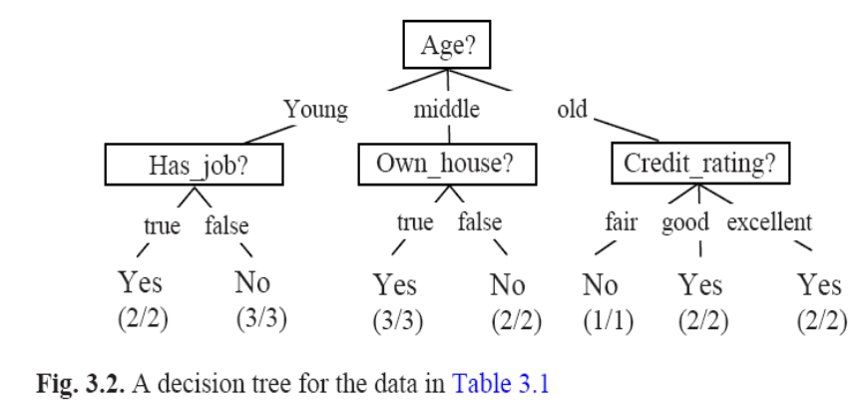
Supervised Learning Algorithms-Decision Tree Induction
Decision tree learning is one of the most widely used techniques for classification.
Its classification accuracy is competitive with other learning methods, and it is very efficient.
The learned classification model is represented as a tree, called a decision tree.
A decision tree is a structure that includes a root node, branches, and leaf nodes. Each internal node denotes a test on an attribute, each branch denotes the outcome of a test, and each leaf node holds a class label. The topmost node in the tree is the root node.
Based on c4.5 System. The C4. 5 algorithm is used in Data Mining as a Decision Tree Classifier which can be employed to generate a decision, based on a certain sample of data.

Slide 14
Example 2: Fig. 3.2 shows a possible decision tree learnt from the data in Table 3.1.
The tree has two types of nodes, decision nodes (which are internal nodes) and leaf nodes.
A decision node specifies some test (i.e., asks a question) on a single attribute.
A leaf node indicates a class.
The root node of the decision tree in Fig. 3.2 is Age, which basically asks the question: what is the age of the applicant? It has three possible answers or outcomes, which are the three possible values of Age.
These three values form three tree branches/edges. The other internal nodes have the same meaning.
Each leaf node gives a class value (Yes or No).
(x/y) below each class means that x out of y training examples that reach this leaf node have the class of the leaf.
For instance, the class of the left most leaf node is Yes.
Two training examples (examples 3 and 4 in Table 3.1) reach here and both of them are of class Yes.

Slide 15
To use the decision tree in testing, we traverse the tree top-down according to the attribute values of the given test instance until we reach a leaf node.
The class of the leaf is the predicted class of the test instance.
Example 3: We use the tree to predict the class of the following new instance, which describes a new loan applicant.
Going through the decision tree, we find that the predicted class is No as we reach the second leaf node from the left.
A decision tree is constructed by partitioning the training data so that the resulting subsets are as pure as possible.

Slide 16
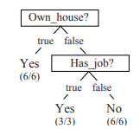
A pure subset is one that contains only training examples of a single class.
There are many possible trees that can be learned from the data.
For example, Fig. 3.3 gives another decision tree, which is much smaller and is also able to partition the training data perfectly according to their classes.
For most real-life data sets, the examples that reach a particular leaf node are not of the same class, i.e., x <= y
Fig. 3.3. A smaller tree for the data set in Table 3.1

Slide 17
Example 4: The tree in Fig. 3.3 generates three rules. “,” means “and”.
Own_house = true → Class =Yes [sup=6/15, conf=6/6]
Own_house = false, Has_job = true → Class = Yes [sup=3/15, conf=3/3]
Own_house = false, Has_job = false → Class = No [sup=6/15, conf=6/6]
These rules are of the same format as association rules.
However, the rules above are only a small subset of the rules that can be found in the data of Table 3.1.
For instance, the decision tree in Fig. 3.3 does not find the following rule:
Age = young, Has_job = false → Class = No [sup=3/15, conf=3/3]
Thus, we say that a decision tree only finds a subset of rules that exist in data, which is sufficient for classification. The objective of association rule mining is to find all rules subject to some minimum support and minimum confidence constraints.

Slide 18
An interesting and important property of a decision tree and its resulting set of rules is that the tree paths or the rules are mutually exclusive and exhaustive. This means that every data instance is covered by a single rule (a tree path) and a single rule only.
By covering a data instance, we mean that the instance satisfies the conditions of the rule.
A decision tree generalizes the data as a tree is a smaller description of the data, i.e., it captures the key regularities in the data.

Slide 19
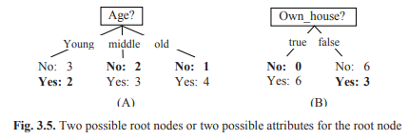
Impurity Function
Example 5: Fig. 3.5 shows two possible root nodes for the data in Table 3.1.
Fig. 3.5(A) uses Age as the root node, and Fig. 3.5(B) uses Own_house as the root node. Their possible values (or outcomes) are the branches.
At each branch, we listed the number of training examples of each class (No or Yes) that land or reach there. Fig. 3.5(B) is obviously a better choice for the root.
From a prediction or classification point of view, Fig. 3.5(B) makes fewer mistakes than Fig. 3.5(A).
In Fig. 3.5(B), when Own_house = true every example has the class Yes. When Own_house = false, if we take majority class (the most frequent class), which is No, we make three mistakes/errors.
If we look at Fig. 3.5(A), the situation is worse. If we take the majority class for each branch, we make five mistakes (marked in bold). Thus, we say that the impurity of the tree in Fig. 3.5(A) is higher than the tree in Fig. 3.5(B).

Slide 20
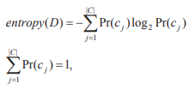
To learn a decision tree, we prefer Own_house to Age to be the root node.
Instead of counting the number of mistakes or errors, C4.5 uses a more principled approach to perform this evaluation on every attribute in order to choose the best attribute to build the tree.
Impurity Function: The impurity function measures the extent of purity for a region containing data points from possibly different classes.
The most popular impurity functions used for decision tree learning are information gain and information gain ratio, which are used in C4.5 as two options.
Information gain, which can be extended slightly to produce information gain ratio.
The information gain measure is based on the entropy function from information theory:
where Pr(c_{j}) is the probability of class c_{j} in data set D, which is the number of examples of class c_{j} in D divided by the total number of examples in D. In the entropy computation, we define 0log0 = 0. The unit of entropy is bit.

Slide 21
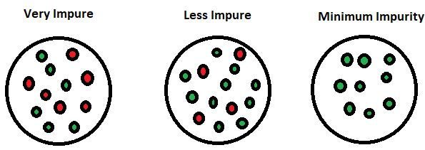
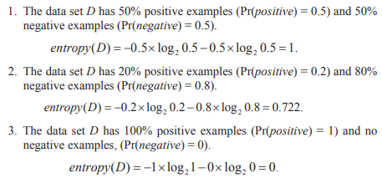
Entropy is an information theory metric that measures the impurity or uncertainty in a group of observations. It determines how a decision tree chooses to split data.
Example 6: Assume we have a data set D with only two classes, positive and negative. Let us see the entropy values for three different compositions of positive and negative examples:

Slide 22
When the data becomes purer and purer, the entropy value becomes smaller and smaller.
In fact, it can be shown that for this binary case (two classes), when Pr(positive) = 0.5 and Pr(negative) = 0.5 the entropy has the maximum value, i.e., 1 bit.
When all the data in D belong to one class the entropy has the minimum value, 0 bit.
The entropy measures the amount of impurity or disorder in the data. That is exactly what we need in decision tree learning.

Slide 23

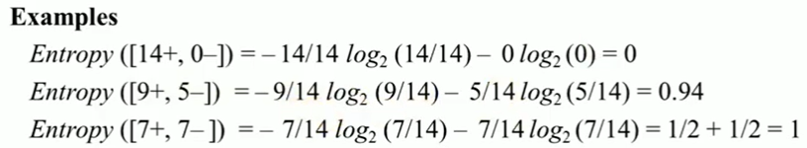
Entropy measures homogeneity of examples
Entropy measures the impurity of a collection of examples. It depends from the distribution of the random variable p.
S is a collection of training examples
P+ the proportion of positive examples in S
P- the proportion of negative examples in S.

Slide 24
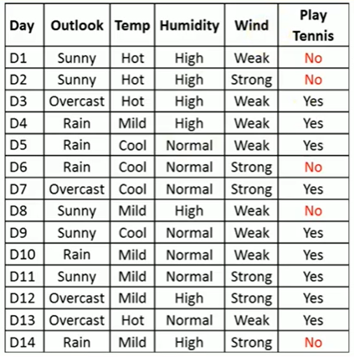
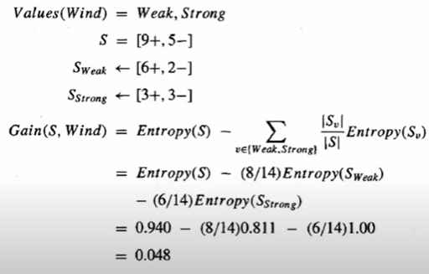
Information Gain
Information Gain measures the expected reduction in Entropy
Given entropy as a measure of the impurity in a collection of training examples, the information gain, is simply the expected reduction in entropy caused by partitioning the examples according to an attribute.
Table2:

Slide 25


Information Gain
The idea is the following:
1. Given a data set D, we first use the entropy function to compute the impurity value of D, which is entropy(D). The impurityEval-1 function in line 7 of Fig. 3.4 performs this task.
2. Then, we want to know which attribute can reduce the impurity most if it is used to partition D. To find out, every attribute is evaluated (lines 8–10 in Fig. 3.4). Let the number of possible values of the attribute A_{i} be v. If we are going to use A_{i} to partition the data D, we will divide D into v disjoint subsets D₁, D₂, …, D_{v}. The entropy after the partition is
The impurityEval-2 function in line 9 of Fig. 3.4 performs this task.
3. The information gain of attribute Ai is computed with:

Slide 26

Example 7: Let us compute the gain values for attributes Age, Own_house and Credit_Rating using the whole data set D in Table 3.1, i.e., we evaluate for the root node of a decision tree. First, we compute the entropy of D. Since D has 6 No class training examples, and 9 Yes class training examples, we have
We then try Age, which partitions the data into 3 subsets (as Age has three possible values) D1 (with Age=young), D2 (with Age=middle), and D3 (with Age=old). Each subset has five training examples. In Fig. 3.5, we also see the number of No class examples and the number of Yes examples in each subset (or in each branch).
entropy_{Age}(D) = - 5/15 x entropy(D₁) - 5/15 x entropy(D₂) - 5/15 x entropy(D₃)
= 5/15 x 0.971+5/15 x 0.971 +5/15 x 0.722=0.888

Slide 27
Likewise, we compute for Own_house, which partitions D into two subsets, D1 (with Own_house=true) and D2 (with Own_house=false).
entropy_{Own_house}(D) = - 6/15 x entropy(D₁) - 9/15 x entropy(D₂)
= 6/15 x 0 + 9/15 x 0.918 =0.551
Similarly, we obtain entropy_{Has_job}(D) = 0.647, and entropy_{Credit_rating}(D) = 0.608. The gains for the attributes are:
gain(D, Age) = 0.971 - 0.888 = 0.083
gain(D, Own_house) = 0.971 - 0.551 = 0.420
gain(D, Has_job) = 0.971 - 0.647 = 0.324
gain(D, Credit_rating) = 0.971 - 0.608 = 0.363.
Own_house is the best attribute for the root node. Fig. 3.5(B) shows the root node using Own_house. Since the left branch has only one class (Yes) of data, it results in a leaf node (line 1 in Fig. 3.4). For Own_house = false, further extension is needed. The process is the same as above, but we only use the subset of the data with Own_house = false, i.e., D2.

Slide 28

Information Gain Ratio
The gain criterion tends to favor attributes with many possible values. An extreme situation is that the data contain an ID attribute that is an identification of each example. If we consider using this ID attribute to partition the data, each training example will form a subset and has only one class, which results in entropyID(D) = 0. So the gain by using this attribute is maximal. From a prediction point of review, such a partition is useless.
Gain ratio remedies this bias by normalizing the gain using the entropy of the data with respect to the values of the attribute. Our previous entropy computations are done with respect to the class attribute:
where s is the number of possible values of A_{i}, and D_{j} is the subset of data that has the jth value of A_{i}. |D_{j}|/|D| corresponds to the probability of Equation (2).
Equation above we simply choose the attribute with the highest gain Ratio value to extend the tree.

Slide 29
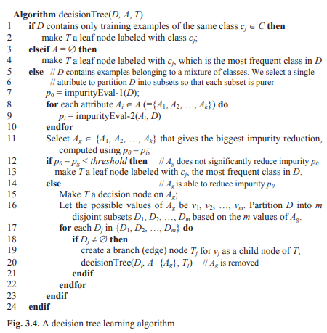
Learning Algorithm

Slide 30
Learning Algorithm
A decision tree T simply partitions the training data set D into disjoint subsets so that each subset is as pure as possible (of the same class).
The learning of a tree is typically done using the divide-and conquer strategy that recursively partitions the data to produce the tree.
At the beginning, all the examples are at the root. As the tree grows, the examples are sub-divided recursively.
We assume that every attribute in D takes discrete values. The stopping criteria of the recursion are in lines 1–4 in Fig. 3.4. The algorithm stops when all the training examples in the current data are of the same class, or when every attribute has been used along the current tree path.
In tree learning, each successive recursion chooses the best attribute to partition the data at the current node according to the values of the attribute.
The best attribute is selected based on a function that aims to minimize the impurity after the partitioning (lines 7–11).

Slide 31
In other words, it maximizes the purity. The key in decision tree learning is thus the choice of the impurity function, which is used in lines 7, 9 and 11 in Fig. 3.4.
The recursive recall of the algorithm is in line 20, which takes the subset of training examples at the node for further partitioning to extend the tree. This is a greedy algorithm with no backtracking. Once a node is created, it will not be revised or revisited no matter what happens subsequently.
Issues in decision tree learning
Tree Pruning and Overfitting: A decision tree algorithm recursively partitions the data until there is no impurity or there is no attribute left. This process may result in trees that are very deep and many tree leaves may cover very few training examples. If we use such a tree to predict the training set, the accuracy will be very high. However, when it is used to classify unseen test set, the accuracy may be very low. The learning is not effective, i.e., the decision tree does not generalize the data well. This phenomenon is called overfitting. Overfitting is usually caused by noise in the data, i.e., wrong class values/labels and/or wrong values of attributes. To reduce overfitting in the context of decision tree learning, we perform pruning of the tree, i.e., to delete some branches or sub-trees and replace them with leaves of majority classes. There are two main methods to do this, stopping early in tree building (which is also called pre-pruning) and pruning the tree after it is built (which is called post-pruning).

Slide 32
Rule Pruning: A decision tree can be converted to a set of rules. In fact, C4.5 also prunes the rules to simplify them and to reduce overfitting. First, the tree (C4.5 uses the unpruned tree) is converted to a set of rules. Rule pruning is then performed by removing some conditions to make the rules shorter and fewer (after pruning some rules may become redundant). In most cases, pruning results in a more accurate rule set as shorter rules are less likely to overfit the training data. Pruning is also called generalization as it makes rules more general (with fewer conditions). A rule with more conditions is more specific than a rule with fewer conditions.
Handling Missing Attribute Values: In many practical data sets, some attribute values are missing or not available due to various reasons. There are many ways to deal with the problem. For example, we can fill each missing value with the special value “unknown” or the most frequent value of the attribute if the attribute is discrete. If the attribute is continuous, use the mean of the attribute for each missing value.
Handling Skewed Class Distribution: In many applications, the proportions of data for different classes can be very different. For instance, in a data set of intrusion detection in computer networks, the proportion of intrusion cases is extremely small (< 1%) compared with normal cases. Directly applying the decision tree algorithm for classification or prediction of intrusions is usually not effective. The resulting decision tree often consists of a single leaf node “normal”, which is useless for intrusion detection. One way to deal with the problem is to over sample the intrusion examples to increase its proportion.

Slide 33
Classifier Evaluation
A classifier utilizes some training data to understand how given input variables relate to the class. In this case, known spam and non-spam emails have to be used as the training data. When the classifier is trained accurately, it can be used to detect an unknown email.
Classification belongs to the category of supervised learning where the targets also provided with the input data.
After a classifier is constructed, it needs to be evaluated for accuracy. Effective evaluation is crucial because without knowing the approximate accuracy of a classifier, it cannot be used in real-world tasks. The main measure is the classification accuracy, which is the number of correctly classified instances in the test set divided by the total number of instances in the test set. Some researchers also use the error rate, which is 1 – accuracy.
Evaluation Methods
Precision, Recall, F-score and Breakeven Point
Receiver Operating Characteristic Curve
Lift Curve

Slide 34
Evaluation Methods
Holdout Set: The available data D is divided into two disjoint subsets, the training set D_{train} and the test set D_{test}, D = D_{train} ∪ D_{test} and D_{train} ∩ D_{test} = ∅.The test set is also called the holdout set. Mainly used when the data set D is large.
The training set is used for learning a classifier and the test set is used for evaluating the classifier.
To partition D into training and test sets, we can use a few approaches:
If the data is collected over time, then we can use the earlier part of the data for training/learning and the later part of the data for testing.
We randomly sample a set of training examples from D for learning and use the rest for testing.
Multiple Random Sampling: When the available data set is small, using the above methods can be unreliable.
One approach to deal with the problem is to perform the above random sampling n times.
Each time a different training set and a different test set are produced.
This produces n accuracies. The final estimated accuracy on the data is the average of the n accuracies.

Slide 35
Cross-Validation: When the data set is small, the n-fold cross-validation method is very commonly used.
In this method, the available data is partitioned into n equal-size disjoint subsets.
Each subset is then used as the test set and the remaining n-1 subsets are combined as the training set to learn a classifier.
This procedure is then run n times, which gives n accuracies. The final estimated accuracy of learning from this data set is the average of the n accuracies. 10-fold and 5-fold cross-validations are often used.
Special case of cross-validation is the leave-one-out cross-validation.
In this method, each fold of the cross validation has only a single test example and all the rest of the data is used in training.
That is, if the original data has m examples, then this is m-fold cross-validation.
This method is normally used when the available data is very small. It is not efficient for a large data set as m classifiers need to be built.

Slide 36
Cross Validation: Method of splitting all your data into three parts: Training , testing and validation data. Data is split into K sub sets and the model has trained on k-1 of those datasets. The last subset is held for testing. This is done for each of the subsets. This is K-fold cross validation. Finally, the scores from all the K-Folds are averaged to produce the final score.
All Data
Train
Valid
Test
Make Model
Evaluate
Repeat until satisfied
Best Model
Evalaute

Slide 37
Precision, Recall, F-score and Breakeven Point
In some applications, we are only interested in one class. This is particularly true for text and Web applications. For eg. we may be interested in only the documents or web pages of a particular topic.
Also, in classification network intrusion and financial fraud detection, we are typically interested in only the minority class.
The class that the user is interested in is commonly called the positive class, and the rest negative classes (the negative classes may be combined into one negative class).
Accuracy is not a suitable measure in such cases because we may achieve a very high accuracy but may not identify a single intrusion.
Precision and recall are more suitable in such applications because they measure how precise and how complete the classification is on the positive class.
A confusion matrix contains information about actual and predicted results given by a classifier.

Slide 38
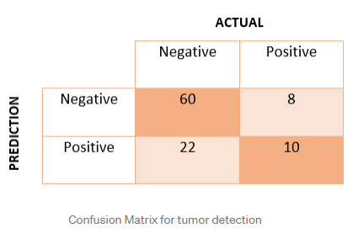
What is a confusion matrix?
It is a matrix of size 2×2 for binary classification with actual values on one axis and predicted on another.
EXAMPLE
A machine learning model is trained to predict tumor in patients. The test dataset consists of 100 people.
True Positive (TP): model correctly predicts the positive class (prediction and actual both are positive). In the above example, 10 people who have tumors are predicted positively by the model. True Negative (TN):model correctly predicts the negative class (prediction and actual both are negative). In the above example, 60 people who don’t have tumors are predicted negatively by the model.
False Positive (FP) — model gives the wrong prediction of the negative class (predicted-positive, actual-negative). In the above example, 22 people are predicted as positive of having a tumor, although they don’t have a tumor. FP is also called a TYPE I error. False Negative (FN) — model wrongly predicts the positive class (predicted-negative, actual-positive). In the above example, 8 people who have tumors are predicted as negative. FN is also called a TYPE II error.

Slide 39
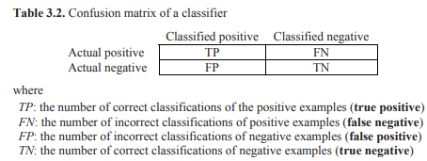

Based on the confusion matrix, the precision (p) and recall (r) of the positive class are defined as follows:

Slide 40

Precision p is the number of correctly classified positive examples divided by the total number of examples that are classified as positive.
Recall r is the number of correctly classified positive examples divided by the total number of actual positive examples in the test set.
The intuitive meanings of these two measures are quite obvious.
Example11: A test data set has 100 positive examples and 1000 negative examples. After classification using a classifier, we have the following confusion matrix.
This confusion matrix gives the precision p = 100% and the recall r = 1% because we only classified one positive example correctly and classified no negative examples wrongly.

Slide 41


If we need a single measure to compare different classifiers, the F-score is often used.
The F-score (also called the F1-score) is the harmonic mean of precision and recall. It takes both false positive and false negatives into account. Therefore, it performs well on an imbalanced dataset.
The break even point is when the precision and the recall are equal. This measure assumes that the test cases can be ranked by the classifier based on their likelihoods of being positive.
For instance, in decision tree classification, we can use the confidence of each leaf node as the value to rank test cases.

Slide 42


Receiver Operating Characteristic Curve
A receiver operating characteristic (ROC) curve is a plot of the true positive rate against the false positive rate.
It is also commonly used to evaluate classification results on the positive class in two-class classification problems.
The classifier needs to rank the test cases according to their likelihoods of belonging to the positive class with the most likely positive case ranked at the top.
The true positive rate (TPR) is defined as the fraction of actual positive cases that are correctly classified.
The false positive rate (FPR) is defined as the fraction of actual negative cases that are classified to the positive class.

Slide 43


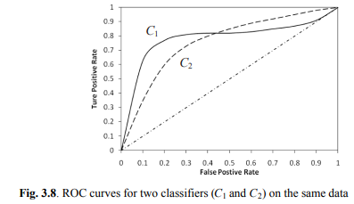
TPR is basically the recall of the positive class and is also called sensitivity in statistics.
There is also another measure in statistics called specificity, which is the true negative rate (TNR), or the recall of the negative class.
TNR is defined as follows
From the equations of FPR and TNR
Fig. 3.8 shows the ROC curves of two example classifiers (C1 and C2) on the same test data. Each curve starts from (0, 0) and ends at (1, 1). (0, 0) represents the situation where every test case is classified as negative, and (1, 1) represents the situation where every test case is classified as positive. This is the case because we can treat the classification result as a ranking of the test cases in the positive class, and we can partition the ranked list at any point into two parts with the upper part assigned to the positive class and the lower part assigned to the negative class.

Slide 44
In Fig. 3.8, we also see the main diagonal line, which represents random guessing, i.e., predicting each case to be positive with a fixed probability. In this case, it is clear that for every FPR value, TPR has the same value, i.e., TPR = FPT.
For classifier evaluation using the ROC curves in Fig. 3.8, we want to know which classifier is better. The answer is that when FPR is less than 0.43, C1 is better, and when FPR is greater than 0.43, C2 is better.
Sometimes we cannot say any one of the classifiers is strictly better than the other. For an overall comparison, researchers often use the area under the ROC curve (AUC). If the AUC value for a classifier C_{i} is greater than that of another classifier C_{j}, it is said that C_{i} is better than C_{j}. If a classifier is perfect, its AUC value is 1. If a classifier makes all random guesses, its AUC value is 0.5.

Slide 45
Lift Curve
The lift curve (also called the lift chart) is similar to the ROC curve.
It is also for evaluation of two-class classification tasks, where the positive class is the target of interest and usually the rare class.
It is often used in direct marketing applications to link classification results to costs and profits.
For example, a mail order company wants to send promotional materials to potential customers to sell an expensive watch.
Since printing and postage cost money, the company needs to build a classifier to identify likely buyers, and only sends the promotional materials to them.
The question is how many should be sent. To make the decision, the company needs to balance the cost and profit (if a watch is sold, the company makes a certain profit, but to send each letter there is a fixed cost). The lift curve provides a nice tool to enable the marketer to make the decision.

Slide 46
Like an ROC curve, to draw a lift curve, the classifier needs to produce a ranking of the test cases according to their likelihoods of belonging to the positive class with the most likely positive case ranked at the top.
After the ranking, the test cases are divided into N equal-sized bins (N is usually 10 – 20). The actual positive cases in each bin are then counted.
A lift curve is drawn with the x-axis being the percentages of test data (or bins) and the y-axis being the percentages of cumulative positive cases from the first bin to the current bin.
A lift curve usually also includes a line (called the baseline) along the main diagonal [from (0, 0) to (100, 100)] which represents the situation where the positive cases in the test set are uniformly (or randomly) distributed in the N bins (no learning), i.e., each bin contains 100/N percent of the positive cases.
If the lift curve is above this baseline, learning is said to be effective. The greater the area between the lift curve and the baseline, the better the classifier.

Slide 47
Example 14: A company wants to send promotional materials to potential buyers to sell an expensive brand of watches. It builds a classification model and tests it on a test data of 10,000 people (test cases) that they collected in the past. After classification and ranking, it decides to divide the test data into 10 bins with each bin containing 10% of the test cases or 1,000 cases. Out of the 1,000 cases in each bin, there are a certain number of positive cases (e.g., past buyers). The detailed results are listed in Table 3.5, which includes the number (#) of positive cases and the percentage (%) of positive cases in each bin, and the cumulative percentage for that bin. The cumulative percentages are used in drawing the lift curve which is given in Fig. 3.10. We can see that the lift curve is way above the baseline, which means that the learning is highly effective. Suppose printing and postage cost $1.00 for each letter, and the sale of each watch makes $100 (assuming that each buyer only buys one watch).

Slide 48
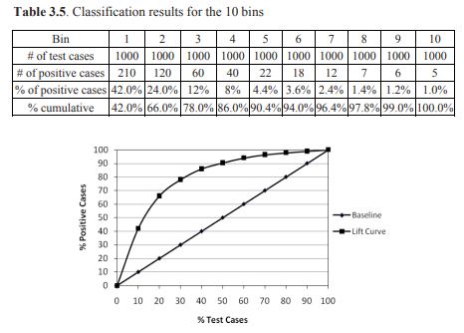
If the company wants to send promotional letters to 3000 people, it will make $36,000,
i.e., $100 × (210 + 120 + 60) - $3,000 = $36,000
Fig. 3.10. Lift curve for the data shown in Table 3.5

Slide 49
Rule Induction
The set of rules can be used for classification as the tree.
The process of learning such rules is called rule induction or rule learning.
Sequential Covering
Most rule induction systems use a learning strategy called sequential covering. A rule-based classifier built with this strategy typically consists of a list of rules, which is also called a decision list.
The basic idea of sequential covering is to learn a list of rules sequentially, one at a time, to cover the training data.
After each rule is learned, the training examples covered by the rule are removed.
Only the remaining data are used to find subsequent rules.
A rule covers an example if the example satisfies the conditions of the rule.

Slide 50
Rule Induction- Algorithm 1 (Ordered Rules) (Learn-one-rule-1)
Algorithm 1 (Ordered Rules)
This algorithm learns each rule without pre-fixing a class. That is in each iteration, a rule of any class may be found. Thus rules of different classes may intermix in the final rule list. The ordering of rules is important.
D is the training data. RuleList is the list of rules, which is initialized to empty set (line 1). Rule is the best rule found in each iteration.
The function learn-one-rule-1() learns the Rule (lines 2 and 6).
The stopping criteria for the while-loop can be of various kinds. Here we use D = NULL or Rule is NULL (a rule is not learned).
Once a rule is learned from the data, it is inserted into RuleList at the end (line 4).
All the training examples that are covered by the rule are removed from the data (line 5).

Slide 51
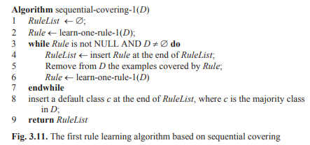
The remaining data is used to find the next rule and so on.
After rule learning ends, a default class is inserted at the end of RuleList. This is because there may still be some training examples that are not covered by any rule as no good rule can be found from them, or because some test cases may not be covered by any rule and thus cannot be classified.

Slide 52
The final list of rules is as follows:
where r_{i} is a rule.
Rule Induction-Algorithm 2 (Ordered Classes) (Learn-one-rule-2)
This algorithm learns all rules for each class together.
After rule learning for one class is completed, it moves to the next class. Thus all rules for each class appear together in the rule list. The sequence of rules for each class is unimportant, but the rule subsets for different classes are ordered.
Typically, the algorithm finds rules for the least frequent class first, then the second least frequent class and so on. This ensures that some rules are learned for rare classes.
Otherwise, they may be dominated by frequent classes and end up with no rules if considered after frequent classes.

Slide 53
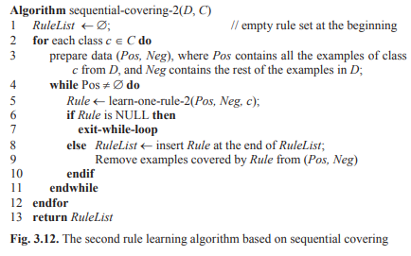

Slide 54
The algorithm is given in Fig. 3.12. The data set D is split into two subsets, Pos and Neg, where Pos contains all the examples of class c from D, and Neg the rest of the examples in D (line 3).
c is the class that the algorithm is working on now.
Two stopping conditions for rule learning of each class are in line 4 and line 6.
The other parts of the algorithm are quite similar to those of the first algorithm in Fig. 3.11

Slide 55
Rule Learning: Learn-One-Rule Function
The function learn-one-rule(),works as follows:
It starts with an empty set of conditions. In the first iteration, one condition is added. In order to find the best condition to add, all possible conditions are tried, which form candidate rules.
A condition is of the form A_{i} op v, where A_{i} is an attribute and v is a value of A_{i} . We also called it an attribute-value pair. For a discrete attribute, op is “=”. For a continuous attribute, op ∈ {>, ≤}.
The algorithm evaluates all the candidates to find the best one (the rest are discarded). After the first best condition is added, it tries to add the second condition and so on in the same fashion until some stopping condition is satisfied.
We omit the rule class here because it is implied, i.e., the majority class of the data covered by the conditions. This is a heuristic and greedy algorithm in that after a condition is added, it will not be changed or removed through backtracking.

Slide 56
We would want to try all possible combinations of attributes and values. However, this is not practical as the number of possibilities grows exponentially. Hence, the above greedy algorithm is used.
However, instead of keeping only the best set of conditions, we can improve the function a little by keeping k best sets of conditions (k > 1) in each iteration. This is called the beam search (k beams), which ensures that a larger space is explored.
We use two specific implementations of the algorithm, namely learn-one-rule-1() and learn-one-rule-2(). learn-onerule-1() is used in the sequential-covering-1 algorithm, and learn-one-rule2() is used in the sequential-covering-2 algorithm.

Slide 57
Learn-One-Rule-1
This function uses beam search. The number of beams is k. BestCond stores the conditions of the rule to be returned.
The class is omitted as it is the majority class of the data covered by BestCond.
candidate-CondSet stores the current best condition sets (which are the frontier beams) and its size is less than or equal to k.
Each condition set contains a set of conditions connected by “and” (conjunction).
newCandidateCondSet stores all the new candidate condition sets after adding each attribute-value pair (a possible condition) to every candidate in candidateCondSet (lines 5–11).
Lines 13–17 update the BestCond. Specifically, an evaluation function is used to assess whether each new candidate condition set is better than the existing best condition set BestCond (line 14).
If so, it replaces the current BestCond (line 15). Line 18 updates candidateCondSet, which selects k new best condition sets (new beams).

Slide 58
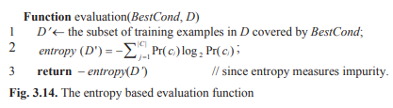
Once the final BestCond is found, it is evaluated to see if it is significantly better than without any condition (∅) using a threshold (line 20).
If yes, a rule will be formed using BestCond and the most frequent (or the majority) class of the data covered by BestCond (line 21). If not, NULL is returned to indicate that no significant rule is found.
The evaluation() function (Fig. 3.14) uses the entropy function as in the decision tree learning. Other evaluation functions are possible too. Note that when BestCond = ∅, it covers every example in D, i.e., D = D’.

Slide 59
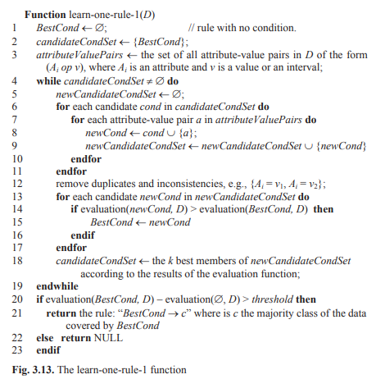

Slide 60
Learn-One-Rule-2
In the learn-one-rule-2() function (Fig. 3.14), a rule is first generated and then it is pruned. This method starts by splitting the positive and negative training data Pos and Neg, into growing and pruning sets.
The growing sets, GrowPos and GrowNeg, are used to generate a rule, called BestRule.
The pruning sets, PrunePos and PruneNeg are used to prune the rule because BestRule may overfit the data.
growRule() function: growRule() generates a rule (called BestRule) by repeatedly adding a condition to its condition set that maximizes an evaluation function until the rule covers only some positive examples in GrowPos but no negative examples in GrowNeg. This is basically the same as lines 4–17 in Fig. 3.13, but without beam search (i.e., only the best rule is kept in each iteration). Let the current partially developed rule be R:

Slide 61


where each av_{j} is a condition (an attribute-value pair). By adding a new condition av_{k+1}, we obtain the rule R⁺ : av₁, .., av_{k}, av_{k+1} → class. The evaluation function for R⁺ is the following information gain criterion (different from the gain function used in decision tree learning)
where p₀ (respectively, n₀) is the number of positive (negative) examples covered by R in Pos (Neg), and p₁ (n₁) is the number of positive (negative) examples covered by R⁺ in Pos (Neg). The GrowRule() function simply returns the rule R⁺ that maximizes the gain.
PruneRule() function: To prune a rule, we consider deleting every subset of conditions from the BestRule, and choose the deletion that maximizes:
where p (respectively n) is the number of examples in PrunePos (Prune-Neg) covered by the current rule (after a deletion).

Slide 62
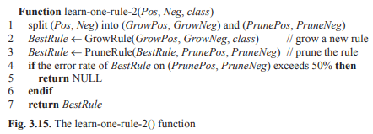

Slide 63
Classification Based on Associations(CBA)
Classification Based on Associations(CBA) uses association rules for classification.
Classifiers built using association rules are often called associative classifiers. Three approaches to employing association rules for classification:
1. Using class association rules for classification directly.
2. Using class association rules as features or attributes.
3. Using normal (or classic) association rules for classification.
Classification Using Class Association Rules
A class association rule (CAR) is an association rule with only a class label on the right-hand side of the rule .
Own_house = false, Has_job = true ->Class = Yes [sup=3/15, conf=3/3],
There is no difference between rules from a decision tree (or a rule induction system) and CARs
The differences are in the mining processes and the final rule sets.
CAR mining finds all rules in data that satisfy the user-specified minimum support (minsup) and minimum confidence (minconf) constraints.
A decision tree or a rule induction system finds only a subset of the rules (expressed as a tree or a list of rules) for classification.

Slide 64
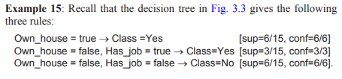
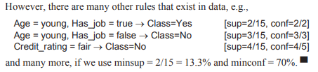
Decision tree learning and rule induction do not use the minsup or minconf constraint.
Thus, some rules that they find can have very low supports, which, of course, are likely to be pruned because the chance that they overfit the training data is high.
CAR mining does not use continuous (numeric) attributes, while decision trees deal with continuous attributes naturally.
Rule induction can use continuous attributes as well.

Slide 65
Mining Class Association Rules for Classification
Issues related to CAR mining for classification.
Rule Pruning: CAR rules are highly redundant, and many of them are not statistically significant (which can cause overfitting). Rule pruning is thus needed.
Multiple Minimum Class Supports: A single minsup is inadequate for mining CARs because many practical classification data sets have uneven class distributions, i.e., some classes cover a large proportion of the data, while others cover only a very small proportion.
Example: Suppose we have a dataset with two classes, Y and N. 99% of the data belong to the Y class, and only 1% of the data belong to the N class. If we set minsup = 1.5%, we will not find any rule for class N. To solve the problem, we need to lower down the minsup. Suppose we set minsup = 0.2%. Then, we may find a huge number of overfitting rules for class Y because minsup = 0.2% is too low for class Y.

Slide 66
Multiple minimum class supports can be applied to deal with the problem.
We can assign a different minimum class support minsup_{i} for each class c_{i}, i.e., all the rules of class c_{i} must satisfy minsup_{i}.
Alternatively, we can provide one single total minsup, denoted by t_minsup, which is then distributed to each class according to the class distribution.
minsup_{i} = t_minsup * sup(c_{i})
where sup(c_{i}) is the support of class c_{i} in training data.
The formula gives frequent classes higher minsups and infrequent classes lower minsups.
Parameter Selection: The parameters used in CAR mining are the minimum supports and the minimum confidences.
One minimum confidence is sufficient as long as it is not set too high.
To determine the best minsup_{i} for each class c_{i}, we can try a range of values to build classifiers and then use a validation set to select the final value. Cross-validation may be used as well.

Slide 67
Data Formats: The algorithm for CAR mining is for mining transaction data sets. However, many classification data sets are in the table format. A tabular data set can be easily converted to a transaction data set.
Classifier Building
After all CAR rules are found, a classifier is built using the rules. There are many existing approaches, which can be grouped into three categories.
Use the Strongest Rule: It simply uses CARs directly for classification. For each test instance, it finds the strongest rule that covers the instance. A rule covers an instance if the instance satisfies the conditions of the rule. The class of the strongest rule is then assigned as the class of the test instance. The strength of a rule can be measured in various ways, e.g., based on confidence , test, or a combination of both support and confidence values.

Slide 68
Select a Subset of the Rules to Build a Classifier: The representative method of this category is the one used in the CBA system. The method is similar to the sequential covering method, but applied to class association rules with additional enhancements.
Let the set of all discovered CARs be S. Let the training data set be D. The basic idea is to select a subset L (⊆ S) of high confidence rules to cover the training data D. The set of selected rules, including a default class, is then used as the classifier. The selection of rules is based on a total order defined on the rules in S.

Slide 69
Definition: Given two rules, r_{i} and r_{j}, r_{i} > r_{j} (also called r_{i} precedes r_{j} or r_{i} has a higher precedence than r_{j}) if
the confidence of r_{i} is greater than that of r_{j}, or
their confidences are the same, but the support of r_{i} is greater than that of r_{j}, or
both the confidences and supports of r_{i} and r_{j} are the same, but r_{i} is generated earlier than r_{j}.
A CBA classifier L is of the form:
L = <r₁, r₂, …, r_{k}, default-class>
where r_{i} ∈ S, r_{a} > r_{b} if b > a. In classifying a test case, the first rule that satisfies the case classifies it. If no rule applies to the case, it takes the default class (default-class). A simplified version of the algorithm for building such a classifier is given in Fig. 3.16. The classifier is the RuleList.

Slide 70
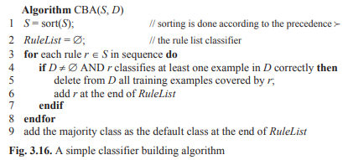
This algorithm can be easily implemented by making one pass through the training data for every rule. However, this is extremely inefficient for large data sets. An efficient algorithm that makes at most two passes over the data.

Slide 71
Combine Multiple Rules: Like the first approach, this approach does not take any additional step to build a classifier.
At the classification time, for each test instance, the system first finds the subset of rules that covers the instance.
If all the rules in the subset have the same class, the class is assigned to the test instance. If the rules have different classes, the system divides the rules into groups according to their classes, i.e., all rules of the same class are in the same group.
The system then compares the aggregated effects of the rule groups and finds the strongest group. The class label of the strongest group is assigned to the test instance.

Slide 72
Class Association Rules as Features
In the above two methods, rules are directly used for classification. In this method, rules are used as features to augment the original data or simply form a new data set, which is then fed to a classification algorithm eg., decision trees or the naïve Bayesian method.
To use CARs as features, only the conditional part of each CAR rule is needed, and it is often treated as a Boolean feature/attribute.
If a data instance in the original data contains the conditional part, the value of the feature/attribute is set to 1, otherwise it is set to 0.
The reason that such CAR based features are helpful is that they capture multi-attribute or multi-item correlations with class labels.

Slide 73
Classification Using Normal Association Rules
Not only can class association rules be used for classification, but also normal association rules. For example, association rules are commonly used in e-commerce Web sites for product recommendations. Recommendation is essentially a classification or prediction problem.
The classification process is as follows:
The system first uses previous purchase transactions to mine association rules. Any item can appear on the left-hand side or the right hand side of a rule. For recommendation purposes, usually only one item appears on the right-hand side of a rule.
At the prediction (e.g., recommendation) time, given a transaction (e.g., a set of items already purchased by a customer), all the rules that cover the transaction are selected. The strongest rule is chosen and the item on the right-hand side of the rule (i.e., the consequent) is then the predicted item and is recommended to the user. If multiple rules are very strong, multiple items can be recommended.
This method is basically the same as the “use the strongest rule” method
The key advantage of using association rules for recommendation is that they can predict any item since any item can be the class item on the right hand side. Traditional classification algorithms only work with a single fixed class attribute, and are not easily applicable to recommendations.

Slide 74
Support Vector Machines
Support vector machines (SVM) is another type of learning system ,which has many desirable qualities that make it one of most popular algorithms.
SVM is considered as the most accurate algorithm for text classification.
The class that the user is interested in is commonly called the positive class, and the rest negative classes (the negative classes may be combined into one negative class).
In general, SVM is a linear learning system that builds two-class classifiers.
Let the set of training examples D be
{(x₁, y₁), (x₂, y₂), …, (x_{n}, y_{n})},
where x_{i} = (x_{i1}, x_{i2}, …, x_{ir}) is a r-dimensional input vector in a real-valued space X ⊆ R^{r} , y_{i} is its class label (output value) and y_{i} ∈ {1, -1}.
1 denotes the positive class and -1 denotes the negative class.
Each data instance is called an input vector and denoted by a bold face letter.

Slide 75

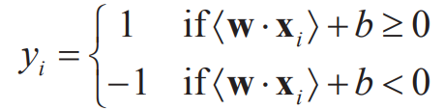
In the following, we use bold face letters for all vectors.
To build a classifier, SVM finds a linear function of the form
so that an input vector x_{i} is assigned to the positive class if f(x_{i}) ≥ 0, and to the negative class otherwise, i.e.,
Hence, f(x) is a real-valued function f: X ⊆R^{r} R. w = (w₁, w₂, …, w_{r}) ∈R^{r} is called the weight vector. b ∈ R is called the bias. <w . x> is the dot product of w and x (or Euclidean inner product).
Without using vector notation, Equation can be written as:
where x_{i} is the variable representing the i^{th} coordinate of the vector x.

Slide 76
SVM finds a hyperplane < w . x > + b = 0 that separates positive and negative training examples. This hyperplane is called the decision boundary or decision surface.
the hyperplane < w . x > + b = 0 divides the input space into two half spaces: one half for positive examples and the other half for negative examples.
A hyperplane is commonly called a line in a 2-dimensional space and a plane in a 3-dimensional space.
Figure shows an example in a 2-dimensional space. Positive instances (also called positive data points or simply positive points) are represented with small filled rectangles, and negative examples are represented with small empty circles.
The thick line in the middle is the decision boundary hyperplane (a line in this case), which separates positive (above the line) and negative (below the line) data points.
Equation , which is also called the decision rule of the SVM classifier, is used to make classification decisions on test instances.

Slide 77
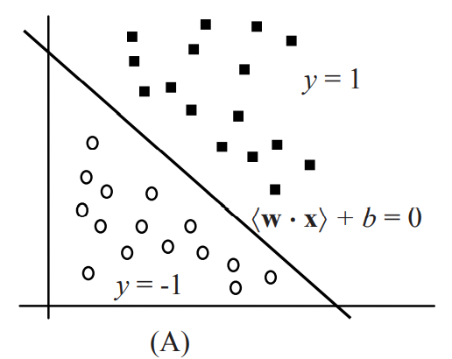
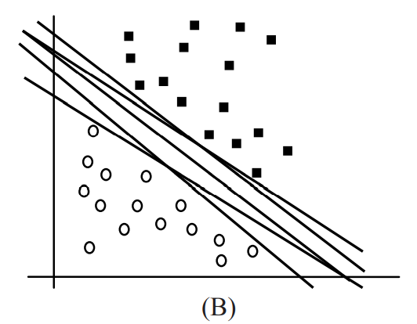
Figure: A linearly separable data set and (B) possible decision boundaries
How can we find the hyperplane
The distance between the hyperplane and the nearest data point is known as the margin.
The goal is to choose a hyperplane with a greatest possible margin between hyperplane and any point within the training set

Slide 78
Linear SVM: Separable Case
It is assumed that the positive and negative data points are linearly separable.
Linear SVM: Non-separable Case
The training data is almost always noisy, i.e., containing errors due to various reasons.
In this case positive and negative data are not separable.
There is a negative point (circled) in the positive region, and a positive point in the negative region

Slide 79
Linear SVM: Separable Case
From linear algebra, we know that in <w . x> + b = 0,
w defines a direction perpendicular to the hyperplane . (Figure)
w is also called the normal vector (or simply normal) of the hyperplane.
Without changing the normal vector w, varying b moves the hyperplane parallel to itself.
Note also that <w . x> + b = 0 has an inherent degree of freedom. We can rescale the hyperplane to < λ w . x> + λ b = 0 for λ ∈ R⁺ (positive real numbers) without changing the function/hyperplane.
Since SVM maximizes the margin between positive and negative data points, let us find the margin.
Let d₊ (respectively d₋) be the shortest distance from the separating hyperplane (<w . x> + b = 0) to the closest positive (negative) data point.

Slide 80
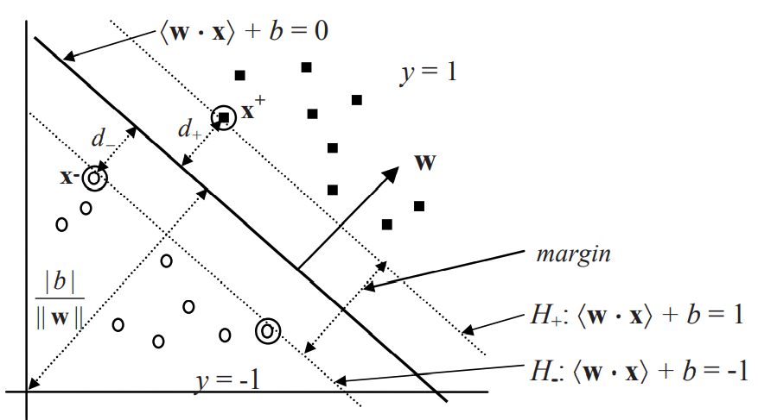
Figure: Separating hyperplanes and margin of SVM: Support vectors are circled
The margin of the separating hyperplane is d₊+d₋. SVM looks for the separating hyperplane with the largest margin, which is also called the maximal margin hyperplane, as the final decision boundary.

Slide 81
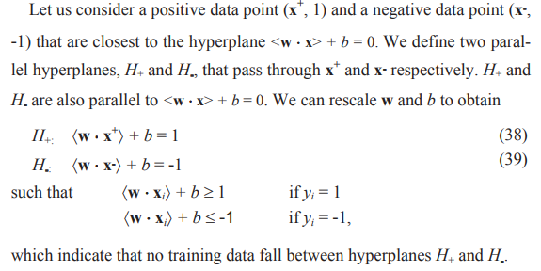

Slide 82
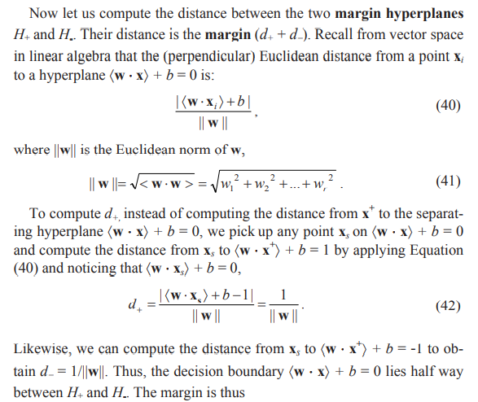


Slide 83
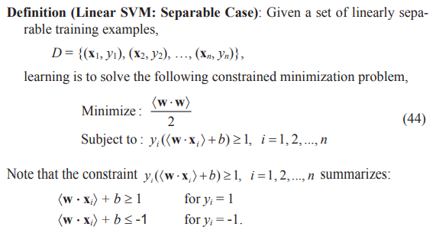

Slide 84
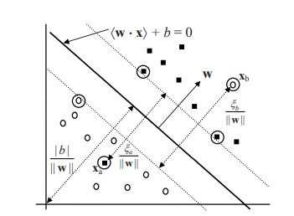
Linear SVM Non separable case
The training data is almost always noisy, i.e., containing errors due to various reasons.
For SVM to be useful, it must allow noise in the training data. However, with noisy data the linear separable SVM will not find a solution because the constraints cannot be satisfied.
In Figure, there is a negative point (circled) in the positive region, and a positive point in the negative region. Clearly, no solution can be found for the problem.
The non-separable case: x_{a} and x_{b} are error data points

Slide 85
