Slide 1
Natural Language Processing using TensorFlow 2.0
Usha Rengaraju

Slide 2
About me
Kaggle Grandmaster
WiMLDS(Bangalore and Mysore)
TensorFlow User Group Organizer Mysuru
GDG Mysore Organizer Mysuru
Twitter : @URengaraju
Github : https://github.com/ushareng
Ambassador : Women TechMakers Mysuru , WiDS Mysuru(Women in Data Science)

Slide 3
Communities
WiMLDS Mysore :
https://www.meetup.com/Mysore-Women-in-Machine-Learning-and-Data-Science/
GDG Mysuru :
https://www.meetup.com/Google-Developers-group-Mysuru/
TensorFlow User Group Mysuru :
https://www.meetup.com/TFUG-Mysuru/

Slide 4
Agenda
Deep Learning Refresher
NLP Refresher
TF 2.0
[HandsOn] Text Classification
[HandsOn] Poetry Generation
[HandsOn] Bangla Article classifier

Slide 5
Pic Credit
Pic are taken from official TensorFlow Documentation and videos from official Tensorflow channel

Slide 6
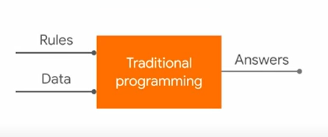
Traditional Programming
.
Notes:
Pic Credit : Laurence Moroney’s Videos in TensorFlow
https://bit.ly/Coding-TensorFlow

Slide 7
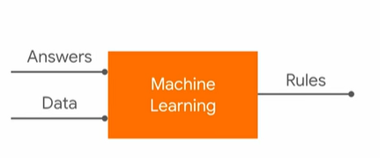
Machine Learning
.

Slide 8

Hello World of ML
.

Slide 9
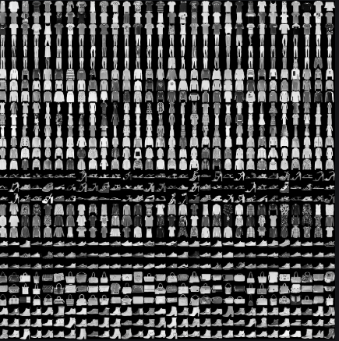
Fashion MNIST
.

Slide 10
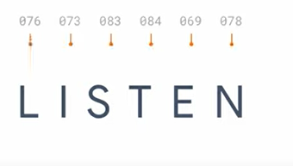
NLP Refresher
.

Slide 11
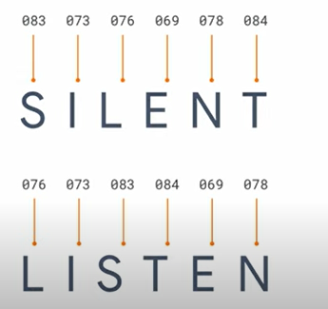
.

Slide 12
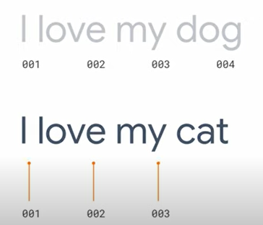
.

Slide 13
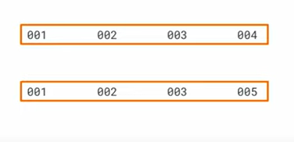
.

Slide 14
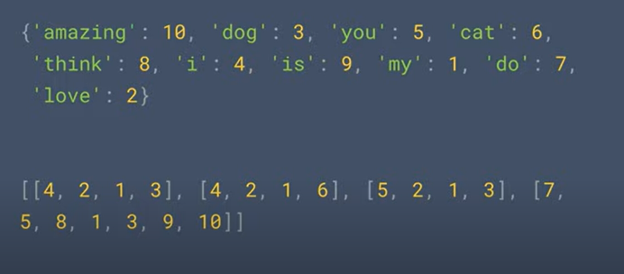
.

Slide 15
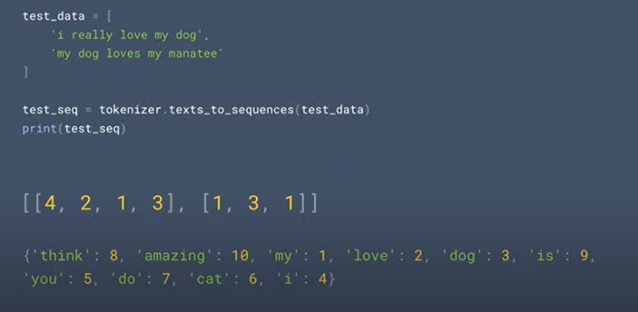
.

Slide 16
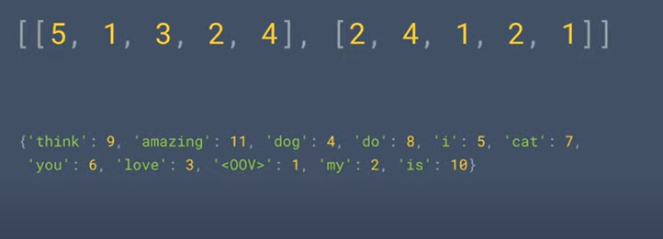
.

Slide 17
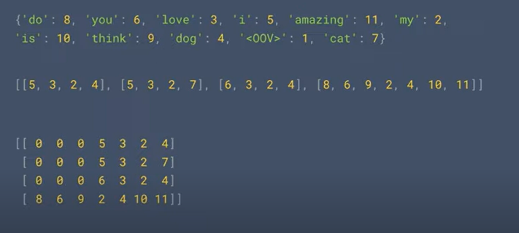
.

Slide 18
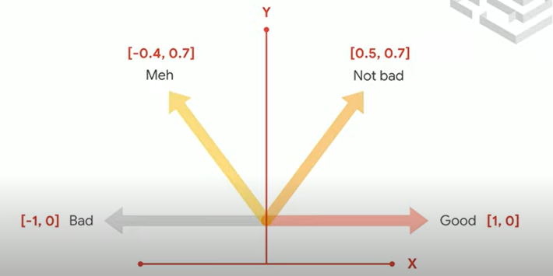
.

Slide 19
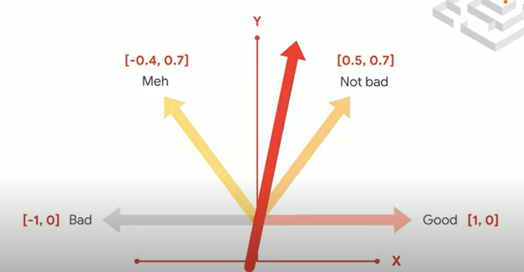
.

Slide 20
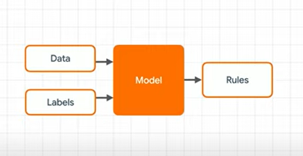
.

Slide 21
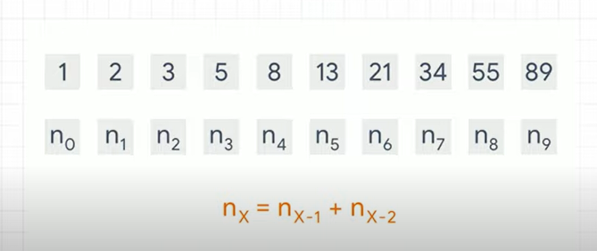
.

Slide 22
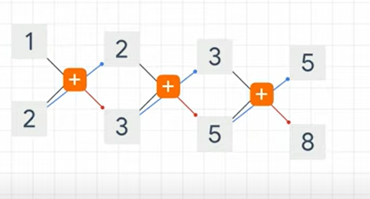
.

Slide 23
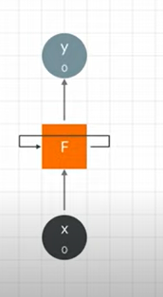
.

Slide 24
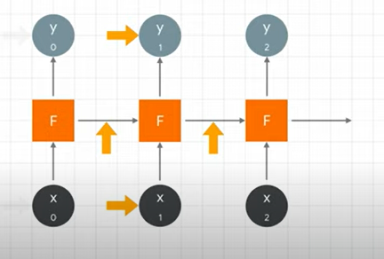
.

Slide 25
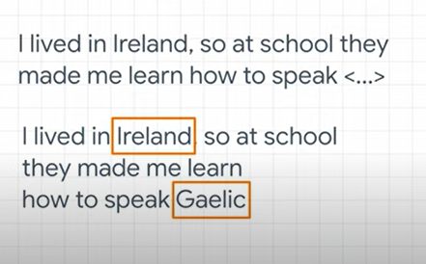
.

Slide 26
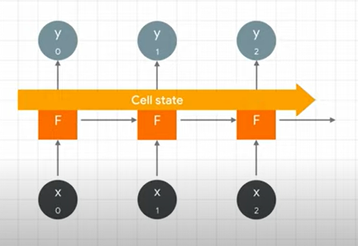
.

Slide 27
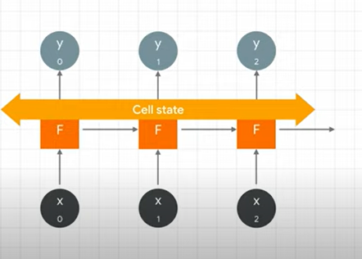
.

Slide 28
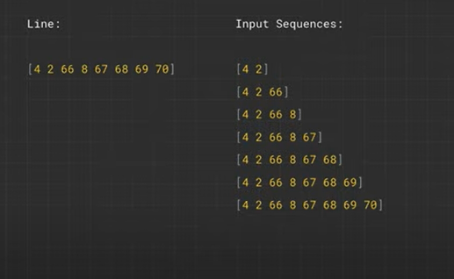
.

Slide 29
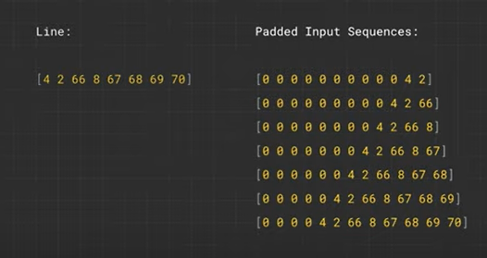
.

Slide 30
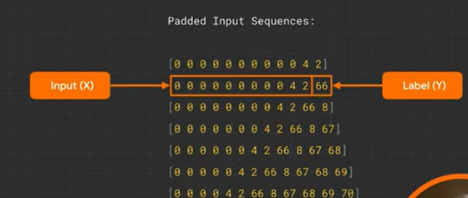
.

Slide 31
References
The notebooks and slide materials are taken from Official TensorFlow documentation and videos from official TensorFlow youtube channel

Slide 32
Thank You

