Slide 1
Regional Language Translation:
English to Telugu Using Deep Learning

Slide 2
Introduction
Language is not just a tool for communication but a bridge that connects cultures, knowledge systems, and communities.
In India, with its vast linguistic diversity, language plays a central role in ensuring inclusivity. Among the many Indian languages, Telugu stands out as one of the most widely spoken Dravidian languages,
with more than 80 million speakers worldwide. Despite this, English remains the dominant language in higher education, governance, research, and global communication.

Slide 3
Motivation
Telugu is a rich and expressive language with many variations in words and grammar. Translating it accurately is challenging, which motivates the need to build systems that can truly understand and convey its meaning in English.
Language Complexity
2. Education and E-learning
Translate higher-education and e-learning content into Telugu to help rural and regional students access knowledge easily.
3.Government Services
and E-Governance
Many policies are launched in English first. Translating them into Telugu ensures wider participation in welfare schemes
4. Expanding Research Scope
Most research targets English–Hindi, while highly morphological languages like Telugu and other South/East Indian languages remain low-resource and underexplored.

Slide 4
Objective
To develop an English–Telugu Neural Machine Translation (NMT) and analyze its performance limitations, identifying the factors that affect translation quality and model stability.

Slide 5
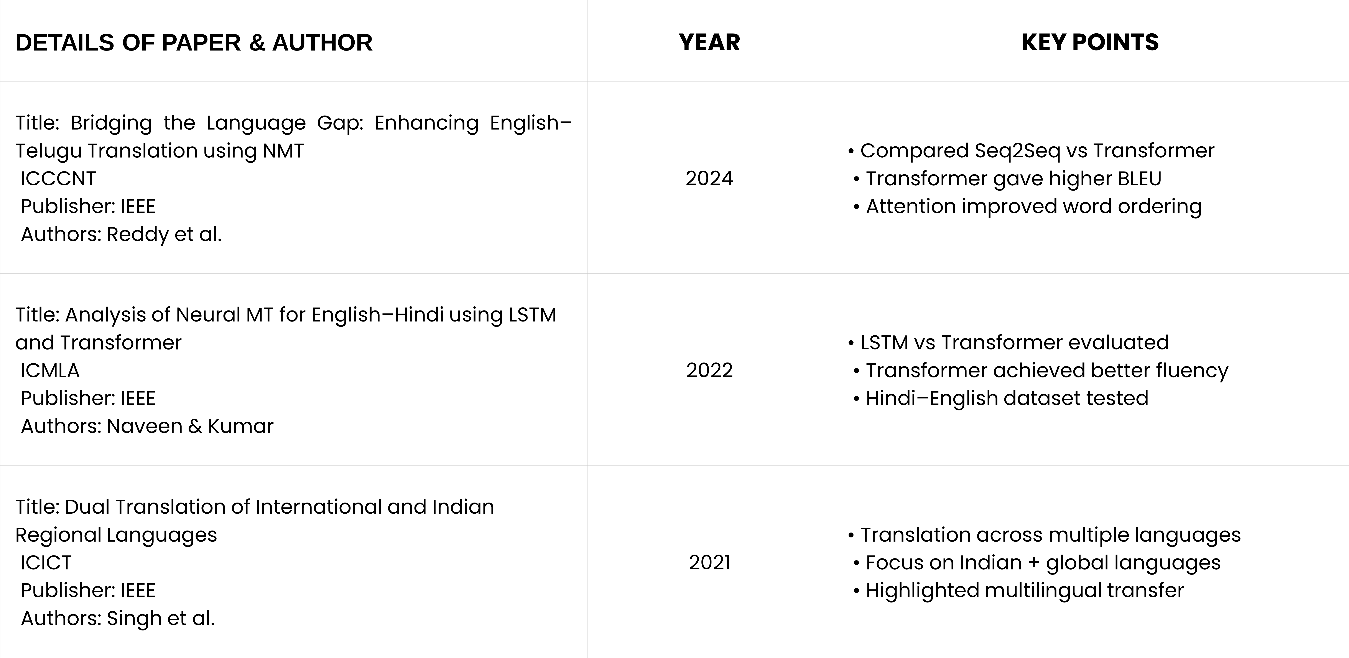
Literature Survey

Slide 6
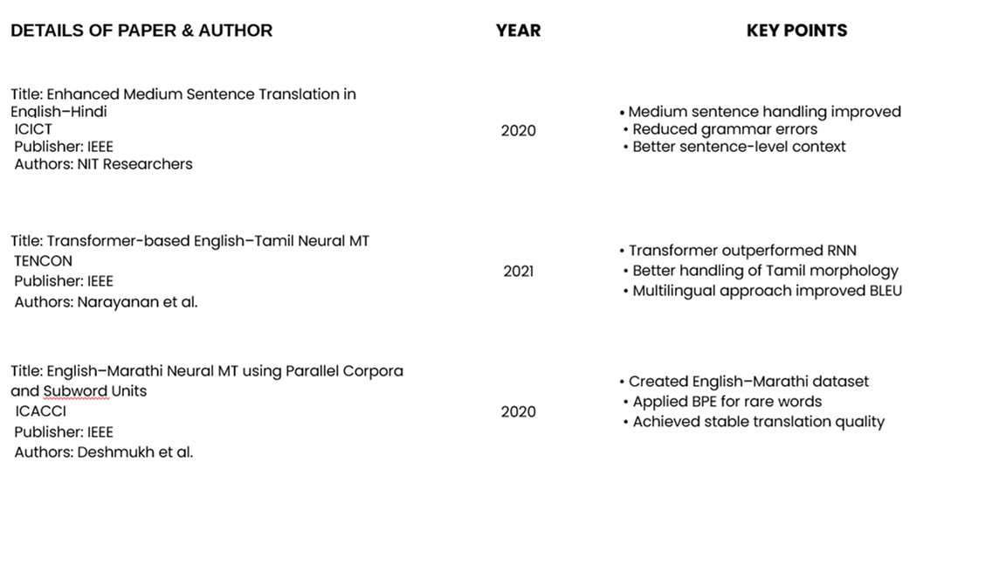

Slide 7
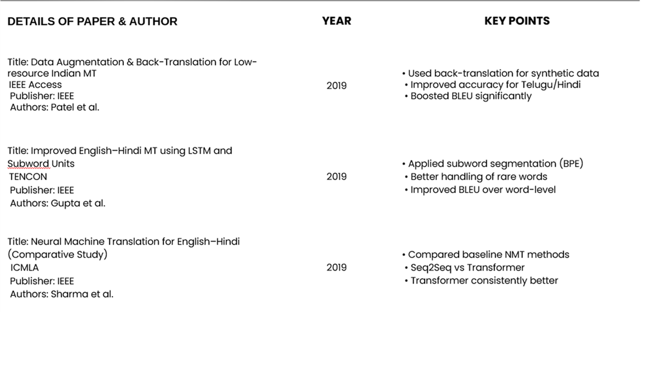

Slide 8
Conclusion from Literature Survey
Transformer models consistently give better accuracy and BLEU
Attention mechanisms improve grammar handling and correct word order
Sub-word segmentation (BPE) helps manage rare words and morphology
Research still shows BLEU ~17–25 for English Telugu

Slide 9
Limitations of Existing Methods
• Lack of large, high-quality English Telugu parallel corpora.
• Poor handling of morphological variations and compound words.
• Frequent named-entity and transliteration errors.
• Weak context preservation in long or complex sentences.
• Limited domain adaptability for technical or conversational text.

Slide 10
Proposed System
Dataset loading
Preprocessing: Custom separator-based parsing of parallel data (++++$++++)
Seq2Seq Neural Machine Translation Model Architecture: 4-layer encoder + 4-layer decoder with multi-head attention
Training: Adam optimizer, warm-up learning rate, label smoothing 0.1.
Save model and tokenizer to local/Google Drive.
Testing the model and result evaluation

Slide 11
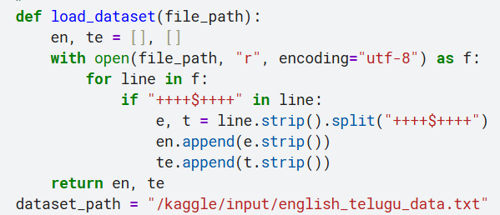
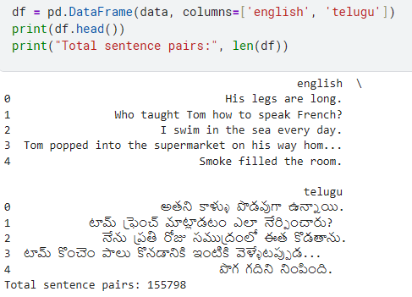
Preprocessing
Dataset loading
Dataset:
Custom separator-based parsing of parallel data (++++$++++)
Cleaning & trimming of sentences
Dataset size : (155798, 2)
Dataset link : https://www.kaggle.com/datasets/pavanreddy6/english-telugu-pairs?select=english_telugu_data.txt

Slide 12
MODEL ARCHITECTURE
Input Text → Preprocessing (Tokenization)
→ Encoder (4 layers, 8-head Transformer)
→ Decoder (4 layers, 8-head Transformer)
→ Linear + Softmax → Detokenization → Output Translation

Slide 13
MODEL LOADING AND TRAINING
Framework : Transformer
Optimizer: AdamW
Learning rate: 0.0014
Epochs:10
Loss regularization: weight decay 0.01
Batch size: 128
warmup_steps=4000

Slide 14

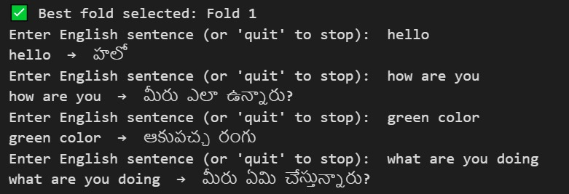
Save model
TESTING

Slide 15
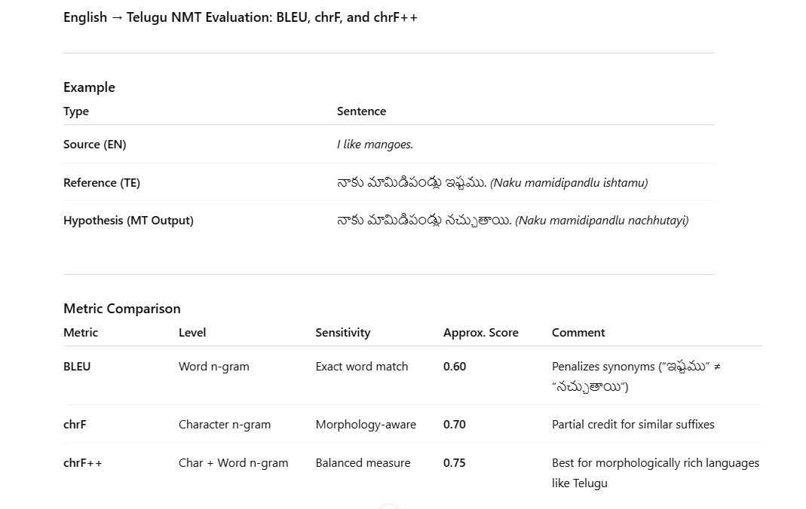

Slide 16
EVALUATION RESULTS
English → Telugu (seq2seq model):
Metrics (BLEU (Bilingual Evaluation Understudy)| chrF(Character n-gram F-score)):
Metric | Trained | New Test
BLEU | 22.21 | 0.23
CHRF | 55.22 | 12.7

Slide 17
EVALUATION RESULTS
English → Telugu (Transformer(BART) model):
Metrics (BLEU (Bilingual Evaluation Understudy)| chrF(Character n-gram F-score)):
Metric | Trained | New Test
BLEU | 0.16 | 0.13
CHRF | 12.64 | 5.72

Slide 18
EVALUATION RESULTS
English → Telugu (Transformer model):
Metrics (BLEU (Bilingual Evaluation Understudy)| chrF(Character n-gram F-score)):
Metric | BLEU | CHRF
Transformer | 1.59 | 2.91

Slide 19
Cross Validation
5-fold cross validation:
Metric | Fold-1 | Fold-2 | Fold-3 | Fold-4 | Fold-5
BLEU | 63.3697 | 63.2564 | 63.1482 | 63.1887 | 63.5662
CHRF | 82.1624 | 82.1292 | 82.0905 | 82.1032 | 82.2937

Slide 20
CHALLENGES FACED
Dataset quality and availability issues.
Computational resource limitations (RAM/GPU).
Model underfitting or slow convergence.
Tokenization/encoding issues for regional scripts.

Slide 21
Tools used
Sacrebleu
Tensorflow
Tokenizer
Numpy
Pandas
SentencePiece

Slide 22
Conclusion
A Seq2Seq-based English–Telugu NMT system was developed and evaluated.
The model shows basic translation capability, but struggles with accuracy, reliability, and robustness.
Performance is limited by dataset quality, morphological complexity of Telugu, and lack of contextual understanding.
Insufficient GPU resources restricted training efficiency and model convergence, leading to slower learning and underfitting.
The study highlights the need for powerful GPUs, advanced architectures, and larger datasets to achieve higher translation quality.

Slide 23
Future Scope
Upgrade the system to Transformer-based models (e.g., BART, mBART, or T5) for improved reliability and fluency.
Utilize high-performance GPUs or cloud computing to enable deeper training and faster convergence.
Expand the English–Telugu parallel dataset with diversified and domain-specific text sources.
Develop a web-based or mobile application for real-time English–Telugu translation and user feedback collection.

Slide 24
References
[1] M. Asmitha and C. R. Kavitha, “Bridging the Language Gap: Enhancing English-to-Telugu Translation using NMT and Encoding Decoding Techniques”, ICCCNT 2024, IEEE, 2024. https://ieeexplore-ieee-org.vitaplibrary.remotexs.in/document/10724821
[2] R. Naveen and A. Praveen Kumar, “Analysis of Neural Machine Translation for English to Hindi using Long Short-Term Memory Model and Transformer Model”, ICSES 2024, IEEE, 2024. https://ieeexplore-ieee-org.vitaplibrary.remotexs.in/document/10763246
[3] N. Jayanthi, A. Lakshmi, C. Suresh Kumar Raju, and B. Swathi, “Dual Translation of International and Indian Regional Language using Recent Machine Translation”, ICISS 2020, IEEE, 2020. https://ieeexplore-ieee-org.vitaplibrary.remotexs.in/document/9316016
[4] S. Thakur and J. Srivastava, “Enhancing Medium-Sized Sentence Translation in English-Hindi NMT Using Clause-Based Approach”, ICCCNT 2024, IEEE, 2024. https://ieeexplore-ieee-org.vitaplibrary.remotexs.in/document/10725451
[5] P. Gupta and B. K. Joshi, “Improved English to Hindi MT using Long Short-Term Memory”, INDIACom 2022, IEEE, 2022. https://ieeexplore-ieee-org.vitaplibrary.remotexs.in/document/9788235
[6] S. R. Laskar, A. Dutta, P. Pakray, and S. Bandyopadhyay, “Neural Machine Translation: English to Hindi”, CICT 2019, IEEE, 2019. https://ieeexplore-ieee-org.vitaplibrary.remotexs.in/document/9066238
[7] N. Biraja Isac and H. Das, “Transformer vs. LSTM: Evaluating Machine Translation Models for Sanskrit to English and Sanskrit to Hindi Datasets”, IDSTA 2024, IEEE, 2024. https://ieeexplore-ieee-org.vitaplibrary.remotexs.in/document/10722015
[8] A. Naik, M. Karani, K. Chheda, and M. Gada, “NMT for English-Marathi using RNNs & Attention”, IBSSC 2022, IEEE, 2022. https://ieeexplore-ieee-org.vitaplibrary.remotexs.in/document/10010782/
[9] M. R. Suryakusuma, M. F. Ash Shiddiq, H. Lucky, and I. A. Iswanto, “Investigating T5 Generation Neural Machine Translation Performance on English to German”, ICIMCIS 2023, IEEE, 2023. https://ieeexplore.ieee.org/document/10349061

Slide 25
THANK YOU
Team Members:
22BCE20302
22BCE20324
22BCE20327
22BCE20507

