Slide 1





https://www.hindawi.com/journals/wcmc/2021/6627217/
DATE: 28.04.2002
THIRD EYE FOR BLIND
TEAM MEMBERS:
Mr.ASHOK AT 3rd year cse
https://arunai.org/ideathon

Slide 2
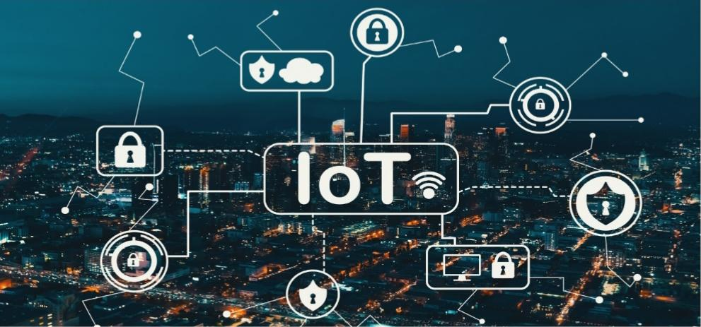
DOMAIN
INTERNET OF THINGS
The Internet of Things (IoT) describes the network of physical object “things”that are embedded with sensors, software, and other technologies for the purpose of connecting and exchanging data with other devices and systems over the internet.
https://arunai.org/ideathon

Slide 3
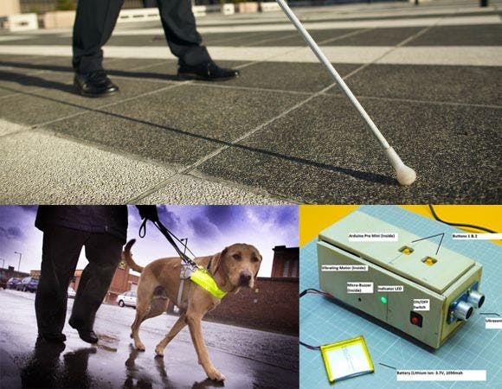
PROBLEM STATEMENT
The problems of existing systems:
White cane – May easily crack/break. The stick may get stuck at pavement cracks of different objects.
Pet dog – Huge cost. (~$42,000 / 280000Rs )
Common Disadvantages (Including the the smart devices) Cannot be carried easily, needs a lot of training to use.
https://arunai.org/ideathon

Slide 4
OUR IDEA
Third eye for blinds is an innovation which helps the blind peoples.
We have designed a special device based on the Arduino board which can be wearable This device is equipped with ultrasonic sensor.
Using the ultrasonic sensors, blind people can detect the objects around them and so they can easily travel anywhere. When it detects obstacle the device will notify the user through sound beeps.
The rate of beeping increases with decrease in distance and this is a fully automated device.
https://arunai.org/ideathon

Slide 5
PRE REQUISITE
Hardware
Arduino UNO
Ultrasonic sensor
Buzzer
Jumper wire
Gloves
Hw battery and connector
Software
Arduino IDE
https://arunai.org/ideathon

Slide 6
ALGORITHM
STEP 1 : All the sensors are connected by IOT.
STEP 2 : Ultrasonic sensor is fixed with Arduino UNO.
STEP 3 : It is used to calculate distance of object.
STEP 4 : If any object appears in front of ultrasonic sensor the buzzer gives the alert sound.
STEP 5 : Buzzer sound will increase when object comes closer, When the object moves apart from the module then the buzzer sound will be decreased.
STEP 6 : When the object is moved away from the module then the buzzer sound will
be automatically stop.
https://arunai.org/ideathon

Slide 7
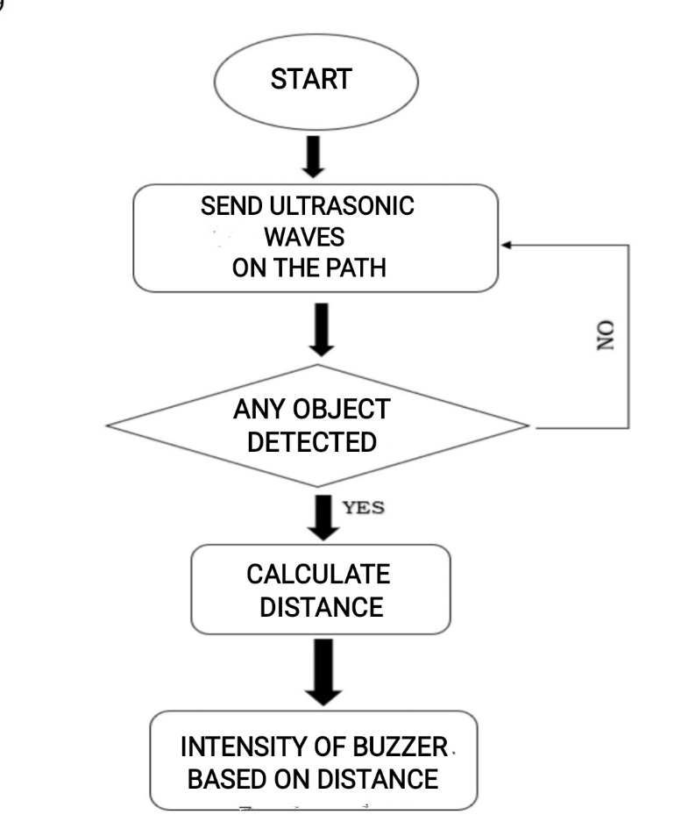
FLOW CHART
https://arunai.org/ideathon

Slide 8
DEMO
https://arunai.org/ideathon

Slide 9
FUTURE ENHANCEMENT
The entire project can be made in the form of jacket so that the device doesn’t need to be worn everytime.
Use of specially designed boards instead of arduino and high quality ultrasonic sensors provides faster response which make the device capable of working even in a crowded environment.
Further improvements in features can be made with advancing technological developments.
If the corona case increase the social distance must be followed. For social distancing we can implement this project to everyone.

Slide 10
ADVANTAGE
Low design time.
Low production cost.
It is used to maintain social distance.
This system is applicable for both the indoor and outdoor environment.
It is dynamic system.
Less space.
Less power consumption.
https://arunai.org/ideathon

Slide 11
Thank you！

