Slide 1
Cloudera Spark and Hadoop Developer Certification

Slide 2
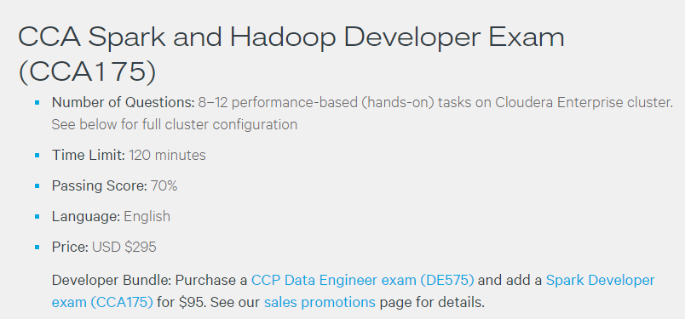
EXAM DETAILS

Slide 3
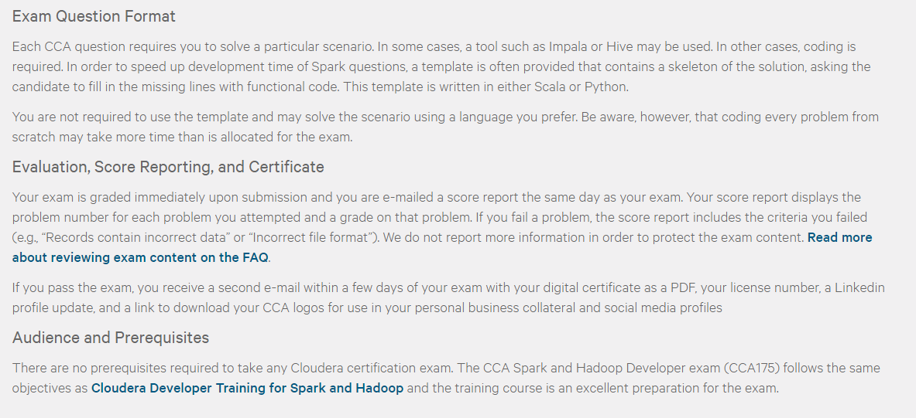
EXAM DETAILS cntd…

Slide 4
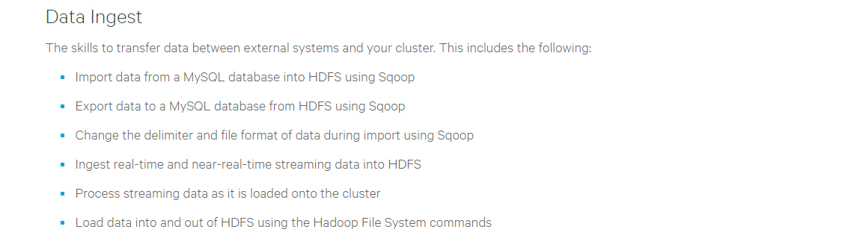
Calendar – DAY 1
HUE – Hadoop User Experience
Sqoop
Import
Export
Flume
Spark Streaming

Slide 5
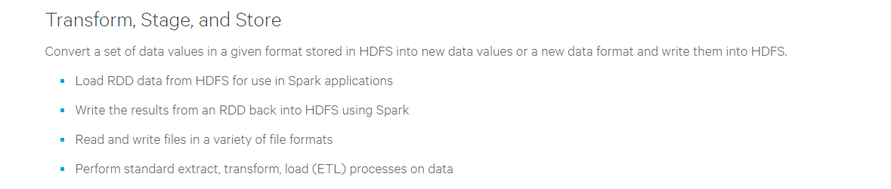
Calendar – DAY 2
Spark Core
Read and Writing RDDs
Transformations and Actions

Slide 6
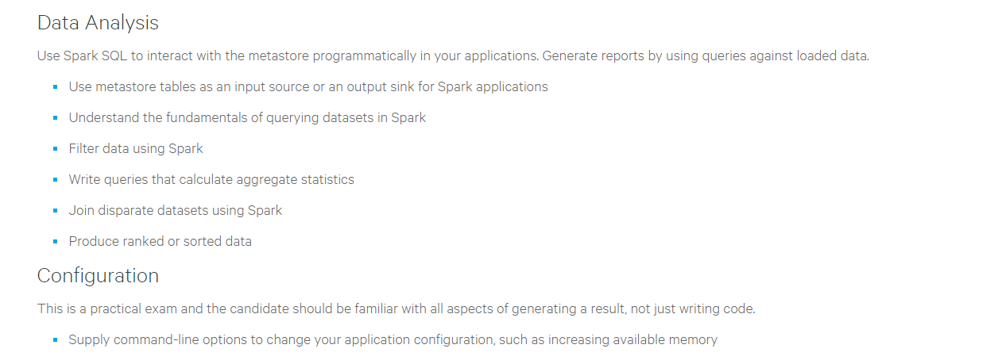
Calendar – DAY 3
Spark SQL
Spark Configurations

Slide 7
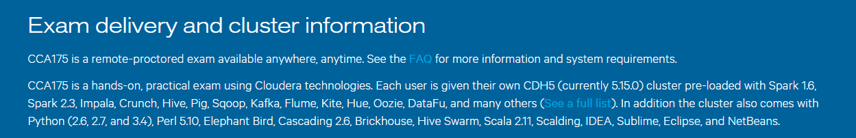
Cluster Environment
** Don’t be overwhelmed, you really need only a few…

Slide 8
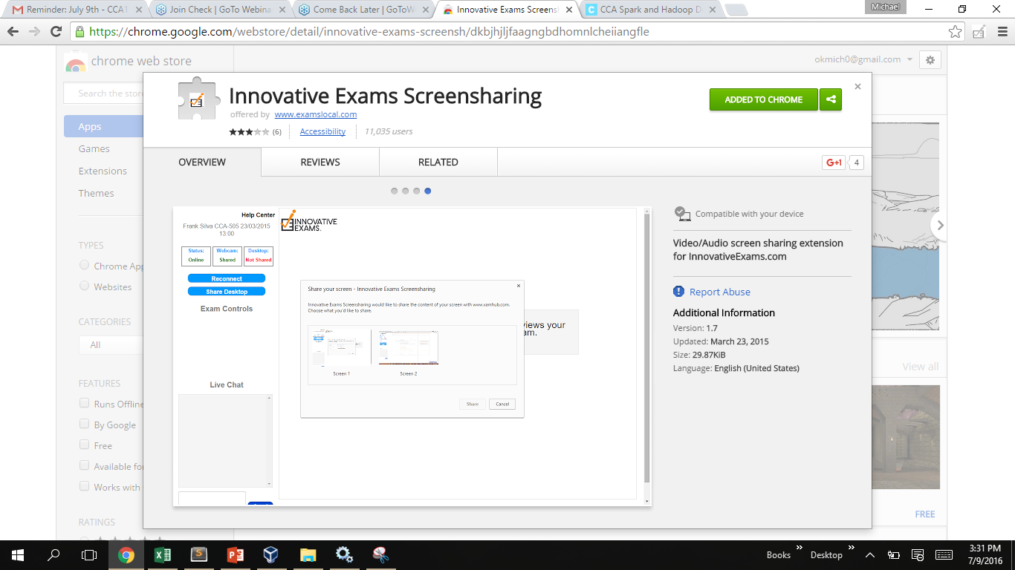
Exam Environment

