Slide 1
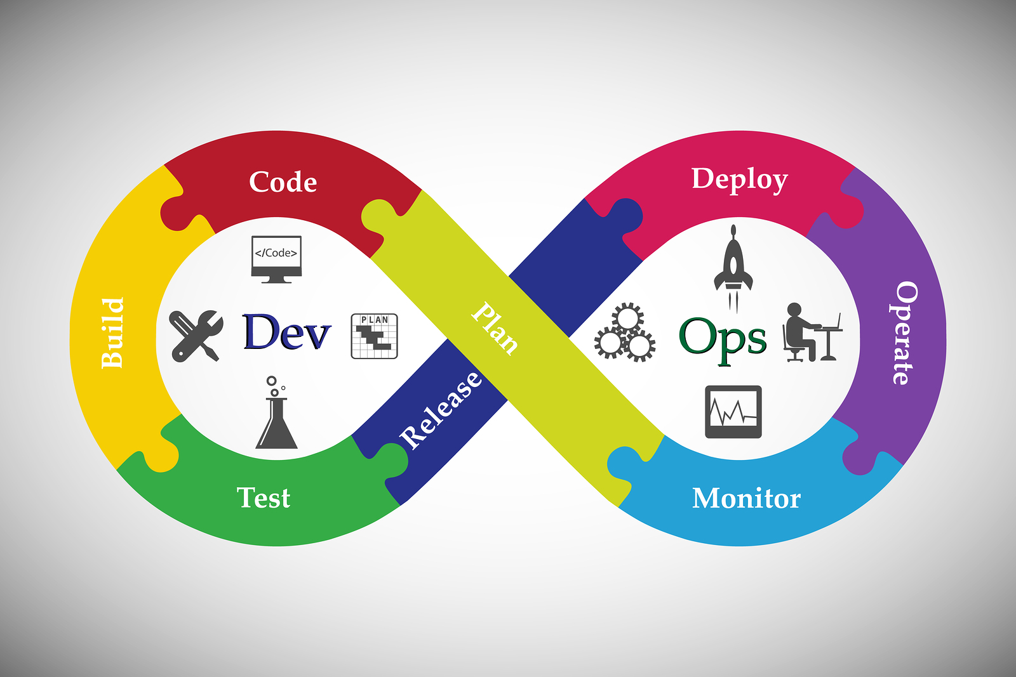
DevOps Written by- Ashok Anupam
Course Content
1→Devops-Introduction
2→GIT
3→Maven
4→Jenkins
5→Chef
6→Ansible
7→Docker
8→Nagios
9→Kubernetes
10→Terraform
11→Helm

Slide 2
DevOps-Introduction
DevOps is a methodology where a single team performs the task of entire Software Development Lifecycle(SDLC).
Main objective of DevOps is Implementing automation at every stage.
Stages include:-
Version control(performed by GIT).
Continuous Integration(performed by Jenkins).
Continuous Deployment(performed by Maven).
Continuous Delivery(performed by Docker,Ansible,Chef)
Continuous Monitoring(performed by Nagios)

Slide 3
Why The Need For DevOps
To overcome the short-comings of waterfall model and Agile model, DevOps was introduced.
Waterfall model took lot of time to complete project, almost 5-10 years, also requirements once decided, could not be rolled back.
In Agile model ,work happens fast ,it’s done in sprints but here also gap between Development and operations Team called Silos which results in hostile relationships between departments, which negatively impacts efficiency and harms the bottom line.
In DevOps ,both Development and operations Team, work together and give better results.

Slide 4
Dev Ops
Plan
DEPLOY
Plan
↓
Code(p (GIT,GITHUB)
↓(Jenkins)
(Maven,Gradle)
↓(Jenkins)
Test(Seleni
Deploy(Ch (Docker)
↓ (Jenkins)
(Kubernetes,Chef,
N Ansible)
↓(Jenkins)
Monitor(Nag
(Nagios,Grafana)
CODE
OPERATE
BUILD
MONITOR
TEST

Slide 5
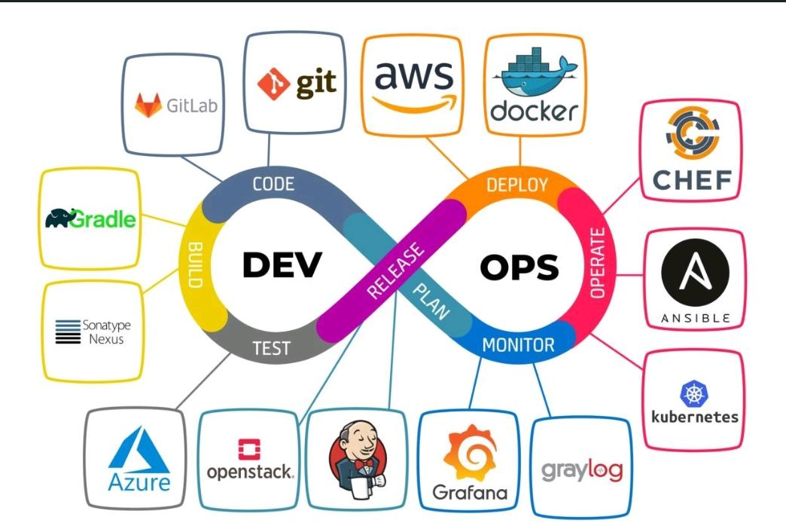
Plan→Code→Build→Test→Release→Deploy→Operate→Monitor

Slide 6

GIT - A Distributed Version Control System

Slide 7
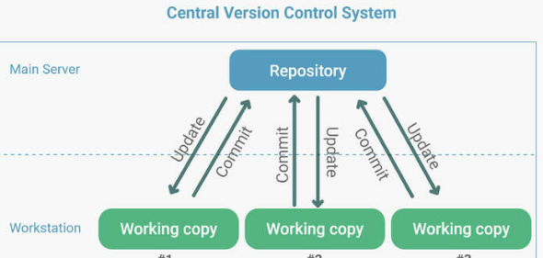
Central Version Control system
First Developer writes code and uploads it to Central repository.
Second Developer will pull the code ,make changes and will commit and upload code.
Similarly rest Developers will do.
Commands are easy to learn.
Single Copy of code is maintained here.
Difficult to work in Branches.
Merge Conflicts can occur.
Complete Dependency on Internet, if Internet slow ,it will impact working.
If Central Repository goes down, everything goes down.
Examples are SVN Tool.

Slide 8
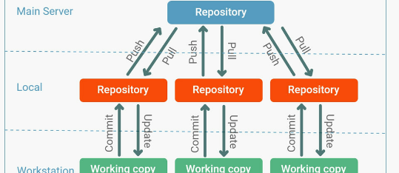
Distributed Version Control System-GIT
Here, each Developer will maintain a local copy of the code in his machine.
First Developer will write code, first commit it to local Repository and then push to Central Repository.
Second Developer will pull the entire code in his local repository first, Commit changes in local repository and then push to Central repository.
Similarly rest Developers will do.
Hence each Developer will have two copy of codes one at Local and other at Central Repository.
Here, working in Branches is easy.
Merge conflict don’t occur, if occur, can be resolved easily.
Helpful for parallel Development.
Difficult commands compared to Central Version Control system.
Works fast as Local copy maintained.
Example is GIT

Slide 9
GIT-In-Action
Git has three stages of workflow
1. Working area 2. Staging area 3. Local Repository.
We send data or code from working area to staging area by add command and staging area to Local repository by commit command and finally send data/code from Local repo to central repo by push command.
Update Linux operating system in working area (Mumbai Ec2-user)
# yum update –y
# yum install git -y
# which git
User /bin /git
# git –version
2.40.1
# git config –-global user.name “Ashok”
# git config –-global user.email ashok.anupam465@gmail.com
# git config –list (this command shows the all configurated list)

Slide 10
GIT-In-Action
Now work inside the Mumbai machine, create Directory and make file inside localrepo
[Ec2-user] # mkdir mumbaigit
[Ec2-user] # cd mumbaigit
[Mumbaigit]# git init ( init command turn Dir into local Repo)
[Mumbaigit]# cat >Mumbai1 (write inside the [Dir] local repo by cat > command)
# cat Mumbai 1 (to check the data/code what has been written in repo)
Put and write some code/data inside the file mumbai1, and come out by Ctrl+d
I Love India
# git status
Untracked files: Mumbai1 (it’s in red color means not added yet staging aria)
[mumbaigit]# git add . (Add command to add created file to staging aria)
# git status
New file: Mumbai1 (it’s in green color means added staging area )

Slide 11
GIT-In-Action
Now commit data from staging area to Local repo
[Mumbaigit]# git commit -m “first commit from Mumbai” (m=message)
# git status
# git log (to check what commits have been done, when and who did?)
You will see commit Id like 12345678KD458F4lW3E4 .Author, Mail id, Date, Time, message: first commit from Mumbai
[Mumbaigit] # git show (show command the content of commit ID)
first commit from Mumbai
+ I Love India
If we run the git commit command again it will show nothing to commit, working tree clean means data has been committed.
If want to send this code to my central repository,
I have to connect local repo to central repo first, for this action I have to create a new repository (any name) and paste the URL of git repo and execute command as given below
[Mumbaigit] # git remote add origin https://github.com/ashok1012/centralgit.git
Now local repo has been connected to central repo, for pushing data to central repo execute this command
[Mumbaigit] # git push -u origin master (push command local repo to central repo)
It will ask for username and password of your git hub account, after filling this and you can see all committed data/code inside central repo but now tokens being asked.

Slide 12
GIT-In-Action
Now create a machine in Singapore region and connect to git hub.
[ec2-user] # yum update -y
# yum install git -y
# git config –global username
# git config –-global user.name “Alok”
# git config –-global user.email alok.anupam26@gmail.com User.name=Alok User.email= alok.anupam26@gmail.com
[Ec2-user] # mkdir singaporegit
# cd singaporegit
[singaporgit] # git init (Initialized empty git repository in Home/ec2- user/singaporegit/.git/)
[singaporgit]# ls -a
. .. .git
[singaporgit] # git remote add origin https://github.com/ashok1012/centralgit.git
Now local repo has been connected to central repo, for Pulling data to central repo, execute this command
[singaporgit]# git pull -u origin master (you can execute without -u as well)
Now you can see it has pulled all data/code from remote directory central repo, all details and commits has been done by other Mumbai machine.

Slide 13
GIT-In-Action
[singaporgit]# cat >mumbai1 (> used to write and overwrite code inside mumbai1) I love Bengaluru too Ctrl+D
If you want to add lines or something on this code inside the file use command
# cat >>file
# git status
Modified: mumbai1
# git add .
# git status
Modified: mumbai1
# git commit -m “first commit from singapore”
# git log
Now it will show all messages commits ids and steps done by both Mumbai and Singapore machines
# git show 12345678KD458F4lW3E4
I Love India Old commit
I Love Bengaluru new commit
Push data/code into central git from local repo
# git push -u origin master (you can use -f instead of -u for force push)
Now Enter username and password of git hub account, after that you will see all new and old commits updates in central git, click mumbai1 file you will get code “I Love Bengaluru

Slide 14
GIT-IGNORE
-This command is used to ignore some specific file which we don’t want to add & commit.
[mumbaigi1]# vi .gitignore
* CSS * used to ignore particular file
* java Esc+:wq
# git add .gitignore
# git commit -m “ignore file format” can use single comma as well
# git status
Nothing to commit, working tree is clean, now create some files in different formats by using touch command
# touch file1.txt file4.java file3.css file5.java file2.txt
# ls
# git status File1.txt only showing 2 untracked files rest three have been ignored File2.txt
# git add .
# git status Now both files have been added and showing us in green color after status command File1.txt File2.txt
# git commit -m “IGNORE JAVA CSS FILES”
# git log 12345678KD458F4lW3E4 (HEAD -> master) So many commit Ids are showing 12345678KD458F4lW3E4 (HEAD -> master) 12345678KD458F4lW3E4 (HEAD -> master)
# git show 12345678KD458F4lW3E4 IGNORE JAVA CSS FILES

Slide 15
GIT-IGNORE
# touch ashok.java
# git status
Nothing to commit, working tree is clean, now create some files in different formats by using touch command
# touch Alok.txt
# git status
Alok.txt (Again it showed text file, not java file means ignored)
If I want to see latest commit, last 2 commits, last-n commits and all commits in one line.
# git log -1
# git log -2
# git log –oneline
12345678KD458F4lW3E4 (HEAD -> master) message “1” So many commits are showing in one column
12345678KD458F4lW3E4 message “2”
12345678KD458F4lW3E4 message “3”
If I want to find specific commit, Acton and file use grep command with specific name rest will be ignored. [mumbaigi1]
# git log -–grep “ignore”
ignore=ignore css and java files

Slide 16
GIT BRANCHES:
Each task has one separate branches, after done with code other branches merge with master.
This concept is useful for parallel development. Master branch is default branch
We make branches, one for little features and other one for longer running features.
It keeps the main master branch free from error.
Files created in workspace will be visible in any of the branch workspace, until you commit,
once you commit then those files belong to that particular branch
How to create Branches:
[ec2-user] # cd mumbaigit
[mumbaigit] # git log –-oneline
# git branch
*master
# git branch branch1
# git branch
*master
Branch1
# git checkout branch1 (switch to branch branch1)
Master
*Branch1
# git branch -d (to delete any branch)

Slide 17
GIT BRANCHES:
Branches Working process:
# git checkout branch1
# cat >branch1file (create branch1file and write anything inside by >)
Something is better that Nothing
# ls
mumbai1
# git checkout master
# ls
mumbai1 branch1
branch1file and code is showing inside master branch because it hasn’t committed with any branch yet.
# git commit -m “branch1 first commit”
# git log –oneline
Branch1 first commit
# git checkout master
# git log –oneline
branch1file & code will not show inside master branch because that file has been committed with Branch1.
How to Merge Branches: we use pulling mechanism, we can’t merge branches of different repositories
# git checkout master
# git merge branchA (to verify the merge)
Executed checkout command before merge command means, you wanted to merge any branch with master branch
# git log –oneleine

Slide 18
GIT BRANCHES:
Now you can see All commits of both branches which have been merged together
# ls
Now you can see All files of both branches which have been merged together.
# git push origin master (to push central repo lit git hub)
Enter username & password you can see merged data in central repository on git hub.

Slide 19
GIT CONFLICT:
<<<<<
When same files having different content in different branches, if you do merge ,conflict can occur. (Resolve conflict then add and commit)
# Cat >anupfile
hello anup <ctrl+d >
# git add .
# git commit -m “commit before conflict”
# git checkout branch1 (switch to branch1 )
# Cat >anupfile
create same file but write different code inside
hello Ashok <ctrl+d>
# git commit -m “commit from branch1”
# git checkout master (switch to Master)
# git merge branch1 Merge failed: fix conflict, then commit result
# vi anupfile (update inside anupfile)

Slide 20
GIT CONFLICT:
<<<<<<HEAD delete HEAD
Hello anup
============ delete =====
Hello Ashok
>>>>>> branch1 Esc+:wq
You can change data according to yourself which you exactly needed before conflict do changes in file git will understand the change and execute data accordingly.
# git status
# git add .
# git commit -m “Resolve conflict”
# git log --oneline 12h3a8g90 (HEAD  master) Resolve conflict

Slide 21
GIT BRANCH STASH
If your code is in progress and suddenly need changes through client escalation, you have to keep aside current code and have to work on new features for some hours.
You can’t commit your parallel code, so you need some temporary storage to store partial changes and later on commit it.
To stash an item only applied for modifies files not new files.
# git checkout master
# cat >anupamfile1
# git commit -m “anupamfile1 commit”
# vi anupamfile1
Boss asks to do some other work
# git stash
# Cat anupamfile1 (anupamfile1 empty, data stashed ,now you can do new work)
# Git stash list
Stash (0) : WIP on master 1372ee7 .anupamfile1
# vi anupamfile1 My super anupam code-2 Esc+:wq
# cat anupamfile1 My super anupamfil2 code-2

Slide 22
GIT BRANCH STASH
# git stash
# git stash list
Stash (0)
Stash (1)
# cat anupamfile1
(anupamfile1 empty, data/code has been stashed) Now going to do old pending work
# git stash apply stash@{1}
# cat anupamfile1
My super anupam code-2
# git add.
# git commit -m “anupamfile1 commit done”
# git stash apply stash@{0}
Auto merging anupamfile1; CONFLICT:Merge conflict in

Slide 23
GIT BRANCH STASH
# Vi anupamfile1
(update inside anupamfile1)
<<<<< update stream My super anupam-1 final code would be my super anupam-2
=================== delete ========
My super anupamcode-2
>>>> stashed changes Esc+:wq
# git add .
# git commit -m “anupamfile1 commit done2”
# git status (empty)
# git log --oneline anupamfile commit anupamfile xommit done anupamfile commit done2
# git stash list
Stash (0)
Stash (1) (still available in stash list delete it by # git stash clear, recheck by stash list command)

Slide 24
GIT RESET:
It is a powerful command that is used to undo local changes to the state of a git repository.
It used to undo the add . command.
# cat >testfile
Hello Ashok
# git add .
# git status
New file:testfile (now realized did mistake in data, wanted to change)
• • To reset from staging aria
# git reset testfile
# git reset . (removed data from staging aria)
# git status
testfile
# git add .
# git status testfile
• • To reset from staging area
# git reset –hard
# git status
One branch master nothing to commit: working tree clean

Slide 25
GIT REVERT:
Revert command helps you to undo the existing commit, it doesn’t delete any data, instead git creates a new commit with the included previous files reverted to the previous state.
So, history moves forward while the state of your file moves backward.
# cat >checkfile
I LOVE MY INDIA
# git add.
# git commit -m “checkfile1 commit” after commit I realized did wrong commit
# git log –oneline
Now you can see so many commits copy previous commit id just before the mistake and paste on revert command
# git revert 12h3a8g90
Wrong commit undo state moves to backward also write a message in this commit “please ignore previous commit”
How to remove untracked files
# git clean -n dry run
# git clean -f forcefully

Slide 26
Git Tags
Tag operation allows giving meaningful name to a specific version in the repository.
To Apply Tag
# git tag -a -m “message” commit-id
# git tag -a Ashok -m “love you India” 12h3a8g90g6k
To see tag # git tag
# git show tag-name to see particular commit content by using Tag
To delete a tag
# git tag -d tag-name

Slide 27
Git Hub Clone:
go to existing repo in git Hub copy the URL of central repo and paste with run command of Linux machine.
# git clone
[ec2-user] # git clone https://github.com/ashok1012/centralgit.git
It creates a local repo automatically inside Linux machine with the same name of git hub account.
# ls Mumbai1
git Anupamfile centralgit node1git
Both repositories can be connected together easily by master branch

Slide 28

Maven- A project Management tool

Slide 29
Maven-Introduction
Maven is an automation and project management tool developed by apache software foundation.
It is based on POM (project object model).
Maven can build any number of projects into desired output such as .jar, .war, metadata.
Mostly used for java-based project.
It was initially released on 13th July 2004.
Maven is written in java language.
Meaning of maven is ‘accumulator of knowledge’.
Maven helps to get the right .jar file for each project as there may be different version of separate packages.
To download dependencies, it is no more needed to visit the official website of each software. It could now be easily done by visiting ‘mvnrepository.com’
Dependencies: it refers to the java libraries that are needed for the project.
Repositories: it refers to the directories of packaged .jar files.
Build tools: C, C++: make file .Net: visual studio Java: Ant, Maven,Gradle

Slide 30
Problems without Maven:
1. Adding set of jar in each project:
in case if struts, spring we need to add jar files in each project.
It must include all the dependencies of jars also.
2. Creating the right project structure: we must create the right project structure in servlet, struts etc, otherwise it will not be executed.
3. Building and deploying the project: we must have to build and deploy the project so that it may work.
What Maven does?
1. It makes a project easy to build.
2. It provides project information (for e.g: log documents, crossreference sources, mailing list, dependencies list, unit testing)
3. Easy to add new dependencies, therefore apache maven helps to manage
a. Build
b. Dependencies
c. Reports
d. Release
e. Distributon

Slide 31
What is Build Tool:
A build tool takes care of everything for building a process.
It does following:
Generate source code.
Generate documentation from source code.
Compiles source code.
Install the package code in local repo., server repo. Or central repo
POM (project object model):
POM refers to the .xml file that have all the information regarding project and configuration details.
Main configuration file in pom.xml.
It has the description of the project details regarding the version and configuration management of the project.
The .xml file is in the project home directory.
Pom.xml contains: • Metadata • Dependencies • Kind of project • Kind of output (.jar, .war) • Description One project – one workspace – one pom.xml file

Slide 32
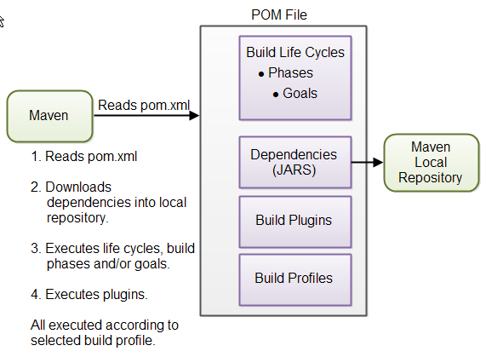
Maven- Architecture

Slide 33
Requirement for Build
Source code (present in workspace)
Compiler (remote repo – local repo – work space)
Dependencies (remote repo – local repo – work space)
Local Repository: local repo. refers to the machine of the developer where all the project material is saved.
Remote Repository: it refers to the repo. present on a webserver which is used when maven needs to download dependencies. This repo. works same as the central repo. whenever anything is needed form remote repo. it is first downloaded to the local repo. and then it is used.
Central Repository: central repo. refers to the maven community that comes into action when there is a need of dependencies and those dependencies are not found in the local repo.

Slide 34
Maven Build Life-Cycle
Goals:
1. Generate resources (dependencies)
2. Compile code
3. Unit test
4. Package (build 5. Install (into local repo. and artifactory)
6. Deploy (to server)
7. Clean (delete all run time files)
e.g- mvn install
mvn clean package
1 to 6 – default and sequence order
7 – not default and it won’t allow sequence
Build life cycle consists of a sequence of build phases and each build phase consists of a sequence of goals.
Each goal is responsible for a particular task.
When a phase is run all the goals related to that phase and its plugins are also compiled. e.g- mvn install
mvn clean package

Slide 35
ANT vs MAVEN
Ant doesn’t have formal conventions, so we need to provide information of the project structure in build.xml file.
➢ Ant is procedural, you need to provide info about what to do and when to do through code.
➢ There is no lifecycle in ant.
➢ It is a tool box.
➢ It is mainly a build tool.
➢ It is less preferred than maven.
Maven have a convention to place source code, compiled code etc. so we don’t need to provide information about the project structure in pom.xml file.
➢ Maven is declarative, everything you define in the pom.xml file.
➢ There is a life cycle in maven. ➢ It is a framework.
➢ It is mainly a project management tool.
➢ It is more preferred

Slide 36

Jenkins
Jenkins-An Integration Tool

Slide 37
JENKINS-Introduction
Jenkin is an open-source project written in Java that runs on windows, macOS and other unix like os. It is free, community supported and might be your first-choice tool for CI.
Jenkins can automate the entire s/w development life cycle.
Jenkins was originally developed by sun microsystem in 2004 under the name hadson.
The project was later named Jenkins when oracle bought microsystem.
It can run on any major platform without any compatibility issues.
Whenever developer write code, we integrate all that code of all developers at that point of time and we build test and deliver/ deploy to the client. This process is called as CI/CD.
Jenkins helps us to achieve this.
Because of CI now bugs will be reported fast and get rectified fast. So that entire software development happens fast.

Slide 38
Workflow of Jenkins:
We can attach git, maven, selenium and artifactory plugins to Jenkins.
Once developers put codes in github Jenkins pull that code and send to maven for build.
Once build is done, then Jenkins will pull that code and send to artifactory as per requirement and so on.
We can also deploy with Jenkins.

Slide 39
Advantages of Jenkins:
It has lots of plugins available.
You can write your own plugins.
You can use community plugins.
Jenkins is not just a tool. It is a framework i.e you can do whatever you want. All you need is plugins.
We can attach slaves (nodes) to jenkins master. It instructs other (slaves) to do job. If slaves are not available, Jenkins itself does the job.
➢ Jenkins also behave as cron server replacement i.e can do scheduled task.
➢ It can create labels.

Slide 40
CI/CD Project:
Go to google chrome – search ‘git download’ – download 2.44.0 for windows – click to download. Open the download file preamble
– c:\programfiles\Git
– select components
– select start menu folder
– choosing default editor vim
– let git decide
– git from the command line and also from the 3rd party s/w
– use the open SSL library
– check as-is, commit Unix-style line endings
– use minty
– choose default behavior
– git credentials manager core
– enable file system caching
- enable experimental built-in file system monitor
– install.

Slide 41
Download and Installation of JDK21:
Go to google chrome – search ‘java development kit download’ – download java SE development kit 21.0.2 for windows x64.
Run and follow the steps to install.
Now go to C drive – program files – java jdk21 – select path and copy it
Search ‘edit system environment variables’ in laptop – go to use variables – new
Variable name- JAVA_HOME
Variable value- paste the path here
Now go to system variable – new
Variable name – JAVA_HOME
Variable value- paste the path here
Now go inside program files – bin – copy the path
Again, go to ‘edit system variables’ – system variable – path – new – paste path
Now verify in command prompt
C:\users\home\echo% JAVA_HOME%
o/p- c:\ Program Files\Java\jdk-21

Slide 42
Maven download and install:
Go to google chrome – search maven.apache.org – download Apache Maven 3.9.6– binary zip archive
Extract files – c:\Devtools
Go to c:\ - Devtools – apache-maven – copy the path
Now search ‘edit system environmental variables’ – system variable – new
Variable name – M2_HOME
Variable value - paste the path here
Now go inside apache maven folder – bin – copy path
Now again go to ‘environmental variable’ – system variable – path – new – paste path
Now open command prompt
C:\users\home > mvn -version
C:\users\home > echo % M2_HOME%
Now restart the laptop

Slide 43
Jenkins download and install:
Go to google chrome – Jenkins.io – download – select LTS – windows – download
Open download file – run and install
After installation it automatically open as local host: 8080
Unlock the page by using password
Now install suggested plugins
Ask for username and password
Username – admin
Password – admin123
Email address- ashok.anupam465@gmail.com
Save and continue
Start using Jenkins
Plugins: plugins are small libraries that add new abilities to Jenkins and can provide integration points to other tools.
Go to google chrome – localhost:8080 – login

Slide 44
Manage Jenkins
Go to google chrome – localhost:8080 – login
Go to manage Jenkins on left side of Jenkins dashboard – manage plugins – available – select maven integration and green balls – install without restart
Go to new item – maven project
Now go to manage Jenkins – global tool configuration
Go to add JDK
Uncheck the install automatically option
NAME – JAVA
JAVA_HOME – c:\programfiles\java\jdk
Now go to maven
Name – MAVEN
MAVEN_HOME – c:\devtools\apache-maven

Slide 45
Maven Project (by maven):
Go to https://github.com/technicalguftgu/time-tracker
Click on time tracker repo
‘fork’ to copy this repo
Sign-in into your github account
Click on time-tracker repo
Clone
Go to c drive
Git clone <url of time-tracker repo>
Cd time-tracker
C:\time-tracker > maven clean package
Maven Project (by Jenkins):
Now go to Jenkins – new item – entername -> mymavenproject
Then select maven project – ok
Source code management – git – repo url
Build option – root POM – pom.xml
Goals and options – clean package – save
Go to Jenkins home page – click on mymavenproject – build now

Slide 46
Scheduled Project: and Source Code Polling (Poll SCM):
Click on any project – configure – build triggers – build periodically - * * * * * - save
Can see automatic builds after every 1 min.
You can manually trigger build as well.
Source Code Polling (Poll SCM):
Now go to Jenkins home page – go to mymavenproject – configure
Now go to build trigger
Enable poll SCM
Schedule * * * * * - save
Now go to github account – do some changes in README.md – commit changes.
You can see after 1 min, it builds automatically.

Slide 47
User Management:
go to Jenkins homepage – manage Jenkins – manage user
create two users – Ashok and Anupam
now login as Ashok
{by default you have all the permissions}
Login as ‘admin’ again
Go to manage Jenkins – manage plugins – search ‘role-based authorization strategy’ – install without restart.
Go to Jenkins homepage – manage Jenkins – configure global security – select role-based strategy – save.
Login as ‘Ashok’ – access denied
Now attach permission
Go to Jenkins – manage Jenkins – manage and assign role – manage roles
Role to add – employee
Go to item project – add developer and tester [pattern – dev* test*]
Then assign roles
User/group to add Ashok and Anupam.

Slide 48
How to install Jenkins on Ubuntu:
Login into AWS account and create one ubuntu instance.
➢ Access it through putty and login as ‘ubuntu’.
➢ Use given commands
# sudo apt-get update
# sudo apt-cache search openjdk
#sudo apt-get install openjdk-8-jdk
#java -version
#sudo vi /etc/apt/source.list
Paste at the bottom
deb https://pkg.jenkins.io/debian-stablebinary/
#sudo apt-get update
# wget -q -o ---
# sudo apt-cache search Jenkins
# sudo apt-cache Madison Jenkins
# sudo apt-get install Jenkins -y
# sudo service Jenkins status -q
Copy public ip from AWS and paste in chrome url – public:8080
Go to instance #sudo cat /var/lib;initialpassword

Slide 49

Chef-A pull based Configuration Management Tool

Slide 50
CHEF-Introduction
It is a pull -based configuration management tool unlike Ansible which is push based in nature.
It turns our code into Infrastructure hence, its Infrastructure As Code[IAC].
Chef has following components.
(a)-Workstation-They are personal machine or virtual servers , where configuration codes are created, Codes are called Recipes and collection of recipes is called cookbook.
Workstation communicate with Chef Server through Knife.
(b)Chef-Server-It is stored between Workstation and Node.
All Cookbooks are stored here. Servers may be stored locally or remote.
(c) Nodes-They are systems which require configuration.
OHAI fetches current state of node.
Node communicate with Chef Server with help of Chef-Client

Slide 51
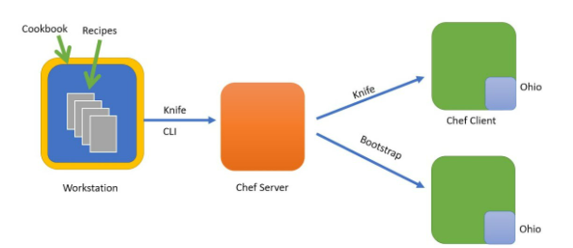
CHEF-Architecture
Workstation- Where we write our code called Recipe.
Chef-Server- Where we upload our Code.
Node-Where we apply our code.
Knife-Command Line Interface to communicate between Workstation and Chef-Server and between Chef-server to Chef-Client.
Ohai-It contains Meta data about Node
Node communicate with Chef-server through Chef Client.

Slide 52
CHEF-Installation
Download & install Chef and create Cookbook, Recipes
❖ Wget <chef download link>[Install Chef Workstation for Linux]
❖ mkdir cookbooks
❖ cd cookbooks/
❖ chef generate cookbook Ashok-cookbook
❖ cd Ashok-cookbook
❖ yum install tree -y
❖ tree
❖ chef generate recipe Ashok-recipe
❖ cd ..
vi Ashok-cookbook/recipes/Ashok-recipe.rb
file '/myfile' do
content 'Welcome Ashok Anupam'
action :create
end
enter+esc+:wq

Slide 53
CHEF
Chef exec ruby -c Ashok-cookbook/recipes/Ashok-recipe.rb (check the syntax)
❖ Syntax OK
❖ (run the chef client)
❖ Chef-client -zr “recipe[Ashok-cookbook::Ashok-recipe]”
❖ Cat /myfile(xyz) (also try ls /) (to check inside the file)
Apache server:
[cookbooks]#chef generate cookbook apache-cookbook
#cd apache-cookbook
#chef generate recipe apache-recipe

Slide 54
CHEF
#cd ..
#vi Apache-cookbook/recipes/apache-recipe.rb
package 'httpd' do
action :install
end
file '/var/www/html/index.html' do
content 'Welcome Ashok Anupam'
action :create
end
service 'httpd' do
action [:enable, :start]
End
#Chef-client -zr “recipe[Apache-cookbook::Apache-recipe]”
Now ping public IP address to see content on apache website,First enable All Traffic in EC2-Instance else will not work.

Slide 55
ATTRIBUTES
What is this: Attributes is a key value pair which represent a specific detail about node.
Who uses? Chef client
Why uses? To determine
• current state of node
• what was the state of the node at the end of previous chef client run?
• What should be the state of the node at the end of current chef client will run?
Types: Priority
1. Default 1 st maximum
2. Force-default 2 nd more
3. Normal 3 rd may be
4. Override 4 th less
5. Force override 5 th very less
6. Automatic 6th minimum

Slide 56
ATTRIBUTES
Who defines Attributes?
Ans: (Node, Cookbooks, Roles, Environment)
**(attribute defined by Ohai have highest priority)
# sudo su
# ohai
# ohai ipaddress
# ohai memory/total
# ohai cpu/0/mhz
# ls
# cd cookbooks
# cd Apache-cookbook
# Chef generate recipe recipe10
# cd ..

Slide 57
ATTRIBUTES
# vi apache-cookbook/recipes/recipe10.rb
[+ Enter then ]
file '/basicinfo' do
content "This is to get Attributes
HOSTNAME: #{node['hostname']}
IPADDRESS: #{node['ipaddress']}
CPU: #{node['cpu']['0']['mhz']}
MEMORY: #{node['memory']['total']}"
owner 'root'
group 'root'
action :create
End
# chef exec ruby -c apache-cookbook/recipes/recipe10.rb
# chef-client -zr “recipe[apache-cookbook::recipe10]” (call the client)
SEE OUTPUT ATTRIBUTES

Slide 58
ATTRIBUTES
Insert Linux commands [cookbooks]
# vi ABC-cookbook/recipes/ABC-recipe.rb
i+ Enter then
#
# Cookbook:: ABC-cookbook
# Recipe:: ABC-recipe
#
# Copyright:: 2024, The Authors, All Rights Reserved.
execute "run a script" do
command <<-EOH
mkdir /ashokdir
touch /ashokdir/anupamfile
EOH
End
[ABC-cookbook] ls /
ashokdir

Slide 59
ATTRIBUTES
Create user
# vi ABC-cookbook/recipes/ABC-recipe.rb
user "ashok" do
action :create
End
Enter+Esc+:wq
(now run the recipe,call chef-client)
# chef-client -zr “recipe[ABC-cookbook::ABC-recipe]”
Create group
# vi ABC-cookbook/recipes/ABC-recipe.rb
group "devopsgroup" do
action :create
members 'ashok'
append true
End
Enter+Esc+:wq (now check the recipe)
# Chef exec ruby -c ABC-cookbook/recipes/ABC-recipe.rb
# syntax OK (now run the recipe)
# chef-client -zr “recipe[ABC-cookbook::abc-recipe]”
# cat /etc/group (also try ls /) (to check the group

Slide 60
RUNLIST
To run the recipe in a sequence order , we mention that in a run list.
With this process we can run multiple recipes but the condition is, they must be from one cookbook.
***(chef client calling default recipes from Ashok-cookbook & Apache-cookbook together) ***
[cookbooks]# chef-client -zr “recipe[Ashok-cookbook::default],recipe[Apache-cookbook::default]”
Include Recipe: To call recipes/recipe from another recipe with in same cookbook.
To run multiple recipes from same cookbook. We can run any numbers of recipes with include command but all must be from same cookbook. Here including recipes with default recipe in Ashok-Cookbook.
[cookbooks]# vi Ashok-cookbook/recipes/default.rb
Include_recipe “ABC-cookbook::ABC-recipe”
Include_recipe “ABC-cookbook::XYZ-recipe”
Include_recipe “ABC-cookbook::PQR-recipe”
Esc+:wq (call the chef client)
#chef-client -zr “recipe[Ashok-cookbook::default]”

Slide 61
BOOTSTRAP
Connect workstation to chef server to node using chef-repo, bootstrap
Chef server is going to be mediator between the code and cookbooks.
Bootstrapping is Attaching a node to chef server, while using Bootstrap command, both workstation and node should be in same AZ.
Two actions will be done while bootstrapping
1. adding node to chef server
2. installing chef package.
Chef-repo It would be the main directory inside it you have to run any commands, it is also having cookbooks).
Create chef manage account by “manage.chef.io” and download starter kit.
Go to download and extract file chef-repo,
After extracting we got more files inside chef-repo are (.chef ,cookbooks ,gitignore, README.md, roles)
For sending chef-repo file to Linux machine we use the software called WinSCP. Drag Chef-repo from left window and drop

Slide 62
BOOTSTRAP
# Sudo su
# ls
chef-repo chef-workstation-20.7.96-1.e17.x86_64.rpm cookbooks nodes
# cd chef-repo
# ls-a
. .. .chef cookbooks .gitignore README.md roles
# cd .chef/
[.chef]# ls/
# config.rb kritikaji.pem (organization name is kritikaji)
# cat config.rb
Inside config.rb you will get chef_server_url
https://api.chef.io/organizations/kritikaji
# knife ssl check (to check workstation is connected with chef server ?)
Create Linux machine (Node1) same AZ of workstation with new security group and new key pair name node1-key, save Private IP for further knife bootstrap commands.(SSH & HTTPs)

Slide 63
BOOTSTRAP
Attach Advance details
[ #!/bin/bash
Sudo su
Yum update -y]
With the help of WinSCP please transfer downloaded node1-key.pem to Chef-repo for bootstrap command
Now go to chef workstation and execute Bootstrap command to attach node1 to chef-server.
[chef-repo] # knife bootstrap 172.31.44.20 --ssh-user ec2-user --sudo -i node1.pem -N Node1
(Y for YES/NO) Node has been connected to server and node package has installed
[chef-repo] # knife node list
node1 →(showing result node1 means node1 has been connected to server

Slide 64
Moving and delete cookbooks in chef-repo to avoid cookbooks confusion
# mv cookbooks/apache-cookbook chef-repo/cookbooks
# mv cookbooks/Ashok-cookbook chef-repo/cookbooks
# ls [didn’t get any cookbook, all empty]
# cd chef-repo
# ls [get (cookbooks node1-key.pem README.md roles)]
apache-cookbook ,chefignore starter, Ashok-cookbook (got inside the chef-repo-cookboook)
It means both cookbooks have been moved to Chef-repo Cookboooks from
Upload apache-cookbook to chef-server:
[Chef-repo] # knife cookbook upload apache-cookbook
# knife cookbook list (confirm uploading?)
apache-cookbook
Now we will attach the recipe on node1 which we would like to run on node1, by this command
[chef-repo]# knife Node1:node set node1 “recipe[apache-cookbook::apache-recipe] run_list: recipe[apachecookbook::apache-recipe] [chef-repo]
# knife node show node1 (get so many info including recipes in run_list)

Slide 65
NODE-SERVER
Now access the Node1
# sudo su
# chef-client
**This chef-client implement the code (inside the recipe) on server Automatically** Now back to workstation and edit the recipe:
[Chef-repo]# vi cookbooks/apache-cookbook/recipes/apache-recipe.rb
“Update recipe”
Upload apache-cookbook to chef-server
[chef-repo] # knife cookbook upload apache-cookbook
Now go to the node1 and call chef client
# chef-client
You can see all updated content, also you can ping node1’s public IP and see change.

Slide 66
How can we automate this process:
Go to node1
[ec2-user] # vi /etc/crontab
* * * * * root chef-client
Esc+:wq */n (HR DAY MONTH YEAR WEEK)
With the help of this command automation will start no need to call the chef client again=2 Chef-client command execute periodically according to “*/n * * * * crontab method”
Now see full automation:
Create one more linux machine Node2 *(we also can use existing key of node1 for node2 creation)
Attach Advance details
[ #!/bin/bash
Sudo su
Yum update -y
echo”* * * * *root chef-client”>> etc/crontab]
Now back to workstation and run Bootstrap command
[chef-repo]# knife bootstrap 172.31.10.120 -–ssh-user ec2-user -–sudo -i node- 2key.pem -N node2
(Y for YES/NO) Node has been connected to server and node package has been installed
Now Attach the Recipe to node2 run_list
[chef-repo]# knife node run_list set node2 “recipe[apache-cookbook::apache-recipe]”
then for check ping the IP of node2 and see webpage.

Slide 67
How to Delete everything from chef-server:
To see list of client present inside chef-server,To delete clients
[chef-repo] #knife client list
# knife client delete clientname -y
To see cookbook list,To delete cookbook
[chef-repo] # knife cookbook list
#knife cookbook delete cookbookName -y
To see Role list To delete Role
[chef-repo] # knife role list
#knife cookbook delete roleName –y
To see Node list,To delete Node
[chef-repo] # knife node list
#knife cookbook delete nodeName -y

Slide 68
How to create ROLE:
[chef-repo]# ls
.chef roles
# cd roles/ [roles]
#ls
#starter.rb [roles]
# vi Engineer.rb *(this is the command to create role name Engineer)
Name “Engineer”
Description “webserver role”
run_list “recipe[apache-cookbook::apache-recipe]” ESC+:wq
Now back to chef-repo
# cd .. and upload the role on chef server [chef-repo]
# knife role from file roles/Engineer.rb
If you want to see the created role
# knife role list
o/p: Engineer Now create 4 instances (1,2,3,4) by one IMA on same availability zone as of workstation with new security group sg-1 with SSH +HTTP.

Slide 69
How to create ROLE:
Attach Advance details
[ #!/bin/bash
Sudo su
Yum update -y
echo”* * * * *root chef-client”>> etc/crontab]
Now Bootstraps the nodes 1,2,3,4 one by one
#[chef-repo]# knife bootstrap 172.31.10.121 -–ssh-user ec2-user -–sudo -i node-1key.pem -N node1
#[chef-repo]# knife bootstrap 172.31.10.122 -–ssh-user ec2-user -–sudo -i node-1key.pem -N node2
#[chef-repo]# knife bootstrap 172.31.10.123 -–ssh-user ec2-user -–sudo -i node-1key.pem -N node3
#[chef-repo]# knife bootstrap 172.31.10.124 -–ssh-user ec2-user -–sudo -i node-1key.pem -N node4

Slide 70
How to create ROLE:
Now connect these nodes to roles one by one.
# knife node run-list set node1 “role[Engineer]”
Node1:Run_list:role[Engineer] (similarly for rest 3 nodes)
# knife node run-list set node2 “role[Engineer]”
# knife node run-list set node3 “role[Engineer]”
# knife node run-list set node4 “role[Engineer]”
UPLOAD cookbook to server
# knife cookbook upload apache-cookbook
Now we can check public IP of any node on webserver, every node will behave like server cause, now cookbook has been uploaded despite of uploading different recipes, all recipes have uploaded together inside role by cookbok.

Slide 71
How to create ROLE:
Now we are doing changes in recipe
# vi cookbooks/apache-cookbook/recipes/apache-recipe.rb
Content change to “I Love India”
ESC+:wq
Now see if Boss need changes, said do work on another recipe (recipe10)
#cat cookbooks/apache-cookbook/recipes/recipe10.rb
Paste code update recipe and go to the role in workstation
# vi roles/Engineer.rb vi Engineer.rb
Name “Engineer”
Description “webserver role”
run_list “recipe[apache-cookbook::apache-recipe]” update apache-recipe to recipe10 in role
run_list “recipe[apache-cookbook::recipe10]”
ESC+:wq *for update in recipe we can create user and file by these commands below
#user”Ashok” #file “Anupamfile”
now upload role to server
[chef-repo] # knife role from file roles/Engineer.rb

Slide 72
How to create ROLE:
Again, go to the workstation
# vi roles/Engineer.rb
Name “Engineer”
Description “webserver role” (change last line only apache-cookbook in role)
run_list “recipe[apache-cookbook]”
ESC+:wq now upload role to server
[chef-repo] # knife role from file roles/Engineer.rb
Do not mention any recipe just upload only cookbook for all recipes, will update automatically on serve
# knife cookbook upload apache-cookbook
Now we are adding 2 cookbooks in roles

Slide 73
How to create ROLE:
vi roles/Engineer.rb Name
“Engineer” Description “webserver role”
run_list “recipe[apache-cookbook]”,”recipe[Ashok-cookbook]”
esc+:wq
now upload role to server
[chef-repo] # knife role from file roles/Engineer.rb
Do not forget to upload Ashok-cookbook on server otherwise role will not perform properly
# knife cookbook upload Ashok-cookbook
Boss need changes again but this time in Ashok-recipe
[Chef-repo]# vi cookbooks/apache-cookbook/recipes/Ashok-recipe.rb
%W (httpd mariadb-server unzip git vim) .each do |p| Package p do
Action :install end
end esc+:wq # knife cookbook upload Ashok-cookbook
Go to inside any node and search git by using command
# which git after 1 minute execute again same command and you will see output /bin/git it means working properly.

Slide 74

Ansible- A push-based Configuration management Tool

Slide 75
Ansible-Introduction
Ansible is an opensource IT configuration management, deployment and orchestration tool.
It aims provide large productivity gains to a wide variety of automation challenges.
Ansible History:
Michael Dehaan developed ansible and the ansible project began in February 2012.
Redhat acquired the ansible tool in 2015
Ansible is available for RHEL, Debian, cent OS and oracle Linux.
You can use this tool whether your servers are in on-premises or in cloud.
It turns your code into infrastructure i.e. your computing environment has some of the same attributes as your application.

Slide 76
Ansible-Advantages& Disadvantages
Advantages:
Ansible is free to use by everyone.
Ansible is very consistent and light weight and no constrains regarding the OS or underlying hardware are present.
It is very secure due to its agentless capabilities and open SSH security features.
Ansible doesn’t need any special system administrator skills to install and use it.
It is push mechanism.
Disadvantages:
Insufficient user interface, though ansible tower is GUI, but it is still in development stage.
Cannot achieve full automation by ansible.
New to the market, therefore limited support and document is available.

Slide 77
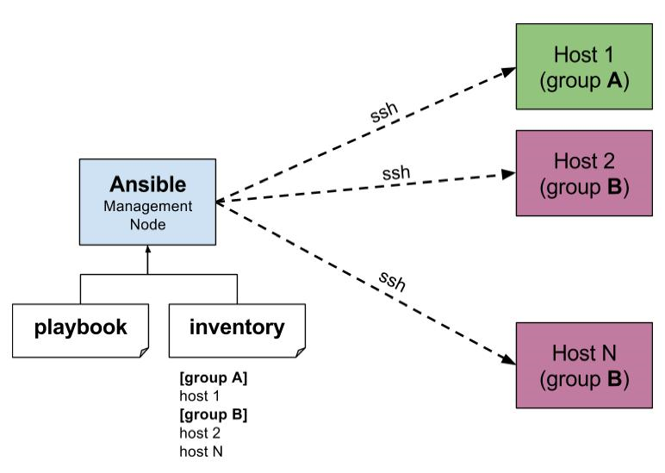
Ansible-Architecture

Slide 78
Terms used in Ansible:
Ansible Server: the machine where ansible is installed and from which all tasks and Playbooks will be run.
Module: a module is a command or set of similar commands meant to be executed on the client side.
Task: a task is section that consist of a single procedure to be completed.
Role: a way of organizing tasks and related files to be later called playbook.
Fact: information fetched from the client form the global variables with the gather facts operation.
Inventory: file containing data about the ansible client servers. g. Play: execution of playbook.
Handler: task which is called only if notifier is present.
Notifier: section attributed to a task which calls a handler if the output is changed.
Playbooks: it consists code in YAML format which describes tasks to be executed.
Host: nodes which are automated by ansible

Slide 79
Ansible-Installation
Go to AWS account- create 3 EC2 instances in same AZ.
Take access of all machines via putty.
Now go inside ansible server and download ansible package
# wget https://dl.fedoraproject.org/pub/epel/epel-release-latest-9.noarch.rpm
Now do #ls
# yum install epel-release-latest-9.noarch.rpm
#yum update -y
Now we have to install all the packages one by one
sudo yum install ansible
sudo yum install python
sudo yum install git
Let’s rename Master server and Node 1 and Node2,their names
[ec2-user@ip172-31-91-98] $ sudo hostnamectl set-hostname ansible-master
[ec2-user@ip172-31-80-251] $ sudo hostnamectl set-hostname ansible-Node1
[ec2-user@ip172-31-82-233] $ sudo hostnamectl set-hostname ansible- Node2
[ec2-user@ip172-31-91-98] $ hostname
ansible-master ansible- Node1 ansible- Node2

Slide 80
Ansible->Node Connection
Now go to host file- inside ansible server and paste private ip of node1 and node2
# vi /etc/ansible/hosts
Now this host file is only working after updating ansible.cfg file
# vi /etc/ansible/ansible.cfg
[defaults] inventory = /etc/ansible/hosts
sudo-user = root
Now create one user, in all the three instances
# adduser ansible
Now set password for this user
# passwd ansible
Now switch as ansible user
# su – ansible
This ansible user don’t have sudo priviledges right now.If you want to give sudo priviledge to ansible user
# visudo

Slide 81
Ansible->Node Connection
Now go inside this file
Root ALL= (ALL) ALL
(ansible ALL= (ALL) NOPASSWD: ALL)
:wq!
Now do this thing in other nodes also.
Now go to ansible server and try to install httpd package as an ansible user.
# sudo you install httpd –y
Now establish connection between server and node, go to ansible server
$ ssh 172.31.41.240
o/p- permission denied now we have to do some changes in sshd-config file, go to ansible server

Slide 82
Ansible->Node Connection
# vi /etc/ssh/sshd-config
Do some changes and saved the file.
Do this work in node1 and node2 also.
Now verify in ansible server
# su –ansible
# ssh 172.31.41.240
Now it asks for passwd, enter the password after that you will be inside node1.
Now go to ansible server and create keys.
Run this command as ansible user.
# ssh-keygen
# ls -a
o/p- .ssh
# cd .ssh/
ls
o/p- id_rsa id_rsa_pub
now I need to copy public key in both the nodes. (ansible@private_ip of node)
# ssh-copy-id ansible(username)@172.31.41.240

Slide 83
Ansible->Node Connection
Ask for password
# ssh-copy-id ansible@172.31.41.228
–Ask for password
Now verify, go to ansible server
# cd ..
# ssh 172.31.41.240
Now you will enter into node1.

Slide 84
Host Patterns:
# vi /etc/ansible/hosts
“all” pattern refers to all the machines in an inventory
Ansible all –list-host
Ansible<group name> --list-hosts
Ansible<group name>[0] –list-hosts
Groupname[0]- picks first machine of the group
Groupname[1]- picks second machine of the group
Groupname[-1]- picks last machine of the group
Groupname[0:1]- picks first two machines of the group
Groupname[2:5]- picks 3,4,5 and 6 machines of the group
Group separated by colon (:) can be used to use hosts from multiple groups. Groupname1:groupname2

Slide 85
Ad-hoc Commands:
Ad-hoc commands are commands which can be run individually to perform quick functions.
These ad-hoc commands are not used for configuration management and deployment, because these commands are of one-time usage
The ansible ad-hoc commands uses the /usr/bin/ansible command line tool to automate a single task.
Go to ansible server
$ ansible demo -a “ls”
$ ansible demo[0] -a “touch filez”
$ ansible all -a “touchfile4”
$ ansible demo -a “ls-al”
$ ansible demo -a “sudo yum install httpd -y” or
$ ansible demo -ba “yum install httpd -y”
$ ansible demo -ba “yum remove httpd -y

Slide 86
Ansible Modules:
Ansible ships with a number of modules (called module library) that can be executed directly on remote hosts or through “playbooks”
Your library of modules can reside on any machine and there are no servers, daemons or databases required.
Q. where ansible modules are stored?
The default location of the inventory file is /etc/ansible/hosts.
$ ansible demo -b -m yum -a “pkg=httpd state=present”
$ ansible demo -b -m yum -a “pkg=httpd state=latest”
$ ansible demo -b -m yum -a “pkg=httpd state=absent”
$ ansible demo -b -m service -a “name=httpd state=started”
$ ansible demo -b -m user -a “name=raj”
$ ansible demo -b -m copy -a “src=file4 dest=/tmp”
$ ansible demo -m setup
$ ansible demo -m setup -a “filter= *ipv4*

Slide 87
Playbook
Playbooks in ansible are written in YAML format
It is human readable data serialization language and is commonly used for configuration files.
Playbook is like a file where you write codes consists of variables, tasks, handlers, files, templates and roles.
Each playbook is composed of one or more ‘modules’ in a list. Module is a collections of configuration files.
Playbooks are divided into many sectors like
a. Target section: defines the host against which playbooks task has to be executed.
b. Variable: define variables
c. Task section: list of modules that we need to run in an order. YAML (Yet Another Markup Language):
For ansible nearly every YAML files starts with a list.
Each item in the list is a list of key-value pairs commonly called as a directory.

Slide 88
Playbook
All YAML files have to begins with “---” and ends with “…”.
All members of a list lines must begin with same indentation level starting with “-”.
For e.g:
--- # a list of fruits
-Fruits:
Mango
Strawberry
Banana
Grapes
Apple
… A directory is represented in a sample key : value form
--- # details of customer
-Customer: Name: Ashok
Job: ASE
Skills: devops
Exp: 12 year

Slide 89
Playbook
Extension for playbook files is .yml.
Note: there should be space between : and value.
Go to ansible server.
Now create one playbook.
# vi target.yml
--- # target playbook
-hosts: demo
-user: ansible
-become: yes
-connection: ssh
-gather_facts: yes
Esc- :wq!
$ ansible-playbook target.yml

Slide 90
Variables
Ansible uses variables which are defined previously to enable more flexibility in playbooks and roles.
They can be used to loop through a set of given values, access various information like the host name of a system and replace certain strings in templates with specific values.
Put variable section above tasks so that we define it first and use it later. Now go to ansible server and create one playbook.
$ vi vars.yml
--- # my variable playbook
-host: demo
- user: ansible
-become: yes
-connection: ssh
Vars:
Pkgname: httpd
Tasks:
-name: install httpd server
-action: yum name= “{{packagename}}” state=install
Esc - :wq!
Now execute playbook $ ansible-playbook vars.ym

Slide 91
Handlers Section:
A handler is exactly the same as a task, but it will run when called by another task.
Or Handlers are just like regular tasks in an ansible playbook, but are only run if the task contains a ‘notify’ directive and also indicates that it changed something.
DRY-RUN:
Check whether the playbook is formatted correctly or not.
Anible-playbook handlers.yml –check

Slide 92
Handlers Section:
Go to ansible server
$ vi handler.yml
---# handlers playbook
-hosts: demo
-user: ansible
-become: yes
-connection:ssh
Tasks:
Name: install httpd server
Action: yum name=httpd state=installed
Notify: restart HTTPD
Handlers:
Name: restart HTTPD
Action: service name=httpd state=restarted
Esc- :wq!
Now execute this playbook $ ansible-playbook handlers.yml

Slide 93
Loops
Sometimes you want to repeat a task multiple time. In computer programming this is called as loops.
Common ansible loops include changing ownership on several files and/or directories with the file module, creating multiple users with the user module and repeating a polling step until certain result is reached.
Now go to ansible server.
$ vi loops.yml
---# my loops playbook
-host: demo
-user: ansible
-become: yes
-connection:ssh
Tasks: -name:
add a list of users
-user: name= “{{item}}” state=present
With items:
-Ashok
-Anupam
-Kritika
-Sunny
-Summy
Esc- :wq!
$ansible-playbook loops.yml To verify go inside node1 $cat /etc/passwd

Slide 94
Conditions
Whenever we have different different scenarios we put conditions to the scenario.
We put conditions in ansible by “when” statement.
---# condition playbook
-hosts: demo
-user: ansible
-become: yes
-connection:ssh
Tasks:
-name: install apache on Debian
Command: apt-get -y install apache2
When: ansible_os_family == “Debian”
-name: install apache for redhat
Command: yum -y install httpd
When: ansible_os_family == “Redhat”

Slide 95
Vault
Ansible allows keeping sensitive data such as passwords or key in encrypted files, rather that a plaintext in your playbooks.
Creating a new encrypted playbook:
$ ansible-vault create vault.yml
Edit the encrypted playbook:
$ ansible-vault edit vault.yml
To change the password:
$ ansible-vault rekey vault.yml
To encrypt on existing playbook:
$ ansible-vault encrypt target.yml
To decrypt an encrypted playbook:
$ ansible-vault decrypt target.yml

Slide 96
Roles
We can use two techniques for reusing a set of tasks :
includes and role.
Roles are good for organizing tasks and encapsulating data needed to accomplish those tasks.
We can organize playbook into a directory structure called roles.
Adding more and more functionality to the playbooks will make it difficult to maintain in a single file.
Ansible Roles:
a. Default:
it stores the data about role/ application. Default variables e.g: if you want to run to port 80 or 8080 then variables need to define in this path.
b. Files: it contains files need to be transferred to the remote VM (static files).
c. Handles: they are triggers or task. We can segregate all the handlers required in playbook.
d. Meta: this directory contains files that establish roles dependencies. E.g: author name, supported platform, dependencies if any.
e. Templates:
f. Tasks: it contains all the tasks that is normally in the playbook. E.g: installing packages and copies files etc.
g. Vars: variables for the role can be specified in this directory used in your configuration files. Both vars and default stores variables

Slide 97
Roles
$ mkdir -p playbooks/roles/webserver/tasks
$ tree -p playbook/roles/webserever/handler
$cd playbook/
$ tree
$ touch roles/webserver/tasks/main.yml
$ touch master.yml
$ vi roles/webserver/tasks/main.yml
Inside main.yml
-name: install apache
-yum: pkg=httpd state=latest
Esc- :wq!
$vi master.yml
-host: all
-user: ansible
-become: yes
-connection:ssh
Roles:
-webserver
$ansible-playbook master.yml

Slide 98

Docker- A Containerization Tool

Slide 99
Docker-Introduction
Docker is an opensource centralized platform designed to create, deploy and run applications.
Docker uses container on the host OS to run applications. It allows applications to use same Linux kernel as a system on the host computer rather than creating a whole virtual OS.
We can install docker on any OS but docker engine runs natively on Linux distributions.
Docker written in “GO” programming language.
Docker is a tool that performs OS level virtualization also known as Containerization.
Before docker many users face the problem that a particular code is running in the developer’s system but not in the user’s system.
Docker was first released in march 2013. It is developed by Solomon Hykes and Sebastian Pahl.
Docker is a set of Platform-as-a-Service that uses OS level virtualization whereas VMWare uses hardware level of virtualization.

Slide 100
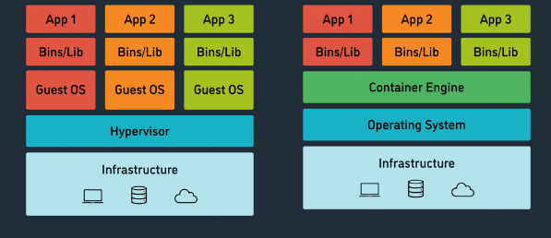
Docker uses container on the host OS to run applications
Here OS Level Virtualisation, whereas VMWARE has Hardware level virtualisation.

Slide 101
Advantages of Docker:
No pre-allocation of RAM.
CI efficiency: - docker enables you to build a container image and use that same image across every step of the deployment process.
Less cost.
It is light in weight.
It can run on physical h/w / virtual h/w or on cloud.
You can reuse this image.
It takes very less time to create Containers

Slide 102
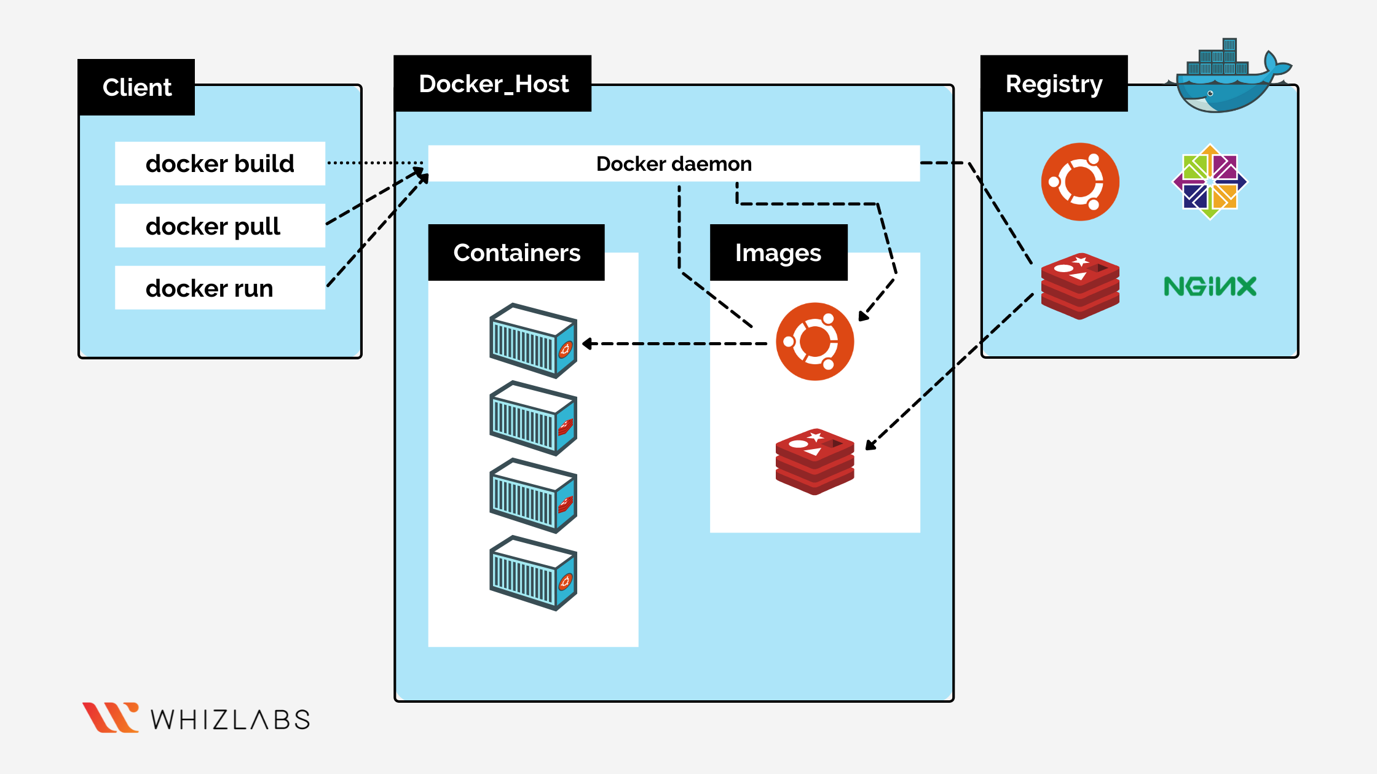
Architecture
Docker

Slide 103
Components of Docker:
A. Docker Daemon:
Docker daemon runs on host O.S
It is responsible for running containers to manages docker services.
Docker daemon can communicate with other daemons.
B. Docker Client:
Docker users can interact with docker through a client.
Docker client uses commands and REST API to communicate with the docker daemon.
When a client runs any server command on the docker client terminal, the client terminal sends these docker commands to the docker daemon.
It is possible for docker client to communicate with more than one daemon.
C. Docker Host:
Docker host is used to provide an environment to execute and run applications.
It contains the docker daemon, images, containers, networks and storages

Slide 104
Components of Docker:
D. Docker Hub/ Registry:
Docker registry manages and stores the docker image.
There are two types of registries in the docker:
a. Public Registry: it is also called as docker hub.
b. Private Registry: it is used to share image with in the enterprise.
E. Docker Image:
Docker images are the read only binary templates used to create docker containers.
Or Single file with all the dependencies and configuration required to run a program.
Ways to Create an Image:
a. Take image from the docker hub.
b. Create image from docker file.
c. Create image from existing docker containers.

Slide 105
Components of Docker:
F. Docker Containers
Containers hold the entire packages that is needed to run the application.
Or In other words, we can say that the image is a template and the container is a copy of that template.
Container is like a virtual machine.
Images becomes container when they run on docker engine.

Slide 106
Basic Docker Commands:
To see all images present in your local repo: # docker images
To find out images in docker hub: #docker search image_name
To download image from dockerhub to local machine # docker pull image_name:
To check service start or not (status) : # docker service status
To start: #docker service start
To stop: # docker service stop
To start container : #docker start container_name
To go inside container # docker attach container_name
To see all containers: # docker ps -a
To see running containers: # docker ps
To stop container: # docker stop container_name
To delete a container: # docker rm container_name

Slide 107
Create container from our own Image:
Login into AWS account and start your EC2 instance,
access it from putty.
Now we have to create container from our own image.
Therefore, create one container first:
#docker run -it --name container_name image_name /bin/bash
#cd tmp/
Now create one file inside this tmp directory
# touch myfile
Now if you want to see the difference between the basic image and the changes on it
# docker diff container_name image_name

Slide 108
Now create image of this container
# docker commit newcontainer_name image_name
# docker images
Now create container from this image
# docker run -it --name newcontainer_name image_name /bin/bash
# ls
# cd tmp
# ls (you will get all of your files)

Slide 109
Dockerfile
Dockerfile is basically a text file. It contains some set of instructions. Automation of docker image creation.
Dockerfile components:
FROM: for base image, this command must be on the top of the dockerfile.
RUN: to execute commands, it will create a layer in image
MAINTAINER: author/ owner/ description
COPY: copy files from local system (docker vm) we need to provide source, destination (we can’t download) file from internet and any remote repo.)
ADD: similar to copy but it provides a feature to download files from internet, also extract file at docker image side.
EXPOSE: to expose ports such as port 8080 for tomcat , port 80 for nginx etc.CMD: execute commands but during container creation.
ENTRYPOINT: similar to CMD but has higher priority over CMD, first commands will be executed by ENTRYPOINT only.
ENV: environment variables

Slide 110
Dockerfile
➢ Create a file named Dockerfile
➢ Add instructions in Dockerfile
➢ Build dockerfile to create image
➢ Run image to create container
# vi Dockerfile
FROM ubuntu
RUN echo “Ashok Anupam” > /tmp/testfile
To create image out of Dockerfile
# docker build -t myimg
# docker ps -a
# docker image

Slide 111
Dockerfile
Now create container from the above image
#docker run -it --name mycon myimg /bin/bash
#cat /tmp/testfile
#vi dockerfile
FROM ubuntu
WORKDIR /tmp
RUN echo “thank you” > /tmp/testfile
ENV myname Ashok
COPY testfile1 /tmp
ADD test.tar.gz /tmp

Slide 112
Docker Volume:
Volume is simply a directory inside our container.
➢ Finally, we have to declare this directory as a volume and then share volume.
➢ Even if we stop the container still, we can access volume.
➢ Volume will be created in one container.
➢ We can declare a directory as a volume only while creating container.
➢ We can’t create volume from existing container.
➢ We can share one volume across any number of containers.
➢ Volume will not be included when We update an image.
➢ We can map volume in two ways:
a. Container to container
b. Host to container
Benefits of Volume
➢ Decoupling container from storage.
➢ Share volume among different containers.
➢ Attach volume to containers.
➢ On deleting container volume doesn’t delete.

Slide 113
Creating Volume from Dockerfile:
Create a Dockerfile and write
FROM ubuntu
VOLUME “myvolume”
Then create image from this Dockerfile
#docker build -t myimage
Now create a container from this image and run
# docker run -it --name container1 myimage /bin/bash
Now do ls, you can see myvolume.
Now share volume with another container
Container to container
# docker run -it --name container2 (new) --privileged=true –volumesfrom container1 ubuntu /bin/bash

Slide 114
Creating Volume from Dockerfile
Now after creating container2, myvolume is visible. Whatever you do in one volume, can see from other volume.
#touch /myvolume/samplefile
#docker start container1
# docker attach container1
#ls/myvolume
You can see sample file here then exit.
Now create volume by using command:
#docker run -it --name container3 -v /volume2 ubuntu /bin/bash
# ls
#cd /volume2
Now create one file cont3file and exit
Now create one more container and share volume2
#docker run -it --name container4 --privileged=true --volumefrom container3 ubuntu /bin/bash
Now you re inside container do ls you can see volume2 Now create one file inside this volume and then check in container3 you can see that file

Slide 115
Volumes (Host to Container)
Verify files in /home/ec2-user
#docker run -it --name hostcontainer -v /home/ec2-user:/container --privileged=true ubuntu /bin/bash
#cd /container
Do ls, now you can see all files of host machine.
#touch contanerfile (in container) and exit
Now check in EC2 machine you can see this above file

Slide 116
Some other commands:
#docker volume
ls
#docker volume create
#docker volume rm
#docker volume prune (it removes all unused docker volume)
#docker volume inspect
#docker container inspect

Slide 117
Docker Port Expose:
Login into AWS account, create one linux instance .
Now go to putty -> login as -> ec2-user
#sudo su
# yum update –y
# yum install docker –y
# service docker start
# docker run -td --name techserver -p 80:80 ubuntu
# docker ps
# docker port techserver
o/p- 80/tcp – 0.0.0.0/80
# docker exec -it techserver /bin/bash
# apt-get update # apt-get install apache2 –y
# cd /var/www/html
# echo “write some msg” > index.html
#service apache2 start
# docker run -td --name myjenkins -p 8080:8080 jenkins

Slide 118
Difference between docker attach and docker exec:
Docker ‘exec’ creates a new process in the container’s environment
while docker ‘attach’ just connect the standard input/output of the main process inside the container to corresponding standard input/output error of current terminal.
Docker ‘exec’ is specifically for running new things in an already started container be it a shell or some other process.
What is the difference between docker expose and publish:
Basically you have three options:
1. Neither specify expose nor -p Docker
2. Only specify expose
3. Specify expose and -p
1. If you specify neither expose nor -p, the service in the container will only be accessible from inside the container itself.
2. If you expose a port, the service in the container is not accessible from outside docker but from inside other docker containers so this is good for inter-container communication.
3. If you expose and -p a port, the service in the container is accessible from anywhere even outside docker.
If you do –p but do not expose docker does an implicit expose.
This is because if a port is open to the public, it is automatically also open to the other docker containers. Hence -p includes expose

Slide 119
How to push docker image in docker hub:
Go to AWS account – select Amazon linux
Now go to putty – login as – ec2-user
#sudo su
#yum update –y
#yum install docker -y
#service docker start
#docker run -it ubuntu /bin/bash
Now create some files inside container, now create image of this container
#docker commit container1 image1
Now create account in hub.docker.com
Now go to EC2 instance
#docker login
Enter your username and password Now give tag to your image
#docker tag image1 dockerid/newimage
#docker push dockerid/newimage
Now you can see this image in docker hub account
Now create one instance in another region and pull image from hub
#docker pull dockerid/newimage
#docker run -it --name mycon dockerid/newimage /bin/bash

Slide 120

NAGIOS
Nagios-A Monitoring Tool

Slide 121
Nagios-Introduction
Nagios is an open-source software for continuous monitoring of systems, networks and infrastructure.
It runs plugins stored on a server which is connected with a host or another server on your network or the internet.
In case of any failure Nagios alerts about the issues so that the technical team can perform recovery process immediately.
History of Nagios:
➢ In the year 1999, Ethan Galstad developed it as a part of netsaint distribution.
➢ 2002, ethan renames the project to “Nagios” because of trademark issues with the name “netsaint”.
➢ 2009, Nagios releases its first commercial version, Nagios XI.
➢ In 2012, Nagios again renamed as Nagios core.
➢ It uses port number 5666, 5667 and 5668 to monitor its client.

Slide 122
Why Nagios?
Detect all types of network or server issues.
Helps to find the root cause of the problem which allow you to get the permanent solution to the problem.
Reduce downtime.
Active monitoring of entire infrastructure.
Allow you to monitor and troubleshoot server performance issues.
Automatically fix problems.

Slide 123
Features of Nagios: ➢
Oldest and latest.
Good log and database system.
Informative and attractive web interface.
Automatically send alerts if condition changes.
Helps you to detect network errors or server crashes.
You can monitor the entire business process and IT infrastructure with a single pass.
Monitor network services like http, smtp, snmp, ftp, ssh, pop, DNS, LDAP, IPMI etc.

Slide 124
Phases of Continuous Monitoring:
1. Define: develop a monitoring strategy
2. Establish: how frequently you are going to monitor it.
3. Implement
4. Analyze data and report finding
5. Respond
6. Review and update

Slide 125
Nagios Architecture:
Nagios is a client-server architecture. Usually on a network, a Nagios server is running on a host and plugins are running on all the remote host which should you monitor.

Slide 126
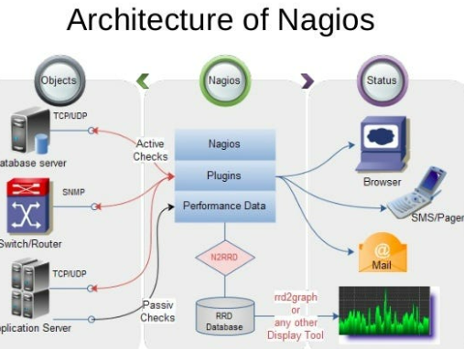
How does Nagios works?
➢ Mention all details in configuration files.
➢ Daemon read those details what data to be collected.
➢ Daemon use NRPE plugins to collect data from nodes and store in its own database.
➢ Finally shows everything in dashboard.

Slide 127
Pre-requisites and Config Files
Pre-requisites:
• Httpd (browser)
• Php (dashboard)
• Gcc and gd (compiler)
• Makefile (to build)
• Perl (script)
Main configuration file: /usr/local/Nagios/etc.Nagios.cfg
All monitoring things called as service.
For e.g: 5 servers – 4 checks each
Then you have to monitor 5*4= 20 services
Dashboard overview:
In dashboard you can see
Host: down, unreachable, up, recovery, none
Service: warning, unknown, critical, recovery, pending

Slide 128
Installation of Nagios on Linux:
To start Nagios core installation, you must have your EC2 instance up and run and have already configured SSH access to the instance.
Step-1: install pre-requisites software on your EC2 machine prior to Nagios installation like apache, php, gcc compiler and gd development libraries.
# sudo su
# yum install httpd php
# yum install gcc glibc glibc-common
# yum install gd gd-devel
Step-2: create account information you need to setup a Nagios user, run the following commands,
# adduser -m Nagios
# passwd Nagios
Now it will ask to enter new password give ‘12345’ as password.
# groupadd Nagioscmd
# usermod -a -G Nagioscmd Nagios
# usermod -a -G Nagioscmd apache

Slide 129
Installation of Nagios on Linux:
Step-3: download Nagios core and the plugins. Create a directory for storing the downloads.
# mkdir ~/downloads
# cd ~/downloads
Download the source code tarballs of both Nagios and the Nagios plugins.
# wget http://prdownloads.sourceforge.net/sourceforge/Nagios/Nagios-4.0.8.tar.gz
#wget http://Nagios-plugins.org/download/Nagios-plugins-2.0.3.tar.gz
Step-4: complete and install Nagios extract the Nagios source code tarball
# tar zxvf Nagios-4.0.8.tar.gz
# cd Nagios-4.0.8
Run the configuration script with the name of the group which you have create in above step.
# ./configure –with-command-grouo=Nagioscmd
Compile the Nagios source code
# make all
Install binaries, init script, sample config files and set permissions on the external command directly.
# make install
# make install-init
# make install-config
# make install-commandmode

Slide 130
Installation of Nagios on Linux:
Setp-5: configure the web interface
# make install-webconf
Step-6: create a ‘Nagiosadmin’ account for login into Nagios web interface, set password as well.
# htpasswd -c /usr/local/Nagios/etc/htpasswd.users Nagiosadmin
Asking for a password, set a new pwd
# service httpd restart
Step-7: compile and install the Nagios plugins. Extract the Nagios plugins source code tarball.
# cd ~/downloads
# tar zxvf Nagios-plugins-2.0.3.tar.gz
# cd Nagios-plugins-2.0.3
Compile and install the plugins
# ../configure --with-Nagios-user=Nagios --with-Nagios-group=Nagios
# make
# make install

Slide 131
Installation of Nagios on Linux:
Step-8: start Nagios. Add Nagios to the list of system services and have it automatically start when the system boots.
# chkconfig --add Nagios
# chkconfig Nagios on
Verify the sample Nagios configuration files
# /usr/local/Nagios/bin/Nagios -v
# usr/local/Nagios/etc/Nagios.cfg
If there are no errors, start Nagios
# service Nagios start
# service httpd restart
Step-9: copy public ip of EC2 instance and paste in google chrome, in given way
For e.g 20.1.1.1/Nagios/Nagios
Ask for username- Nagiosadmin
Password-

Slide 132

KUBERNETES- K8s
A container management tool

Slide 133
KUBERNETES-Introduction
➢ Kubernetes is an open-source container management tool which automates container deployment, container scaling and load balancing.
➢ It schedules, runs and manages isolated containers which are running on virtual/ physical/ cloud machines.
➢ All top cloud providers support Kubernetes.
History:
➢ Google developed an internal system called ‘borg’ (later named as omega) to deploy and manage thousands google application and services on their cluster.
➢ In 2014, google introduced Kubernetes as an open-source platform written in Golang, and later donated to CNCF (cloud Native Computing Foundation).
Online platform for K8s:
i. Kubernetes playground
ii. Play with K8s
iii. Play with Kubernetes classroom

Slide 134
KUBERNETES-Intro
Cloud based K8s services:
i. GKE: Google Kubernetes Services
ii. AKS: Azure Kubernetes services
iii. Amazon EKS: Amazon Elastic Kubernetes Services
Kubernetes installation tool:
i. Minicube
ii. Kubeadm
Problems with scaling up the containers:
➢ Containers cannot communicate with each other.
➢ Autoscaling and load balancing was not possible.
➢ Containers had to be managed carefully

Slide 135
Features of Kubernetes:
➢ Orchestration (clustering of any number of containers running on different networks)
➢ Autoscaling (supports both horizontal and vertical scaling)
➢ Auto-healing
➢ Load balancing
➢ Platform independent (cloud/ virtual/ physical)
➢ Fault tolerance (node/ POD failure)
➢ Rollback (going back to previous version)
➢ Health monitoring of containers
➢ Batch execution (one time, sequential, parellel)

Slide 136
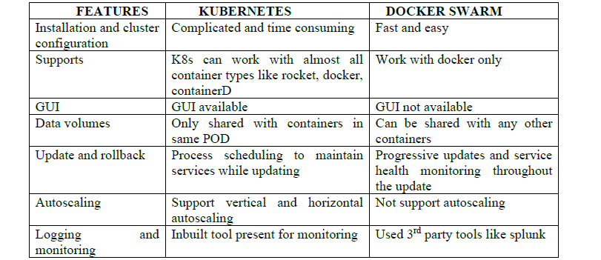
Kubernetes and Docker-Swarm Comparison
Kubernetes-Better option

Slide 137
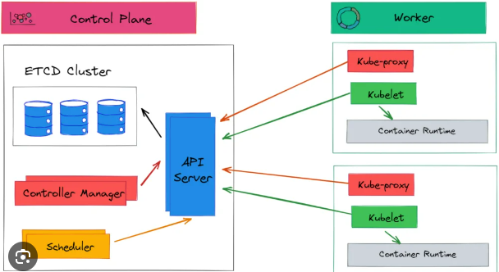
KUBERNETES- ARCHITECTURE
K8’S

Slide 138
Working with Kubernetes
➢ We create manifest (.yml/json).
➢ Apply this to cluster (to master) to bring desired state.
➢ POD runs on node which is controlled by master.
Role of Master Node:
➢ Kubernetes cluster contains containers running or bare metal/ vm instances. Cloud instances/ all mix.
➢ Kubernetes designates one or more of these as master and all others as workers.
➢ The master is now going to run set of k8s processes. These processes will resume smooth functioning of cluster. These processes are called “control plane”.
➢ Can be multi-master for high availability.
➢ Master runs control plane to run cluster smoothly.
Components of Control Plane (master):
1. Kube-API server
2. Etcd
3. Kube-scheduler
4. Controller manager

Slide 139
Components of Control Plane (master):
1. Kube-API server (for all communications):
➢ This api-server interacts directly with user (i.e we apply .yml or json manifest to kube-apiserver).
➢ This kube-apiserver is meant to scale automatically as per load.
➢ Kube api-server is front-end of control-plane.
2. Etcd:
➢ It stores metadata and status of cluster.
➢ Etcd is consistent and high available store (key-value store).
➢ Source of touch for cluster state (info about state of cluster).
Etcd has following features: -
a. Fully replicated: the entire state is available on every node in the cluster.
b. Secure: implements automatic TLS with optional client-certificate authentication.
c. Fast: benchmarked at 10,000 writes per second.

Slide 140
Components of Control Plane (master):
3. Kube scheduler:
➢ When users make request for the creation and management of PODs, kube scheduler is going to take action on these requests.
➢ Handles POD creation and management.
➢ Kube scheduler match/ assign any node to create and run PODs.
➢ A scheduler watches for newly created PODs that have no node assigned. For every POD that the scheduler discovers the scheduler becomes responsible for finding best node for that POD to run on.
➢ Scheduler gets the information for hardware configuration from configuration file and schedules the PODs on nodes accordingly
4. Controller Manager:
➢ Make sure that actual state of cluster matches the desired state.
➢ Two possible choices for controller manager:
a. If k8s on cloud, then it will be cloud-controller-manager.
b. If k8s on non-cloud then it will be kube-controller-manager

Slide 141
Components on master that runs controller:
a. Node controller: for checking the cloud providers to determine of a node has been detected in the cloud after id stops responding.
b. Route controller: responsible for setting up network, routes on your cloud.
c. Service controller: responsible for load balancers on your cloud against services of type load balancers.
d. Volume controller: for creating, attaching and mounting volumes and interacting with the cloud provider to orchestrate volume.

Slide 142
Nodes (kublet and container engine.)
Node is going to run 3 important pieces of software/ process.
1. Kublet
2. Container engine
3. Kubeproxy
1. Kublet:
➢ Agent running on the node.
➢ Listens to Kubernetes master. (e.g-POD creation request)
➢ Use port 10255.
➢ Send success/fail reports to master.
2. Container Engine:
➢ Works with kublet.
➢ Pilling images.
➢ Start/ stop containers.
➢ Exposing containers on ports specified in manifest.
3. Kubeproxy:
➢ Assign IP to each POD.
➢ It is required to assign IP address to PODs (dymanic).
➢ Kube-proxy runs on each node and this make sure that each POD will get its own unique IP address. These 3 components collectively called NODE.

Slide 143
POD:
➢ Smallest unit in Kubernetes.
➢ POD is a group of one or more containers that are deployed together on the same host.
➢ A cluster is a group of nodes.
➢ A cluster has at least one worker node and master node.
➢ In Kubernetes the control unit is the POD, not containers.
➢ It consists of one or more tightly coupled containers.
➢ POD runs on node which is control by master.
➢ Kubernetes only knows about PODs (does not know about individual container).
➢ Cannot start containers without a POD.
➢ One POD usually contains one container.
Multi container PODs:
➢ Share access to memory space.
➢ Connect to each other using local host <container port>.
➢ Share access to the same volume.
➢ Containers within POD are deployed in an all-or-nothing manner.
➢ Entire POD is hosted on the same node (scheduler will decide about which node).

Slide 144
POD
POD limitations:
➢ No auto healing or auto scaling.
➢ POD crashes.
Higher level Kubernetes objects:
a. Replication set: auto scaling and auto healing
b. Deployment: versioning and rollback
c. Service:
d. Static (non-ephemeral) IP and networking.
e. Volume: non-ephemeral storage.
Important:
Kubectl- single cloud
Kubeadm- on premise
Kubefed- federated

Slide 145
DEMO: Setup Kubernetes master and node on AWS:
Login into AWS account – launch 3 instances – ubuntu (t2.medium)
Master must have 2vcpu and 4gb RAM
Now using puttygen, create private key
Access all the 3 instances (1 master, 2 node) using putty.
Commands common for master and node:
# sudo su
# apt-get update
Now install https package
# apt-get install apt-transport-https
This https is needed for intra cluster communication (particularly from control plane to individual pods)
Now install docker on all 3 instances
# sudo apt install docker.io -y
To check whatever docker is installed or not
# docker --version
# systemctl start docker
# systemctl enable docker

Slide 146
DEMO: Setup Kubernetes master and node on AWS:
Setup open GPG key. This is required for intra cluster communication. It will be added to source key on this node i.e when k8s sends signed information to our host, it is going to accept those information because this open GPG key is present in the source key.
# curl -s https://packages.cloud.google.com/apt/doc/apt-key.gpg | # sudo apt-key add
Edit source list file (apt-get install nano)
# nano /etc/apt/source.list.d/Kubernetes.list
# deb http://apt.kubernetes.io/kubernetes-xenial.main
Exit from nano: ctrl+x, caps+y – enter
# apt-get update – install all packages
# apt-get install -y kublet kubeadm kubectl Kubernetes-cni

Slide 147
DEMO: Setup Kubernetes master and node on AWS:
Bootstrapping the master node (in master)
To initialize k8s cluster
# kubeadm init
You will get one long command started from “kubeadm join 172.31.6.165:6443”
Copy this command and save on notepad
Create both .kube and its parent directories (-p)
# mkdir -p $HOME/.kube
Copy configuration to kube directory (in configuration file)
# sudo cp -i /etc/Kubernetes/admin.config $HOME /.kube/config
Provide user permissions to config file
# chown $(id-u): $(id-g) $ HOME/.kube/config
Deploy flannel node network for its repository path. Flannel is going to place a binary in each node.
# sudo kubectl apply -f https://raw.githubusercontent.com/coreos/flannel/master/documentation/kube-flannel.yml
# sudo kubectl apply -f https://raw.githubusercontent.com/coreos/flannel/master/Documentation/k8s-manifest/kube-flannel-rbac.yml
Configure worker node: paste the long commands above on both the nodes
Go to master: # kubectl get nodes

Slide 148
file '/myfile' do
content 'Welcome Ashok Anupam'
action :create
end
~
......................................................................................................................
package 'httpd' do
action :install
end
file '/var/www/html/index.html' do
content 'Welcome Ashok Anupam'
action :create
end
service 'httpd' do
action [:enable, :start]
end
~

Slide 149
file '/basicinfo' do
content "This is to get Attributes
HOSTNAME: #{node['hostname']}
IPADDRESS: #{node['ipaddress']}
CPU: #{node['cpu']['0']['mhz']}
MEMORY: #{node['memory']['total']}"
owner 'root'
group 'root'
action :create
end

Slide 150
#
# Cookbook:: ABC-cookbook
# Recipe:: ABC-recipe
#
# Copyright:: 2024, The Authors, All Rights Reserved
execute "run a script" do
command <<-EOH
mkdir /ashokdir
touch /ashokdir/anupamfile
EOH
end
user "ashok" do
action :create
end
group "devopsgroup" do
action :create
members 'ashok'
append true
end
~
~

Slide 151
#
# Cookbook:: Apache-Cookbook
# Recipe:: default
#
# Copyright:: 2024, The Authors, All Rights Reserved.
#
#
include_recipe "Apache-Cookbook::Apache-recipe"
include_recipe "Apache-Cookbook::ABC-recipe"
include_recipe "Apache-Cookbook::recipe10"
~
chef-client -zr "recipe[Apache-Cookbook::default]"

Slide 152
# Cookbook:: Ashok-Cookbook
# Recipe:: default
#
# Copyright:: 2024, The Authors, All Rights Reserved.
#
#
include_recipe "Ashok-cookbook::Ashok-recipe"
include_recipe "Ashok-cookbook::ABC-recipe"
~
~
chef-client -zr "recipe[Ashok-cookbook::default]"
chef-client -zr "recipe[Apache-Cookbook::default],recipe[Ashok-cookbook::default]"

