Slide 1

HACKATHON
DISPLAY BOOKSHELVES

Slide 2
REQUIREMENTS
The user should be able to use the website https://www.urbanladder.com using Chrome/Firefox.
Selecting Bookshelves from Study>Storage>Bookshelves.
Choosing the price of the bookshelves less than 15000,Storage type as open and Include/Exclude out of stock and Print the first 3 bookshelves.
In the search box, Enter “Study Chairs” and print the first 3 study chairs with highest recommendation.
In the Collections menu, retrieve all the submenu items under “Best Sellers” and print the same.
In the Gift Cards section, choose “Birthday/Anniversary” and fill the necessary details. Enter any one wrong detail in “From To” details and capture the error message.

Slide 3
SCOPE AND PLAN
DISPLAY BOOKSHELVES
We analyzed the requirements and created the requirement document
We created a Functional Testing excel sheet
Each members did the Automation on their respective requirement and tested it
At last, all the Automation codes are integrated
We divided the requirements among the team members

Slide 4
TOOLS & TECHNOLOGIES
Selenium Web Driver (Version 4.1.1)
Maven (Version 4.0.0)
TestNG Reports
Extent Reports API (Version 3.1.5)
TestNG (Version 7.4.0)
Screenshots
POM (Page Object Model)
Apache POI(5.1.0)

Slide 5
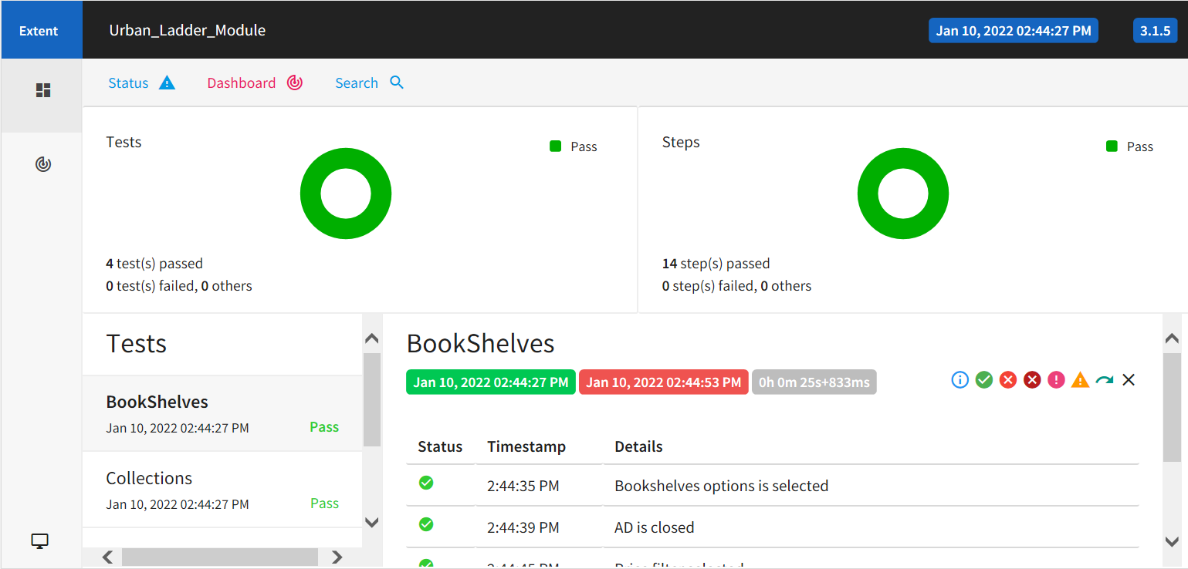
E
X
T
E
N
T R
E
P
O
R
T

Slide 6


ASHOK KUMAR
2072935
SNEAHA
2072859
MANASHA
2072834
SANGAVI
2072952
KAVIYA SRI
2072954
TEAM MEMBERS

Slide 7

THANK
YOU

