Slide 1
SECURE DATA HIDING IN IMAGES USING STEGANOGRAPHY
CAPSTONE PROJECT
Presented By: Ashok Kumar
College Name & Department : JCD Memorial College of Engineering (Computer Science and Engineering)

Slide 2
OUTLINE
Problem Statement
Technology used
Wow factor
End users
Result
Conclusion
Git-hub Link
Future scope

Slide 3
Problem Statement
In today's digital era, secure communication is a major concern. Traditional encryption methods can be detected, making them vulnerable to attacks. This project tackles this issue by hiding encrypted messages inside images using steganography, making the communication both secure and invisible to outsiders.

Slide 4
Technology used
Programming Language: Python.
Libraries:
Tkinter – For creating the user-friendly GUI.
OpenCV – For handling image processing.
Cryptography.Fernet – For message encryption.
NumPy – For handling image data.
Platform: Windows.
Tool Used: Visual Studio Code.

Slide 5
Wow factors
Dual-layer security – The message is first encrypted and then hidden in an image.
No visible changes in the image – The secret message remains undetectable.
Simple and easy to use – The GUI makes it accessible for everyone.
Passcode protection – Only authorized users can retrieve the hidden message.

Slide 6
End users
Journalists & Bankers– To share confidential information securely.
Military & Intelligence Agencies – For covert communication.
Cyber security Experts & Researchers – To explore encryption and steganography.
Anyone Concerned About Privacy – To protect sensitive messages.

Slide 7
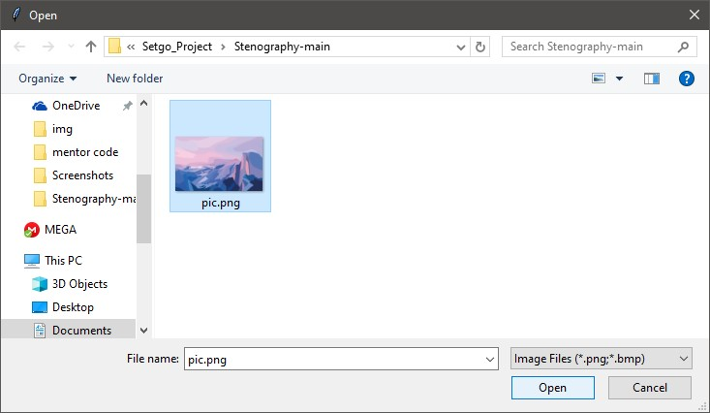
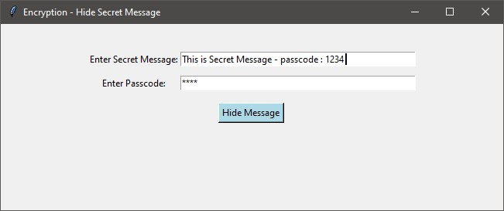
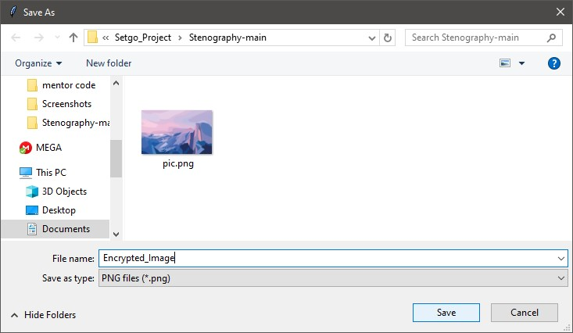
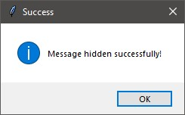
Results
Step 2: Open an Image (User selects an image in which the encrypted message will be hidden.)
GUI for Encryption
Step 3: Save the Encrypted Image (The image with the hidden message is saved securely.)
Step 1: Enter Secret Message and Passcode (User enters the secret message and a passcode to encrypt the message.)

Slide 8


Results
Image before & after embedding the message
Original Image (Before Encryption) (This is the image before any data is hidden inside it.)
Encrypted Image (After Message Embedding) (Visually, the image looks the same, but it contains the hidden, encrypted message inside.)

Slide 9
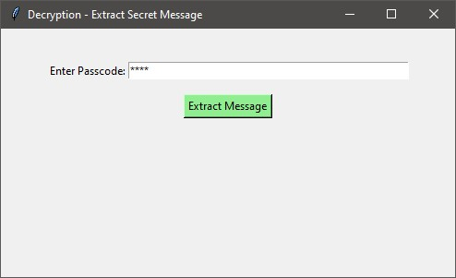
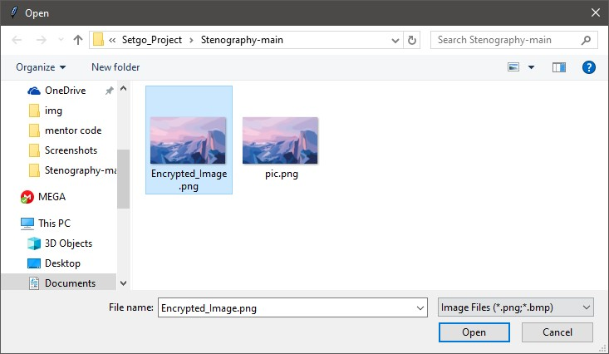
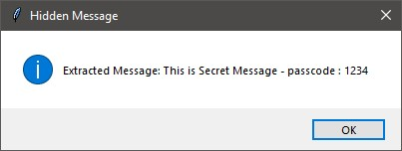
Results
GUI for Decryption
Step 1: Enter Passcode (User inputs the correct passcode to decrypt the hidden message.)
Step 2: Choose the Encrypted Image (User selects the image that contains the hidden message.)
Step 3: Display the Secret Message (If the passcode is correct, the hidden message is revealed.)

Slide 10
Conclusion
This project successfully combines encryption and steganography to provide a secure method of hiding messages in images. The image remains visually unchanged, ensuring that no one can detect the hidden data. With an easy-to-use interface, even non-technical users can use this tool for private communication.

Slide 11
GitHub Link
GitHub Repository Link : https://github.com/Ashok3201/Secure-Data-Hiding-In-Images-Using-STEGANOGRAPHY.git
Readme Link : https://github.com/Ashok3201/Secure-Data-Hiding-In-Images-Using-STEGANOGRAPHY/blob/main/README.md

Slide 12
Future scope
Enhancing security – Implementing stronger encryption algorithms like RSA.
More image format support – Expanding to JPG, GIF, and other formats.
Mobile App Development – Creating an Android/iOS version.
Cloud-based Steganography – Storing hidden messages securely on cloud platforms.

Slide 13
THANK YOU

