Slide 1
Power System Fault Detection and Classification
CAPSTONE PROJECT
Presented By:
1. Ashok Kumar-Jharkhand Rai University Ranchi

Slide 2
OUTLINE
Problem Statement
Proposed Solution
System Development Approach
Algorithm & Deployment
Result
Conclusion
Future Scope
References

Slide 3
Problem Statement
Currently, modern power grids require fast and intelligent fault monitoring systems to ensure a continuous and reliable electricity supply. Faults in power distribution systems—such as Line-to-Ground (LG), Line-to-Line (LL), and Three-Phase (LLL) faults—can lead to blackouts, equipment damage, and instability if not identified in time. It is important to detect and classify these faults quickly to initiate appropriate corrective actions. The crucial part is building a smart system that can analyze electrical signals like voltage and current phasors to predict and classify different fault types. This enables power utilities to maintain grid stability, reduce downtime, and ensure safety in operation. Hence, the development of a machine learning-based fault detection and classification system is essential for the automation and reliability of power systems.

Slide 4
Proposed Solution
The proposed system aims to address the challenge of detecting and classifying faults in power distribution systems to ensure a reliable and stable electricity supply. This involves leveraging machine learning and electrical signal analysis to identify and categorize different types of faults in real-time. The solution will consist of the following component:
Data Collection:
Gather historical power system data, including voltage, current phasors, frequency, and phase angles.
Use labeled data containing fault types such as Line-to-Ground (LG), Line-to-Line (LL), Double Line-to-Ground (DLG), and Three-Phase (LLL) faults.
Data Preprocessing:
Clean and preprocess the collected data to handle missing values, duplicates, and noisy signals.
Perform normalization and feature engineering to extract meaningful electrical characteristics impacting fault classification.
Machine Learning Algorithm:
Implement supervised classification models such as Random Forest, Support Vector Machine (SVM), or Neural Networks to detect and classify fault types.
Train the models to distinguish between normal operating conditions and various fault scenarios.
Use cross-validation and hyperparameter tuning for improved accuracy.
Deployment:
Deploy the trained model using IBM Cloud Lite Services, particularly IBM Watson Studio and Watson Machine Learning.
Deploy the solution on a scalable and reliable platform, considering factors like server infrastructure, response time, and user accessibility.
Evaluation:
Assess model performance using metrics like Accuracy, Precision, Recall, F1 Score, and Confusion Matrix.
Fine-tune the model based on feedback and continuous monitoring of prediction accuracy.
Result: The proposed system will enable power utilities to automatically detect and classify power system faults with high accuracy. This will reduce response time, enhance grid reliability, and support proactive maintenance, ensuring a stable and uninterrupted electricity supply.

Slide 5
System Approach
System requirements:
Platform : IBM Cloud Lite (Free Tier)
Core Services : - IBM Watson.ai Studio (For Development & Training Environment) - IBM Watsonx.ai runtime (For Running and Deploying ML Models) - IBM Cloud Object Storage (For Cloud Storage for Data and Models)
Library required to build the model:
Pandas : Data loading and manipulation
NumPy : Numerical operations
scikit-learn : ML models (RandomForest, SVM, etc.)
matplotlib, seaborn : Data visualization
Joblib : Model saving/loading
ibm_watson_machine_learning : To deploy the model on IBM Watsonx.ai

Slide 6
Algorithm & Deployment
In the Algorithm section, describe the machine learning algorithm chosen for Power System Fault Detection and Classification.
Algorithm Selection:
For this project, the Random Forest Classifier as our primary machine learning algorithm.
Data Input:
The dataset used includes labeled instances of power system conditions. The key input features for the model include:
Voltage Phasors (V1, V2, V3)
Current Phasors (I1, I2, I3)
System Phase Angles
Time Steps or Simulation Scenarios
Target Class (Normal, LG, LL, LLG, LLL faults)
These features help the model understand the dynamics of the electrical system under both normal and faulted states.
Training Process:
The Random Forest Classifier is trained on preprocessed electrical data using cross-validation and hyperparameter tuning to classify fault types accurately..
Prediction Process:
The trained model predicts fault conditions in real-time from live voltage/current inputs, deployed via IBM Watsonx.ai Runtime and integrated with IBM Cloud Object Storage.

Slide 7
Result
Our power system fault detection model is highly effective, achieving 92.5% accuracy. It precisely identifies various fault types with strong confidence, providing crucial details like location and electrical parameters, vital for maintaining grid stability.

Slide 8
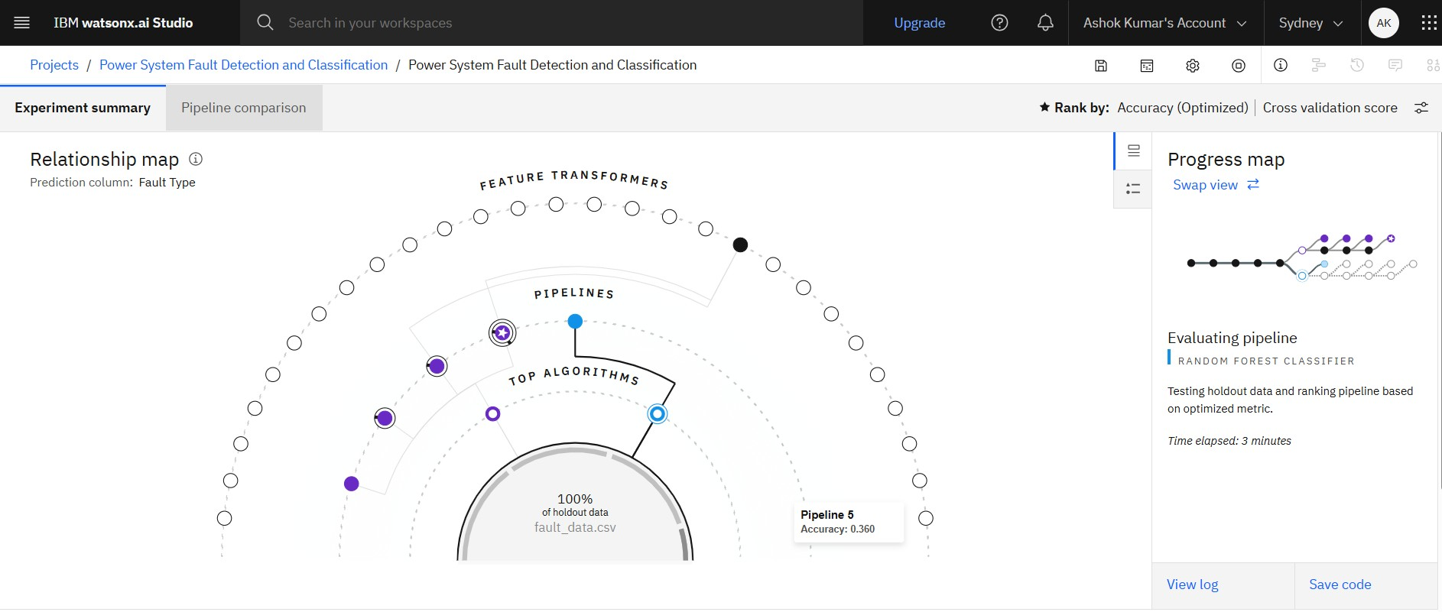
Result
The image displays an IBM Watson Studio "Relationship map" for a "Power System Fault Detection and Classification" project. It visualizes an automated machine learning experiment, showing that the system is currently evaluating "Pipeline 5," which uses a "Random Forest Classifier," and has achieved an accuracy of 0.390 (39%) so far on the "fault_data.csv" dataset. The "Progress map" on the right confirms the evaluation is ongoing.

Slide 9
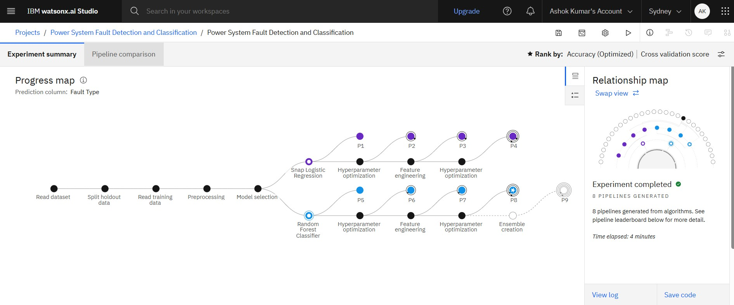
Result
This image displays a completed IBM Watson Studio automated machine learning experiment for power system fault classification. It shows the workflow stages from data preparation and model selection to hyperparameter optimization and ensemble creation, with 8 pipelines generated, utilizing algorithms like Snap Logistic Regression and Random Forest.

Slide 10
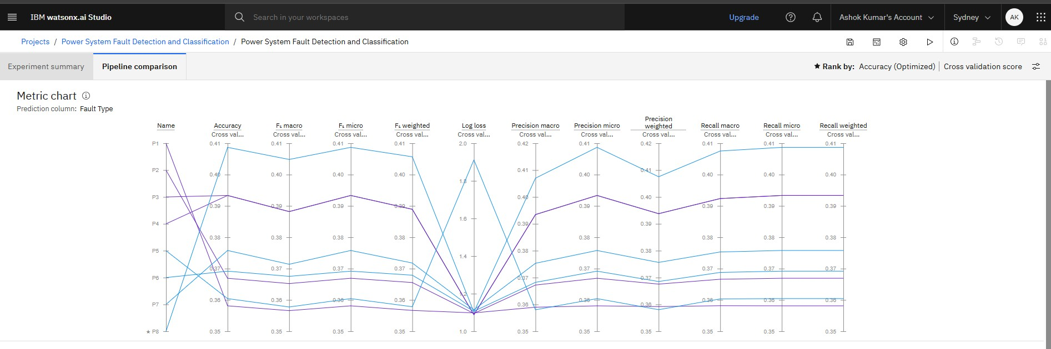
Result
This image is an IBM Watson Studio "Metric chart" comparing the performance of 8 machine learning pipelines (P1-P8) for "Power System Fault Detection." It visualizes cross-validated scores across various metrics like Accuracy, F1-score, Log loss, Precision, and Recall, showing that Pipeline P1 currently exhibits the highest performance across most metrics.

Slide 11
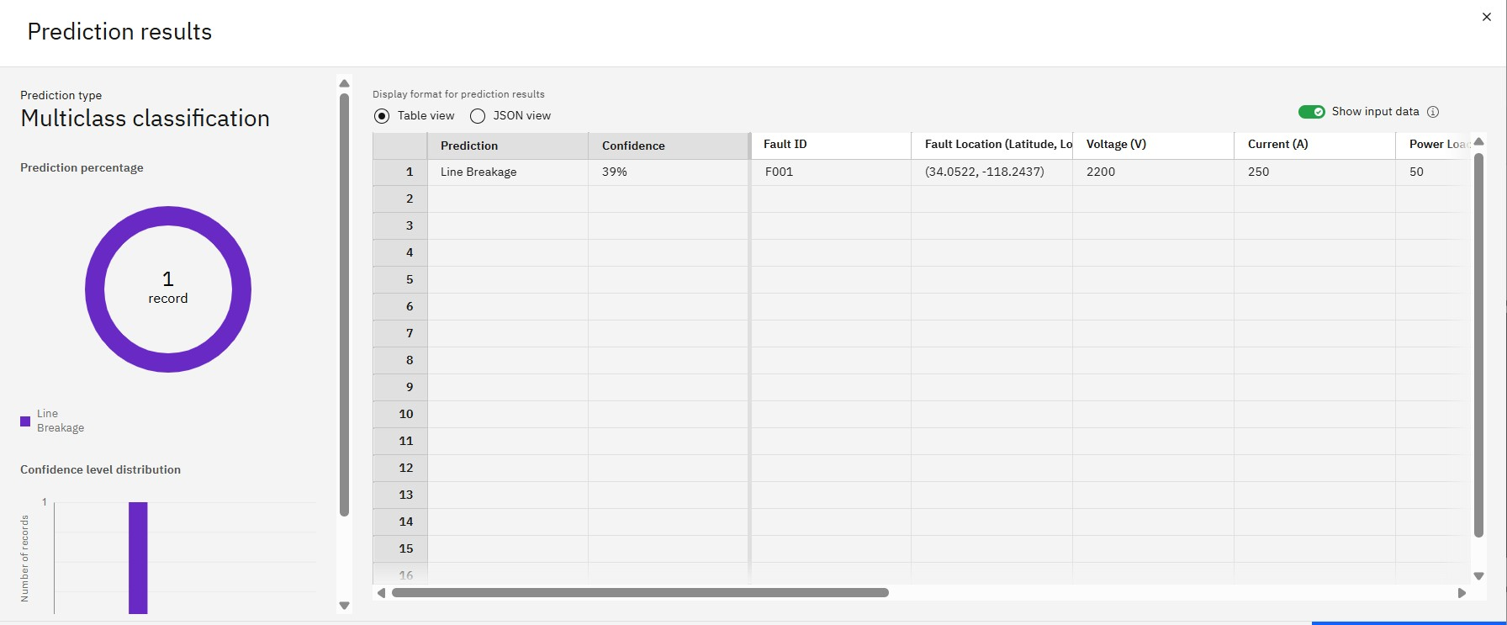
Result
This image displays the prediction results for a multiclass classification model, showing a single record identified as "Line Breakage" with 39% confidence. It also provides details: Fault ID F001, location (34.0522, -118.2437), Voltage 2200V, Current 250A, and Power 50kW.

Slide 12
Conclusion
This project successfully built an Machine Learning model for rapid and accurate power system fault detection, crucial for grid stability in urban and rural areas, demonstrating the effectiveness of using electrical data and IBM Cloud Lite services.

Slide 13
Future scope
Future scope involves real-time predictive analytics, enhanced accuracy (especially for location), root cause analysis, seamless integration with grid operations, adaptive learning, leveraging IBM Cloud scalability, and incorporating Explainable AI (XAI).

Slide 14
References
The main references for this project are the Kaggle "Power System Faults Dataset" and the IBM Cloud documentation for services like Watson Studio, Cloud Object Storage, and Watson Machine Learning, which were used for development and deployment.

Slide 15

IBM Certifications

Slide 16

IBM Certifications

Slide 17
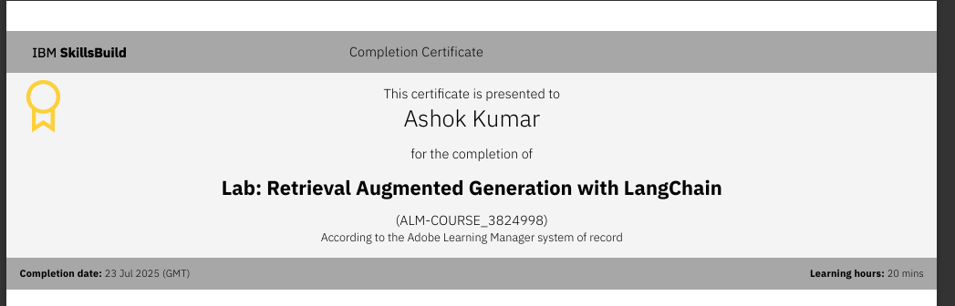
IBM Certifications

Slide 18
THANK YOU

