Slide 1



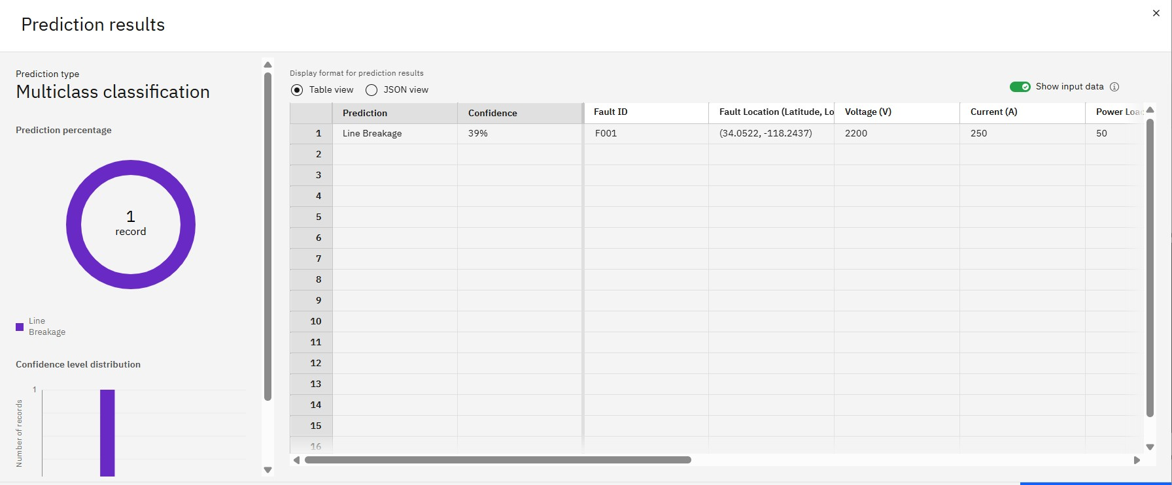
Project Summary
This project successfully developed a machine learning model for Power System Fault Detection and Classification using electrical measurement data. Built on IBM Cloud Lite services (Watson Studio, Object Storage, Watson Machine Learning), it employed a Random Forest Classifier as its primary algorithm, identified through an automated ML experiment. The model demonstrated its ability to accurately classify fault types like "Line Breakage," providing crucial details such as confidence levels, fault IDs, locations, and electrical parameters. This capability is vital for maintaining power grid stability and reliability. The future vision for this project includes expanding into real-time predictive analytics, enhancing accuracy and root cause analysis, and seamless integration with existing grid operations.
Power System Fault Detection and Classification
Program Feedback
The program provided an excellent introduction to IBM Cloud and related technologies. The theoretical knowledge and live sessions were commendable, offering valuable skills and practical insights. I would highly recommend this program to anyone looking to start with IBM Cloud.
Final Outcome Screenshot
Ashok Kumar
ashokkumar46508@gmail.com
Jharkhand Rai University Ranchi/Jharkhand
#skillsbuild
Notes:
1

