Slide 1
Mental Health & Suicide Detection Q&A System
Presented by:
Ashok Kumar Jarugubilli
Neeraj Babu Vaddepalli

Slide 2
Problem Statement
- Suicide-related discussions online can indicate mental health risks.
- Early detection and supportive responses are crucial.
- Objective: Build a system to answer mental health questions empathetically using real posts.

Slide 3
Dataset Overview
- Source: Suicide_Detection.csv
- Columns: text, class, Unnamed: 0
- Classes: suicide, non-suicide
- Sample: 1000 rows

Slide 4
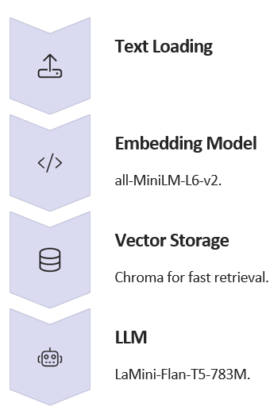

Project Architecture

Slide 5

How It Works
- User asks or selects a question
- ChromaDB retrieves similar real posts
- Retrieved posts form context
- LLM generates empathetic answer
- Output: Context + Response

Slide 6
Challenges
- Handling emotionally sensitive and triggering data
- Ensuring LLM stays on-topic and empathetic
- Avoiding token overflow (context truncation)
- Preventing kernel crashes from large models

Slide 7
Results Snapshot
- Interactive Q&A with retrieved context
- Model: phi-2
- Example Q: 'How can I help a friend who talks about self-harm?'
- Output: Empathetic AI-generated response

Slide 8
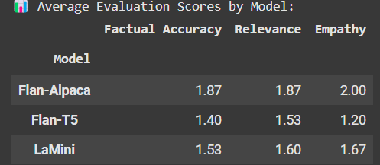
This table compares the performance of three language models—Flan-Alpaca, Flan-T5, and LaMini—across three metrics: Factual Accuracy, Relevance, and Empathy. Flan-Alpaca outperforms the others, especially in empathy (2.00), making it the most suitable for generating sensitive mental health responses.

Slide 9
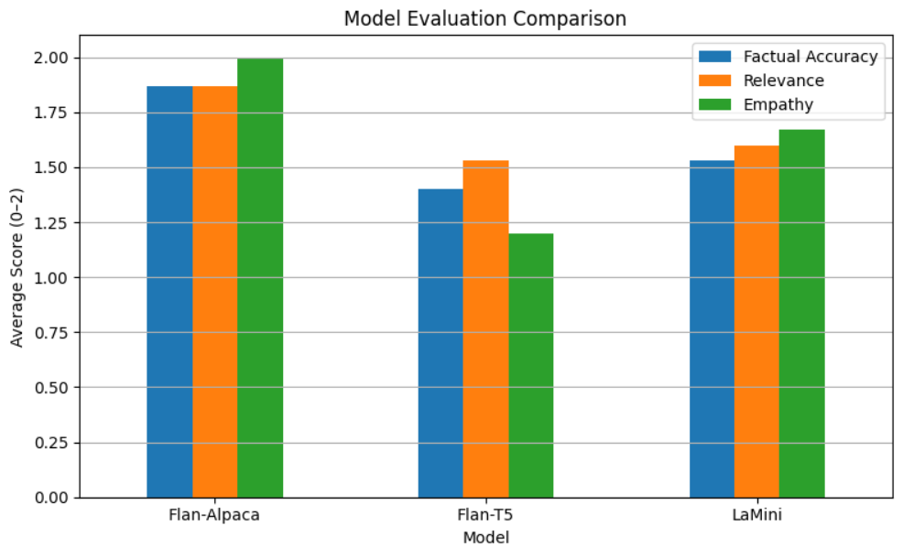
This architecture diagram illustrates a Retrieval-Augmented Generation (RAG) pipeline. User queries are first embedded and matched against a vector database (ChromaDB) to retrieve relevant mental health posts. These retrieved texts are then combined with the query and passed to the Phi-2 language model, which generates an empathetic response in real-time.

Slide 10

Conclusion & Future Work
- ✅ Working RAG system for mental health Q&A
- 📦 Future: Deploy online, add content filters, upgrade models
- 🧠 AI-assisted early intervention for mental health awareness

Slide 11
THANK YOU

