Slide 1
Introduction
What is cloud ? (IAAS)
Core components of IaaS
What is Openstack ?

Slide 2
A Quick demo on how the end user will user our Openstack cloud

Slide 3
Openstack Installation
Production installation
Devstack
Packstack

Slide 4
Packstack installation
sudo yum update
sudo yum install -y https://rdoproject.org/repos/rdo-release.rpm
sudo yum install -y centos-release-openstack-mitaka
sudo yum update -y
sudo yum install -y openstack-packstack
sudo packstack --gen-answer-file=~/answers.cfg
vi ~/answers.cfg
Change the following lines accordingly
CONFIG_DEFAULT_PASSWORD=IAmGoingIn666
CONFIG_NAGIOS_PW=IAmGoingIn666
CONFIG_HEAT_INSTALL=y
sudo packstack --answer-file=~/answers.cfg
(The installation may take upto 2 hours)
Let’s take a quick look at production Openstack deployment - http://docs.openstack.org/kilo/install-guide/install/apt/content/

Slide 5
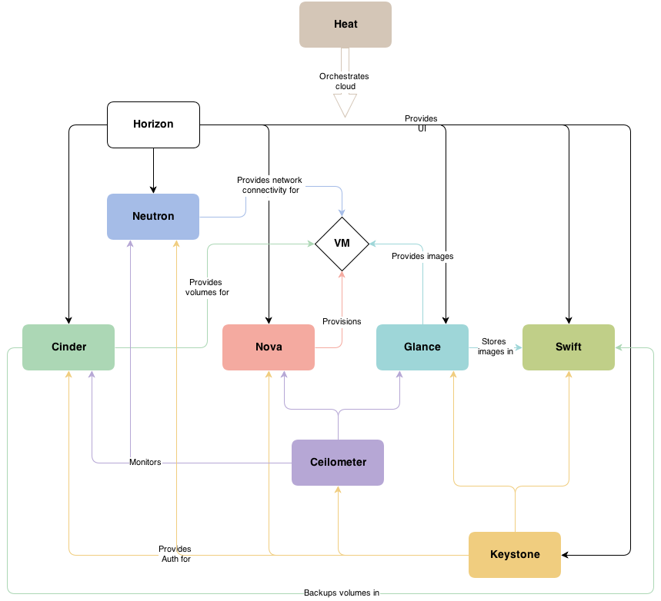
Openstack architecture

Slide 6
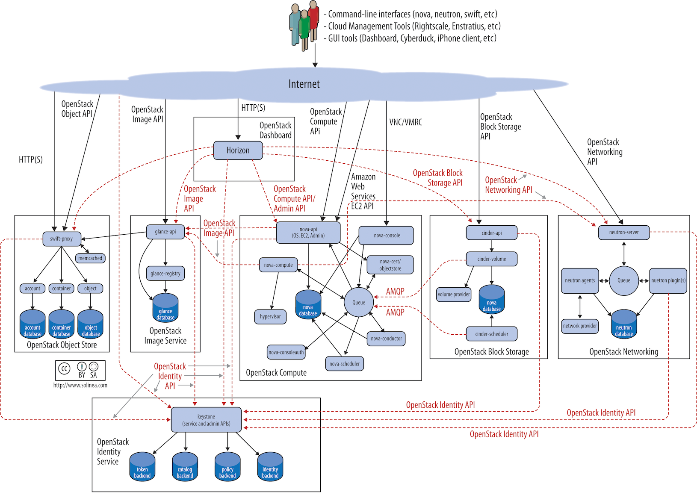

Slide 7
Test drive our new Openstack setup
Openrc file
APIs and End points
Command line clients and Horizon

Slide 8
Openstack multi node architecture examples
http://blogs.rdoproject.org/6838/deploying-openstack-the-enovance-way
http://www.opentcpcloud.org/en/documentation/reference-architecture/
http://redhatstackblog.redhat.com/2014/04/16/the-road-to-high-availability-for-openstack/

Slide 9
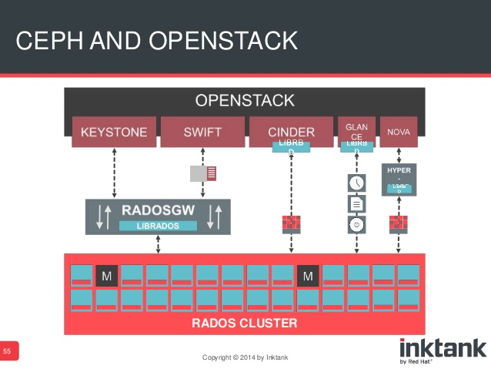

Slide 10
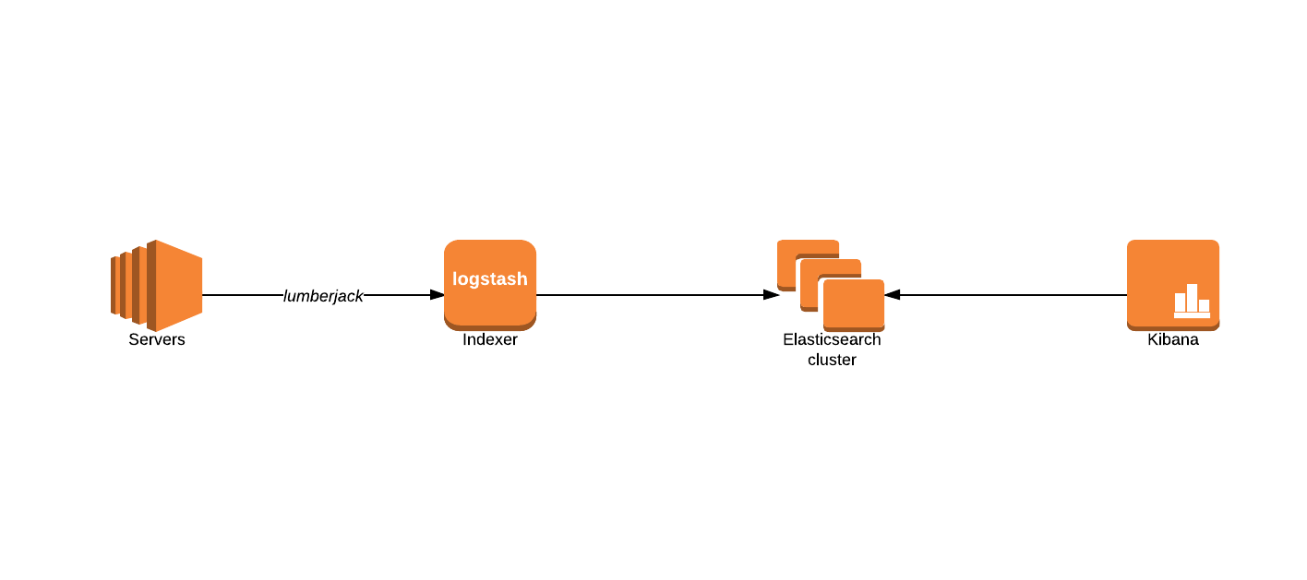
Openstack log analysis

Slide 11
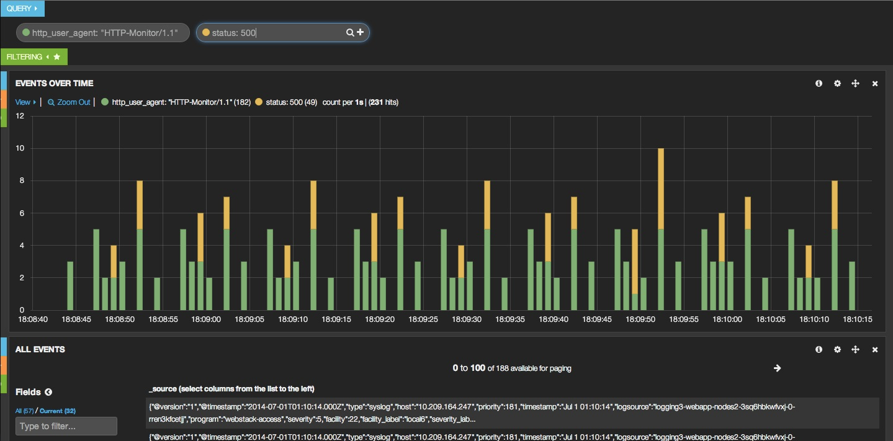
https://developer.rackspace.com/blog/i-have-a-cloud-dot-dot-dot-now-what-part-2-building-a-redundant-webapp-with-log-analysis/

