Slide 1
Transmission control protocol
This protocol divides the sender information in to discrete message packets.
Then it delivers it to the receiver in the internet using a physical connection between them.
At the receiving end it reassembles the received message packets into original data.
This also controls the data flow between the sender and receiver.

Slide 2
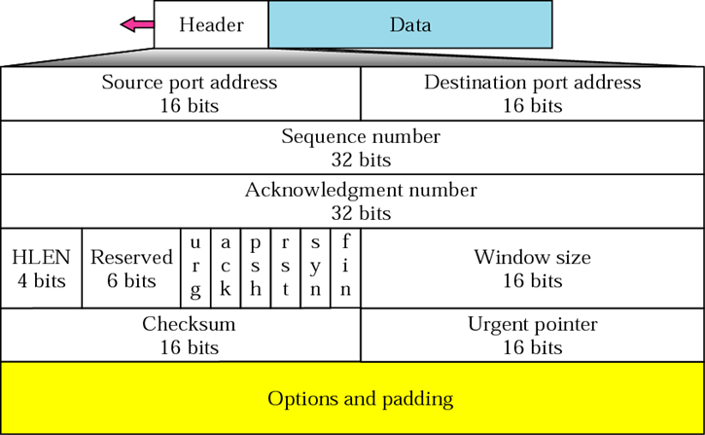

Slide 4
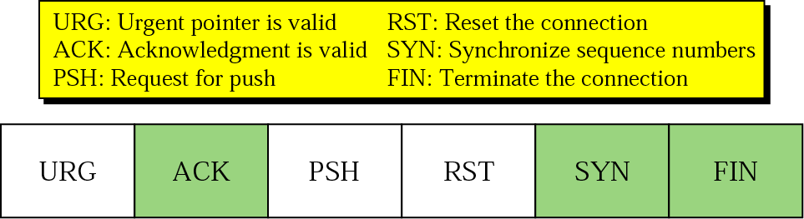

Slide 5
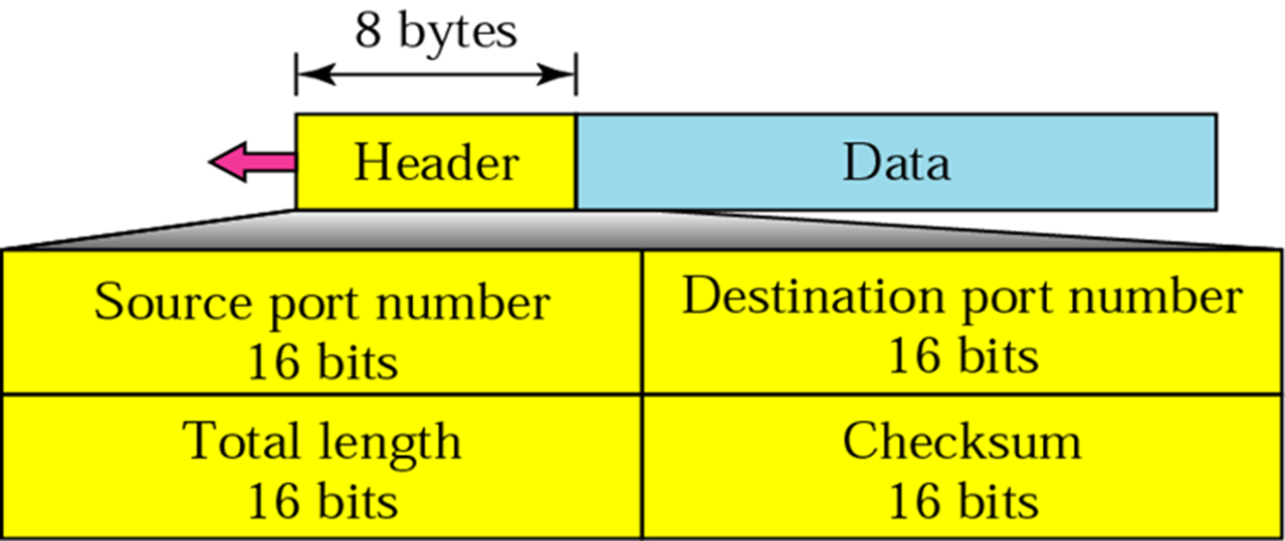
UDP
UDP is a connectionless, unreliable transport protocol.
It does not add anything to the services of IP except for providing process-to-process communication instead of host-to-host communication.
UDP is a connectionless, unreliable protocol that has no flow and error control. It uses port numbers to multiplex data from the application layer.

Slide 7
IP
Network layer protocol
Host-to-host network layer delivery protocol for the Internet.
Unreliable and connectionless datagram protocol
Best-effort: no error control or flow control.
Has error detection mechanism to discard the packets that are corrupted.
For reliability, use IP with TCP.
Each datagram is delivered independently and via different routes.
Datagrams: Packets of IP layer.
Variable-length packet consisting of header [20 to 60 bytes] and data.

Slide 8
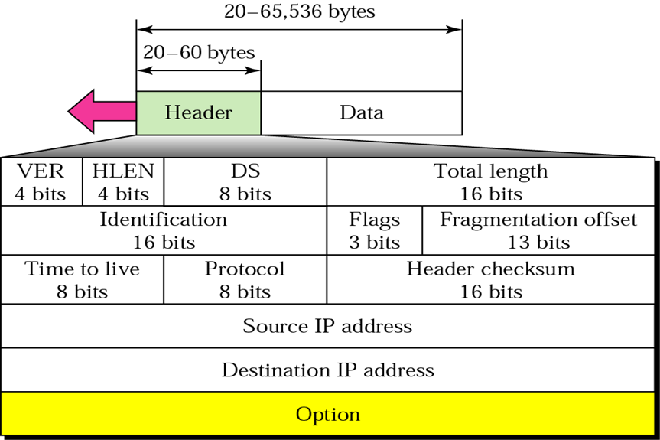

Slide 10
IP datagram
HLEN must be multiplied by 4 to get the length in bytes
Differentiated services: QoS
Total length = length of data + header length
TTL: number of hops; approx 2 times the maximum number of routes between any two hosts.
Protocol: Defines the higher level protocol that uses IP layer.

Slide 11
