Slide 1
Transport layer protocol
The transport layer protocol sits above the network or internet layer and just below the application and other upper layer protocols.
The general service provided by transport layer protocol is the end-to-end transport of data from the sender to receiver and vice versa.

Slide 2
This protocol divides the sender information in to discrete message packets.
Then it delivers it to the receiver in the internet using a physical connection between them.
At the receiving end it reassembles the received message packets into original data.
This also controls the data flow between the sender and receiver.

Slide 3
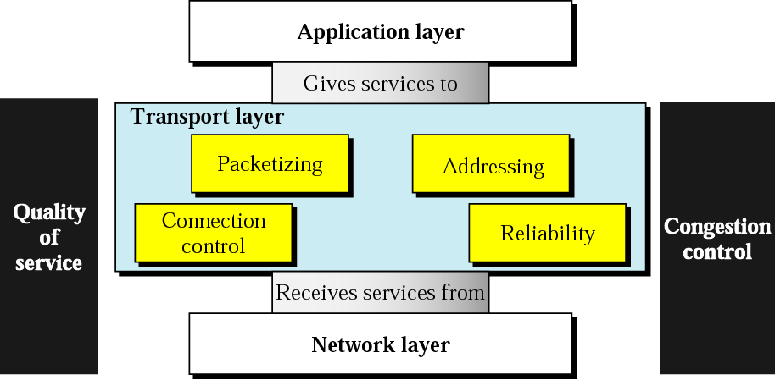
Position of Transport Layer

Slide 4
(i) Packetizing
This is a process of dividing a long message into smaller units called packets. Headers are added in each packet. In the receiving side, the data packets are reassembled to form the data string.
(ii) Connection control
This is responsible for establishing connection between the sender and the receiver. This can be either connection oriented or connectionless.

Slide 5
(iii) Addressing
The client needs the address of the remote computer to complete the communication. This addressing is implemented in the network layer.
(iv) Providing reliability
To guarantee the reliable delivery of data, acknowledgment and retransmission timers are used.
Each time the data is sent a timer is started. If the receiver receives the data packet, it sends back the acknowledgment to the sender.
If the sender wont receive the acknowledgment packet with in the time, the data packet is retransmitted.

Slide 6
Connection oriented and connection less service
In connection oriented service, a physical connection must be established between the sender and the receiver
Sender requests the receiver for establishing a connection.
Receiver accepts the request
Connection established
Data transfer takes place between sender and receiver.
Connection termination after sending all data.
In connection less service data packet are send from the sender to the receiver without establishing any physical connection.

Slide 7
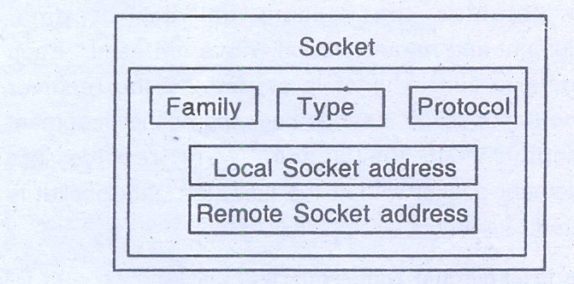
Socket
A socket is defined as a software endpoints that establishes two way communication between a server and one or more clients in a internet protocol based computer network.
Each socket associates with a port number and a TCP/IP address.

Slide 8
(i) Family : This field defines the protocol group:IPV4, IPV6, UNIX domain protocols
(ii) Type : This field defines the type of socket. Stream socket, packet socket, raw socket.
(iii) Protocol : This field is usually set to zero for TCP and UDP.

Slide 9
(iv) Local socket address : This field defines the local socket address, a combination of the local IP address and the port address of the local application program.
(v) Remote socket address : This field defines the remote socket address, a combination of the remote IP address and the port address of the remote application program.

Slide 10
Transmission control protocol
This protocol divides the sender information in to discrete message packets.
Then it delivers it to the receiver in the internet using a physical connection between them.
At the receiving end it reassembles the received message packets into original data.
This also controls the data flow between the sender and receiver.

Slide 11
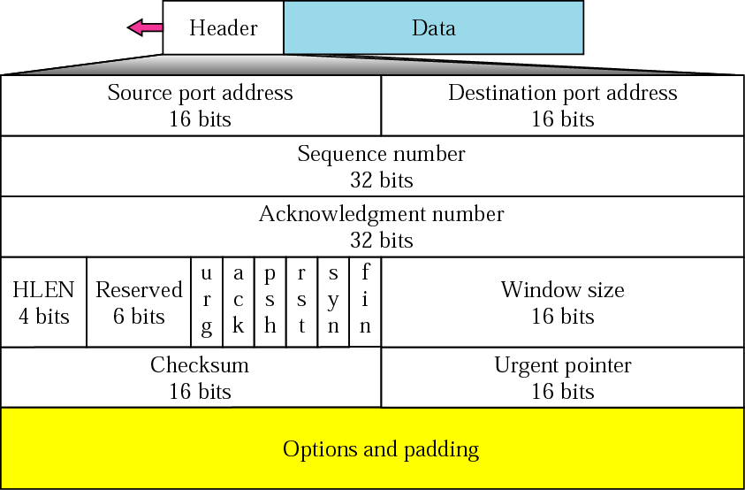
Figure 22.14 TCP segment format
Header Length
Number of 4-byte words in TCP header; 20 to 60 bytes
Reserved: for future use
Control: Used for flow control, connection establishment and termination, mode of data transfer.
Window size: Size of window in bytes
Checksum: Used to detect errors over the entire user datagram (header plus data)
Its optional to do checksum. If not done, put the entries as all 0s.
Urgent pointer: Active only if urgent flag is set. The number is added to the sequence number to obtain the number of the last urgent byte in the data section of the segment.
Options: up to 40 bytes

Slide 12
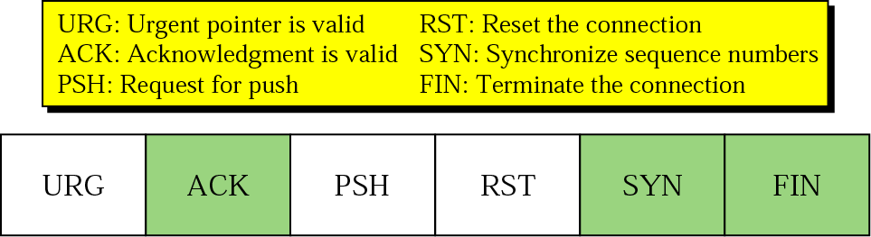

Slide 13
UDP
UDP is a connectionless, unreliable transport protocol.
It does not add anything to the services of IP except for providing process-to-process communication instead of host-to-host communication.
It performs very limited error checking.
UDP is a very small protocol with a minimum of overhead.
If a process wants to send a small message and does not care much about reliability, it can use UDP
Sending a small message using UDP takes much less interaction between the sender and receiver than using TCP.
UDP is a convenient protocol for multimedia and multicasting applications.
UDP is a connectionless, unreliable protocol that has no flow and error control. It uses port numbers to multiplex data from the application layer.

Slide 14
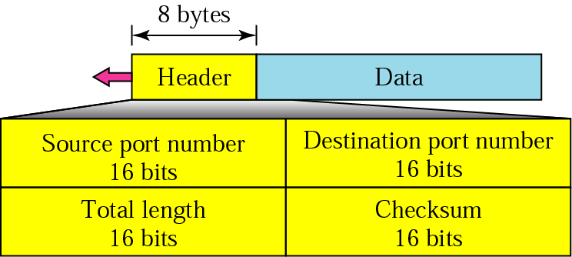
User Datagram Format
UDP packets, called user datagrams, have a fixed-size header of 8 bytes.
Source port number: Port number used by process running source host; 16 bits [0 to 65535]
Destination port number: Port number used by process running destination host; 16 bits
Length: 16-bit field; Total length of user datagram header plus data.
Checksum:
Used to detect errors over the entire user datagram (header plus data)
Its optional to do checksum. If not done, put the entries as all 0s.

Slide 15
IP
Host-to-host network layer delivery protocol for the Internet.
Unreliable and connectionless datagram protocol
Best-effort: no error control or flow control.
Has error detection mechanism to discard the packets that are corrupted.
For reliability, use IP with TCP.
Each datagram is delivered independently and via different routes.
Datagrams: Packets of IP layer.
Variable-length packet consisting of header [20 to 60 bytes] and data.

Slide 16
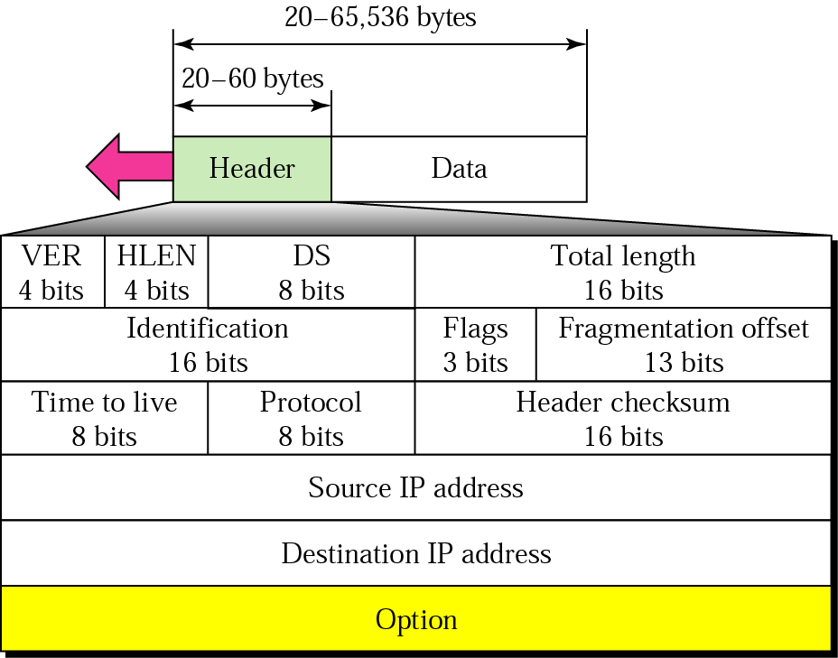
IP datagram
HLEN must be multiplied by 4 to get the length in bytes
Differentiated services: QoS
Total length = length of data + header length
TTL: number of hops; approx 2 times the maximum number of routes between any two hosts.
Protocol: Defines the higher level protocol that uses IP layer.

Slide 17
