Slide 1
PART I
Overview of
Data Communications
and
Networking

Slide 2
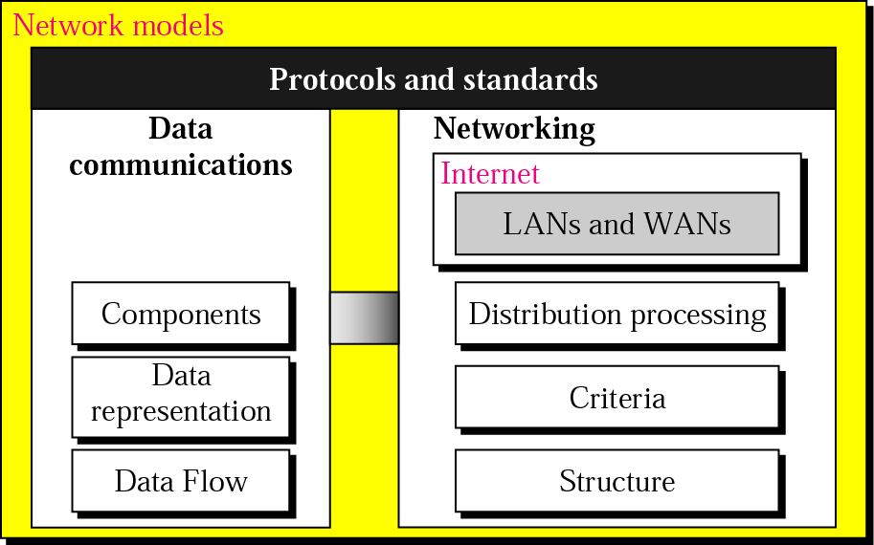
Overview

Slide 3
Chapters
Chapter 1 Introduction
  Data Communications
  Networking
  Protocols and Standards
Chapter 2 Network Models

Slide 4
OVERVIEW of CHAPTER 1
  Data Communications
  Networks
  The Internet
  Protocols and Standards

Slide 5
1.1 Data Communication
Components
Data Representation
Direction of Data Flow

Slide 6
Definitions
Telecommunication: Communication at a distance
Data: Information presented in whatever form is agreed upon by the parties creating and using the data
Data communications: Exchange of data between two devices via some form of transmission medium such as a wire cable.
The effectiveness of data communications depends upon three fundamental characteristics:
  Delivery: Deliver data to the correct destination.
  Accuracy: Deliver the data accurately.
  Timeliness: Deliver data in a timely manner. Real-time transmission requires timely delivery [without significant delay].

Slide 7
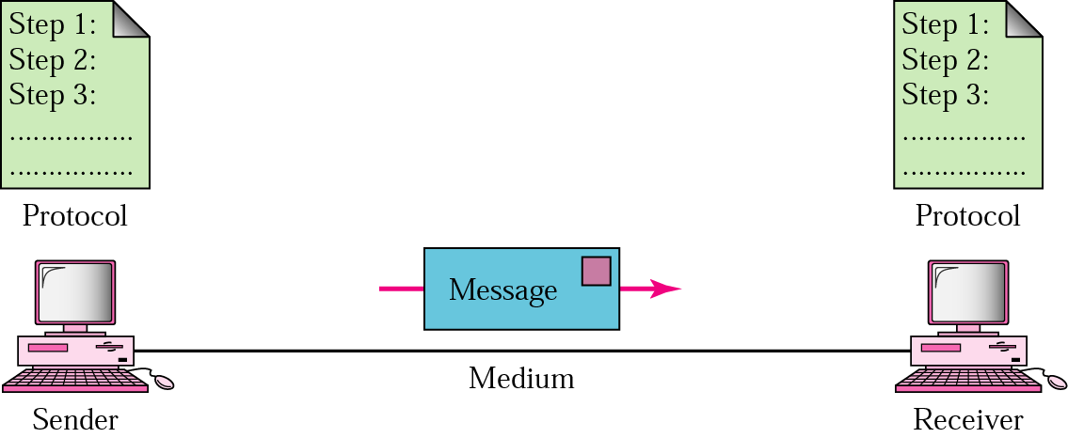
Figure 1.1 Five components of data communication
Message: Data to be communicated
Sender & Receiver
Medium: Transmission medium is the physical path by which a message travels from sender to receiver
  Twisted-pair, coaxial cable, fiber optic cable or radio waves.
Protocol: Set of rules that govern data communications.

Slide 8
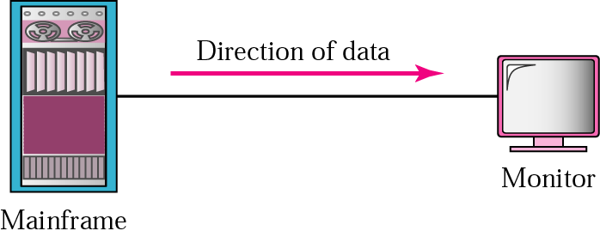
Figure 1.2 Simplex
Data representation:
  Text: bits called as codes.
  ASCII(7 bits), Extended ASCII (8 bits)
  Unicode: 16 bits; used to represent different languages
  ISO: 32-bit
  Numbers, Image [Pixels; size of pixels depends on resolution], Audio, Video
Data Flow: Simplex [Unidirectional]

Slide 9

Figure 1.3 Half-duplex
Half-duplex mode: Each station can both transmit and receive, but not at the same time
The entire capacity of a channel is taken over by whichever of the two devices is transmitting at the time.

Slide 10

Figure 1.4 Full-duplex
Also called as duplex
Both stations can transmit and receive simultaneously
Signals going in either direction share the capacity of the link.
Link might have two lines or a channel is divided between signals travelling in both directions.

Slide 11
1.2 Networks
Network: set of devices connected by communication links.
Distributed Processing: Task is divided among multiple computers.

Slide 12
Network Criteria
Performance: Transit and response time.
  Transit time is the amount of time required for a message to travel from one device to another.
  Response time is the elapsed time between an inquiry and a response.
  Depends upon number of users, type of transmission medium, capabilities of hardware, efficiency of software.
Reliability: Measured by the frequency of failure, the time it takes a link to recover from a failure, and the network’s robustness in catastrophe.
Security: Protecting data from unauthorized access.

Slide 13
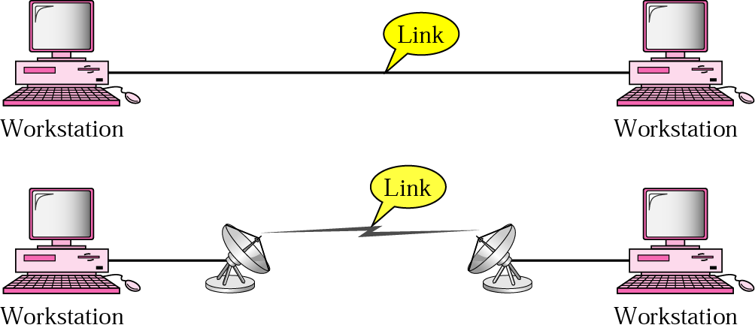
Physical connection
Point-to-point:
  Provides a dedicated link between two devices.
  Entire capacity of the link is used.

Slide 14
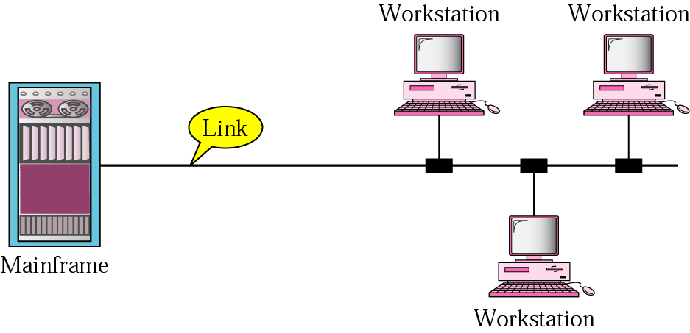
Figure 1.6 Multipoint connection
Also called as multidrop.
More than two specific devices share [spatially or temporally] a single link.
Spatially shared: Several devices can use the link simultaneously
Timeshare: Users must take turns.

Slide 15
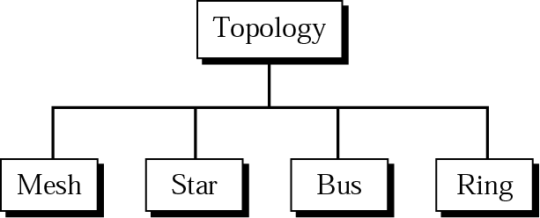
Physical Topology
Figure 1.7 Categories of topology
Refers to the way in which a network is laid out physically.
Two or more devices connect to a link.
Two or more links form a topology.
Topology of a network is the geometric representation of the relationship of all the links and linking devices (nodes) to one another.

Slide 16
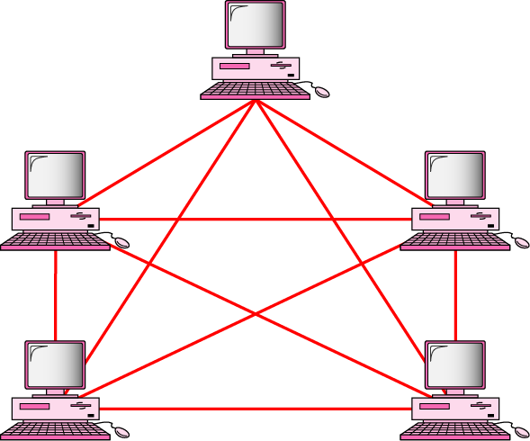
Figure 1.8 Fully connected mesh topology
Every device has a dedicated point-to-point link to every other device.
Dedicated means that the link carries traffic only between the two devices it connects.
Adv: Guaranteed load, robust, privacy or security, fault identification and fault isolation is easier.
Disadv: amount of cabling, I/O ports, installation is difficult, more wiring w.r.t space, expensive hardware.
  Used at Backbone mostly.

Slide 17
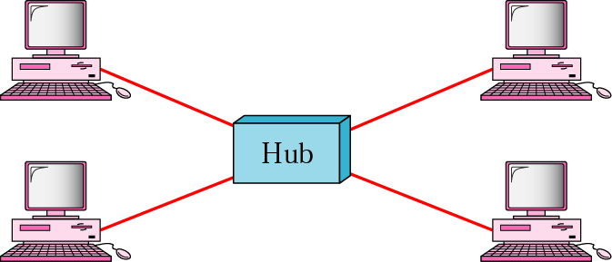
Figure 1.9 Star topology
Each device has a dedicated pt-to-pt link only to a central controller [Hub].
No direct connection or traffic.
Adv: less expensive, one link and one I/O port, easy to install and reconfigure, less cabling (but more than bus or ring), node failure will not affect others, fault identification is easier.
Disadv: Single point of failure.

Slide 18
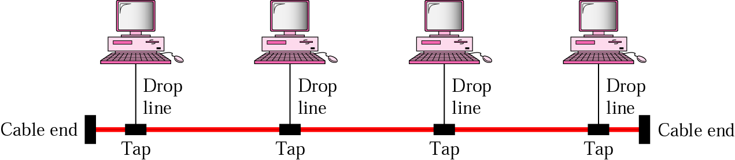
Figure 1.10 Bus topology
Multipoint: One cable acts as a backbone to link all the devices in a network.
Drop line: a connection running between the device and main cable.
Tap: a connector that either splices into the main cable or punctures the sheathing of the cable to create a contact with the metallic core.
Signal degrades due to energy being transformed into heat. So, there is limitation on the number of taps allowed.
Adv: easy to install, less cabling.
Disadv: Limit on number of taps and the distance between taps, difficult to identify fault, signal degradation, modification is difficult.

Slide 19
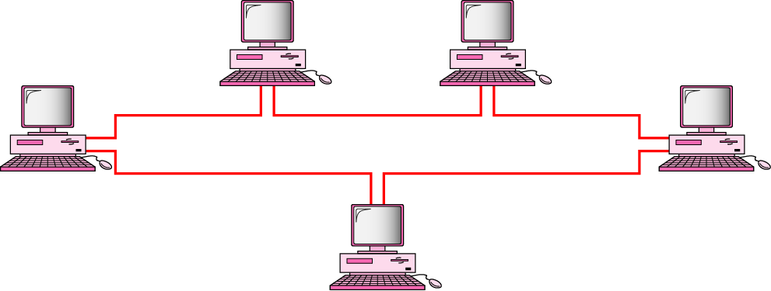
Figure 1.11 Ring topology
Each device has a dedicated pt-to-pt connection only with the two devices on either side of it.
Each device incorporates a repeater.
When a device receives a signal intended for another device, its repeater regenerates the bits and passes them along.
Adv: Easy to install, fault isolation is easier, Signal circulates at all times (alarm alerts the problem and its location).
Disadv: Unidirectional traffic, in a simple ring; break in the ring can disable entire network.
  Some systems have dual ring or switch capable of closing off the break.

Slide 20
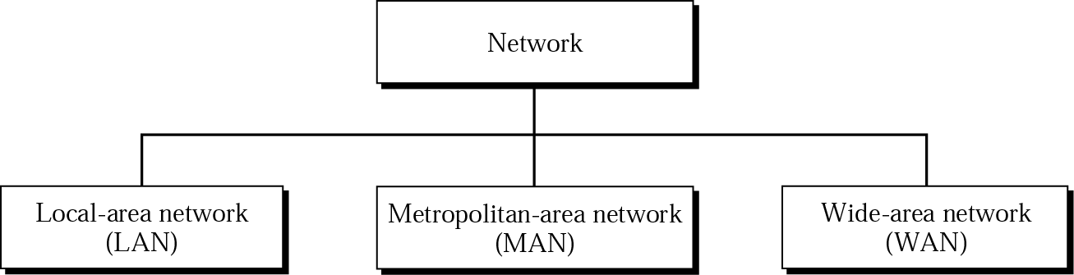
Figure 1.12 Categories of networks
Size
Ownership
Distance it covers
Physical architecture

Slide 21
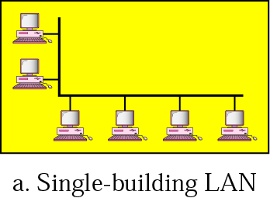
Figure 1.13 LAN
Privately owned
Links devices in single office, building or campus.
Limited to few kilometres.
Sharing of resources: Hardware or data.
Use a single transmission media.
Topology: Ring, bus, star.

Slide 22
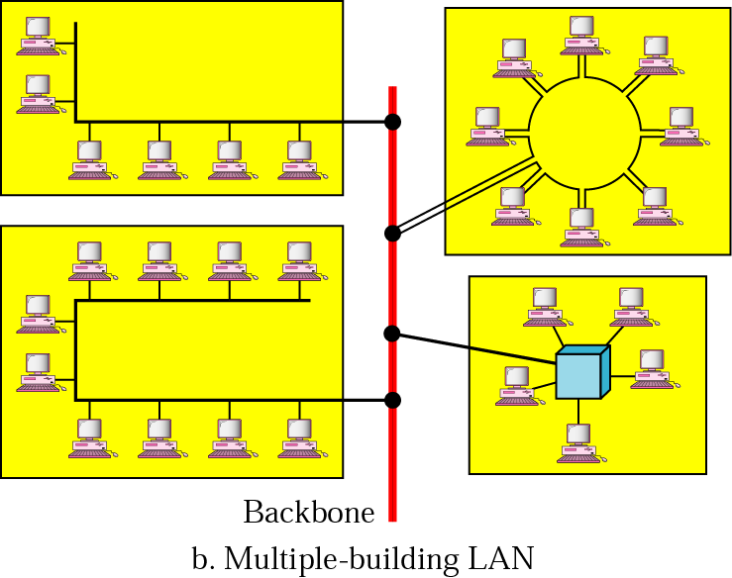
Figure 1.13 LAN (Continued)

Slide 23
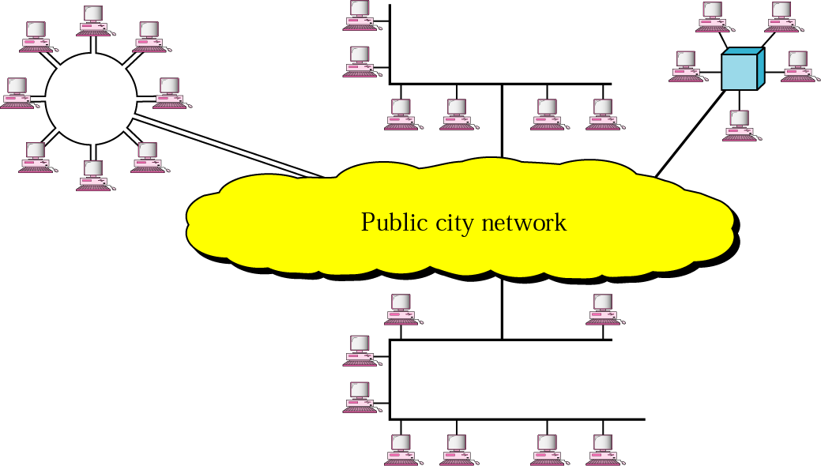
Figure 1.14 MAN
Extend over an entire city.
Owned and operated by a private company
Service provider
Public company.

Slide 24
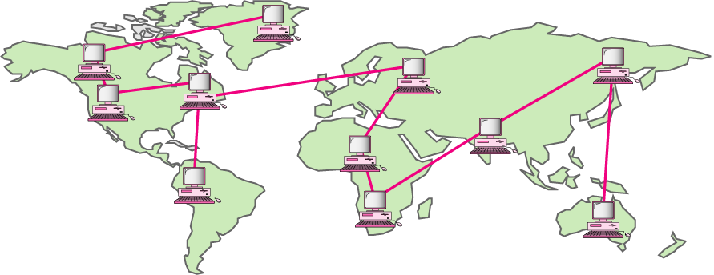
Figure 1.15 WAN
Provides long-transmission of data, voice, image and video information over large geographic areas that may comprise a country, a continent or even the whole world.
WAN that is wholly owned and used by a single company is often referred to as an enterprise network.

Slide 25
1.3 The Internet
A Brief History
1967 → ARPA [Advanced research projects agency]
ARPANET → 1969 (Network Control Protocol- NCP)
1973 → Transmission Control Protocol (TCP)
Further divided into TCP and Internetworking Protocol (IP)
The Internet Today
National Service Providers (NSPs)
  Backbone networks, maintained by specialized companies
Network Access Points (NAP)
  Switching stations that provide connectivity between the end users and backbone networks.
  Regional and local Internet Service Providers (ISP).

Slide 26
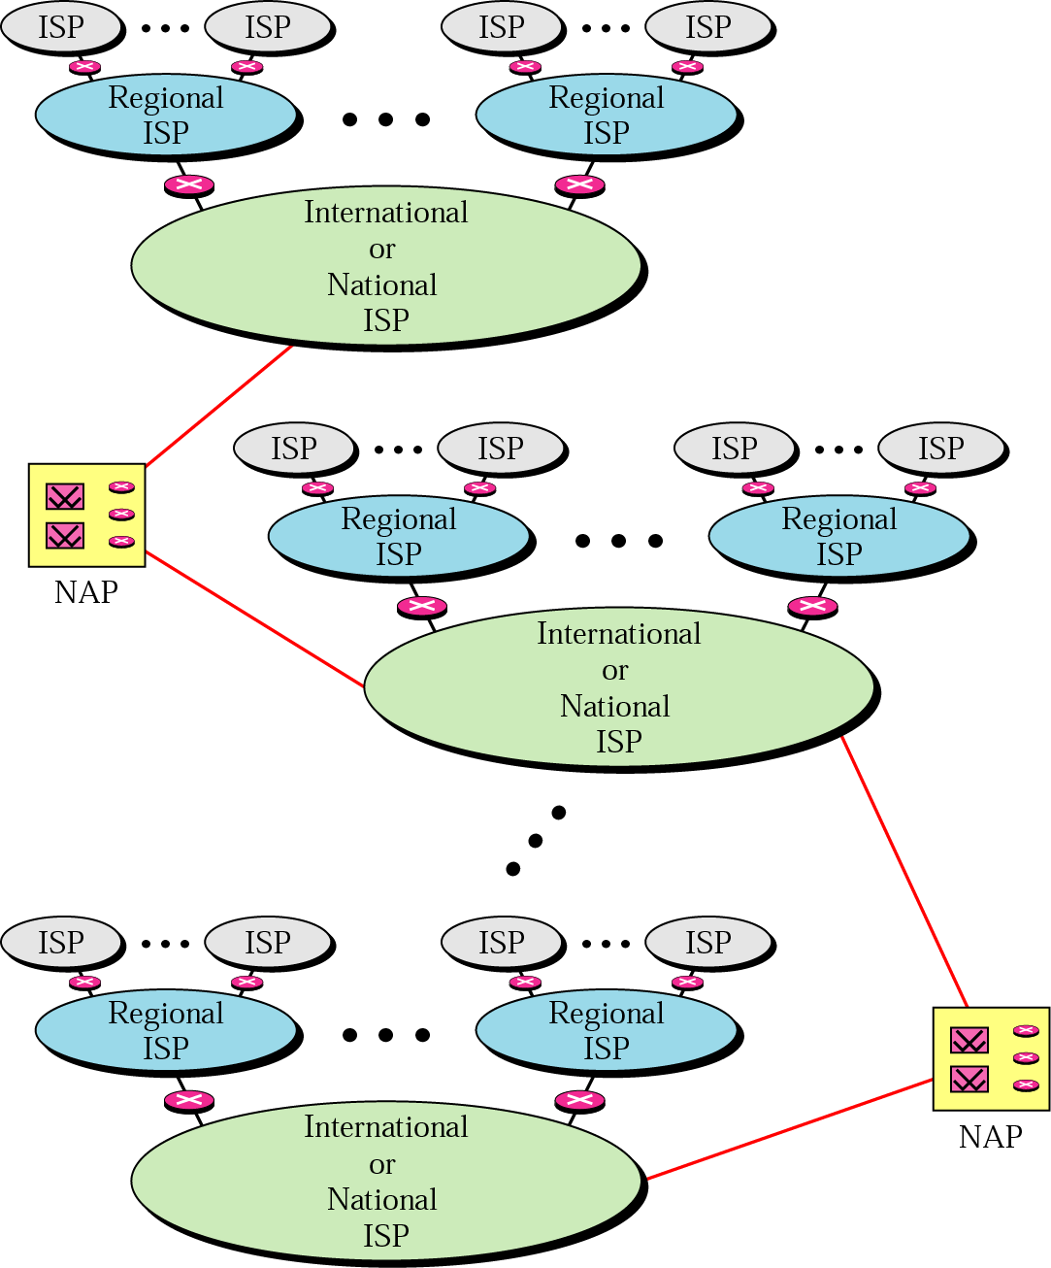
Figure 1.16 Internet today

Slide 27
1.4 Protocols and Standards
Protocols: set of rules that governs data communications.
A protocol defines what is communicated, how it is communicated and when it is communicated.
Syntax: it refers to the structure or format of data.
Semantics: it refers to the meaning of each section of bits
Timing: It refers to two characteristics; when and how much to send.
Standards: Provide guidelines.
de facto [by fact]
de jure [by law].

Slide 28
Standard Organizations
International Organization for Standardization (ISO)
International Telecommunication Union- Telecommunication Standards (ITU-T)
American National Standards Institute (ANSI)
Institute of Electrical and Electronics Engineers (IEEE)
Electronic Industries Association (EIA)
International Engineering Task Force (IETF)

Slide 29
Internet Standards
  Thoroughly tested specification that is useful to and adhered to by those who work with the Internet.
  Strict procedure and must be followed.
Internet draft
  Working document with no official status and 6-month life time.
  Upon recommendation from Internet authorities, can be published as a RFC [With number and made available to all interested parties.] RFC has maturity levels and are categorized according to their requirement levels.

