Slide 1
Types of Networks

Slide 2
CAN
Campus Area Network (CAN) is a group of interconnected Local Area Networks (LAN) within a limited geographical area like school campus, university campus, military bases, or organizational campuses and corporate buildings etc.
A Campus Area Network is larger than Local Area Network but smaller than Metropolitan Area Network (MAN) and Wide Area Network (WAN).

Slide 3
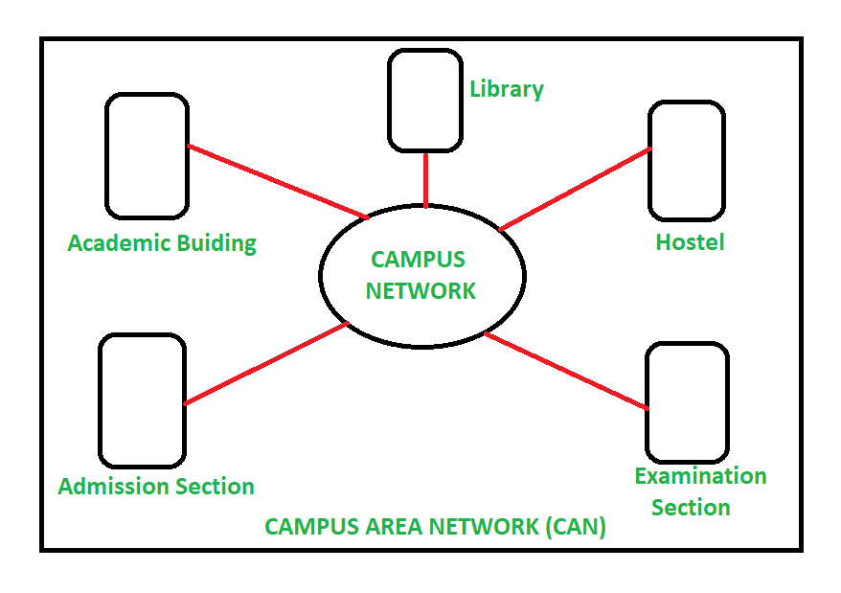

Slide 4
Home Area Network (HAN)
It is a network in a user’s home where all the laptops, computers, smartphones, and other smart appliances and digital devices are connected into a network.
This facilitates communication among the digital devices within a home which are connected to the Home network.
Home Area Network may be wired or wireless. Mostly wireless network is used for HAN

Slide 5
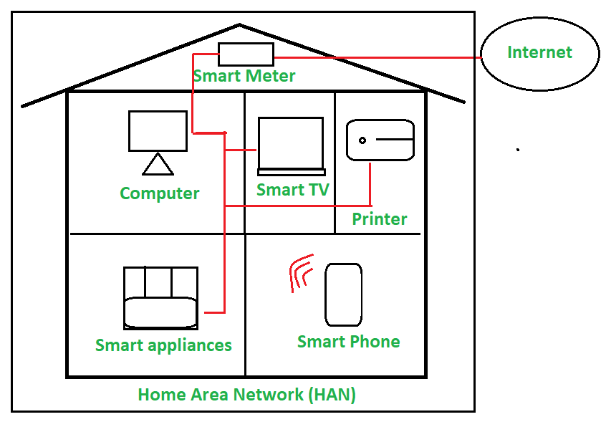

Slide 6
Intranet
An intranet is a kind of private network. For example, an intranet is used by different organizations and only members/staff of that organization have access to this.
It is a system in which multiple computers of an organization (or the computers you want to connect) are connected through an intranet.
As this is a private network, so no one from the outside world can access this network.

Slide 7
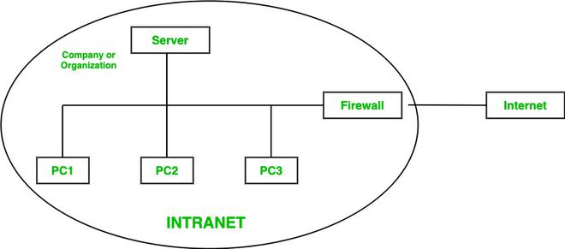

Slide 8
Extranet
Extranet refers to network within an organization, using internet to connect to the outsiders in controlled manner.
It helps to connect businesses with their customers and suppliers and therefore allows working in a collaborative manner.

Slide 9
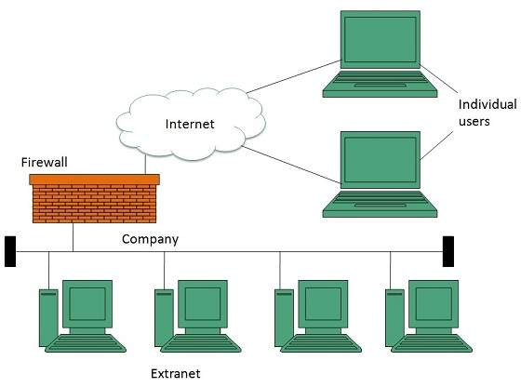
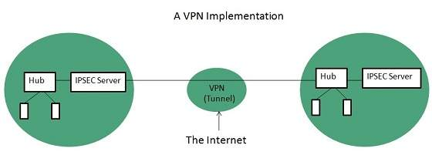

Slide 10
Client/Server
In the client-server architecture, when the client computer sends a request for data to the server through the internet, the server accepts the requested process and delivers the data packets requested back to the client.
Server: A central computer that stores and manages resources (data, files, applications).
Clients: Multiple devices (computers, laptops, smartphones, tablets) that request and receive services from the server.

Slide 11


Slide 12
Peer-to-Peer (P2P) Architecture
In P2P (Peer-to-Peer) Architecture, there is not any concept of a Central Server. Each device is free for working as either client or server.
Decentralized Structure: No central server.
Peer-to-Peer Connections: Each node (peer) can directly communicate and share resources with other nodes.
Dynamic Topology: The network structure can change constantly as peers join and leave.
**Direct sharing of resources

Slide 13
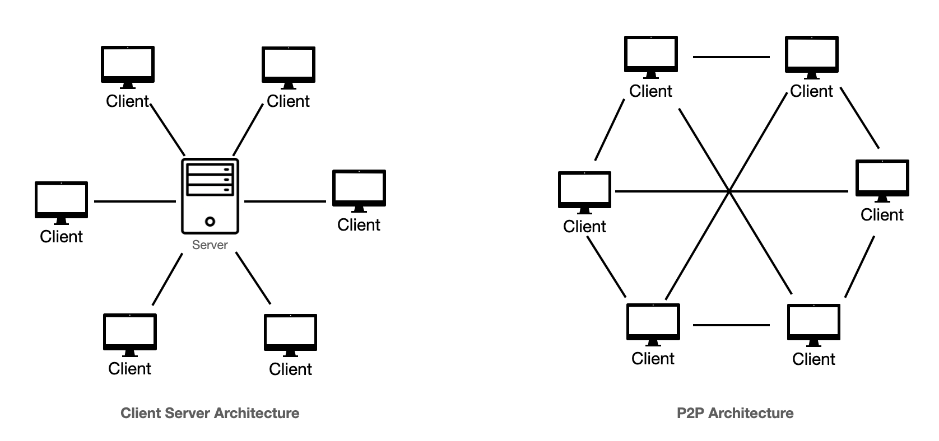

Slide 14
What is Wi-Fi?
Wireless Fidelity
Wi-Fi standards are defined by the IEEE (Institute of Electrical and Electronics Engineers)
Wi-Fi is a technology that allows electronic devices to connect to a wireless local area network (WLAN).
It enables devices like smartphones, laptops, tablets, and smart home gadgets to communicate with each other and access the internet without the need for physical cables.
How It Works
Wi-Fi uses radio waves to transmit data between devices and a router. The router connects to the internet, allowing devices to access online resources.

Slide 15
They transmit at frequencies of 2.4 GHz or 5 GHz.
This frequency is considerably higher than the frequencies used for cell phones, walkie-talkies and televisions.
The higher frequency allows the signal to carry more data.

Slide 16
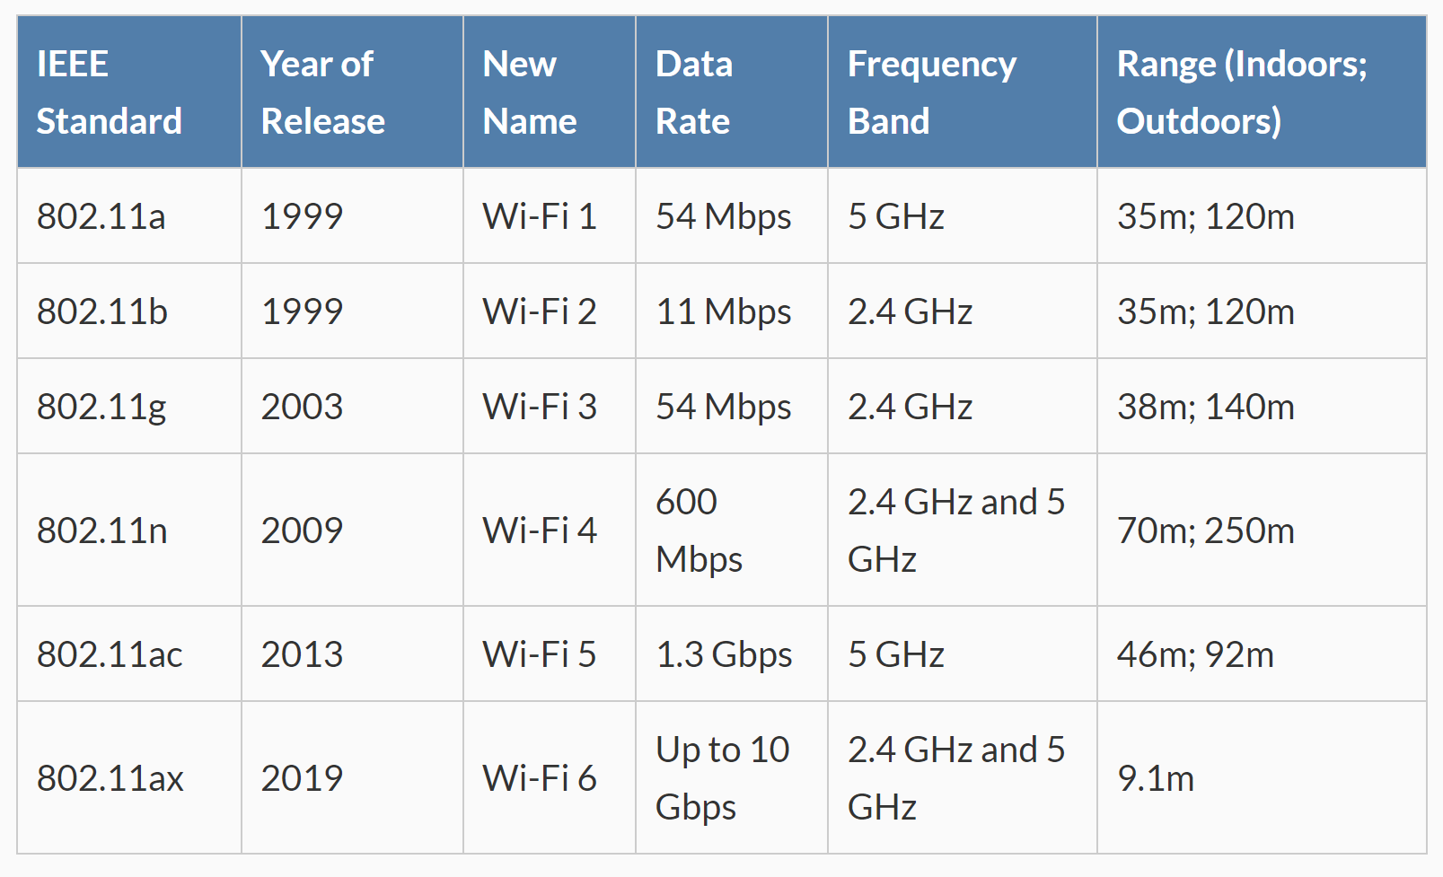

Slide 17
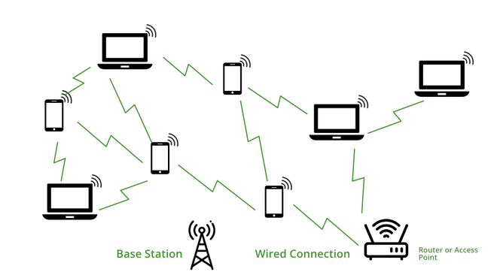

Slide 18
How does a Wi-Fi work?
Wi-Fi is a wireless technology for networking, so it uses Electromagnetic waves to transmit networks.
We know that there are many divisions of Electromagnetic waves according to their frequency such as X-ray, Gamma-ray, radio wave, microwave, etc, in Wi-Fi, the radio frequency is used.
For transmitting Wi-Fi signal there is three medium,
Base Station Network :It is the main host network from where the network connection is provided to the router.
Access Point or Router: it is a bridge between a wired network and a wireless network. It accepts a wired Ethernet connection and converts the wired connection to a wireless connection and spreads the connection as a radio wave.
Accessing Devices: It is our mobile, computer, etc from where we use the Wi-Fi and surfing internet.

Slide 19
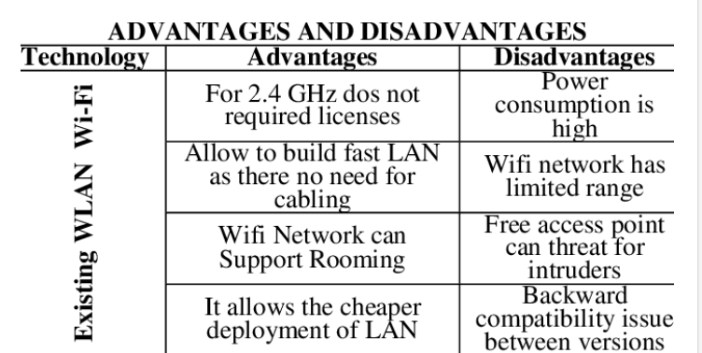

Slide 20
What is Li-Fi?
Light Fidelity
Definition: Li-Fi is a wireless communication technology that utilizes visible light, ultraviolet, and infrared light to transmit data, as opposed to the radio waves used in traditional Wi-Fi.
How It Works: Li-Fi uses light-emitting diodes (LEDs) that modulate their brightness at very high speeds, which can be detected by photodetectors. This modulation enables data transmission, creating a high-speed communication channel.

