Slide 1


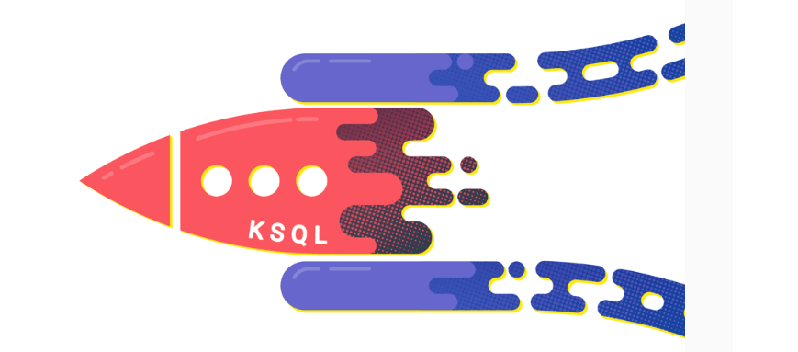

Realtime Data Analytics Using Kafka Eco System Tools
Apache Kafka is one of the best solutions to store the real time / streaming data in a Highly Available and Fault Tolerant way, where several producers can produce (publish) and several consumers can consume (subscribe) the data.
Earlier Kafka is used only for storing the stream data. But with the latest versions of Kafka, it is also possible to process the stream data within the Kafka Cluster in real time and Sink the processed data to the other external systems.
Agenda:
Introduction to Apache Kafka and it’s ecosystem tools.
Architecture
Use cases
Live Demo
Setting up the Cluster.
Writing Kafka connector to ingest the data into Kafka.
Processing data using KSQL / K Streams.
Writing Kafka Connector to sink data to external systems.
Presenter: Ashok Kumar Choppadandi
Date & time: 29th April 2022 [ 11 AM to 12 PM ]

Slide 2



design and flow
Kafka Connect – Sink Connectors
Kafka Connect – Sink Connectors
Kafka Connect
Source & Sink Connectors
6
7
1
1
6
7
BROKER
Schema Registry
BROKER
Kafka Brokers
7
2
2
5
5
KSQL DB
3
Kafka Streams
4

