Slide 1
A Deep Analysis on Quarter1 2019 Airlines Data Set
- Ashok Varma Mudunuri

Slide 2
Problem Statement
You are working for an airline company looking to enter the United States domestic market. Specifically, the company has decided to start with 5 round trip routes between medium and large US airports. An example of a round-trip route is the combination of JFK to ORD and ORD to JFK. The airline company has to acquire 5 new airplanes (one per round trip route) and the upfront cost for each airplane is $90 million. The company’s motto is “On time, for you”, so punctuality is a big part of its brand image.

Slide 3
Business Questions to answer
The 10 busiest round-trip routes in terms of number of round-trip flights in the quarter. Exclude canceled flights when performing the calculation.
The 10 most profitable round-trip routes (without considering the upfront airplane cost) in the quarter. Along with the profit, show total revenue, total cost, summary values of other key components and total round-trip flights in the quarter for the top 10 most profitable routes. Exclude canceled flights from these calculations.
The 5 round trip routes that you recommend to invest in based on any factors that you choose.
The number of round-trip flights it will take to breakeven on the upfront airplane cost for each of the 5 round trip routes that you recommend. Print key summary components for these routes.
Key Performance Indicators (KPI’s) that you recommend tracking in the future to measure the success of the round-trip routes that you recommend.

Slide 4
DATAsets USed
Flights.csv: Information on airports and includes airport code, city, country, and coordinates
Tickets.csv: Flights data for Q1 2019 and includes date, origin, destination, distance, flight number, and occupancy rate
Airport_Codes.csv: Sample tickets data for Q1 2019 and includes itinerary details and fare information. Consider round trips only for your analysis.

Slide 5
Performing data quality Checks on each dataset
Reviewed all three datasets: Flights, Tickets, and Airport Codes
Verified dataset shapes to understand record counts
Checked for: Missing values, Null entries, Outliers and invalid ranges
Printed column schema to check data types and completeness

Slide 6
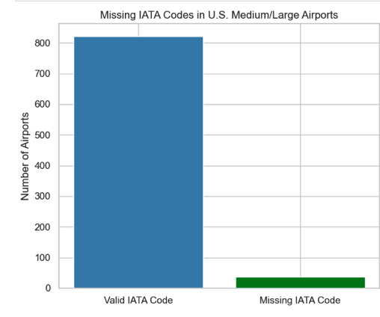
Data quality insights
Checked for missing IATA_CODE values in the airport dataset
Out of the 858 U.S. medium/large airports, only 37 airports were missing valid IATA_CODEs
Only airports with valid IATA codes were used in further analysis

Slide 7
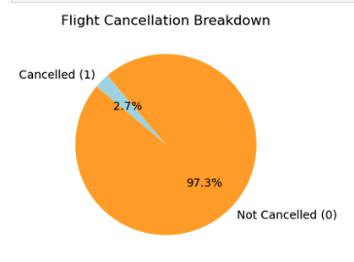
Data quality insights
Analyzed flights dataset to check cancellation status for all the flights.
Only 2.7% were marked as canceled and were excluded from further analysis
Checked for duplicates based on FL_DATE, OP_CARRIER_FL_NUM, ORIGIN, and DESTINATION
Found 5,550 duplicated flight entries in the dataset

Slide 8
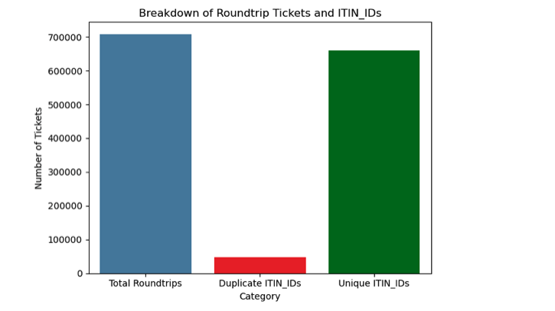
Data quality insights
Checked for null values in the tickets dataset
Checked for unique values in the YEAR, QUARTER, ORIGIN_COUNTRY
Checked if ITIN_IDs were unique or not
Detected duplicate ITIN_IDs, which are meant to be unique according to the dataset’s metadata
Out of 708600 roundtrip tickets, 47722 were duplicates

Slide 9
Data Cleaning - Flights.csv
Removed duplicate flights based on FL_DATE, OP_CARRIER_FL_NUM, ORIGIN, and DESTINATION
Standardized ORIGIN and DESTINATION airport codes (removed whitespace, converted to uppercase)
Replaced missing CANCELLED values with 1 (assumed cancelled), then converted to integers
Converted DISTANCE and OCCUPANCY_RATE to numeric; handled non-numeric entries
Filtered only active flights where CANCELLED = 0
Removed flights with missing or invalid occupancy or distance values
Excluded entries where OCCUPANCY_RATE was outside the valid range [0, 1]

Slide 10
Data Cleaning – Tickets.csv
Ensured each ticket has a unique ITIN_ID by removing duplicates
Filtered to include only roundtrip tickets (ROUNDTRIP = 1)
Standardized ORIGIN and DESTINATION airport codes (trimmed spaces, uppercase)
Converted ITIN_FARE to numeric and handled non-numeric entries
Removed records with missing or invalid ITIN_FARE and PASSENGERS values
Excluded records where fare or passenger count was less than or equal to 0

Slide 11
Data Cleaning – airport_codes.csv
Filtered for U.S. airports only (ISO_COUNTRY = 'US’)
Included only medium and large airports (TYPE)
Removed records with missing IATA_CODEs
Retained only IATA_CODE and TYPE columns
Renamed TYPE to AIRPORT_SIZE for clarity
Used the cleaned list to filter flights and tickets to valid U.S. airport routes only

Slide 12
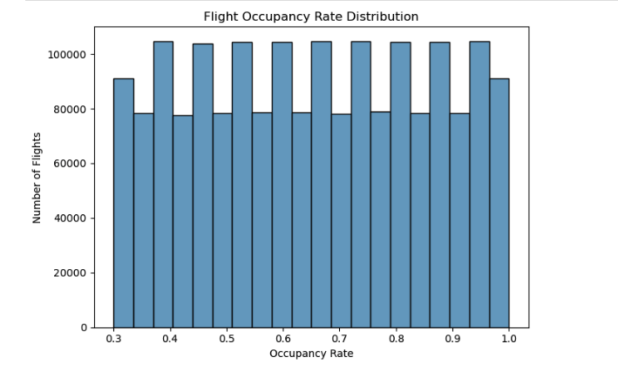
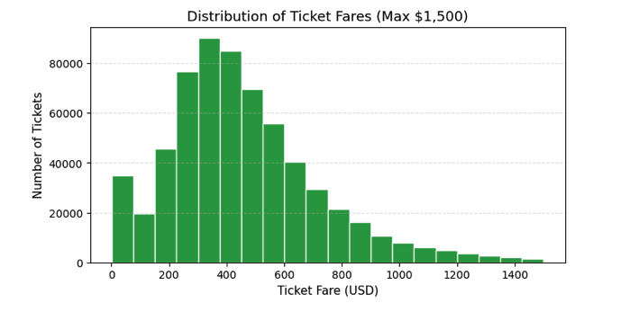
Univariate analysis
Flight Occupancy Rates
Analyzed the distribution of OCCUPANCY_RATE across all active flights
The values were well distributed between 0.3 and 1.0, with no extreme outliers
Ticket Fare Distribution
Visualized ITIN_FARE distribution for all roundtrip tickets priced $1,500 or less
This analysis helps establish a reliable average fare per passenger for revenue modeling

Slide 13
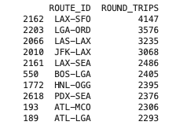
Approaches Considered for Round Trip Calculation
Method 1 – Directional Minimum Count (My Choice)
Counted the number of flights from A ➝ B and B ➝ A
Took the minimum of the two to estimate round trips
Used a consistent, sorted ROUTE_ID (e.g., JFK-ORD) to group all directional flights together

Slide 14
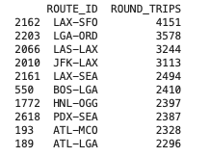
Approaches Considered for Round Trip Calculation
Method 2 – Total Flights Divided with 2
Added total flights between A and B (both directions)
Estimated round trips by dividing by 2
Disadvantages
Assumes every outbound flight has a return, which may not be true
Overestimates round trips when one direction has far more flights

Slide 15
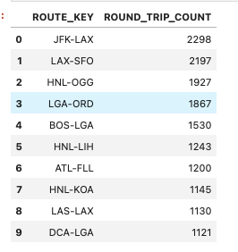
Approaches Considered for Round Trip Calculation
Method 3 – Tail Number Based Matching
Tracked actual aircraft (TAIL_NUM) flight history
Counted a round trip only if a plane flew A ➝ B and its next flight was B ➝ A
Disadvantages
Focuses on aircraft reuse, not actual route demand
Misses round trips when different airlines or aircraft are used in each direction

Slide 16
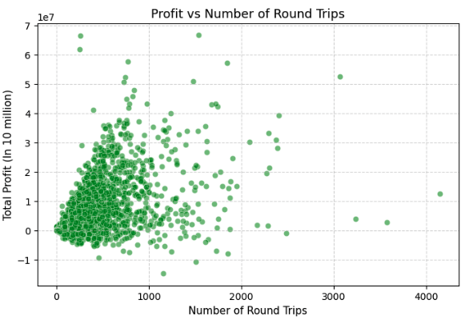
Bivariate Analysis
Plotted the relationship between route profitability and number of round trips
Each point represents a unique route across the network
Observed that higher round trip volume does not guarantee higher profit
Reinforces the need for profitability-based selection, not just frequency

Slide 17
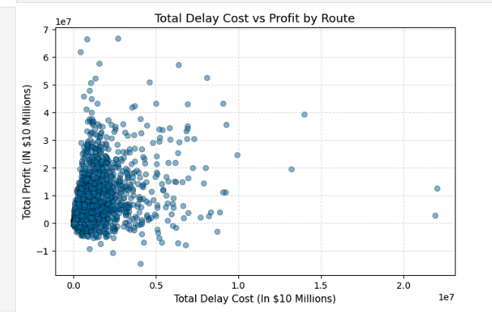
Bivariate Analysis
Plotted each route's total delay cost against its total profit
Most high-profit routes cluster around low delay cost regions
Indicates that operational efficiency (i.e., fewer delays) contributes to higher profitability
However, a few routes remain profitable despite incurring high delay costs
No strong negative correlation — delay cost alone doesn’t determine profit

Slide 18
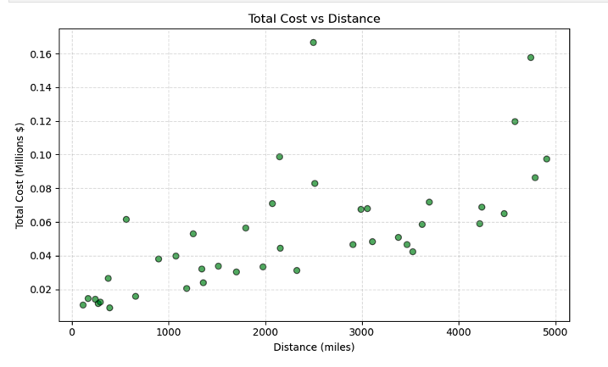
Bivariate Analysis
Visualized how route distance impacts the total cost per route
A clear positive correlation is observed longer routes tend to have higher operating costs
Reflects the cost model that includes fuel, maintenance, depreciation, airport fees, and delays

Slide 19
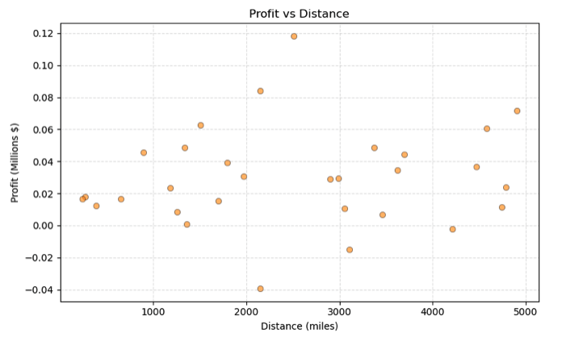
Bivariate Analysis
Analyzed how route distance affects total profit
No clear or strong correlation observed between distance and profitability
Both short and long routes can be profitable — or not
Implies that other factors (like fare pricing, delays, airport fees, occupancy) play a bigger role in driving profit

Slide 20
Conclusion & final recommendations

Slide 21
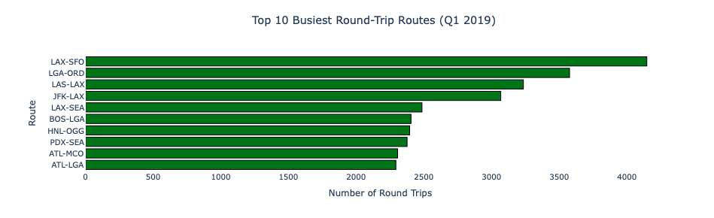
Q1) The 10 busiest round-trip routes in terms of number of round-trip flights in the quarter. Exclude canceled flights when performing the calculation.

Slide 22
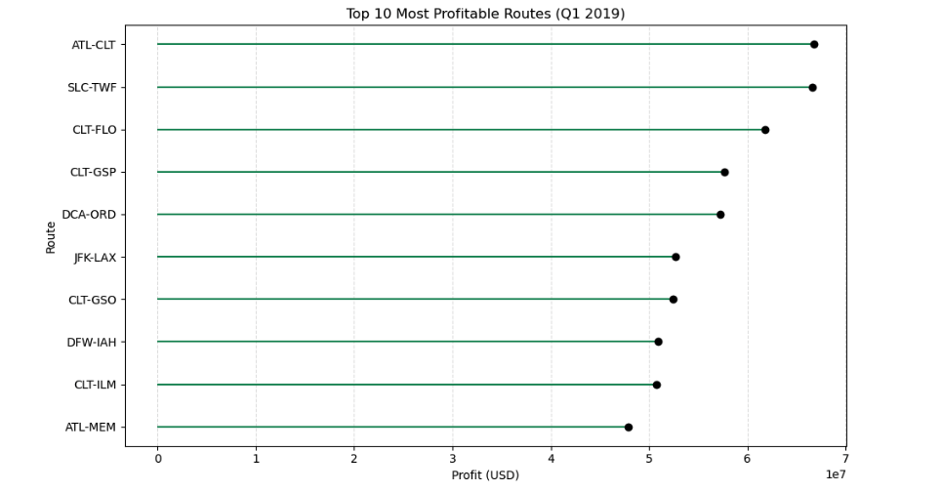
Q2) The 10 most profitable round-trip routes (without considering the upfront airplane cost) in the quarter. Along with the profit, show total revenue, total cost, summary values of other key components and total round-trip flights in the quarter for the top 10 most profitable routes. Exclude canceled flights from these calculations.

Slide 23
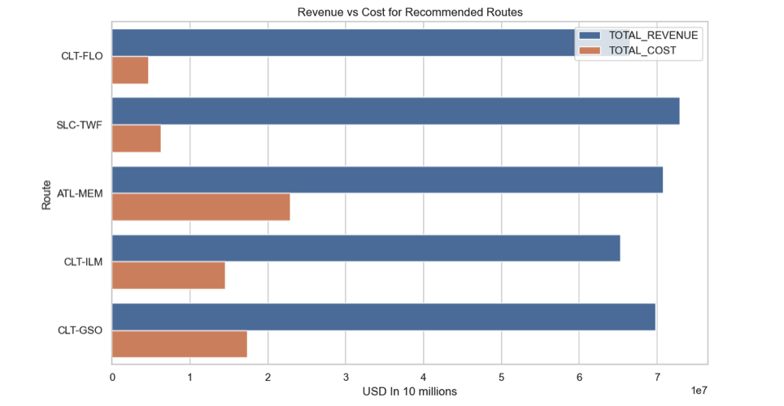
Q3) The 5 round trip routes that you recommend to invest in based on any factors that you choose.

Slide 24
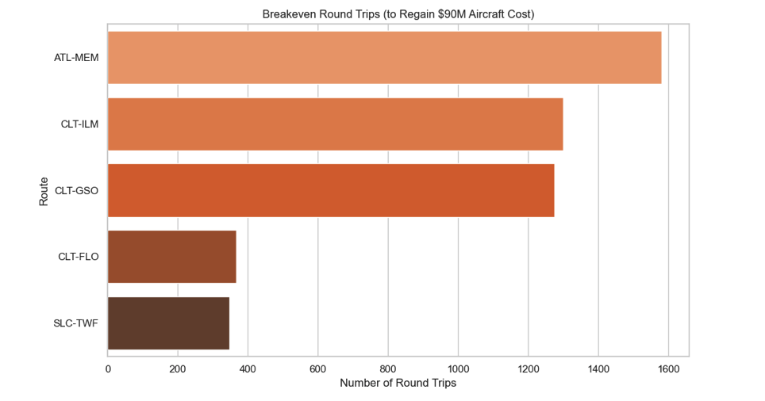
Q4) The number of round-trip flights it will take to breakeven on the upfront airplane cost for each of the 5 round trip routes that you recommend. Print key summary components for these routes.

Slide 25
Q5) Key Performance Indicators (KPI’s) that you recommend tracking in the future to measure the success of the round-trip routes that you recommend.
PROFIT_MARGIN – % of revenue retained as profit
Indicates route profitability and cost efficiency
REVENUE_PER_PASSENGER – Average income per passenger
Helps optimize pricing and identify high-value routes
COST_PER_PASSENGER – Average operating cost per passenger
Useful for evaluating route-level cost management
COST_PER_MILE – Cost incurred per mile flown
Compares cost-efficiency across short- and long-haul routes
BREAKEVEN_PROGRESS_% – % progress toward recovering $90M aircraft investment
Measures long-term financial performance of each route

Slide 26
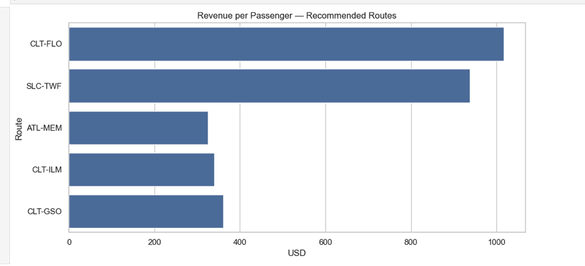
Visualizing KPI metrics
Revenue per Passenger Recommended Routes
Visualizes average revenue generated per passenger on top recommended routes
Supports prioritizing routes not just by volume, but by per-passenger profitability

Slide 27
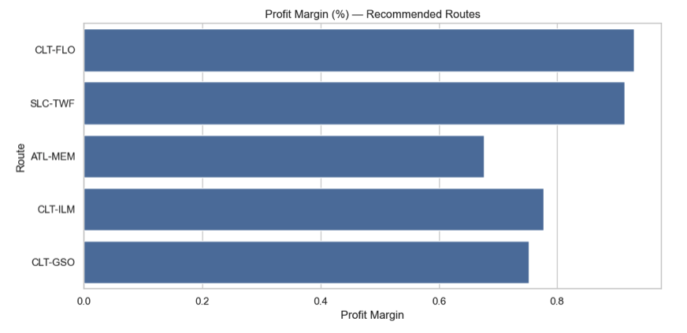
Visualizing KPI metrics
Profit Margin
Highlights the profitability ratio of each recommended route
Routes like CLT-FLO and SLC-TWF show margins close to 90%, indicating high-cost efficiency
Profit margin = percentage of revenue retained after covering all costs
Ensures that selected routes contribute more profit per dollar earned, not just higher revenue

Slide 28
Thank you

