Slide 1
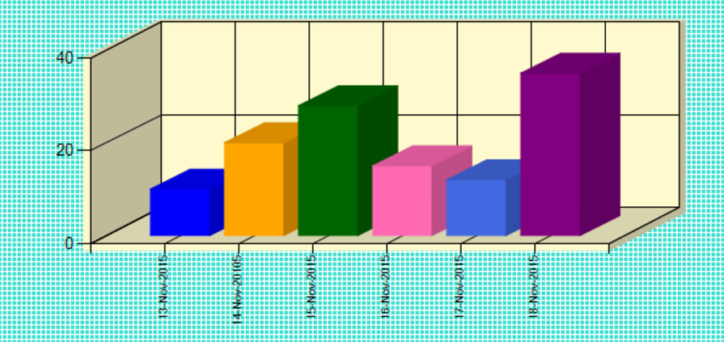
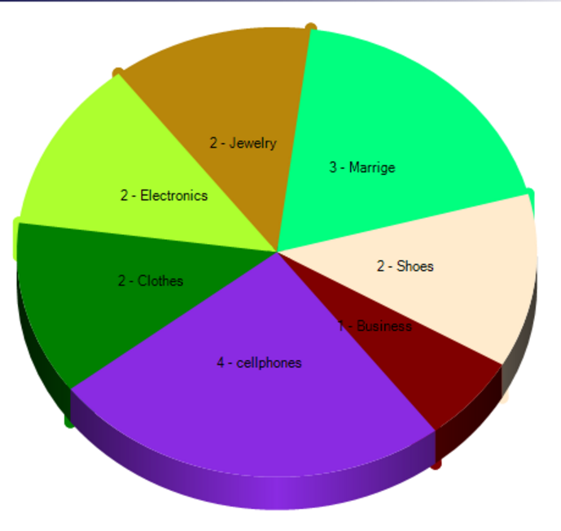
Image Repository
A Place for Efficient Storage and Retrieval of Images
http://www.imagerepository.somee.com
Ashok Yaganti
Yatheesh Pulicharla
Sasidhar Kanumuri

