Slide 1




SMART ENGINEERING PROJECT
EOD PAYMENT SYSTEM USING CRYPTOCURRENCY
PRESENTED BY:
P RAJENDRA 211801390016
T YADHUVAMSI 211801390029
S ASHOK KUMAR -211801340001
Y NARAYANARAO 211801340008
K BHANU 211801340003
V HARSHITH 211801390035
G PAVAN KUMAR 211801340017
M ABHISHEK 211801390030
GUIDED BY
Mr.Mangaldeep Chakraborty
Teaching Assistant
Department of Computer Science and Technology,
School of Engineering and Technology,
Centurion University of Technology and Management, Andhra Pradesh

Slide 2

TABLE OF CONTENTS
Introduction
Project Objective’s
Timeline
Literature Survey
Requirements
Block Diagram
Flow Chart
Output
Conclusion

Slide 3



INTRODUCTION
Blockchain: Decentralized and immutable ledger technology behind cryptocurrencies like Bitcoin.
The EOD (Exam on Demand) Payments System using cryptocurrency aims to revolutionize the examination payment process by leveraging blockchain technology.
It facilitates seamless and secure transactions for exam fees using cryptocurrencies, eliminating traditional payment hurdles.

Slide 4


PROJECT OBJECTIVES
Develop a secure and decentralized payment system for exam fees.
Ensure transparency and traceability of transactions.
Simplify the payment process for students and exam authorities.
Minimize transaction costs and time delays associated with traditional payment methods.
Security Implementation
System Development
User Experience Enhancement

Slide 5

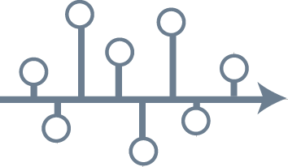
TIMELINE
Sl.NO | PROCEDURE | TIMELINE
1 | Research and Planning | 7 Days
2 | Requirement Analysis | 5 Days
3 | Design and Development | 30 Days
4 | Testing and Quality Assurance | 15 Days
5 | Deployment and Implementation | 10 Days
6 | Evaluation and Feedback | Ongoing

Slide 6

LITERATURE SURVEY
SL.NO | PAPER NAME | YEAR OF PUBLISHED | COUNTRY | PUBLISHER NAME | DOI NUMBER | KEYWORDS | OUR IDEA ABOUT THE PAPER
1 | A Survey of Blockchain based payment system. | 2018 | Switzerland | IEEE transactions on dependable & secure computing. | 10.1109/TDSC.2017.2789642 | Blockchain, Payment systems, Cryptocurrency. | To identify potential applications in EOD payments.
2 | Exploring scalability challenges | 2019 | Italy | IEEE Access | 10.1109/ACCESS.2019.2904055 | Scalability, Blockchain, Payment Systems. | Propose sol^ to enhance scalability.
3 | Towards a practical EOD payment using Cryptocurrencies. | 2018 | Germany | IEEE transactions on computer | 10.1109/TC.2017.2785847 | EOD payments, Cryptocurrencies, Feasibility. | Considering factors such as transaction throughput & latency.

Slide 7

LITERATURE SURVEY
4 | Design & implementation of a Cryptocurrency based on EOD payment system for financial; institutions. | 2020 | Germany | International conference on financial Cryptography & Data Security. | 101.1007/978-3-030-48757-3_1 | Cryptocurrency, financial institutions, Design & implementation. | Addressing regulatory compliance & scalability requirements.
5 | Secure & Efficient EOD payment system using Cryptocurrency & smart contracts | 2019 | Japan | IEEE Access | 10.1109/ACCESS.2019.2937694 | Smart Contracts, Cryptocurrency, Security. | Automating security settlements processes while ensuring security.
6 | Scalability of Blockchain based EOD payment systems : A performance Evaluation | 2018 | Italy | IEEE transactions on services computing | 10.1109/TSC.2017.2762887 | Scalability, Blockchain, performance Evaluation | Analyzing transaction throughput & latency.
7 | Decentralized EOD payment system using permissioned Blockchain | 2021 | Australia | ACM Transactions on internet technology | 10.1145/3439393 | Permissioned blockchain, Decentralization, payment systems | Addressing privacy & scalability concerns.

Slide 8
LITERATURE SURVEY
8 | An Empirical analysis of EOD payment systems using Cryptocurrencies | 2020 | Greece | Journal of Information Security and Applications | 10.1016/j.jisa.2019.102389 | Empirical Analysis, Cryptocurrencies, End-of-Day Payments | Settlement times, and reliability.
9 | Blockchain based EOD payment system for small & medium Enterprises | 2019 | US | International Journal of Advanced Computer Science and Applications | 10.14569/IJACSA.2019.0100596 | SMEs, Blockchain, Payment Systems | Enhancing efficiency and reducing costs.
10 | Enhancing EOD payment systems with blockchain technology | 2017 | Netherlands | International Conference on Financial Cryptography and Data Security | 10.1007/978-3-319-70278-0_9 | Blockchain, Payment Systems, Enhancement | Improving transparency, security, and efficiency.

Slide 9

REQUIREMENTS
Software Requirements:
Blockchain platform (e.g., Ethereum, Hyperledger)
Cryptocurrency wallet integration(Metamask)
User interface for students and administration
Transaction monitoring and reporting functionalities

Slide 10
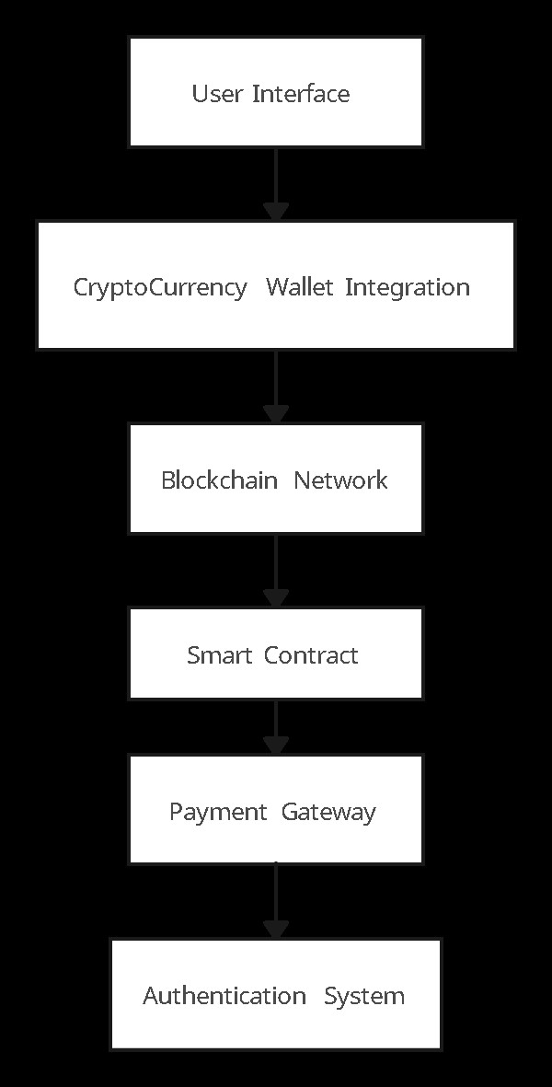

BLOCK DIAGRAM
→
→
→
→
→

Slide 11
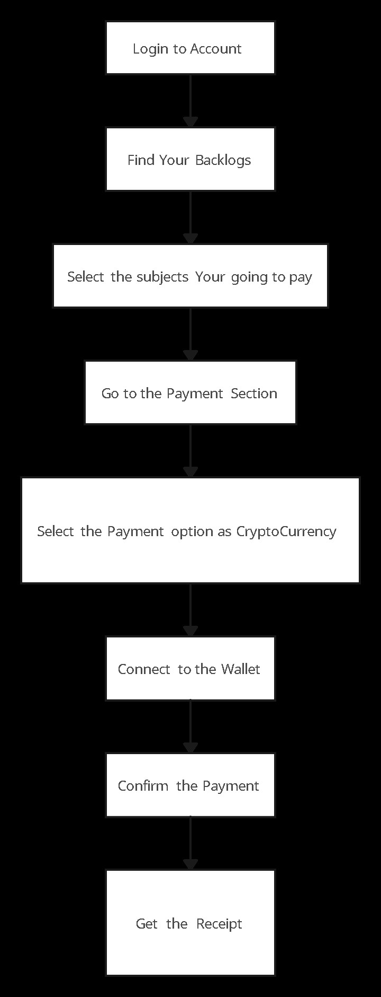
FLOW CHART
→
→
→
→
→
→
→

Slide 12
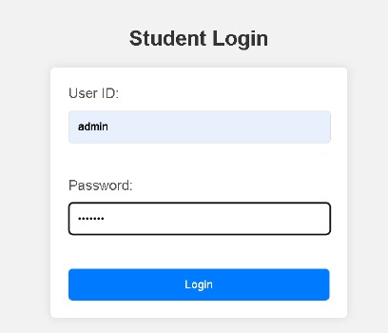
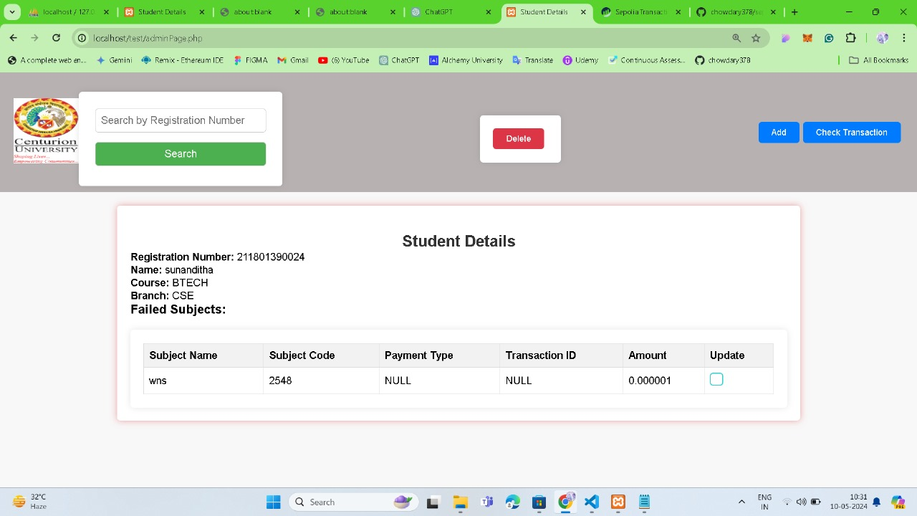
OUTPUT

Slide 13

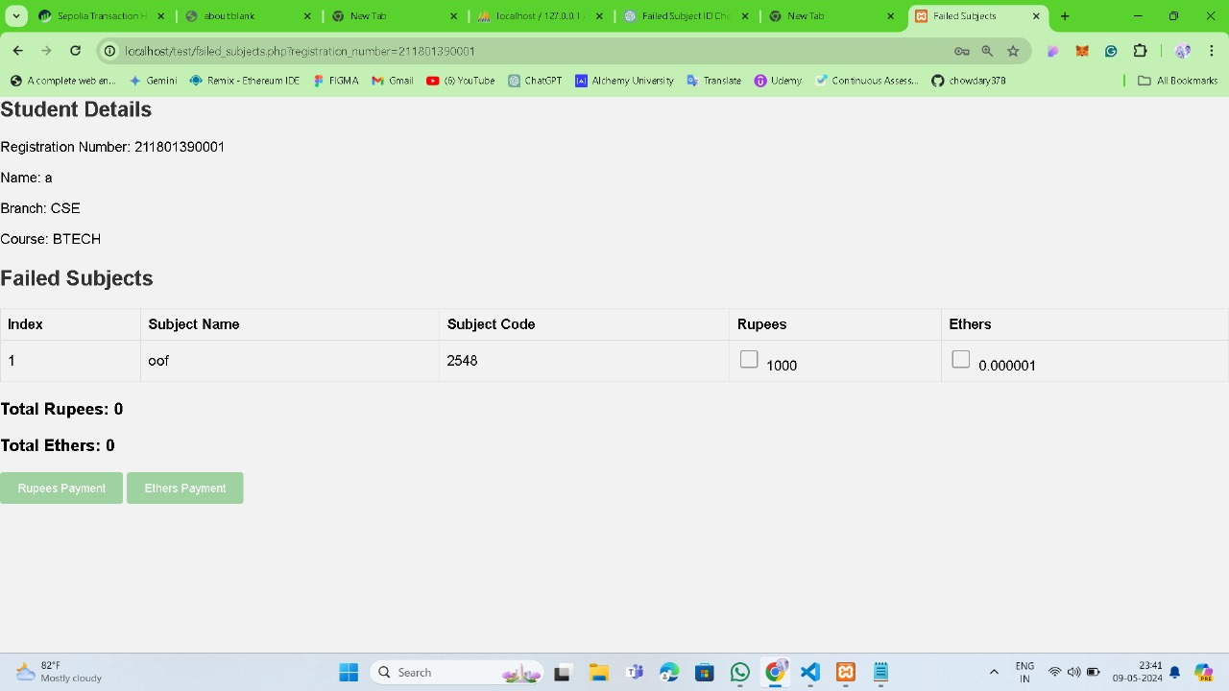
OUTPUT

Slide 14
CONCLUSION
Examinations are a critical component of the academic journey, and the ability to schedule them as per one's convenience can greatly enhance the learning experience.
The "Exam on Demand" system, while novel in its approach by integrating cryptocurrency, recognizes the unique challenges faced by students in today's fast-paced academic environments.
By offering a system that aligns with modern technological advancements and financial trends, it empowers students to take control of their assessment timelines.

Slide 15


