Slide 1

ST.JOSEPH’S INSTITUTE OF TECHNOLOGY
TEAM NAME: NEXUS
TEAM MEMBERS:
ABDUL HAMID
ASHOKMITHRA A
AKASH R
GANESH S
ABDUL ATHIF A
STATE:TAMIL NADU

Slide 2

INTRODUCTION
ABDUL HAMID : BACKEND-DEVELOPER
ASHOKMITRA : BACKEND-DEVELOPER
ABDUL ATHIF : PRESENTER
AKASH : FRONTEND-WEB DESIGNER
GANESH : FRONTEND-WEB DESIGNER

Slide 3
PROBLEM STATEMENT
A WEB PORTAL IN WHICH TEACHER CAN UPLOAD THE STUDY MATERIAL AND RESOURCES IN AN ORGANIZED MANNER. STUDENTS CAN ACCESS THE SAME.
TEACHERS ARE THE FACULTY SHOULD BE ABLE TO UPLOAD MATERIALS ON THE SUBJECT IN AN ORGANIZED MANNER . STUDENTS SHOULD BE ABLE TO ACCESS THEM. THIS SOLVES THE ISSUE OF FILE UNAVAILABILTY IN WHATSAPP GROUPS AND POOR ORGANIZATION IN GOOGLE CLASSROOM

Slide 4
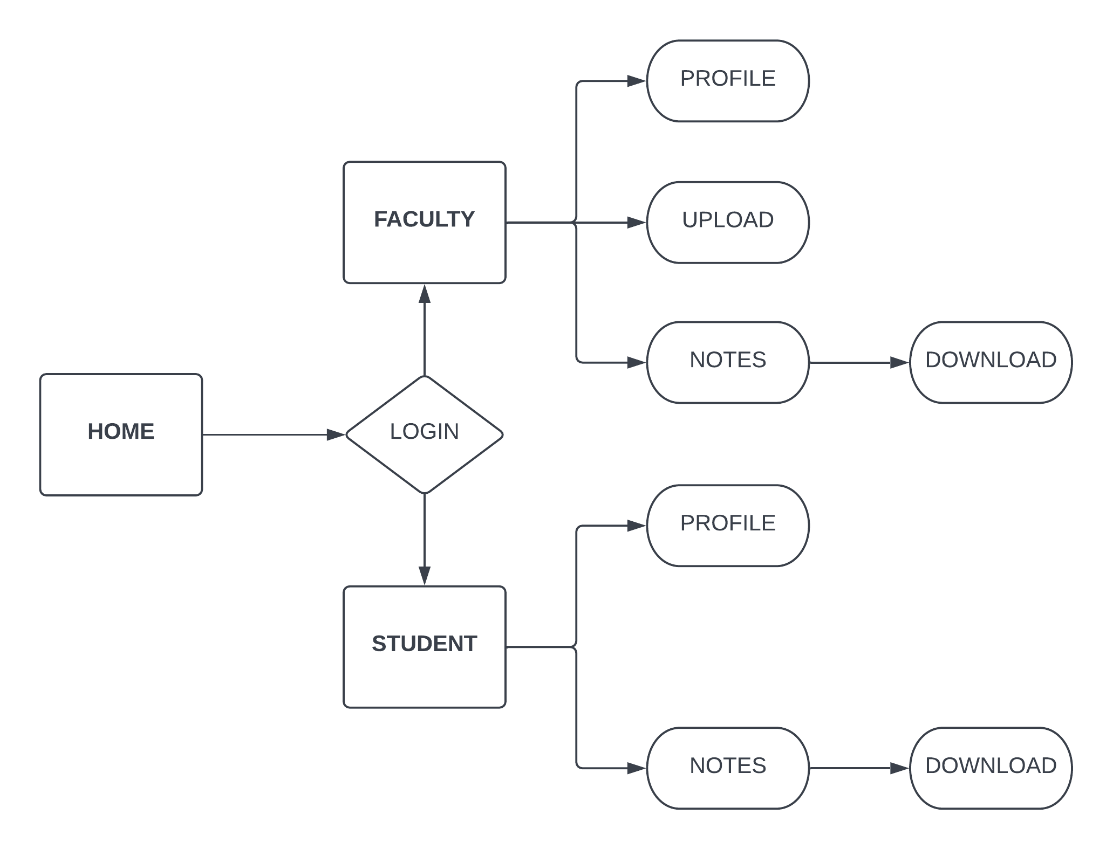
SEQUENCE DIAGRAM

Slide 5

FEATURES
CHATBOX FOR ACCESSING NOTES
EMAIL NOTIFICATION
TIMING TASK(ORGANISED MANNER )
UPLOADING AND DOWNLOADING NOTES
EVENT POSTING BY FACULTY

Slide 6



TECH STACK
HYPERTEXT MARKUP LANGUAGE (HTML)
CASCADING STYLE SHEETS(CSS)
JAVASCRIPT
PYTHON
DJANGO DATABASE
JAVASCRIPT OBJECT NOTATION(JSON) API

