Slide 1
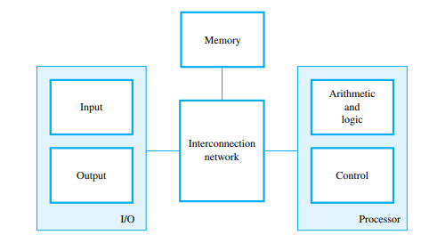
UNIT I BASIC STRUCTURE OF A COMPUTER SYSTEM
FUNCTIONAL UNITS
A computer consists of five functionally independent main parts: input, memory, arithmetic and logic, output, and control units.
The input unit accepts coded information from human operators using devices such as keyboards, or from other computers over digital communication lines.
The information received is stored in the computer’s memory, either for later use or to be processed immediately by the arithmetic and logic unit

Slide 2
Finally, the results are sent back to the outside world through the output unit. All of these actions are coordinated by the control unit.
An interconnection network provides the means for the functional units to exchange information and coordinate their actions.
Input and output equipment is often collectively referred to as the input-output (I/O) unit.
Information Handled by a Computer
Instructions/machine instructions
Govern the transfer of information within a computer as well as between the computer and its I/O devices
Specify the arithmetic and logic operations to be performed
Program

Slide 3
Data
Used as operands by the instructions
Source program
Encoded in binary code 0 and 1
1.Input Unit
Computers accept coded information through input units.
The most common input device is the keyboard.
Whenever a key is pressed, the corresponding letter or digit is automatically translated into its corresponding binary code and transmitted to the processor.
Many other kinds of input devices are touchpad, mouse, joystick, and trackball.

Slide 4
2.Memory Unit
There are two classes of storage, called primary and secondary.
Primary Memory
Primary memory, also called main memory, is a fast memory that operates at electronic speeds. Programs must be stored in this memory while they are being executed.
The memory consists of a large number of semiconductor storage cells, each capable of storing one bit of information
Semiconductor storage Cells are handled in groups of fixed size called words.
The number of bits in each word is referred to as the word length of the computer, typically 16, 32, or 64 bits.

Slide 5
Address is associated with each word location. Addresses are consecutive numbers, starting from 0, that identify successive locations.
Instructions and data can be written into or read from the memory under the control of the processor.
A memory in which any location can be accessed in a short and fixed amount of time after specifying its address is called a random-access memory (RAM).
The time required to access one word is called the memory access time.
Cache Memory
A smaller, faster RAM unit, called a cache, is used to hold sections of a program that are currently being executed, along with any associated data.
The cache is tightly coupled with the processor and is usually contained on the same integrated-circuit chip. The purpose of the cache is to facilitate high instruction execution rates.

Slide 6
At the start of program execution, the cache is empty.
All program instructions and data are stored in the main memory.
As execution proceeds, instructions are fetched into the processor chip, and a copy of each is placed in the cache.
When the execution begins , the data are fetched and copies are also placed in the cache.
Secondary Storage
Less expensive and permanent memory used to store large amount of data.
Access times for secondary storage are longer than for primary memory. Examples magnetic disks, optical disks (DVD and CD), and flash memory devices.

Slide 7
3.Arithmetic and Logic Unit
Most computer operations are executed in the arithmetic and logic unit (ALU) of the processor.
Any arithmetic or logic operation, such as addition, subtraction, multiplication, division, or comparison of numbers, is initiated by bringing the required operands into the processor, where the operation is performed by the ALU.
When operands are brought into the processor, they are stored in high-speed storage elements called registers.
Each register can store one word of data.

Slide 8
4.Output Unit
The output unit is the counterpart of the input unit.
Its function is to send processed results to the outside world. Example: printer.
Some units, such as graphic displays, provide both an output function, showing text and graphics, and an input function, through touchscreen capability.
5.Control Unit
All computer operations are controlled by the control unit.
The timing signals that govern the I/O transfers are also generated by the control unit.
Control unit is usually distributed throughout the machine instead of standing alone.

Slide 9
Operations of a computer:
Accept information in the form of programs and data through an input unit and store it in the memory
Fetch the information stored in the memory, under program control, into an ALU, where the information is processed
Output the processed information through an output unit
Control all activities inside the machine through a control unit

Slide 10
II. Basic Operational Concepts
Activity in a computer is governed by instructions.
To perform a task, an appropriate program consisting of a list of instructions is stored in the memory.
Individual instructions are brought from the memory into the processor, which executes the specified operations.
Data to be used as operands are also stored in the memory.
A Typical Instruction Add LOCA, R0
Add the operand at memory location LOCA to the operand in a register R0 in the processor.
Place the sum into register R0.

Slide 11
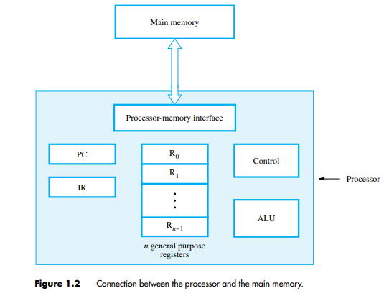
The original contents of LOCA are preserved.
The original contents of R0 is overwritten.
Instruction is fetched from the memory into the processor – the operand at LOCA is fetched and added to the contents of R0 – the resulting sum is stored in register R0.
Connection Between the Processor and the Memory
Registers
Instruction register (IR)
Program counter (PC)
General-purpose register (R₀ – R_{n-1})
Memory address register (MAR)
Memory data register (MDR)

Slide 12
Typical Operating Steps
Programs reside in the memory through input devices
PC is set to point to the first instruction
The contents of PC are transferred to MAR
A Read signal is sent to the memory
The first instruction is read out and loaded into MDR
The contents of MDR are transferred to IR
Decode and execute the instruction

Slide 13
Get operands for ALU
General-purpose register
Memory (address to MAR – Read – MDR to ALU)
Perform operation in ALU
Store the result back
To general-purpose register
To memory (address to MAR, result to MDR – Write)
During the execution, PC is incremented to the next instruction

Slide 14
Interrupt
Normal execution of programs may be preempted if some device requires urgent servicing.
The normal execution of the current program must be interrupted – the device raises an interrupt signal.
Interrupt-service routine
Current system information backup and restore (PC, general-purpose registers, control information, specific information)

Slide 15
III.Performance
The most important measure of a computer is how quickly it can execute programs.
Three factors affect performance:
Hardware design
Instruction set
Compiler
Processor time to execute a program depends on the hardware involved in the execution of individual machine instructions.
1.Technology
The technology of Very Large Scale Integration (VLSI) that is used to fabricate the electronic circuits for a processor on a single chip is a critical factor in the speed of execution of machine instructions

Slide 16
The speed of switching between the 0 and 1 states in logic circuits is largely determined by the size of the transistors that implement the circuits.
Smaller transistors switch faster.
This has two advantages: instructions can be executed faster, and more transistors can be placed on a chip, leading to more logic functionality and more memory storage capacity.
2.Parallelism
Performance can be increased by performing a number of operations in parallel. Parallelism can be implemented on many different levels.
Instruction-level Parallelism
The simplest way to execute a sequence of instructions in a processor is to complete all steps of the current instruction before starting the steps of the next instruction

Slide 17
If we overlap the execution of the steps of successive instructions, total execution time will be reduced.
For example, the next instruction could be fetched from memory at the same time that an arithmetic operation is being performed on the register operands of the current instruction.
This form of parallelism is called pipelining.
3. Multicore Processors
Multiple processing units can be fabricated on a single chip. In technical literature, the term core is used for each of these processors.
The term processor is then used for the complete chip. Hence, we have the terminology dual-core, quad-core, and octo-core processors for chips that have two, four, and eight cores, respectively.

Slide 18
4.Multiprocessors
Computer systems may contain many processors, each possibly containing multiple cores. Such systems are called multiprocessors.
These systems either execute a number of different application tasks in parallel.
All processors usually have access to all of the memory called shared-memory multiprocessor.
The computers normally have access only to their own memory units.
When the tasks they are executing need to share data, they do so by exchanging messages over a communication network.

Slide 19
Performance:
Response time or execution time: The total time required for the computer to complete a task, including disk accesses, memory accesses, I/O activities, operating system overhead, CPU execution time, and so on.
Throughput: The total amount of work done in a given time.
Bandwidth: The amount of data that can be carried from one point to another in a given time period (usually a second). This kind of bandwidth is usually expressed in bits (of data) per second (bps). Occasionally, it's expressed as bytes per second (Bps).
Clock Cycles per Instruction (CPI): Average number of clock cycles per instruction for a program or program fragment.

Slide 21
We can relate performance and execution time for a computer X:

Slide 23
Measuring Performance :
clock cycle: Also called tick, clock tick, clock period, clock, or cycle. The time for one clock period, usually of the processor clock, which runs at a constant rate.
clock period : The length of each clock cycle.

Slide 24
Example:
Example:
Instruction

Slide 26
Instruction Performance:
Clock cycles per instruction (CPI): Average number of clock cycles per Instruction for a program or program fragment.

Slide 27
Example:
Suppose we have two implementations of the same instruction set architecture. Computer A has a clock cycle time of 250 ps and a CPI of 2.0 for some program, and computer B has a clock cycle time of 500 ps and a CPI of 1.2 for the same program. Which computer is faster for this program and by how much?

Slide 28
The Classic CPU Performance Equation.

Slide 29
Example:

Slide 30
solution

Slide 31
The basic Components of Performance and how each is Measured.

Slide 32
Example 1:
Consider a computer with three instruction classes and CPI measurements are given below and instruction counts for each instruction class for the same program from two different compilers are given.
Which code sequence executes the more number of instructions?
Which code sequence will be faster?
What is the CPI for each sequence?
Code Sequence | instruction counts for each instruction class
 | A | B | C
1 | 2 | 1 | 2
2 | 4 | 1 | 1
 | CPI for each Instruction class
CPI | A | B | C
 | 1 | 2 | 3

Slide 33
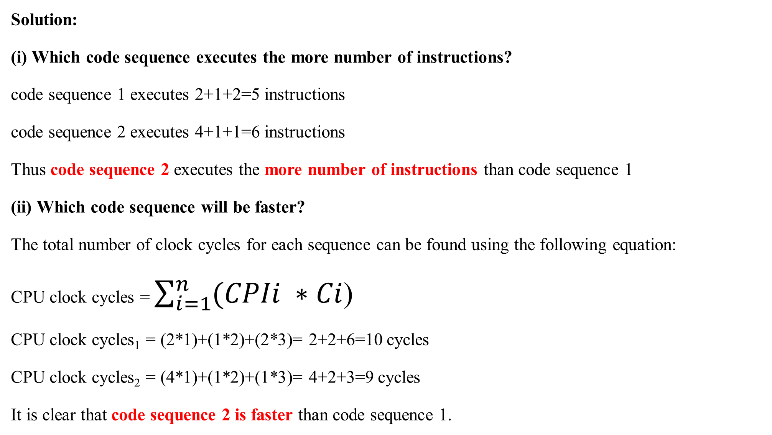
Solution:
(i) Which code sequence executes the more number of instructions?
code sequence 1 executes 2+1+2=5 instructions
code sequence 2 executes 4+1+1=6 instructions
Thus code sequence 2 executes the more number of instructions than code sequence 1
(ii) Which code sequence will be faster?
The total number of clock cycles for each sequence can be found using the following equation:
CPU clock cycles = $\sum_{i=1}^{n}{(CPIi ∗Ci}$)
CPU clock cycles₁ = (2*1)+(1*2)+(2*3)= 2+2+6=10 cycles
CPU clock cycles₂ = (4*1)+(1*2)+(1*3)= 4+2+3=9 cycles
It is clear that code sequence 2 is faster than code sequence 1.

Slide 34
(iii) What is the CPI for each sequence?
The CPI values can be computer by,
CPI = CPU clock cycles / Instruction count.
CPI₁ = CPU clock cycles1 / Instruction count₁ = 10/5 =2.0
CPI₂ = CPU clock cycles2 / Instruction count₂ = 9/6 =1.5

Slide 35
Example 2:
Consider three different processors P1,P2, and P3 executing the same instruction set. P1 has a 3 GHz clock rate and a CPI of 1.5 P2 has a 2.5GHz clock rate and a CPI of 1.0. P3 has a 4.0 GHz clock rate and has a CPI of 2.2
Which processor has the highest performance expressed in instructions per second?
If the processors each execute a program in 10 seconds, find the number of cycles and the number of instructions.
Solution:
(i) Which processor has the highest performance expressed in instructions per second?
CPU execution time can be calculated using this formula:

Slide 36
CPU time = Instruction count * CPI / Clock rate
Let the instruction count be ‘n’ and assume its same for all the 3 processors. Now calculate the CPU time for each processor.
CPU time _{p1} = n* 1.5/ 3*10⁹ = n*0.5*10⁻⁹ sec
CPU time _{p2} = n* 1.0/ 2.5*10⁹ = n*0.4*10⁻⁹ sec
CPU time _{p3} = n* 2.2/ 4*10⁹ = n*0.55*10⁻⁹ sec
CPU time for processor P2 is smallest than other processor. Hence, P2 produces highest performance than other processors.

Slide 37
(ii) If the processors each execute a program in 10 seconds, find the number of cycles and the number of instructions.
Number of clock cycles
CPU time for P1,P2,P3 = 10 sec.
The formula to find the CPU time can be rewritten to find the number of clock cycles.
CPU time = CPU clock cycles / Clock rate
CPU clock cycles = CPU time * Clock rate
CPU clock cycles _{p1} = 10sec * 3*10⁹ Hz= 30*10⁻⁹ sec
CPU clock cycles _{p2} = 10sec * 2.5*10⁹ = 25*10⁻⁹ sec
CPU clock cycles _{p3} = 10sec * 4*10⁹ = 40*10⁻⁹ sec

Slide 38
(b) Instruction count:
The formula to find the CPU clock cycles can be rewritten to find the Instruction count.
CPU clock cycles = Instruction count * CPI
Instruction count = CPU clock cycles / CPI
Instruction count _{p1} = 30*10⁻⁹ /1.5 = 20 * 10⁹ instructions
Instruction count _{p2} = 25*10⁻⁹ /1.0 = 25 * 10⁹ instructions.
Instruction count _{p3} = 40*10⁻⁹ /2.2 = 18.18 * 10⁹ instructions.

Slide 39
IV. Instructions: Language of the computer-operations and operands
The words of a computer’s language are called instructions, and its vocabulary is called an instruction set.
Instructions are kept in the computer as a series of high and low electronic signals and may be represented as numbers.
Each piece of an instruction can be considered as an individual number, and placing these numbers side by side forms the instruction.
Since registers are referred to by almost all instructions, there must be a convention to map register names into numbers.
In MIPS(Million Instruction Per Second) assembly language, registers $s0 to $s7 map onto registers 16 to 23, and registers $t0 to $t7 map onto registers 8 to 15.
Hence, $s0 means register 16, $s1 means register 17, $s2 means register 18,…, $t0 means register 8, $t1 means register 9, and so on.

Slide 40
This instruction can also be represented as fields of binary numbers as opposed to decimal:
This layout of the instruction is called the instruction format.
Counting the number of bits, this MIPS instruction takes exactly 32 bits—the same size as a data word.

Slide 41
V . Instruction format
A form of representation of an instruction composed of fields of binary numbers.

Slide 42
MIPS INSTRUCTION SET

Slide 43
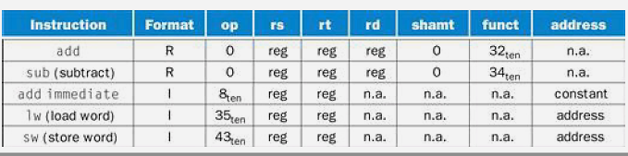
In the table above, ―reg means a register number between 0 and 31, ―address‖ means a
16-bit address, and ―n.a. (not applicable) means this field does not appear in this format. Note that add and sub instructions have the same value in the op field

Slide 44
Translating a MIPS Assembly Instruction into a Machine Instruction(R Type)
The real MIPS language version of the instruction represented symbolically as
add $t0,$s1,$s2
First as a combination of decimal numbers and then of binary numbers.
The decimal representation is:
Each of these segments of an instruction is called a field.
The first and last fields (containing 0 and 32 in this case) in combination tell the MIPS
computer that this instruction performs addition.
The second field gives the number of the register that is the first source operand of the addition operation (17=$s1), and
The third field gives the other source operand for the addition (18=$s2).
The fourth field contains the number of the register that is to receive the sum (8=$t0).
The fifth field is unused in this instruction, so it is set to 0. Thus, this instruction adds register $s1 to register $s2 and places the sum in register $t0.

Slide 45
Example
I TYPE (Immediate)
The 16 bit address means a load word instruction can load any word within a region of 2¹³ of the address in the base register rs.
Similarly, add immediate is limited to constants no longer 2¹⁵.
Example:
Lw $t0, 32($s3)
Here, 35 is placed in op field for lw instruction,
19 (for $s3) is placed in the rs field,
8 (for $t0) is placed in rt fiels, and
32 is placed in the address field.
Op | Rs | Rt | Constant or Address
6 bits | 5 bits | 5 bits | 16 bits
Op | Rs | Rt | Constant or Address
35 | 19 | 8 | 32

Slide 46
J TYPE (Addressing)
The MIPS jump instructions have the simplest addressing. In J-type, 6 bits are used for the operation field and the rest of the bits for the address field.
Example:
J 10000 # go to location 10000
Here, 2 is placed in the OP field to represent jump instruction and 10000 is placed in address field,
Op | Address
6 bits | 26 bits
Op | Address
2 | 10000

Slide 50
Example 1:
Write down the MIPS equivalent for the following C statements.
a= b + c
d= a – c
Solution:
Hence MIPS assembly language instruction for the following C statements. a= b + c, d= a – c; are
add a, b, c
sub d, a, c

Slide 51
Example 2:
The variables f, g, h, i and j are assigned to the registers $s0, $s1, $s2, $s3, $s4 respectively. What is the compiled MIPS code for the following statement?
f = (g+h) – (i+j);
Solution:
Temporary registers $t0 and $t1 are used to store partial result. Thus the final code will be,
add $t0,$s1,$s2 #register $t0 contains g+h
add $t1, $s3,$s4 #register $t1 contains i+j
sub $s0,$t0,$t1 # f gets St0-$t1, which is (g+h)-(i+j)

Slide 52
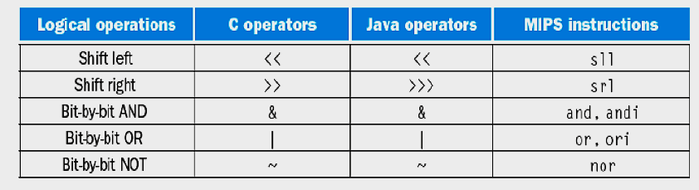

VI. Logical Operations
SHIFT

Slide 53
shamt: how many positions to shift
Shift left logical
Shift left and fill with 0 bits
Sll (Shift Left) by i bits multiplies by 2^{i}
Shift right logical
Shift right and fill with 0 bits
Srl(shift right) by i bits divides by 2^{i} (unsigned only)

Slide 54
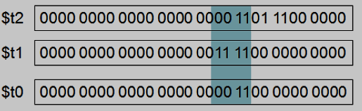
AND
Useful to mask bits in a word
Select some bits, clear others to 0
and $t0, $t1, $t2

Slide 55
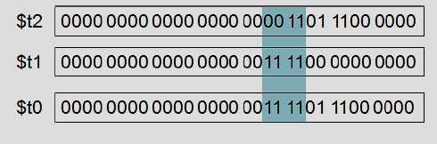
OR
Used to include bit in a word
Set some bits to 1, leave others unchanged
or $t0, $t1, $t2

Slide 56
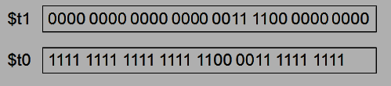
NOT
Useful to invert bits in a word
Change 0 to 1, and 1 to 0

Slide 57
VII. Decision Making
Instructions for making decisions:
Based on the input data and the values created during computation, different instructions execute.
Decision making is commonly represented in programming languages using the if statement, sometimes combined with go to statements and labels.
MIPS assembly language includes two decision-making instructions, similar to an if statement with a go to.
The first instruction is
beq register1, register2, L1
This instruction means go to the statement labeled L1 if the value in register1 equals the value in register2. The mnemonic beq stands for branch if equal.

Slide 58
The second instruction is
bne register1, register2, L1
It means go to the statement labeled L1 if the value in register1 does not equal the value in register2.
The mnemonic bne stands for branch if not equal. These two instructions are traditionally called conditional branches.
Example:
Compiling IF statements:

Slide 60
VIII.Addressing Modes
The method used to identify the location of an operand.
The following are the 5 types of MIPS Addressing Modes.
1. Immediate addressing mode, where the operand is a constant within the instruction itself.
2. Register addressing mode, where the operand is a register.
3. Base or displacement addressing mode, where the operand is at the memory location whose address is the sum of a register and a constant in the instruction.
4. PC-relative addressing mode, where the branch address is the sum of the PC and a constant in the instruction.
5. Pseudo direct addressing mode, where the jump address is the 26 bits of the instruction
concatenated with the upper Four bits of the PC.

Slide 61
1. Immediate addressing mode: The operand is a constant within the instruction itself. i.e. The operand is specified in the instruction itself.
Example: MOVE# 200,R0
The sharp sign(#) is placed in front of the value to indicate that this value is to be used as an immediate operand
Advantage:
No memory fetch operation is needed.
Applications:
It’s used to handle constant values.
It’s used to test bit pattern.
It’s used to increment a counter.

Slide 62
2. Register addressing Mode: The operand is in a CPU register. The name or address of the register is specified in the instruction.
Example: Move R1,R2.
Advantages:
Registers are faster than memory. Hence operands can be accessed faster.
It requires only few bits to access the register contents.

Slide 63
3. Base or displacement addressing Mode: The operand is at the memory location whose address is the sum of a register and a constant in the instruction.
Advantages:
It provides more flexibility in accessing operands.
This is used to implement a three – dimensional aray.

Slide 64
4.PC-Relative addressing mode: in this addressing mode, the effective address is determined by the index mode using a program counter in place of general – purpose register
The branch address is the sum of the PC and a constant in the instruction.
Application:
It’s used to access data operands.
It’s used to specify target address in branch instruction.

Slide 65
5.Pseudo-direct addressing: The jump address is the 26 bits of the instruction concatenated with the upper Four bits of the PC.

Slide 66
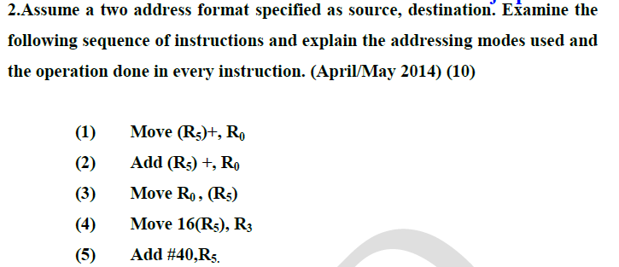
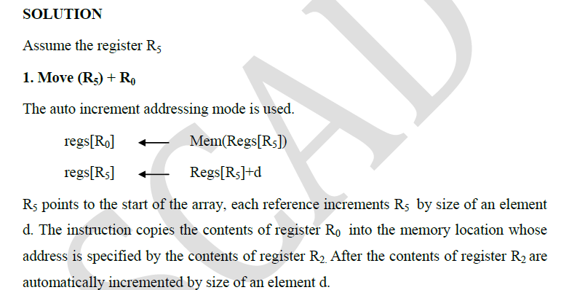

Slide 67
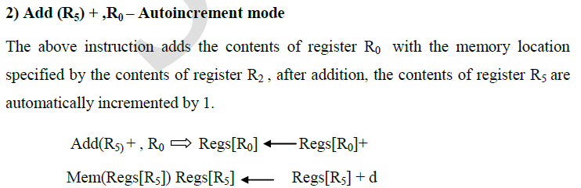
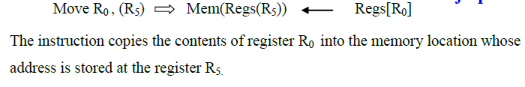

Slide 68
