Slide 1




AI-Powered Student Assistance for Technical Education
•Problem Statement Title – AI-Powered Student Assistance
•Theme –AI- Powered Student Assistance
•Team ID –ASHHAC33
•Team Name -HACKSQUAD
•Participant Names – P. Ashok , M. Ganesh , P. Naveen kumar
Sri Indu College of Engg & Tech - Cyber Club, Department of Cyber Security
Page 01

Slide 2

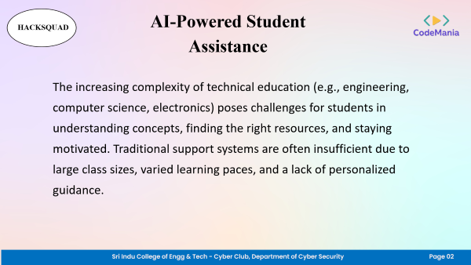
AI-Powered Student Assistance
HACKSQUAD
The increasing complexity of technical education (e.g., engineering, computer science, electronics) poses challenges for students in understanding concepts, finding the right resources, and staying motivated. Traditional support systems are often insufficient due to large class sizes, varied learning paces, and a lack of personalized guidance.
Sri Indu College of Engg & Tech - Cyber Club, Department of Cyber Security
Page 02

Slide 3
TECHNICAL APPROACH
HACKSQUAD
●Programming Languages: HTML,JAVASCRIPT,PYTHON
●Hardware: 512GB RAM,8 ROM
●Server: FLASK Server
Sri Indu College of Engg & Tech - Cyber Club, Department of Cyber Security
Page 03

Slide 4
FEASIBILITY AND VIABILITY
HACKSQUAD
•The project is feasible and viable across all key dimensions—technical, operational, economic, legal, and market.
•CHALLENGES:Accuracy of AI Responses, Integration with Existing Systems
•STRATEGIES: Improving Accuracy of AI Responses, Simplifying Integration with FLASK server
Sri Indu College of Engg & Tech - Cyber Club, Department of Cyber Security
Page 04

Slide 5
IMPACT AND BENEFITS
HACKSQUAD
• Academic Impact
● Institutional Benefits
● Student-Centric Benefits
Sri Indu College of Engg & Tech - Cyber Club, Department of Cyber Security
Page 05

Slide 6
RESEARCH AND REFERENCES
HACKSQUAD
• Academic and Industry Research
● Technologies & Platforms Referenced
Sri Indu College of Engg & Tech - Cyber Club, Department of Cyber Security
Page 06

Slide 7
HACKSQUAD
FUTURE ENHANCEMENTS
● Voice-Enabled and Multilingual Support
● Offline Mode and Low-Bandwidth Optimization
Sri Indu College of Engg & Tech - Cyber Club, Department of Cyber Security
Page 07

Slide 8
HACKSQUAD
CONCLUSION & THANK YOU
The AI-Powered Student Assistance for Technical Education project aims to revolutionize learning by providing personalized, 24/7 academic support using advanced AI technologies. It enhances student engagement, improves outcomes, and makes technical education more accessible and effective for all learners.
Sri Indu College of Engg & Tech - Cyber Club, Department of Cyber Security
Page 09

