Slide 1
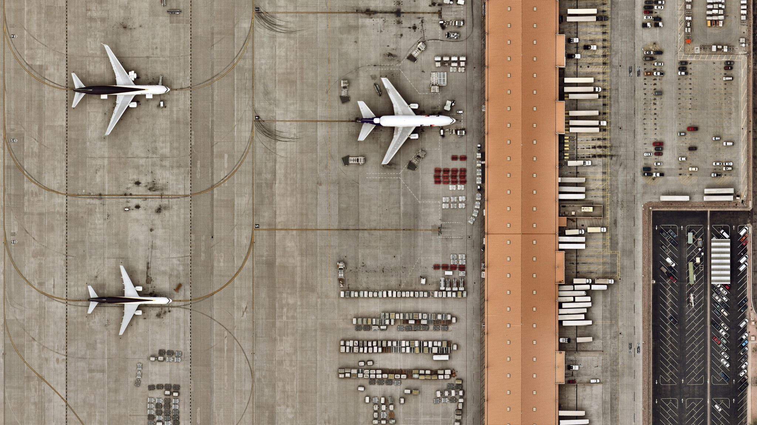
Air Cargo
Database System
Notes:
Greetings, everyone! My name is Abhijit Shine, and I’m here with my team CargoMatrix Creators – which includes Baskaran, Vineeth, Ashok and Santosh to present our project titled ‘Air Cargo Database System.’
Our project addresses the challenges in air cargo logistics by developing an efficient database system that enhances operational transparency and decision-making.

Slide 2

Presented by:
Abhijit Shine
Vineeth Kumar Baradi
Baskaran Palanisamy
Ashok Kumar Parihar
Shanmukha Santosh Reddy Kallam
Under the Guidance of:
Prof. Vijaya Sastry
Database Design
Applied Data Analytics
University of Detroit Mercy
INTRODUCTION
Notes:
Before we begin, I’d like to thank Professor Vijaya Sastry for their invaluable guidance and support throughout this project.
This project is part of our coursework in Database Design and Applied Data Analytics at the University of Detroit Mercy.
As we see in this fast-paced generation, Air cargo logistics plays a crucial role in global trade, enabling the rapid transportation of goods across the world. However, the industry faces challenges like handling large volumes of data, ensuring shipment accuracy, and maintaining transparency.
Our goal was to design a system that addresses these issues effectively, focusing on streamlining operations and improving efficiency.

Slide 3
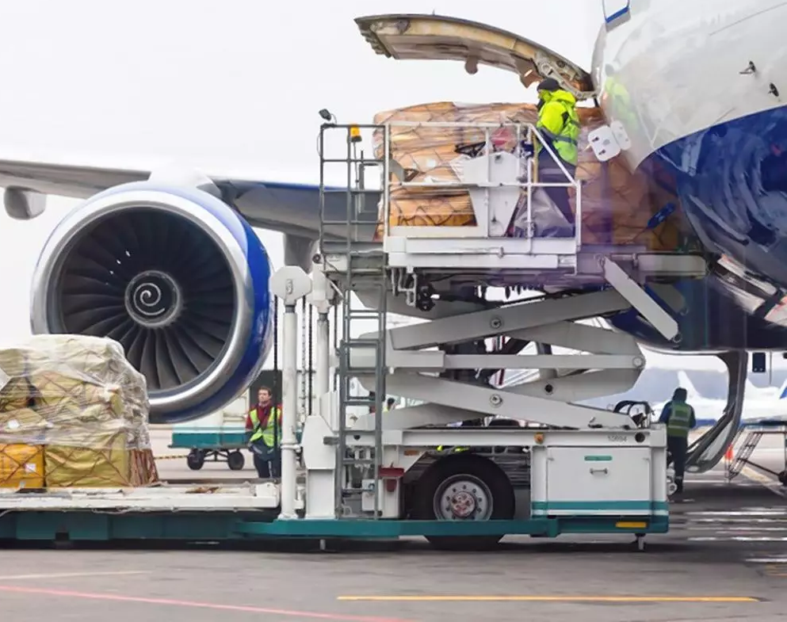
Initially framed ideas for the project:
Air Cargo Database
Crimes in the United States
Employee Performance Mapping
PROJECT IDEAS
Notes:
At the beginning of our project, we brainstormed three potential ideas: a database for air cargo logistics, a system to analyze crimes in the United States, and a framework for employee performance mapping.
While each idea was compelling, we chose air cargo logistics due to its real-world relevance and the growing need for efficient management in this industry.
We aimed to create a solution that directly impacts businesses, helping them track shipments, optimize routes, and make data-driven decisions.

Slide 4
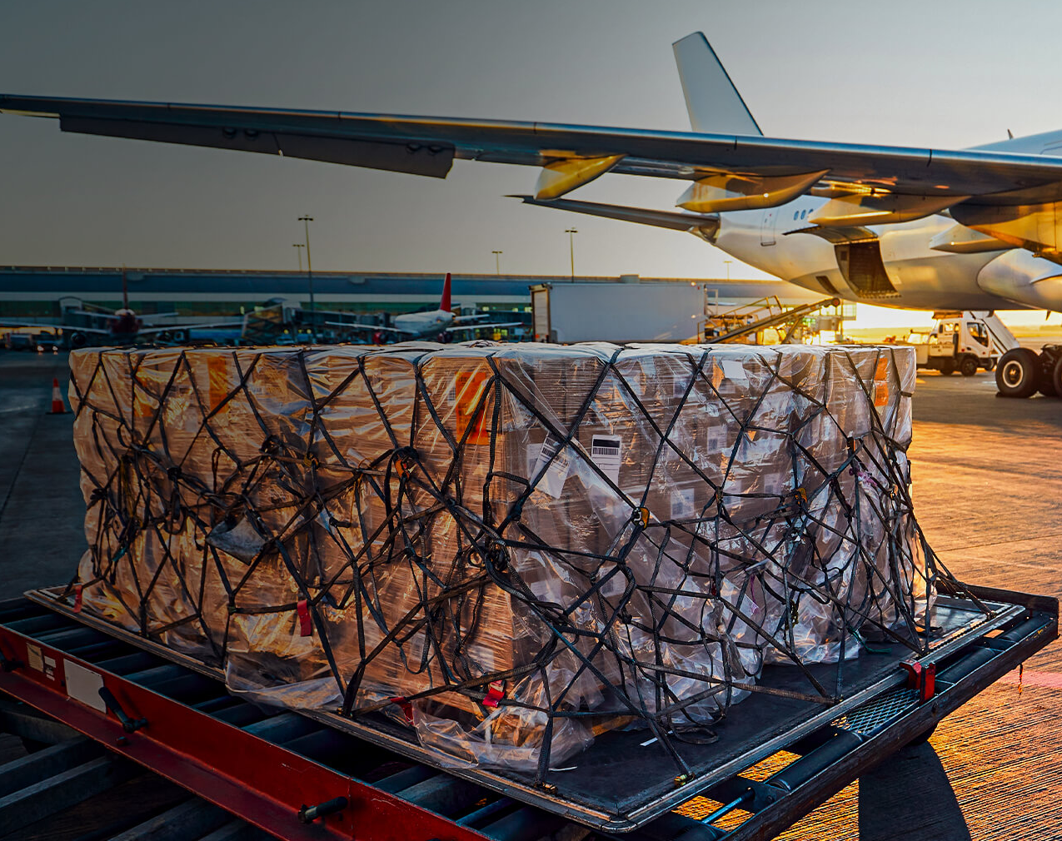

Problem Statement:
Increasing demand due to impact of e-commerce
Increasing demand for quick delivery
Lack of centralized data management.
Missing luggage
Inefficient tracking mechanisms.
Challenges in decision-making due to limited insights.
Our Approach:
$${FlyHigh }_{You Chill, We deliver… }$$
OuR PROJECT
Notes:
The air cargo industry faces several challenges, such as handling vast amounts of shipment data, maintaining operational accuracy, and providing actionable insights for strategic decision-making. These challenges often lead to inefficiencies, delays, and missed opportunities for optimization.
To address these problems, we developed our project, introducting ‘FlyHigh’ This system is designed to organize data efficiently using relational database principles and normalization techniques.
And as our tagline suggests - “You Chill, We Deliver….”, Our solution enables streamlined shipment tracking, provides insightful reports, and helps stakeholders make data-driven decisions to improve overall operational efficiency.

Slide 5

Design a normalized relational database.
Enable efficient tracking of shipments.
Provide insightful reports for strategic decisions.
OUR GOALS
Notes:
To meet the needs of air cargo businesses, we focused on three primary goals: identifying the key entities, optimizing data relationships, and ensuring scalability.
We structured the database around entities such as Customers, Cargo, Shipments, and Carriers, which represent the core aspects of logistics operations.
By optimizing data relationships, we minimized redundancy and ensured faster access to critical information. Additionally, we designed the system to scale seamlessly, making it adaptable for businesses as they grow globally.

Slide 6

Scope: To analyze air cargo shipments, including flight details, cargo weight, type of goods, and delivery status. The goal is to improve logistics and ensure timely delivery.
Resources Needed: Flight schedules, cargo details, destination data, shipment status, and customer information.
SCOPE OF THE PROJECT

Slide 7

Our design methodology involved: 1. Identifying entities and attributes based on domain requirements. 2. Establishing relationships between entities, such as Customers linked to their respective Cargo and Shipments. 3. Defining constraints like Primary and Foreign Keys to maintain data integrity.
DATABASE DESIGN METHODOLOGY

Slide 8
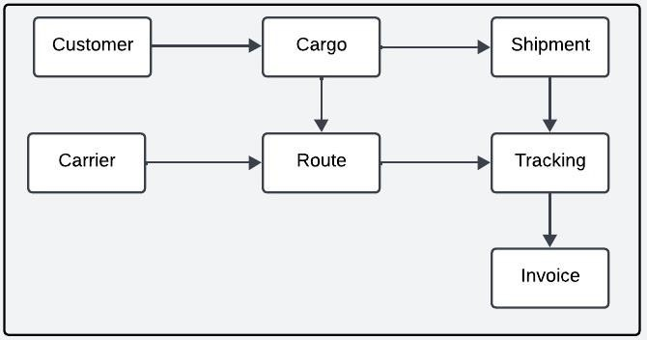
Customer data flows into cargo to capture shipment details.
Cargo is processed for shipment through a carrier along with specific route.
Real-time tracking updates shipment progress.
Invoice generated for the customer once the shipment is complete.
INFORMATION FLOWCHART

Slide 9
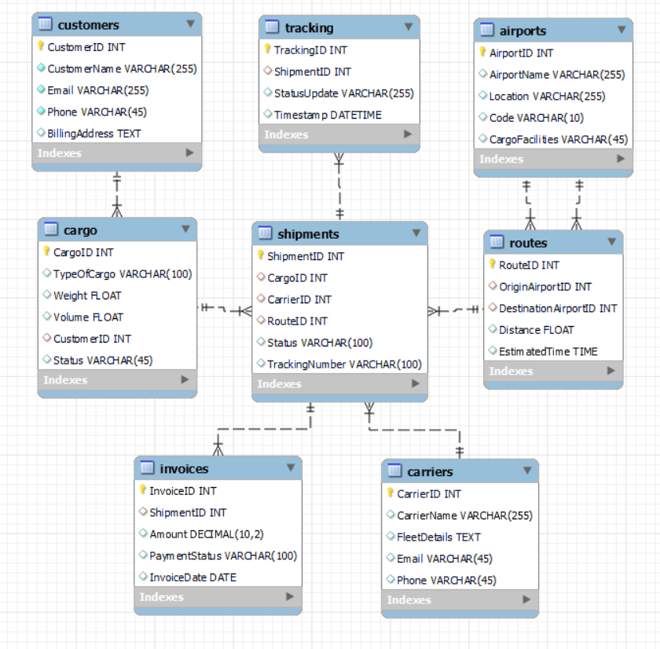
ER DIAGRAM

Slide 10
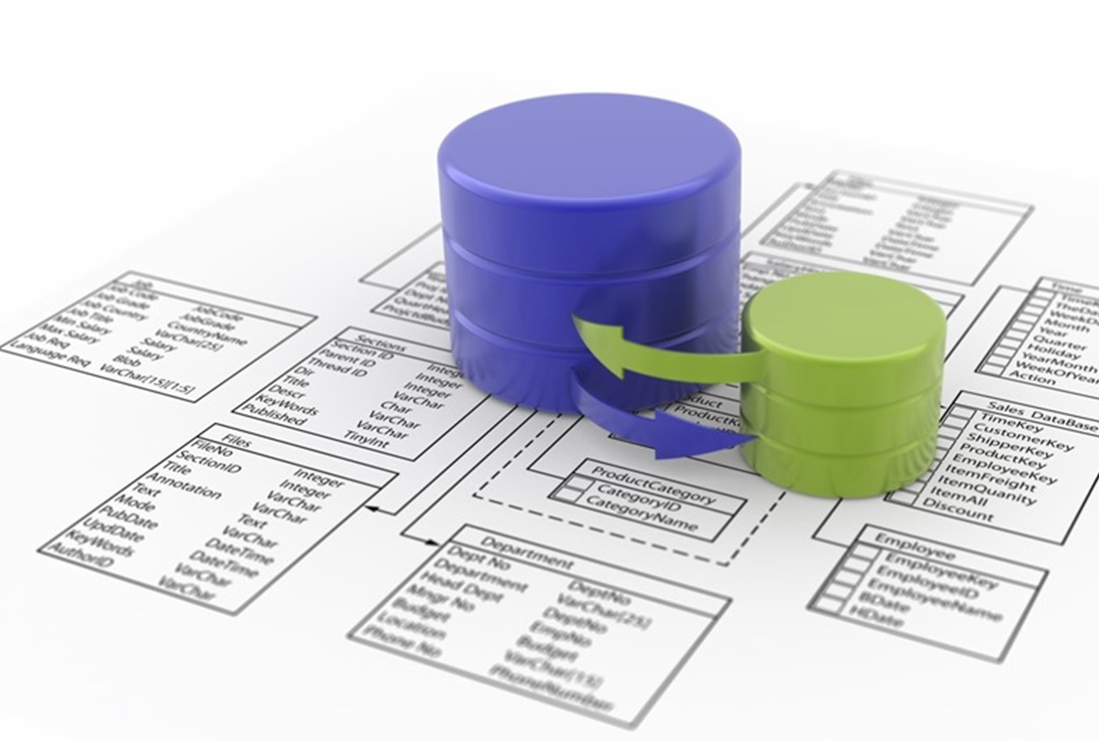
First Normal Form (1NF):
Objective: Ensure atomicity by eliminating repeating groups and having each field contain a single value.
Application: Separate Contact Info in Customers and Carriers into individual fields for Email and Phone.
NORMALIZATION

Slide 11
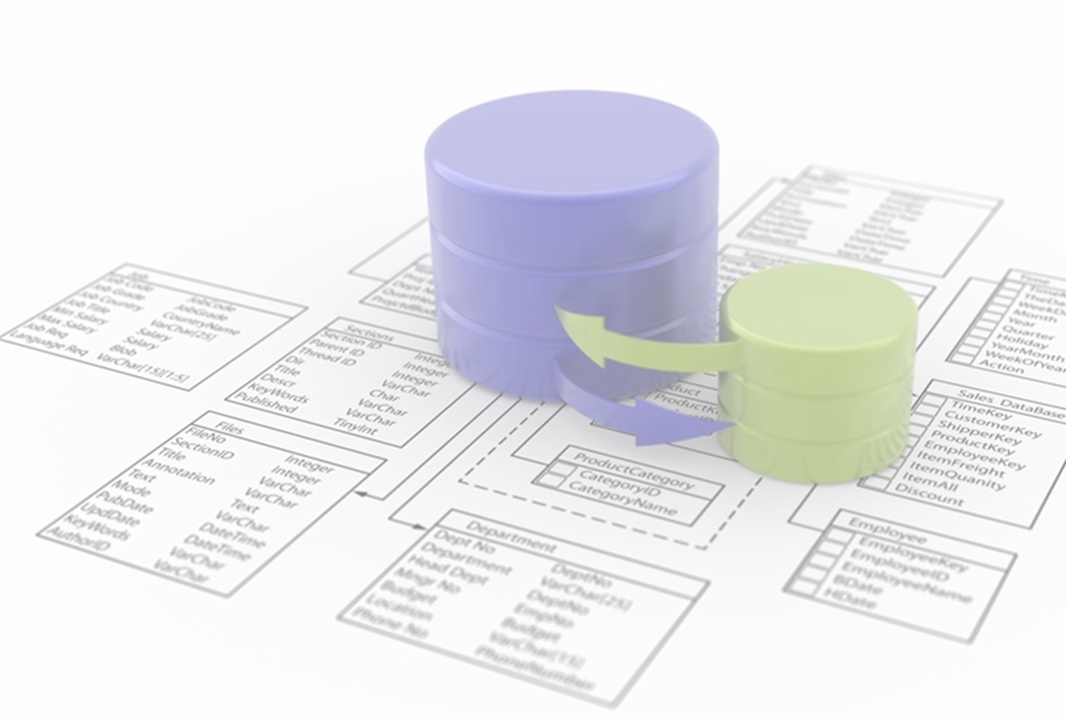
Second Normal Form (2NF): ​
Objective: Eliminate partial dependencies, where fields should depend on the whole primary key.
Application: All tables are already in 2NF because they have single-column primary keys or composite keys without partial dependencies.
NORMALIZATION

Slide 12
Third Normal Form (3NF): ​
Objective: Eliminate transitive dependencies, where non-primary attributes depend on the primary key directly. ​
Application: We removed any non-primary dependencies. For example, Invoices now only stores essential financial details relevant to Shipments and avoids data like Customer Name, which would be redundant. And Separate out Location in Airports to maintain unique data attributes and ensure that attributes in each table are directly related to the primary key.
NORMALIZATION

Slide 13
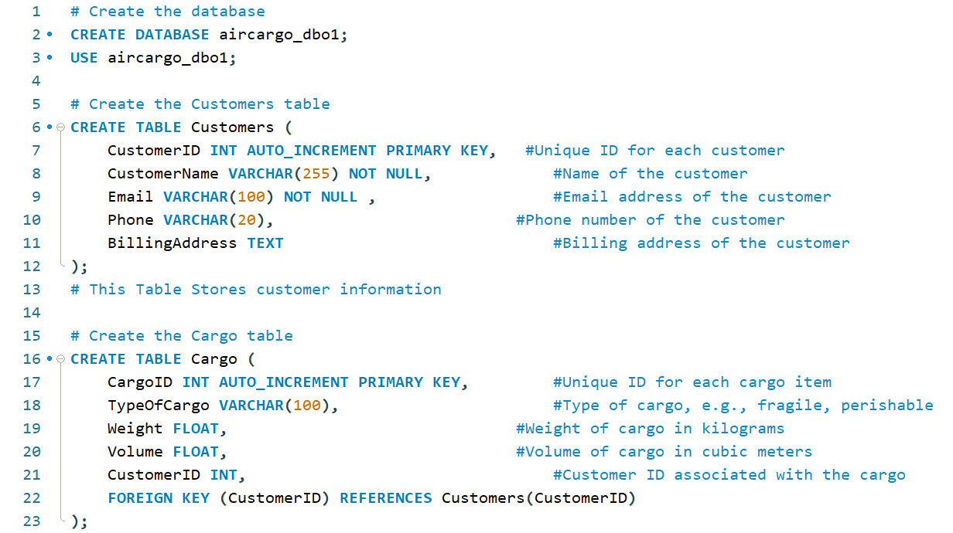
A snippet of database and Table creation in MySQL Workbench

Slide 14
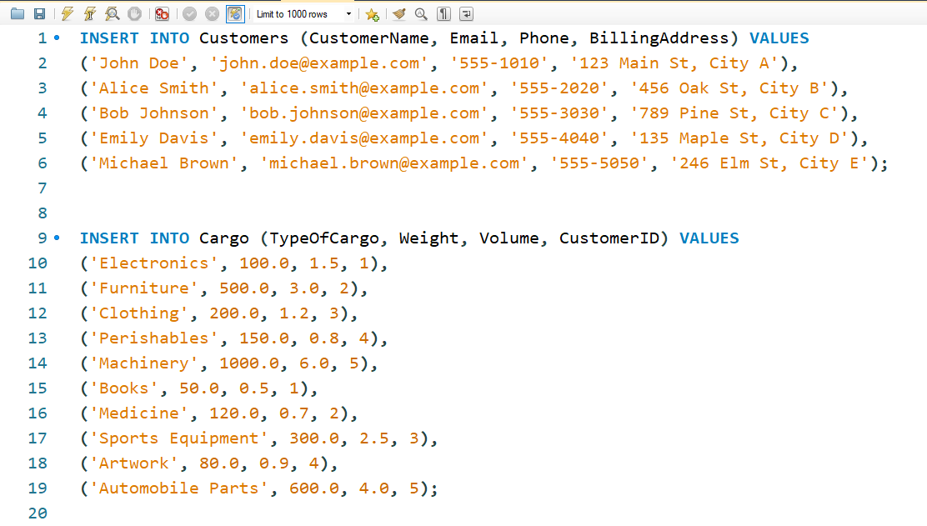
A snippet of Data Ingestion to the tables in MySQL Workbench

Slide 15
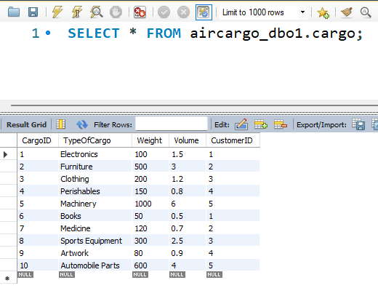
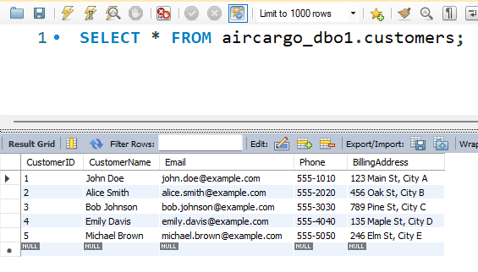
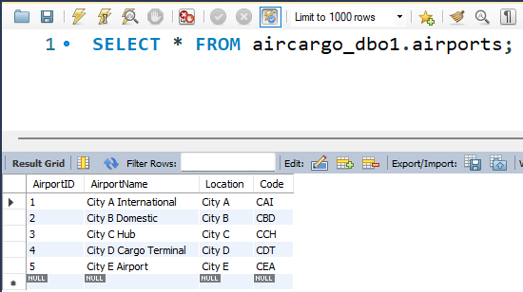
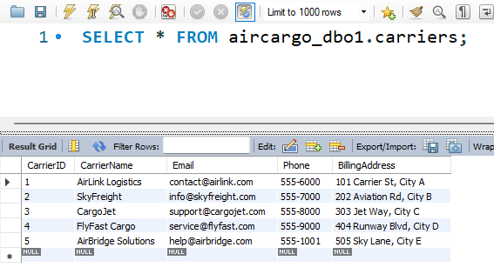
A snippet of the Table and its data

Slide 16
Why do we need Business Reports?
(1) Evaluate performance, whether it reaches business goals or not
(2) Future Decision Making.(provides a basic idea to implement a strategy)
(3) Provides Data Insights.(cost, time consumed ,and other variables)

Slide 17

•Here are the reports created for strategic decision-making:
•(1) Shipment Tracking Report.(Purpose – To track the statues and location.)​
• (2)Customer Shipment History.(Purpose – Customer shipping Frequency, item, destination, cost)​
•(3)Carrier Performance Report.(purpose – to evaluate carrier performance bydelivery times,delays)​

Slide 18
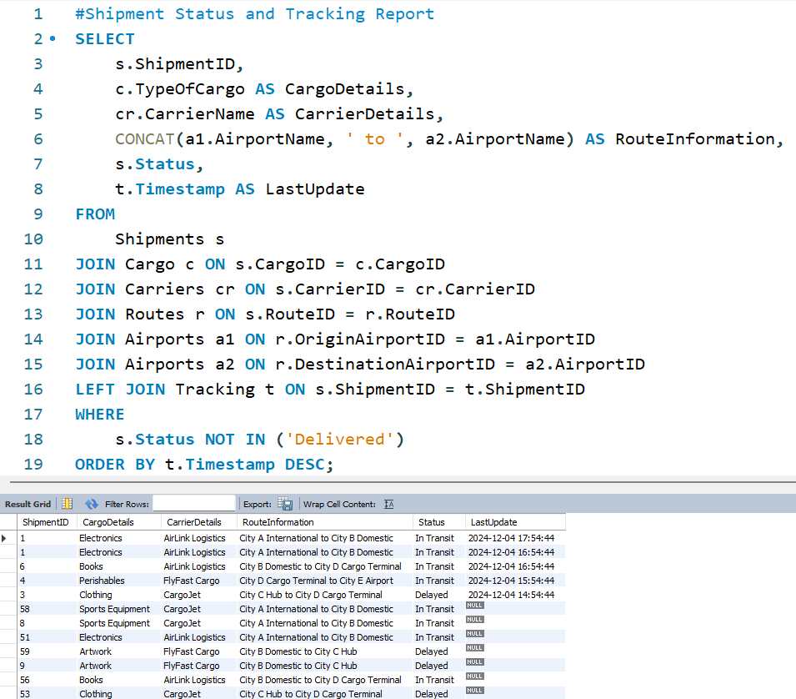
• Here is a sample SQL qurey snippets for generating reports:
(1) Shipment Tracking

Slide 19

Business Report Benefits​
Operational transparency.
Performance analysis.
Data-driven decision-making.

Slide 20


"Our project, the Air Cargo Management System, simplifies air cargo operations by providing a robust database framework. It ensures efficient tracking, operational transparency, and data-driven decision-making for stakeholders."
PROJECT SUMMARY

Slide 21

AI Integration: Implement predictive analytics for demand forecasting and route optimization.
Automation: Introduce IoT devices for real-time condition monitoring of cargo.
Enhanced User Access: Develop mobile-friendly interfaces for easier customer and carrier access.
Scalability Enhancements: Implement cloud-based architecture to handle global data expansion.
Security Features: Strengthen data protection with advanced encryption and access control.
POTENTIAL FUTURE IMPROVEMENTS

Slide 22

Presented by:
Abhijit Shine
Vineeth Kumar Baradi
Baskaran Palanisamy
Ashok Kumar Parihar
Shanmukha Santosh Reddy Kallam
Thank you for your time and attention. We are open for your feedback on our project. We look forward for your valuable insights

