Slide 1
Lung Cancer Prediction
Mining Mavericks
Course: Data Mining
Professor: Dr. Mina Maleki
Manav, Baskaran, Ashok

Slide 2
Content
Introduction
Dataset Visualization
Data Pre-processing
Model selection
Model Evaluation
Conclusion

Slide 3
Introduction
Lung cancer is one of the deadliest cancers, and its early detection is essential for better survival rates. The following study will develop a machine learning model to predict the risk of lung cancer by considering several risk factors like age, gender, smoking habits, blood coughing, and chest pain, thus aiding medical professionals in prioritizing high-risk patients for diagnostic tests on time.
Using a dataset comprising 1,000 samples and 26 attributes, data preprocessing treated missing values and scaled numerical variables to prepare the data for analysis.
The algorithms used for classification, such as Random Forest, Decision Tree, and Logistic Regression, were compared based on the metrics of precision, recall, accuracy, and F1 score.

Slide 4
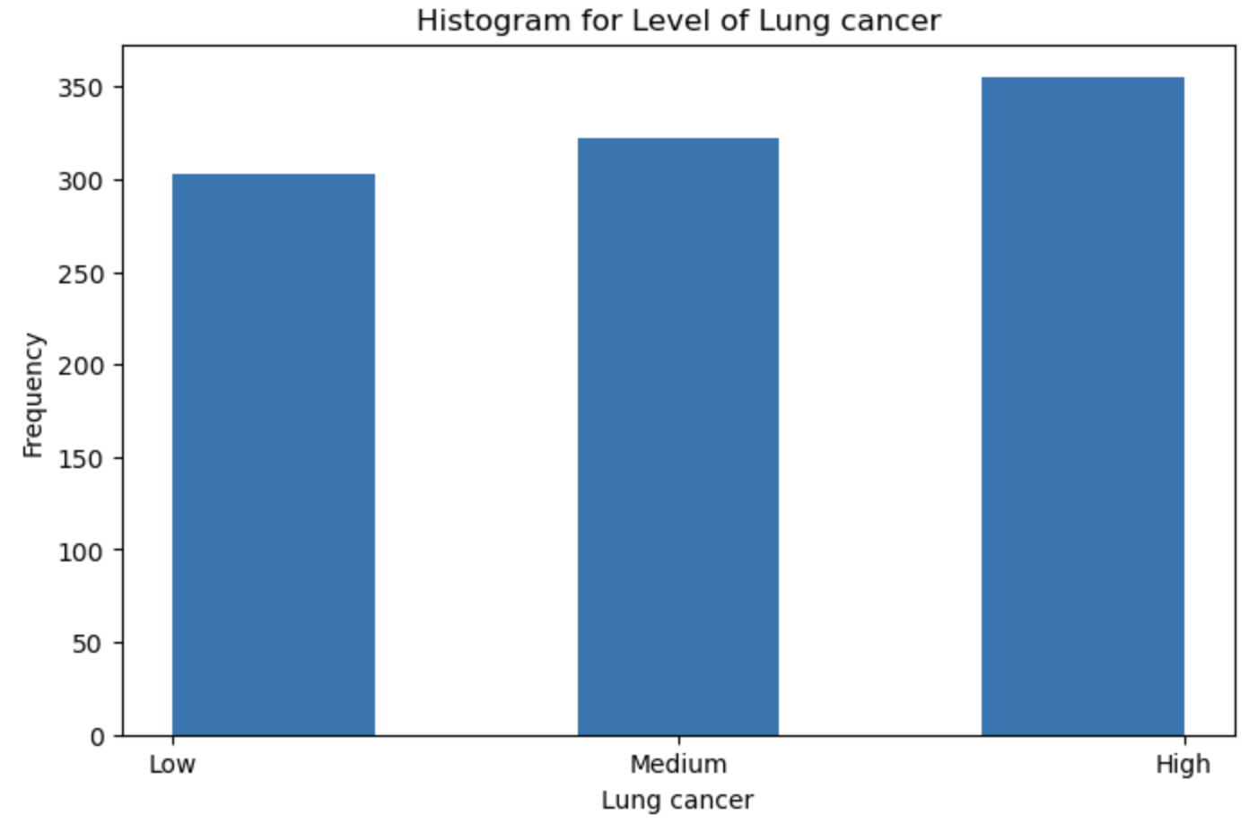
Data Visualization
Our dataset is a balanced one, as we can see, each class label has a similar number of samples:
Low: 300 samples
Medium: 330 samples
High: 350 samples

Slide 5
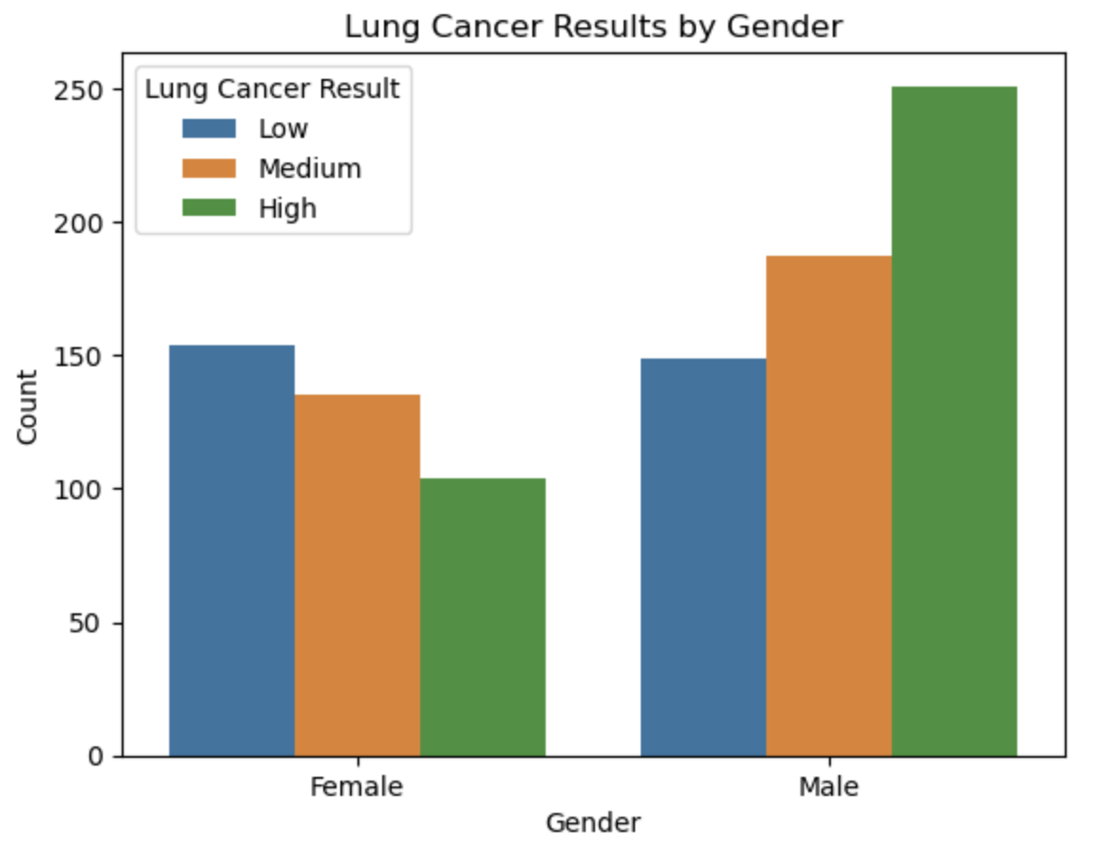
Data Visualization
From this one, we can say there is a higher risk of Lung Cancer in males compared to women.
Whereas most females have a low risk of Lung Cancer.

Slide 6
Data Preprocessing

Slide 7
Data Preprocessing
Data Cleaning
In this step, we checked for null and duplicate values.
Then, using IQR, we checked for outliers in all the features. We found a few outliers in age and snoring and removed them.
 | Samples
Before | 1000
After | 980

Slide 8
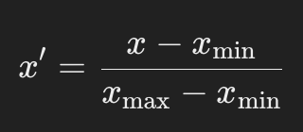
Data Preprocessing
Data Tranformation
Encoding categorical features
We had to change categorical features to numeric ones; we used one-hot encoding.
Normalization of features:
Normalization is a key factor in our dataset as Age features lie between 14 and 75, while all others lie between 1 and 8.
We used the Min-Max technique; the formula is as follows:

Slide 9
Data Preprocessing
Feature Selection
First, we tried to train our model with all features, but the model was overfitting, so we thought removing a few features would help our model get an accurate result.
For feature selection, we used the Information Gain method.
And selected the top 12 features.

Slide 10
Important Features
Features | Importance
Coughing of Blood | 0.8635
Wheezing | 0.7455
Chest Pain | 0.7405
Dust Allergy | 0.6667
Smoking | 0.6136
Occupational hazards | 0.5766
Air Pollution | 0.5745
Fatigue | 0.5496
Clubbing of Finger Nails | 0.4141
Age | 0.4111
Frequent Cold | 0.3643
Gender | 0.0197

Slide 11
Model Selection

Slide 12
Model Selection
We split our dataset into 70-30 ratios for training and testing.
For this dataset, we are going with 3 model algorithms:
Decision Tree
Random Forest
Logistic Regression

Slide 13
Model Evaluation

Slide 14
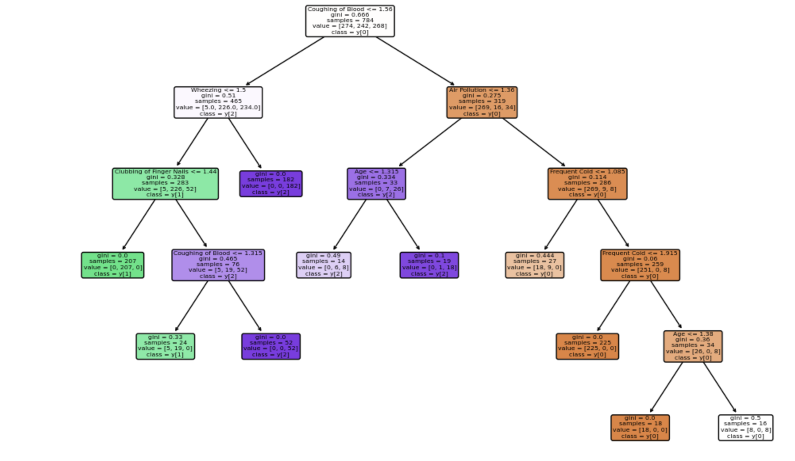
Model Training
Decision Tree
In the decision tree, our accuracy is 97.5%, and our 10-fold Cross-validation is 98.7%.
We can say this model fits perfectly with both training and test data.
Accuracy | Recall | Precision | F1-Score | 10-fold CV
97.5% | 97% | 98% | 97% | 98.7%

Slide 15
Model Training
Random Forest
Random Forest performs similarly to Decision Tree.
We selected the decision tree over the random forest because the 10-fold cross-validation for the random forest is not as accurate with the model as the decision tree.
Accuracy | Recall | Precision | F1-Score | 10-fold CV
97.5% | 97% | 98% | 97% | 99.5%

Slide 16
Model Training
Logistic Regression
Logistic Regression is the lowest model in the accuracy.
Accuracy | Recall | Precision | F1-Score | 10-fold CV
93% | 94% | 95% | 94% | 91.8%

Slide 17
Algorithm with top 8 features
From the importance table, we selected the top eight features to calculate the accuracy with a random combination for all three models.
Features | Decision Tree | Random Forest | Logistic Regression
Coughing of Blood, Wheezing, Fatigue | 97% | 98.5% | 92.5%
Coughing of Blood, Smoking, Wheezing, Fatigue | 96.5% | 98.5% | 97%
Dust Allergy, Wheezing, Fatifue | 98% | 99% | 89%
Chest Pain, Occupational hazards, Dust Allergy | 98% | 97% | 87%

Slide 18
Conclusion
Based on the metrics presented in the table, the Decision Tree model is an excellent choice for predicting lung cancer.
These findings imply that the Decision Tree algorithm is most appropriate for estimating the risk of lung cancer, allowing for prompt measures to enhance medical results.
 | Accuracy | 10 FoldCross Validation
Decision Tree | 97.5% | 98.7%
Random Forest | 97.5% | 99.5%
Logistic Regression | 93% | 91.8%

Slide 19
References
Kaggle: https://www.kaggle.com/datasets/thedevastator/cancer-patients-and-air-pollution-a-new-link

Slide 20
Any Questions?
Thank You

