Slide 1
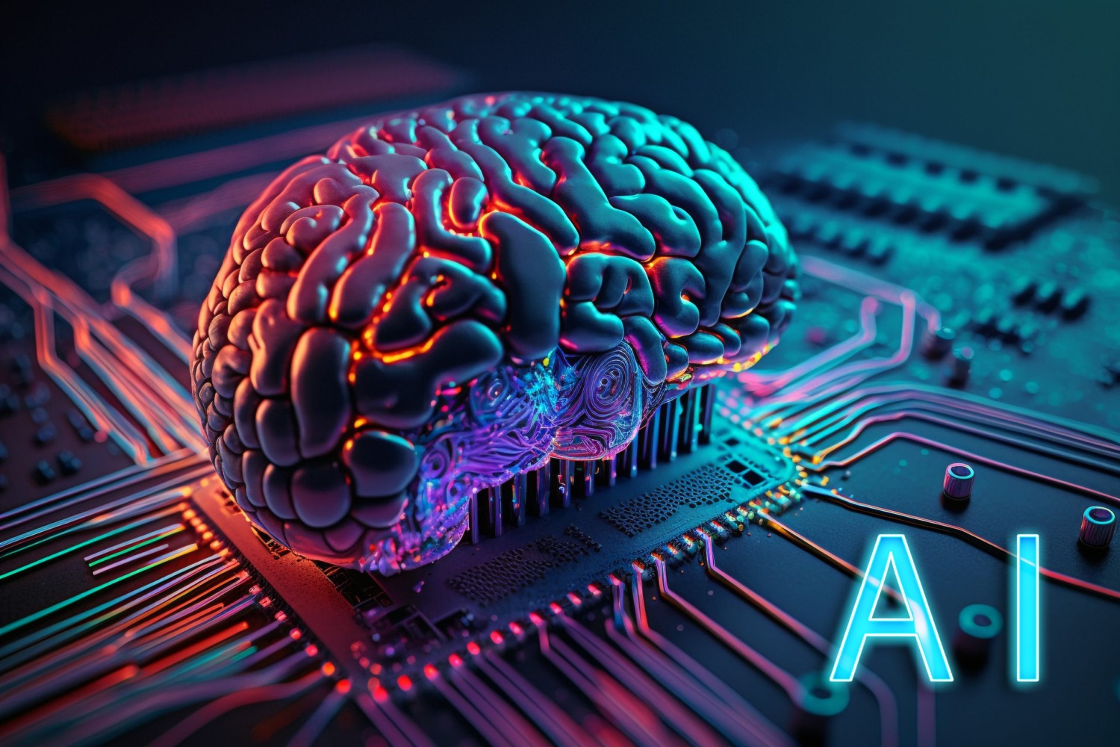
TiTAns bot
Streamline class registration hassle-free with Titans Bot
Presented by: Rajiv Satish Ashok Kumar Parihar
Parvez Ahamed

Slide 2
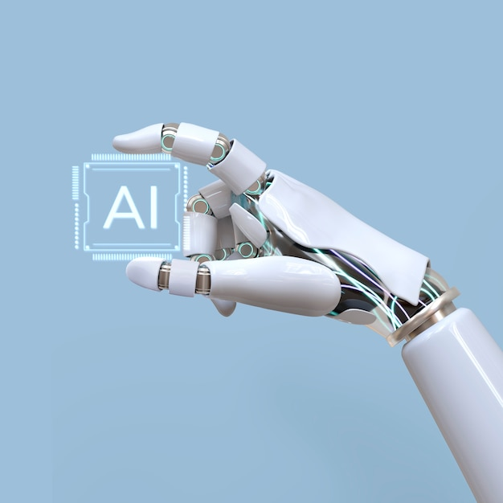
Introduction
Conversational AI leverages machine learning and natural language processing (NLP) to enable machines to understand and interact with humans in a natural manner. These systems can significantly improve the user interface and user experience across various sectors including education, healthcare, and customer service. The technology has evolved rapidly over the years, from simple rule-based systems to sophisticated models capable of understanding context and emotions. This project focuses on applying conversational AI to streamline the class registration process for engineering students, reducing time and improving accuracy.

Slide 3
Requirements
Hardware Requirement: 16GB RAM 2GB graphic card 500GB memory
1
Software Requirement: chainlit
Visual studio
2

Slide 4
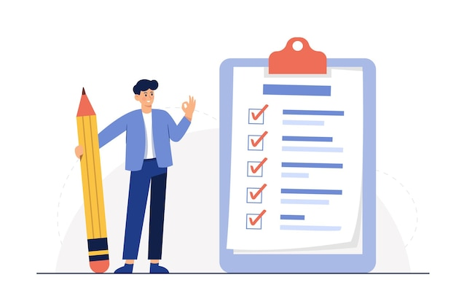
agenda
“Explore our Conversational AI Chatbot solution designed to streamline college course registration. Learn how we utilize cutting-edge technologies like sentence_transformers and chainlit, alongside advanced NLP techniques, to enhance precision and user experience. Discover the meticulous development journey and future directions for optimizing efficiency and satisfaction in class enrollment."

Slide 5
libraries
chainlit
langchain
CT transformer
SENTENCE TRANSFORMERS​
pypdf

Slide 6
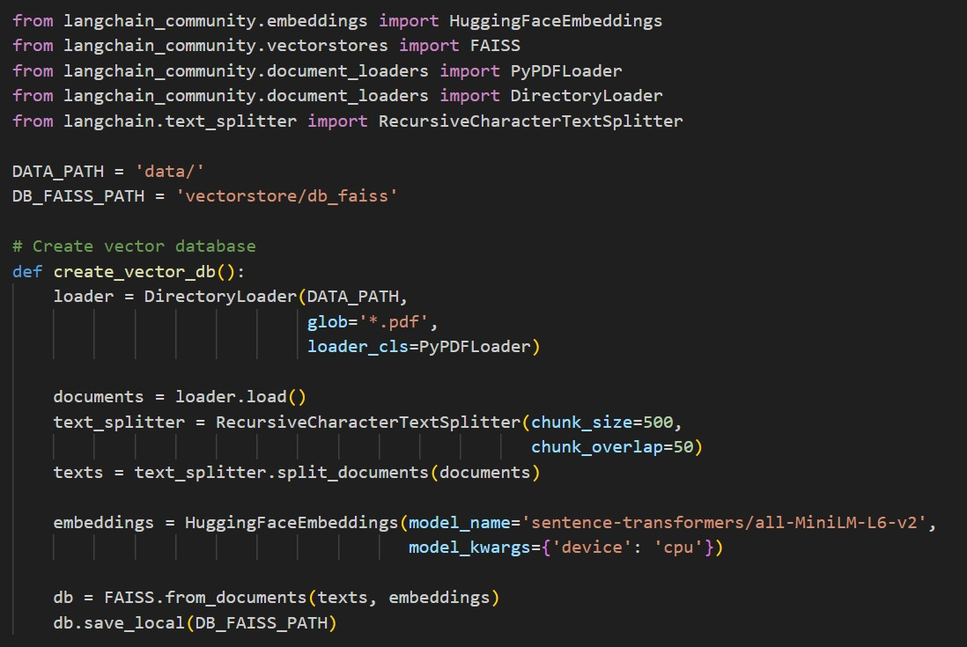
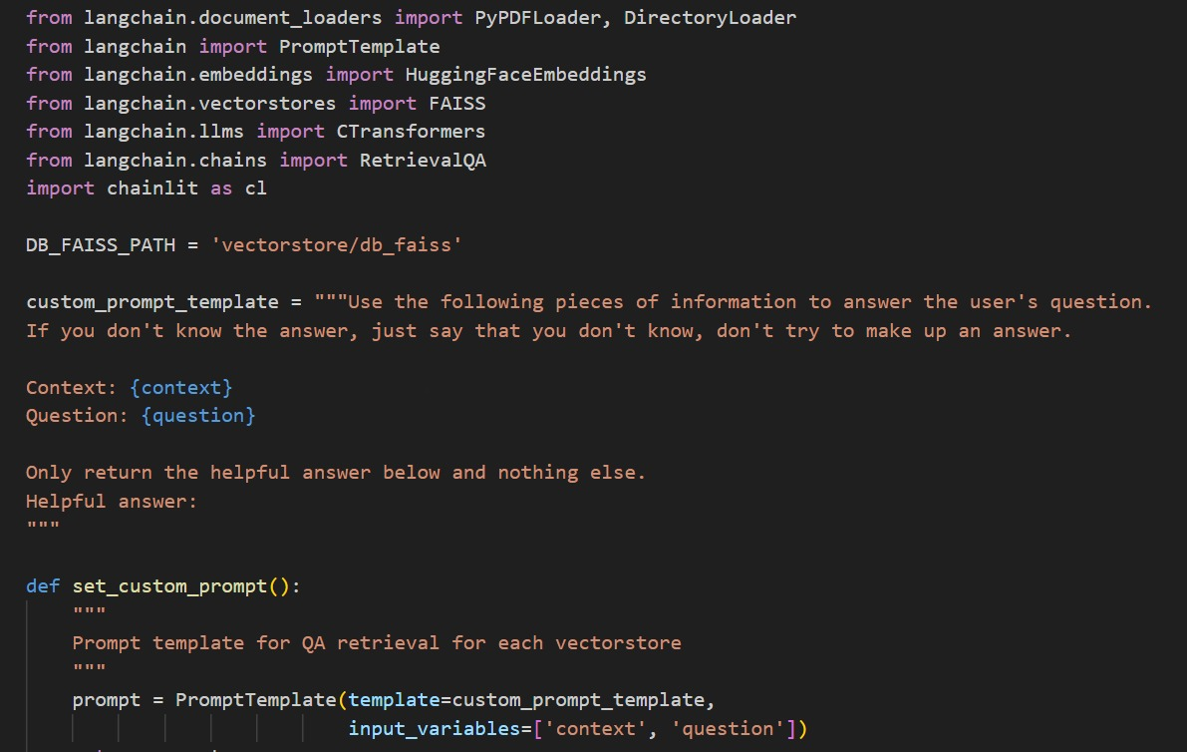
IMPLEMENTATION

Slide 7
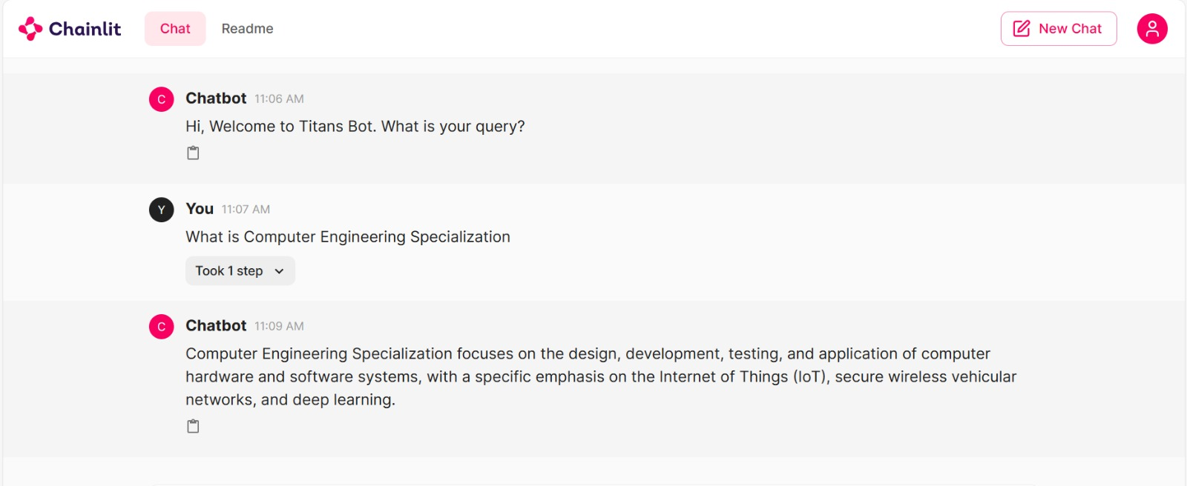
outcome

Slide 8

Future Work

Slide 9
References
https://huggingface.co/TheBloke/Llama... https://github.com/Chainlit/chainlit https://python.langchain.com/docs/get_started/introduction.html https://github.com/marella/ctransformers

Slide 10

Questions

Slide 11
Titans BO
THANK YOU

