Slide 1
School of Computer Science & Engineering
AI Application Development – IA1
MedVoiceai

Slide 2
Team members & roles
Team member name | Role
Ashok | Team Lead
Abhishek R | Developer
Ashfhak Shaikh Chethan G | Customer Contact
Gunesh | Test Lead
Chidananda naik DL Deepak Rathod | Github
Notes:
Talk about how they are managing their documents, how google docs does automatic versioning
As them what they know about Android and IoS versions

Slide 3
Modified Problem Statement
Healthcare providers struggle to effectively communicate with patients who speak different languages, making it difficult to understand patient concerns and provide timely support. An AI-powered multilingual conversational intelligence platform can help healthcare organizations analyse and manage patient conversations efficiently across multiple languages.
Notes:
Talk about how they are managing their documents, how google docs does automatic versioning
As them what they know about Android and IoS versions

Slide 4
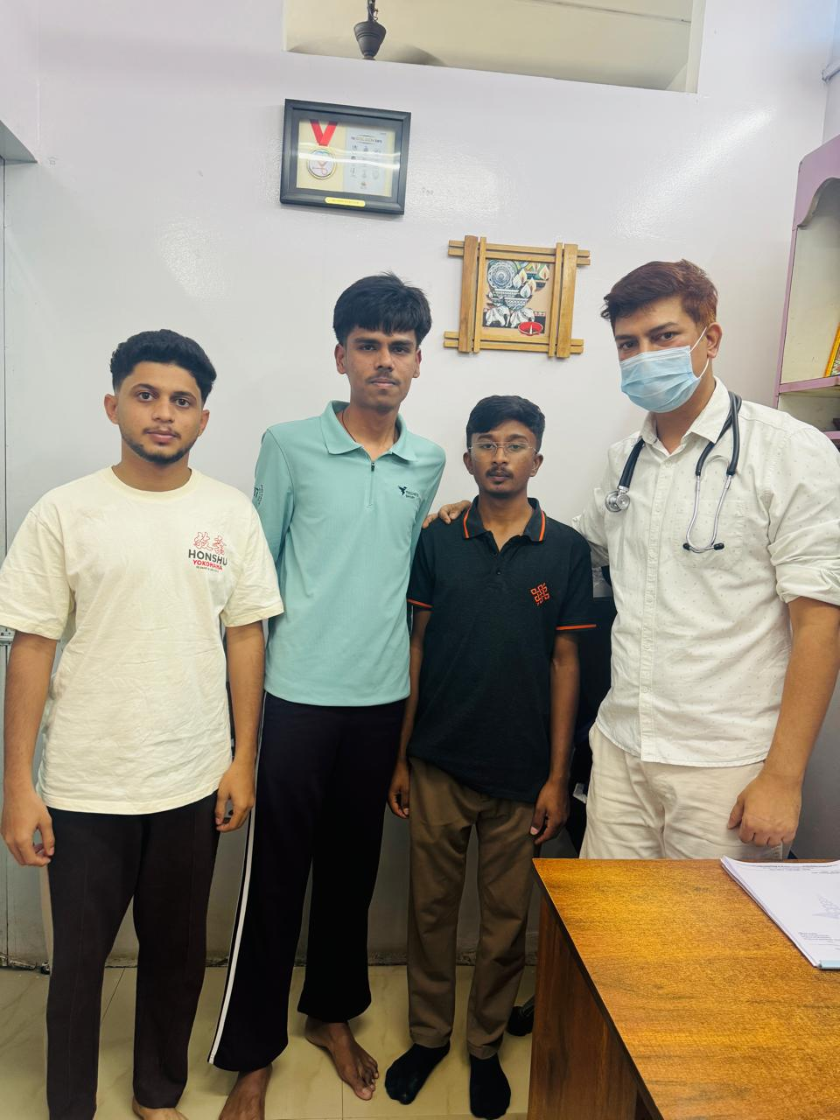
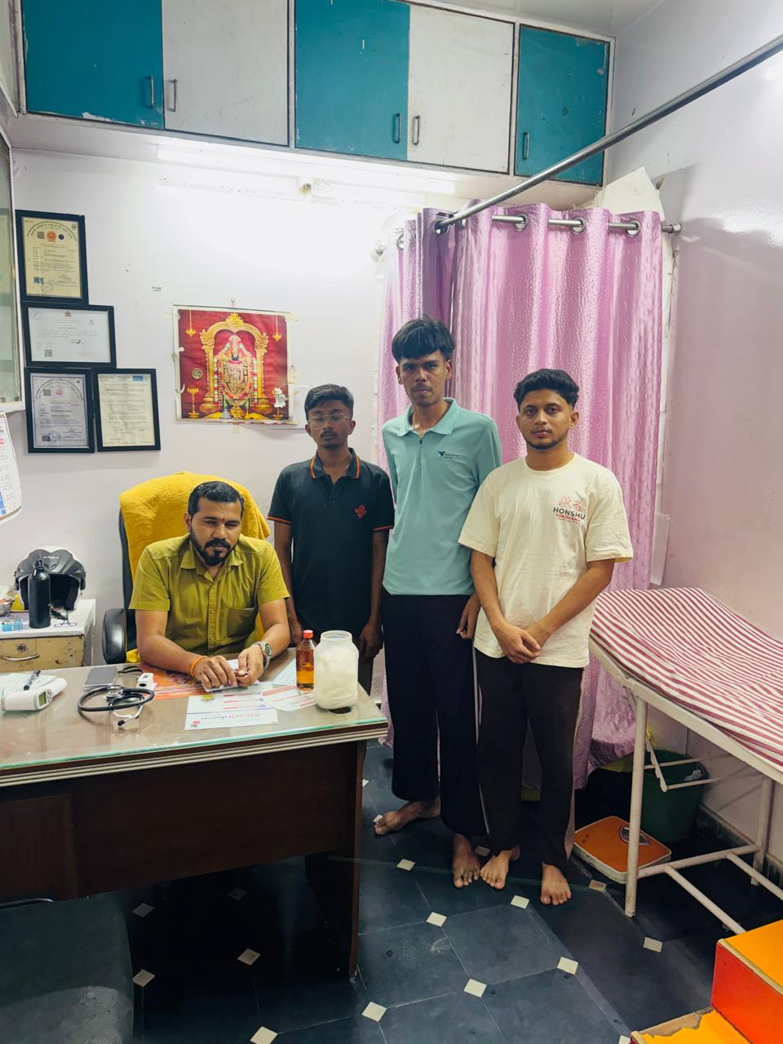
User/ Customer Understanding
Notes:
Talk about how they are managing their documents, how google docs does automatic versioning
As them what they know about Android and IoS versions

Slide 5
Ideal Customer Profile (ICP)
Demographics
Industry
Healthcare and Medical Services
Organization Type
Hospitals
Clinics
Healthcare Call Centers
Organization Size
Medium to Large Healthcare Organizations
Hospitals handling 50–500+ patients per day
Psychographics
Language barriers between doctors and patients
Time-consuming manual medical documentation
Difficulty managing patient consultation records
Limited access to healthcare in rural areas
Notes:
Only stress on the 1st sentence – the definition
Come back to the 2nd sentence in the end as part of revision

Slide 6

Customer Persona (CP)
Name:
Age: 42
Gender: Male
Role: Doctor
Location: Bangalore, Karnataka, India
Problems- Customer Perspective
Language barriers: Customers (patients) often struggle to communicate symptoms in a language the doctor understands.
Delayed documentation: Doctors spend significant time manually recording patient consultations.
Need for clarity and records: Both doctors and patients want structured medical reports and easy access to past consultation history.
Notes:
Only stress on the 1st sentence – the definition
Come back to the 2nd sentence in the end as part of revision

Slide 7
Product USP
Solves critical language barriers between doctors and patients
Improves accuracy of diagnosis by capturing patient concerns correctly
Reduces dependency on human translators (cost + delay)
Real-time multilingual conversation intelligence (not just translation)
Reduces miscommunication errors and medical risks
Notes:
Only stress on the 1st sentence – the definition
Come back to the 2nd sentence in the end as part of revision

Slide 8
Use Cases & High level Requirements
1. Real-Time Patient–Doctor Conversation Translation
Input:
Patient speaks in regional language (e.g., Kannada/Tamil/Hindi)
Doctor speaks in English
Output:
Instant translated speech/text for both sides
Context-aware medical translation
2. Automated Consultation Summary
Input:
Full conversation transcript (voice/chat)
Output:
Structured summary including:
Symptoms
Diagnosis hints
Prescribed actions
Ready-to-save clinical notes
Notes:
Only stress on the 1st sentence – the definition
Come back to the 2nd sentence in the end as part of revision

Slide 9
3. Prescription Letter
Input:
Patient Name
Patient ID / Phone Number
Prescription Letter (text or uploaded document)
Date of consultation
Doctor name
Output (When Needed)
Doctor searches using:
Patient name / ID
System retrieves:
Prescription letter
Options available:
View
Download
Print
Share

