Slide 1


Klinik
An E-Doctor Application
Presented by
Aashifa S, Ashok Reddy, Manish kumar,
Alugoju Sriharshini, Navyashree G M

Slide 2
Modules Developed
User Authentication and Registration
Patient Information Management
Appointment Scheduling Interface
Appointment Management
Doctor Availability Management
Notification System
Admin Dashboard

Slide 3

About Klinik Application
Key purpose: Simplifying doctor- patient interactions and appointment booking.
Key features: Role-based access for users, doctors, and admins.

Slide 4
Use of Klinik Application
Allow patients to easily schedule appointments with preferred doctors.
Provide doctors with a convenient way to manage their appointment schedules.
Improve efficiency in outpatient appointment booking and management.
Enhance patient satisfaction by offering a seamless and user- friendly interface.

Slide 5


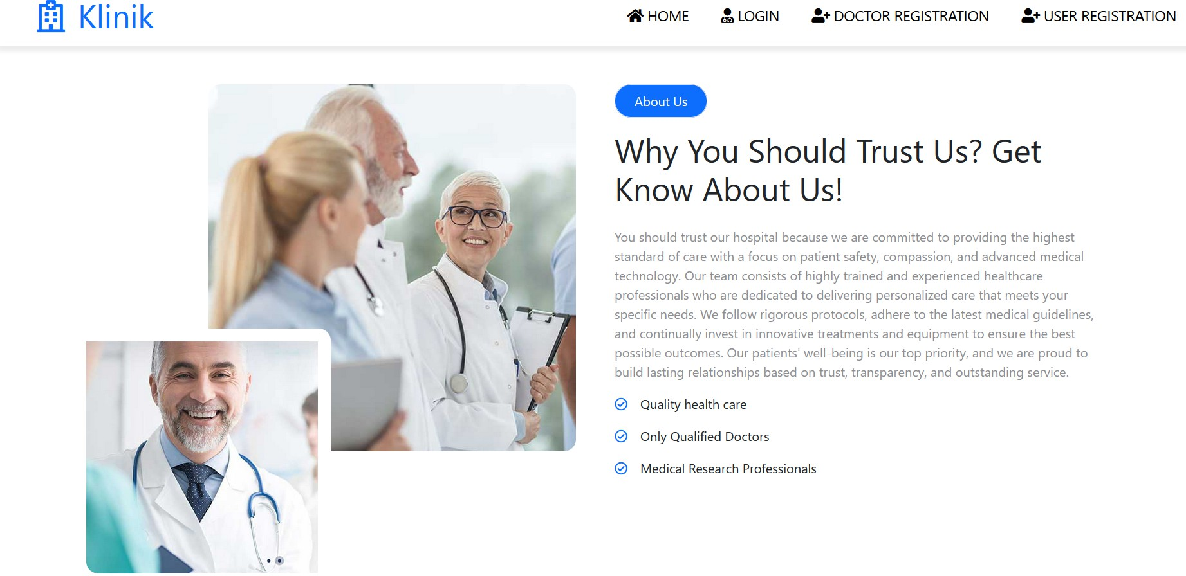
Homepage and Navigation
Key elements:
Navigation bar with icons ( ome, Login, Doctor Registration, User Registration).
"About this application" section.

Slide 6
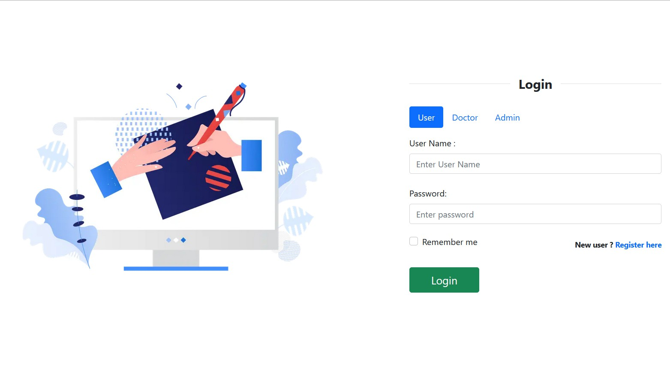
Role-Based Login
Login Page
Roles: User, Doctor,Admin.
Link: Register Here to access registration forms.
Fields: username, password, login button.

Slide 7
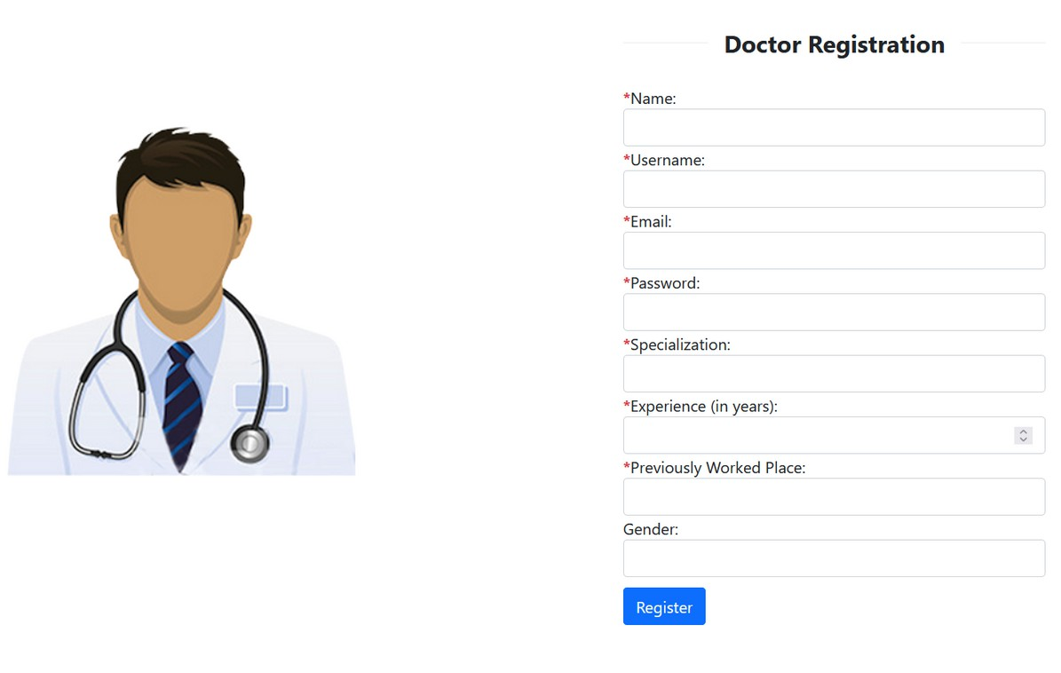
Registration Forms
User and Doctor Registration
User Registration: Full name, email, password, gender, contact, etc.
Doctor Registration: Additional fields like specialization, experience, previous workplace.
Success message and email confirmation.

Slide 8
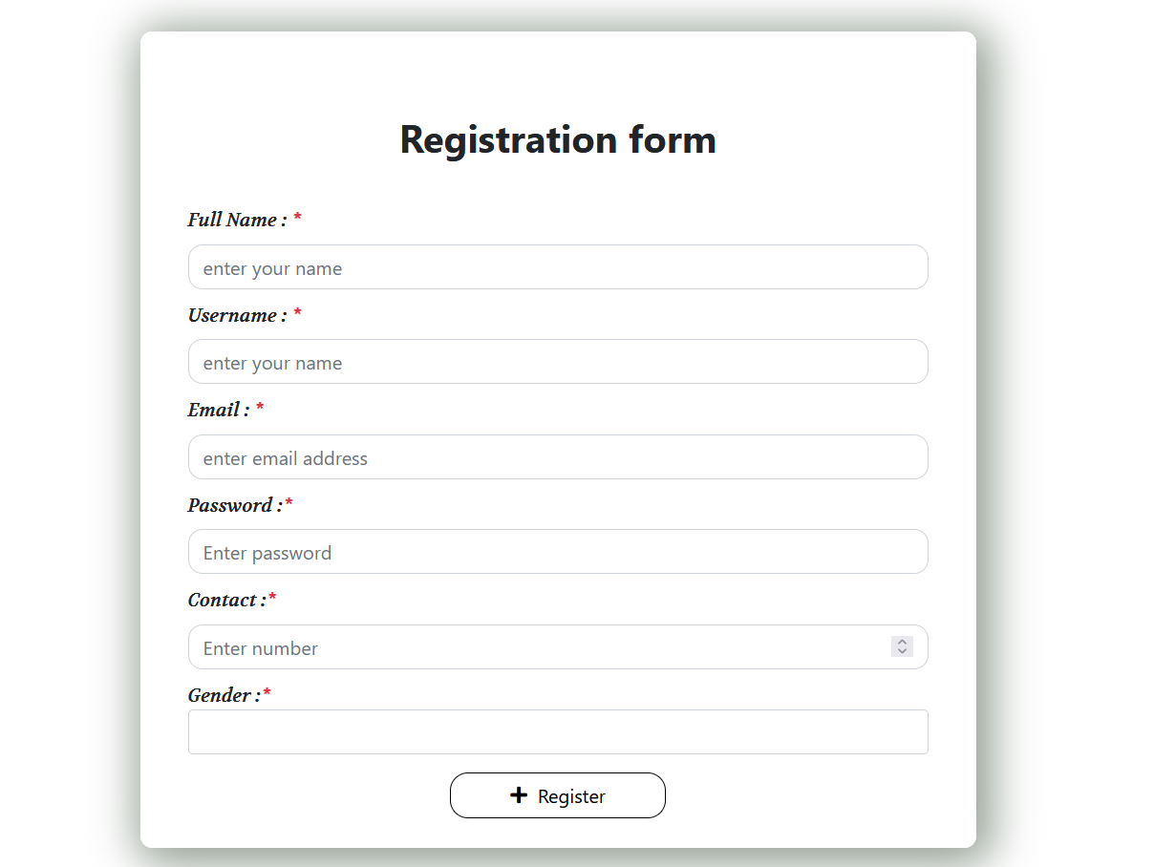


Slide 9
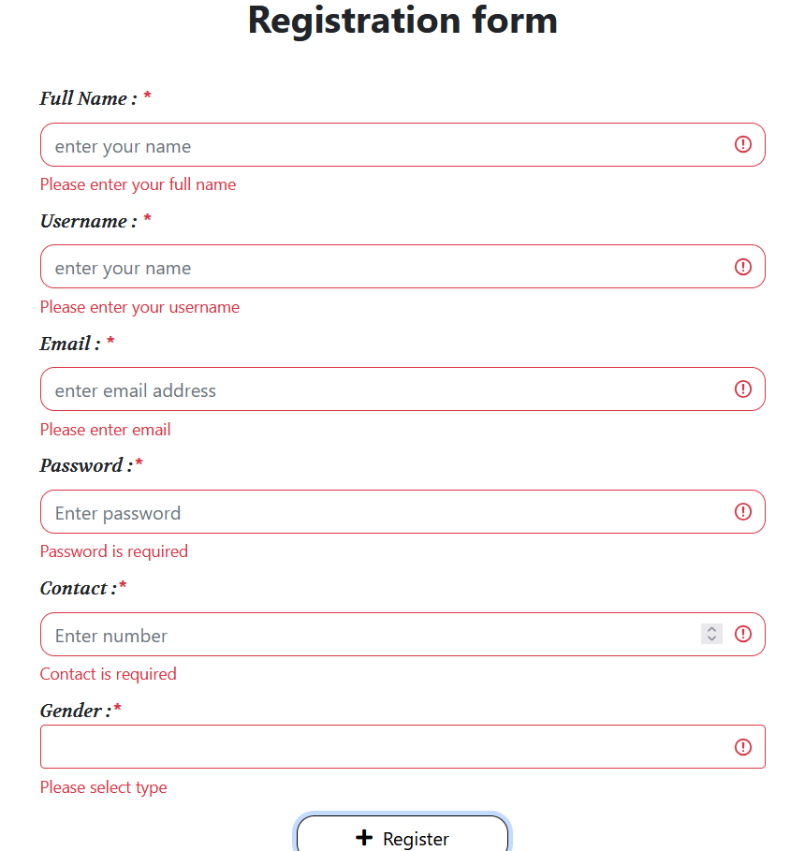

Slide 10
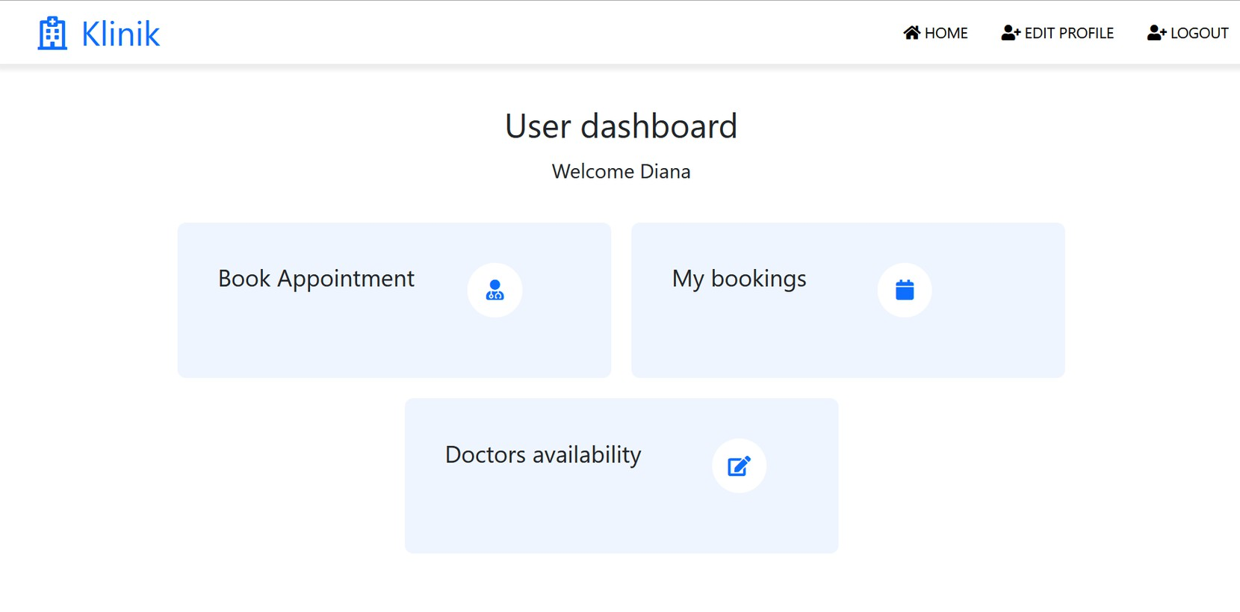
User Dashboard
My Bookings: View all booked appointments.
Book Appointment: View doctor list, specialization, and fees.
Ability to edit profile or log out.

Slide 11

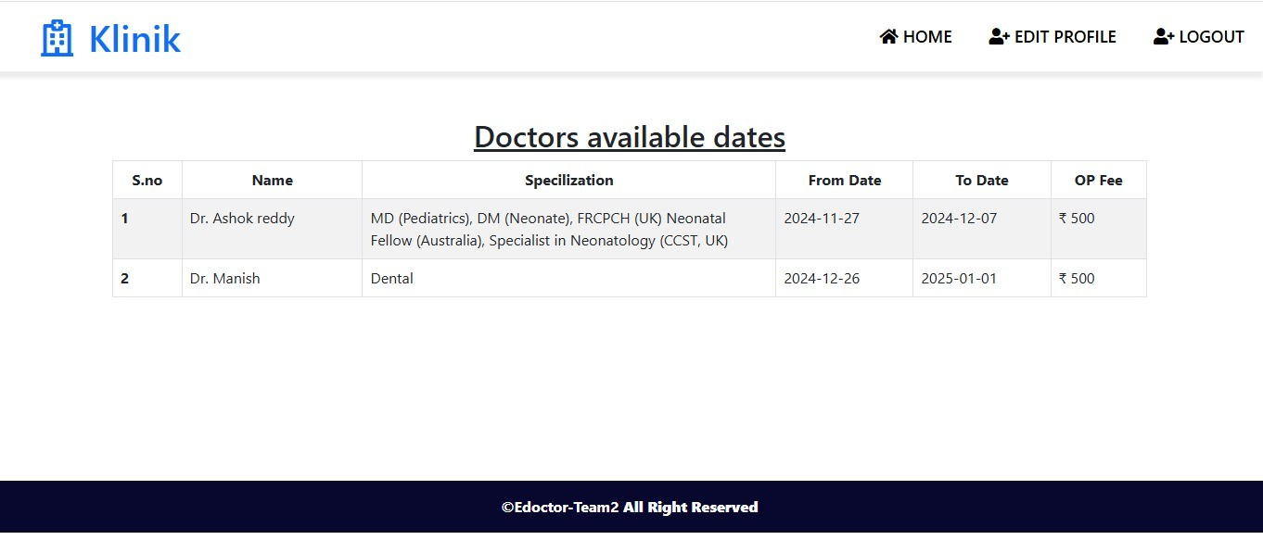

Slide 12



User Dashboard
View doctor list, specialization, and fees
Aashifa Syed
Dermatologist
Ashok Reddy
Ophthalmologist
Manish Kumar
Cardiologist

Slide 13
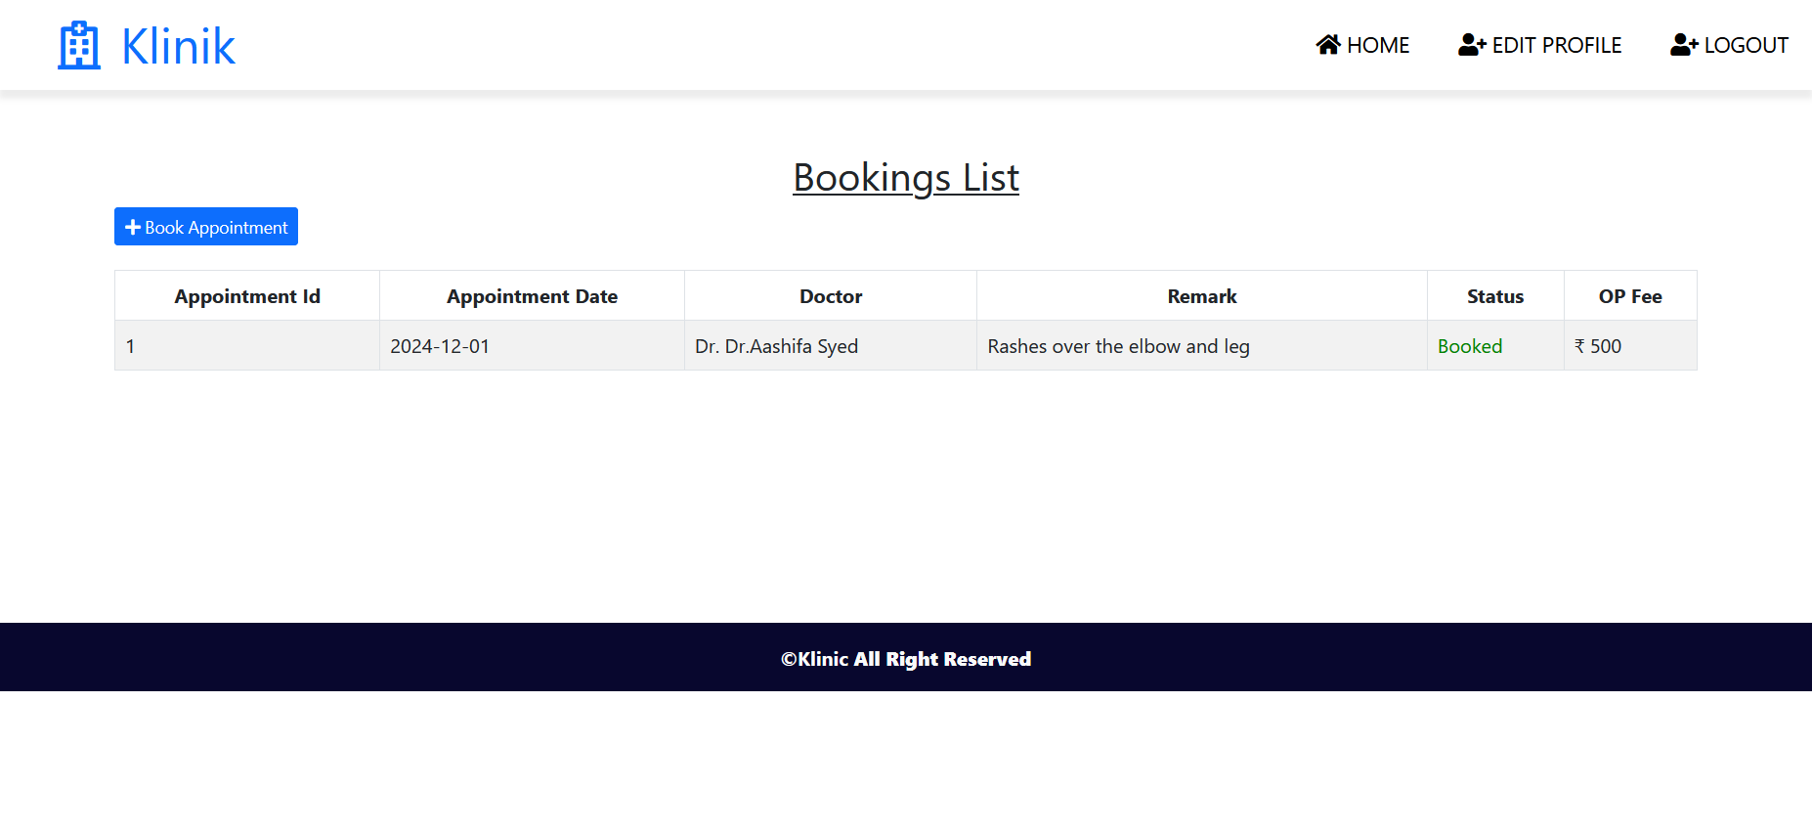

Slide 14
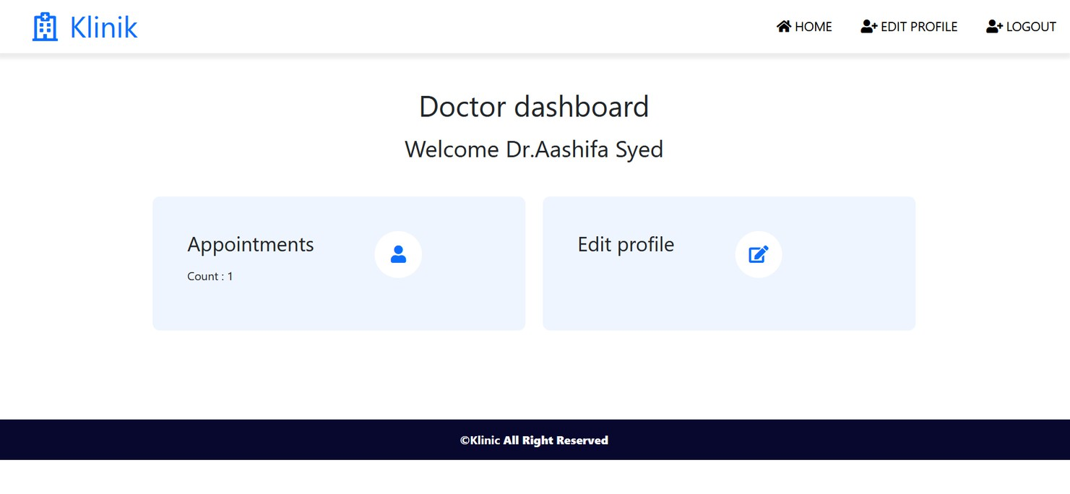
Doctor Dashboard
Appointment list for patients
Ability to edit profile or log out
Manage patient appointments.

Slide 15
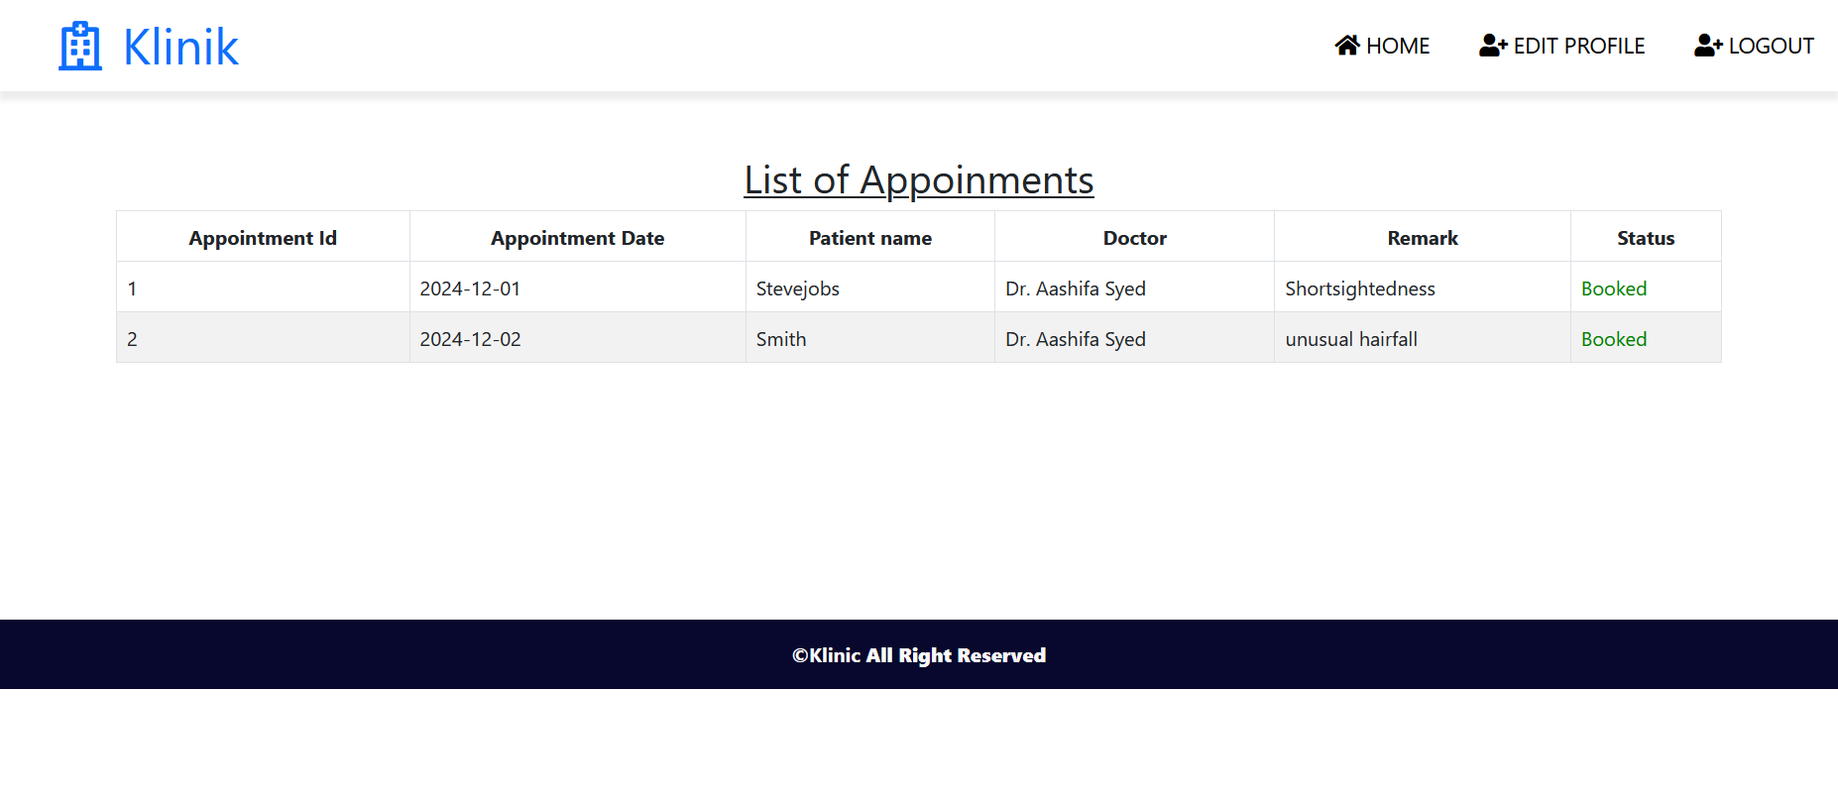

Slide 16

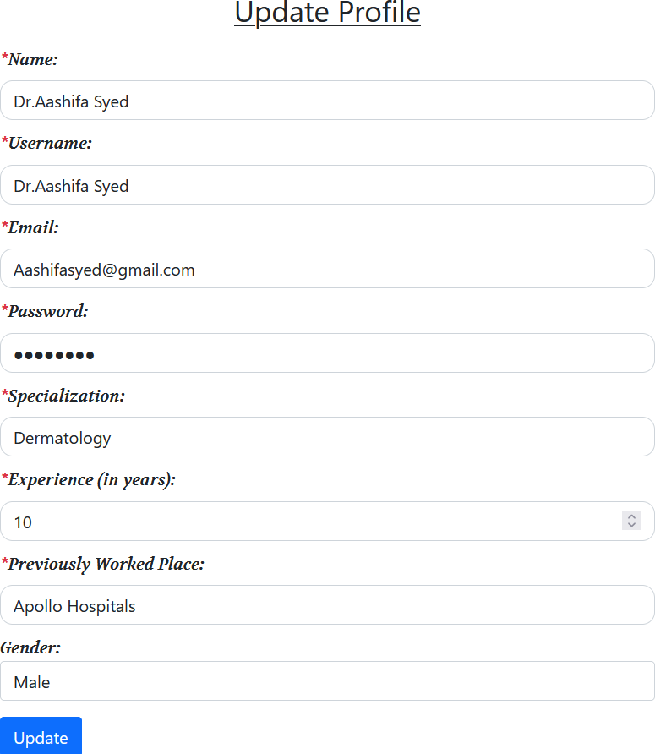
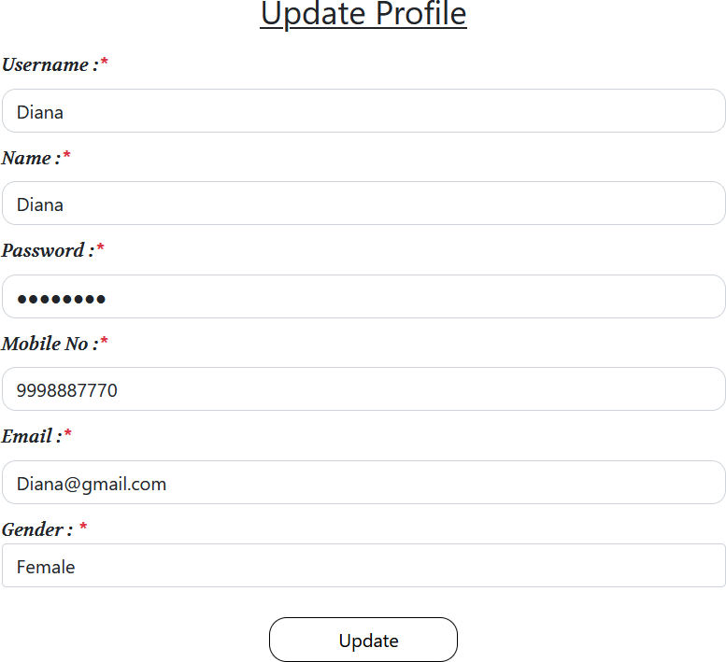
Doctor & User Profile Editing

Slide 17
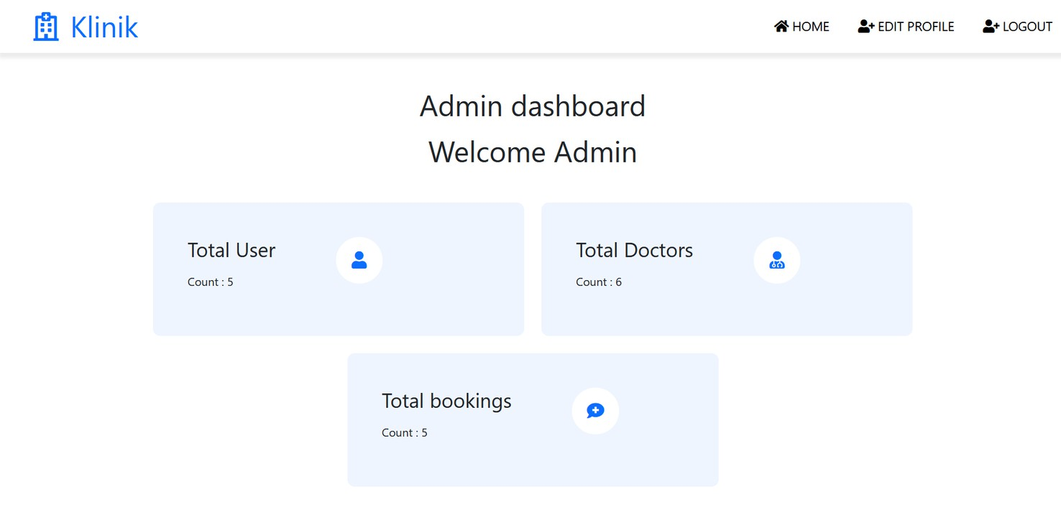
Admin Dashboard
Maintain patient details
Edit and manage system records
Oversee overall system functionality

Slide 18
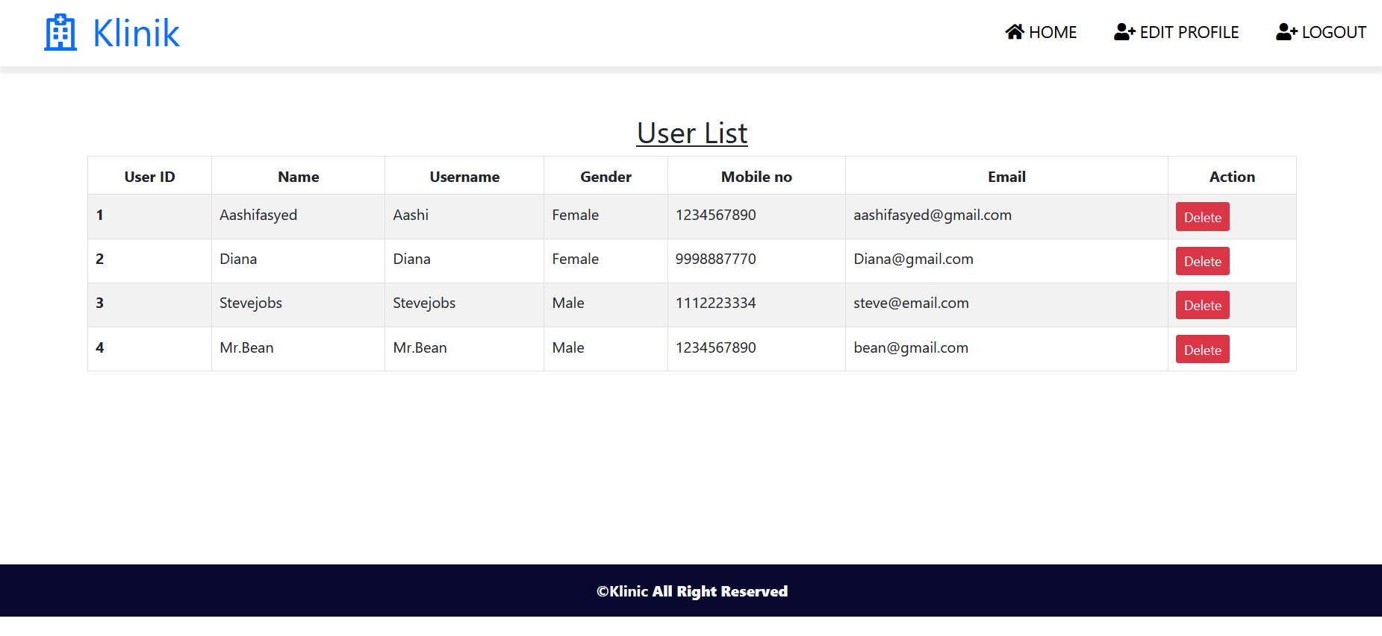

Slide 19
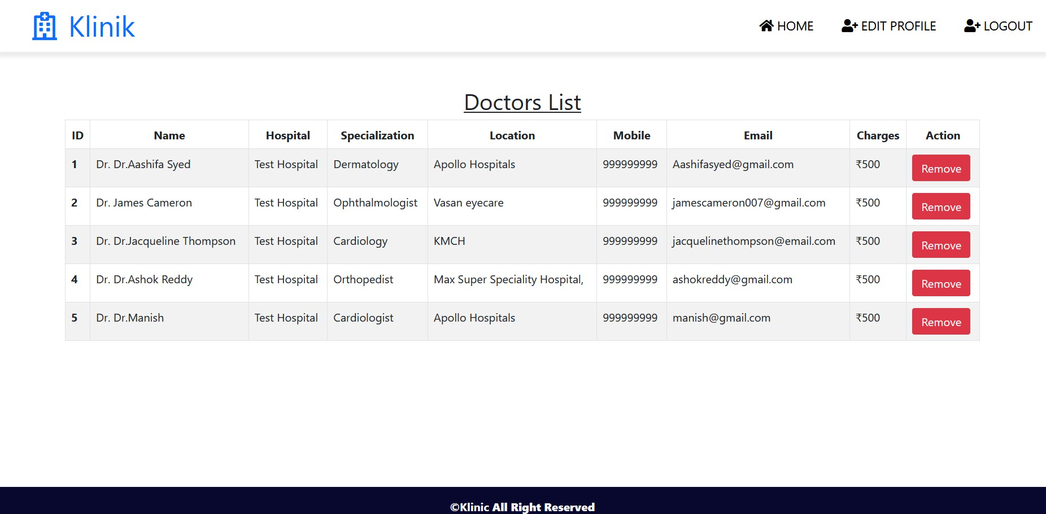

Slide 20
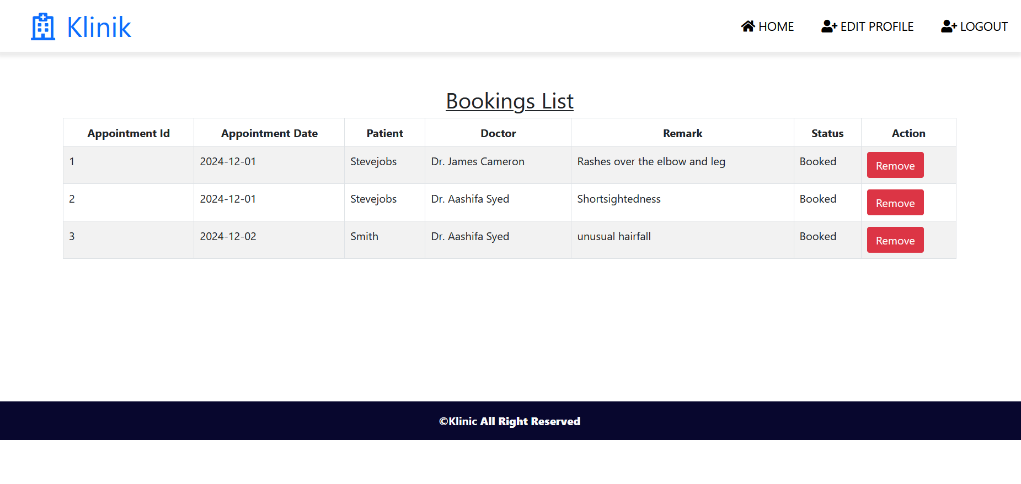

Slide 21



Technologies Used
Frontend: Angular
Backend: Spring Boot
Database: MySQL

Slide 22

Conclusion
Key Highlights:
Simplifies patient-doctor interactions.
Easy-to-navigate interfaces for all roles. Role-based login for enhanced functionality.
Email confirmations for efficient communication.

Slide 23

Thank You!

