Slide 1
Does “AI exposure” predict who actually loses their job?
Critique of Frank, Ahn & Moro (2025), PNAS Nexus
CSCU9DA | Data: github.com/mrfrank8176/unemploymentRisk

Slide 2
Problem & motivation
Fear that generative AI and automation destroy jobs
Many “exposure” scores exist (Frey & Osborne, Webb, Felten, Eloundou, …) built from expert opinion, patents or task text
Almost never checked against real outcomes
RQ: do scores predict real occupational unemployment risk, and does combining them help?
Why it matters: targeting retraining and support

Slide 3
Study design
Outcome: share of an occupation’s workforce on unemployment insurance, per state-month (log10)
01
N = 140,274 state × month × occupation records, 2010–2020
02
Predictors: 8 literatures’ exposure scores at 2-digit SOC level
03
Controls: O*NET skills PCA, education, year / month / state fixed effects
04
Framing: predictive and associational, not causal
05

Slide 4
Data audit: does the repo match the paper?
140,274 rows × 9 columns: exact match with paper’s N
50 states, 22 SOC groups, 132 months; no blanks, no -999/NA codes, no duplicate keys
Unbalanced panel: 4,926 of 145,200 cells (3.4%) absent, undocumented
26 risk values > 1 (impossible share), e.g. Alaska farming 2.42
342 cells with a single claimant (re-identification risk)
Exposure file: state-level, 549 rows; SOC-level scores and code not released

Slide 5
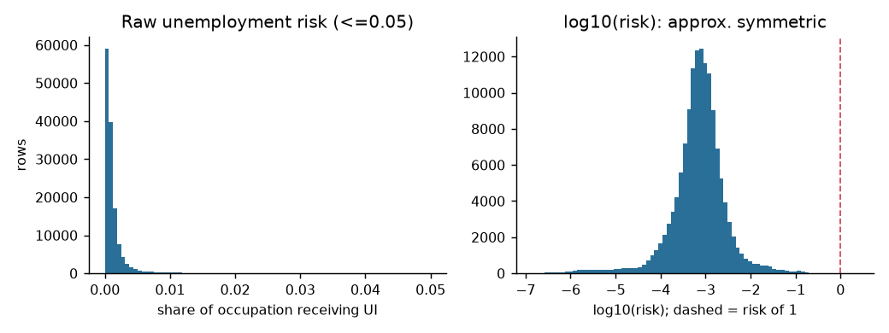
Target is skewed; log10 fixes it
Raw risk is heavily right-skewed
log10(risk) is near symmetric, which justifies the paper’s transform
Tail past 1 are small-denominator occupations

Slide 6
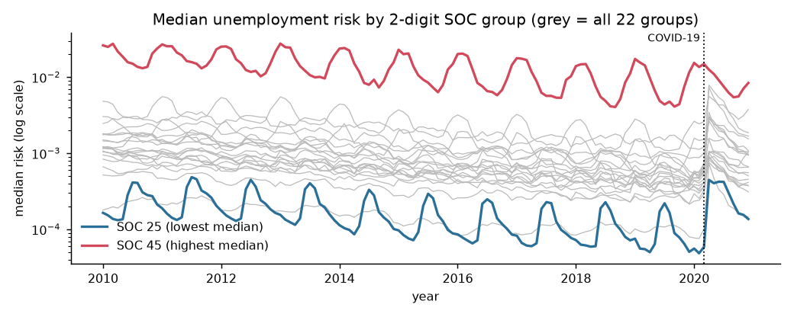
Seasonality and COVID dominate
Education (SOC 25) peaks every summer; farming (SOC 45) every winter
March 2020 spike hits every occupation
Explains month fixed effects and the 2019 cut-off
Risk differs ~100× between occupations

Slide 7
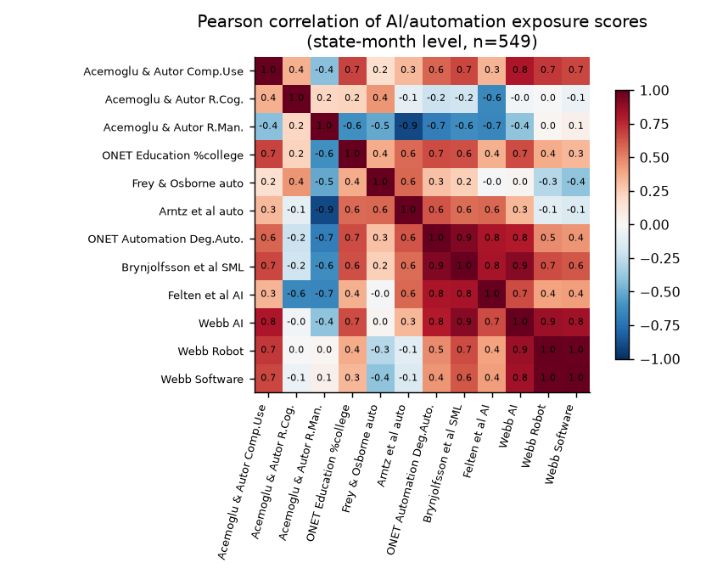
Exposure scores disagree
Median |r| = 0.46; Webb Robot and Software r ≈ 1
Acemoglu R.Man. and Arntz r ≈ −0.9
Several scores uncorrelated: different constructs
Motivates the ensemble

Slide 8
Method & headline results
Single-score regressions, then ensemble LASSO, 10×10-fold CV, metric R²
Best single score (Arntz et al.): R² = 0.107
Ensemble of all scores: 0.298
Baseline controls: 0.574
Baseline + ensemble: 0.755 (+18.1 points)
Takeaway: no single score is reliable, but together they add real signal

