Slide 1
Does “AI exposure” predict who actually loses their job?
Critique of Frank, Ahn & Moro (2025), PNAS Nexus
CSCU9DA | Data: github.com/mrfrank8176/unemploymentRisk

Slide 2
Problem & motivation
Fear that generative AI and automation destroy jobs
Many “exposure” scores exist (Frey & Osborne, Webb, Felten, Eloundou, …) built from expert opinion, patents or task text
Almost never checked against real outcomes
RQ: do scores predict real occupational unemployment risk, and does combining them help?
Why it matters: targeting retraining and support

Slide 3
Study design
Outcome: share of an occupation’s workforce on UI per state-month (log10); state UI + BLS OEWS data
01
N = 140,274 state × month × occupation records, 2010–2020
02
Predictors: 13 exposure scores from 3 waves of studies, at 2-digit SOC level
03
Controls: O*NET skills PCA, education, year / month / state fixed effects
04
Framing: predictive, yet authors read the +18 points causally
05

Slide 4
Data audit: does the repo match the paper?
140,274 rows × 9 columns: exact match with paper’s N, so 2020 is in the regressions
50 states, 22 SOC groups, 132 months; no blanks, no -999/NA codes, no duplicate keys
Unbalanced panel: 4,926 of 145,200 cells (3.4%) absent, 84% in California and Connecticut
26 risk values > 1 (impossible share), e.g. Alaska farming 2.42
342 cells with a single claimant (re-identification risk)
Exposure file: state-level, 549 rows, 12 of 13 scores (LLM missing), so the regressions can’t be re-run

Slide 5
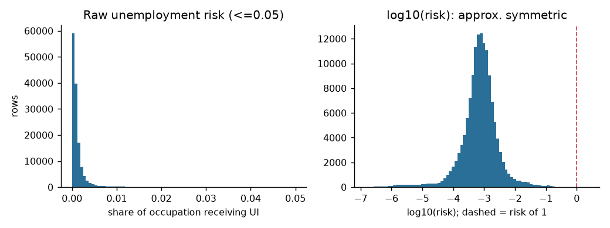
Target is skewed; log10 fixes it
Raw risk is heavily right-skewed
log10(risk) is near symmetric, which justifies the paper’s transform
Left tail (< −5) = tiny claimant counts; 26 values > 1 = source mismatch

Slide 6
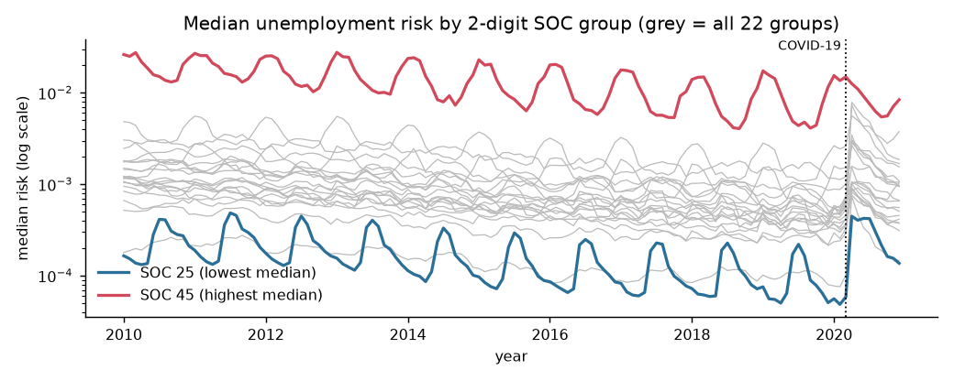
Seasonality and COVID dominate
Education (SOC 25) peaks every summer; farming (SOC 45) every winter
March 2020 spike hits every occupation
Explains month fixed effects and the 2019 cut-off for correlations
Risk differs ~100× between occupations

Slide 7
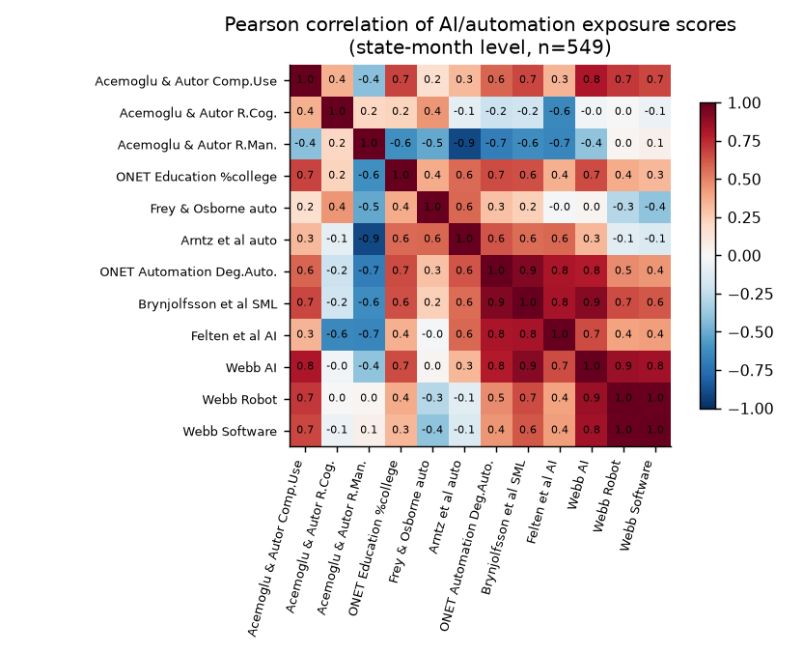
Exposure scores disagree
Median |r| = 0.46; Webb Robot and Software r ≈ 1
Acemoglu R.Man. and Arntz r ≈ −0.9
Several scores uncorrelated: different constructs
Motivates the ensemble

Slide 8
Method & headline results
Single-score regressions, then ensemble LASSO; R² from Table 2, CV gains similar
Best single score (Arntz et al.): R² = 0.107
Ensemble of all scores: 0.298
Baseline controls: 0.574
Baseline + ensemble: 0.755 (+18.1 points)
Takeaway: no single score is reliable, but together they add real signal

Slide 9
Critical reflection: is +18 overstated?
DATA STAGE
MODELLING STAGE
Coverage bias
UI misses the self-employed and non-claimants; claim rates vary by state and wage
Tiny effective sample
Exposure takes only 22 distinct values across 140,274 rows
1
1
Impossible values
26 risks > 1: claims and OEWS employment come from different sources
Occupation in disguise
No occupation fixed effects: 13 scores can mimic occupation dummies
2
2
Patchy occupations
Most recent job only; California reports just 6 of 22 groups
Possible CV leakage
Fold design not stated; random folds put adjacent months in train and test
3
3
Look-ahead scores
Scores published 2011–2024; an LLM score cannot have caused 2010–19 unemployment
Causal overreach
Authors say “technology contributes”, but the design is associational
4
4
Verdict: the ensemble adds real signal, but part of the +18 points may be occupation identity rather than AI

Slide 10
Novelty & Ethics
ETHICS
NOVELTY
13
exposure scores tested against real unemployment, not against each other
1
Re-identification
2
Consent
342 cells hold a single claimant: risky in small states and rare occupations
Workers never agreed to secondary use of their UI records
132
months of state UI claims by occupation: a new data source
+0.012
median R² gain from wave 1 to wave 3: newer scores barely improve
3
Misuse
4
Hidden need
Occupation “risk” scores could justify layoffs, filter applicants or cut training
Low-wage workers under-claim UI, so risk is understated where need is greatest
+18 pts
R² added when the ensemble joins separate literatures

Slide 11
Take-aways
WHAT HOLDS UP
WHAT TO BE CAREFUL ABOUT
Reproducible data
The repository matches the paper’s N exactly (140,274 rows)
Occupation identity
Part of the +18 points may reflect occupation, not AI
1
1
No single score works
Best single score reaches R² = 0.107; most are near zero
Association, not cause
The design cannot show that AI causes job loss
2
2
Combined signal
The ensemble lifts a strong baseline from 0.574 to 0.755
Use responsibly
Use the scores to target support, never to judge individual workers
3
3

Slide 12
References
[1] M. R. Frank, “unemploymentRisk: Unemployment risk data by state, month and occupation,” GitHub repository, 2025. [Online]. Available: https://github.com/mrfrank8176/unemploymentRisk. Accessed: Oct. 22, 2026.
[2] D. Acemoglu and D. Autor, “Skills, tasks and technologies: Implications for employment and earnings,” in Handbook of Labor Economics, vol. 4, Amsterdam, The Netherlands: Elsevier, 2011, pp. 1043–1171.
[3] C. B. Frey and M. A. Osborne, “The future of employment: How susceptible are jobs to computerisation?,” Technol. Forecast. Soc. Change, vol. 114, pp. 254–280, 2017.
[4] E. Brynjolfsson, T. Mitchell, and D. Rock, “What can machines learn, and what does it mean for occupations and the economy?,” AEA Papers Proc., vol. 108, pp. 43–47, 2018.
[5] E. W. Felten, M. Raj, and R. Seamans, “A method to link advances in artificial intelligence to occupational abilities,” AEA Papers Proc., vol. 108, pp. 54–57, 2018.
[6] T. Eloundou, S. Manning, P. Mishkin, and D. Rock, “GPTs are GPTs: Labor market impact potential of LLMs,” Science, vol. 384, no. 6702, pp. 1306–1308, 2024.
[7] M. R. Frank, Y.-Y. Ahn, and E. Moro, “AI exposure predicts unemployment risk: A new approach to technology-driven job loss,” PNAS Nexus, vol. 4, no. 4, Art. no. pgaf107, Apr. 2025, doi: 10.1093/pnasnexus/pgaf107.
[8] R. Tibshirani, “Regression shrinkage and selection via the lasso,” J. R. Stat. Soc. B, vol. 58, no. 1, pp. 267–288, 1996.

