Slide 1
PROJECT TITLE
CAPSTONE PROJECT
Presented By: Ashraf Shaikh
Student Name : Ashraf Shaikh
College Name & Department :Somaiya Vidyavihar University,
Bachelor of Science in Information Technology (BSc IT)

Slide 2
OUTLINE
Problem Statement
Technology used
Wow factor
End users
Result
Conclusion
Git-hub Link
Future scope

Slide 3
Problem Statement
(Secure Data hiding in Images using Steganography)
This project secures data by hiding messages in images using steganography. Encryption embeds the message in pixel values, while decryption requires a passcode. This ensures confidential communication and data protection.

Slide 4
Technology used
Libraries:-
OpenCV (cv2) – Image processing
numpy (np) - Utilized for efficient image data manipulation.
OS – File handling
Platform:-
Python (Version 3.x)
IDLE(Python 3.13 64-bit)
Windows OS

Slide 5
Wow factors
Unique Features:-
Hides a secret message inside an image by modifying pixel values.
The first pixel stores the length of the secret message to ensure correct extraction.
The message is stored across different RGB channels to distribute data and avoid easy detection.
The message can only be decrypted if the correct passcode is provided.
Prevents data corruption due to compression artifacts..

Slide 6
End users
End Users:-
CyberSecurity professionals
Journalists and whistleblowers
Government agencies
Businesses handling confidential data
General users needing secure communication

Slide 7
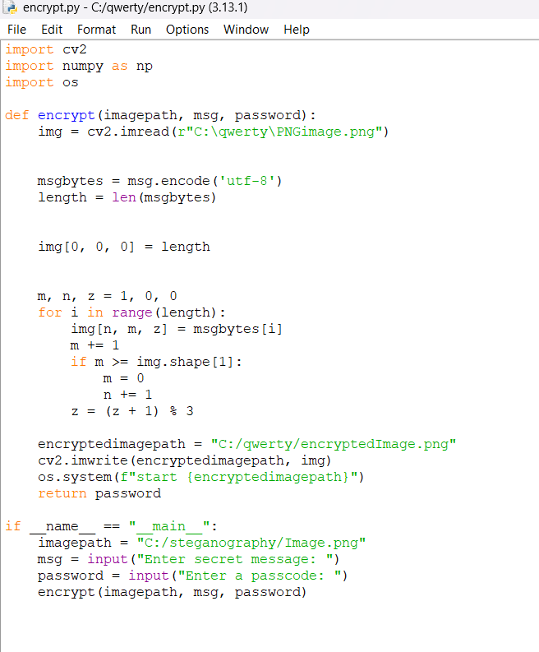
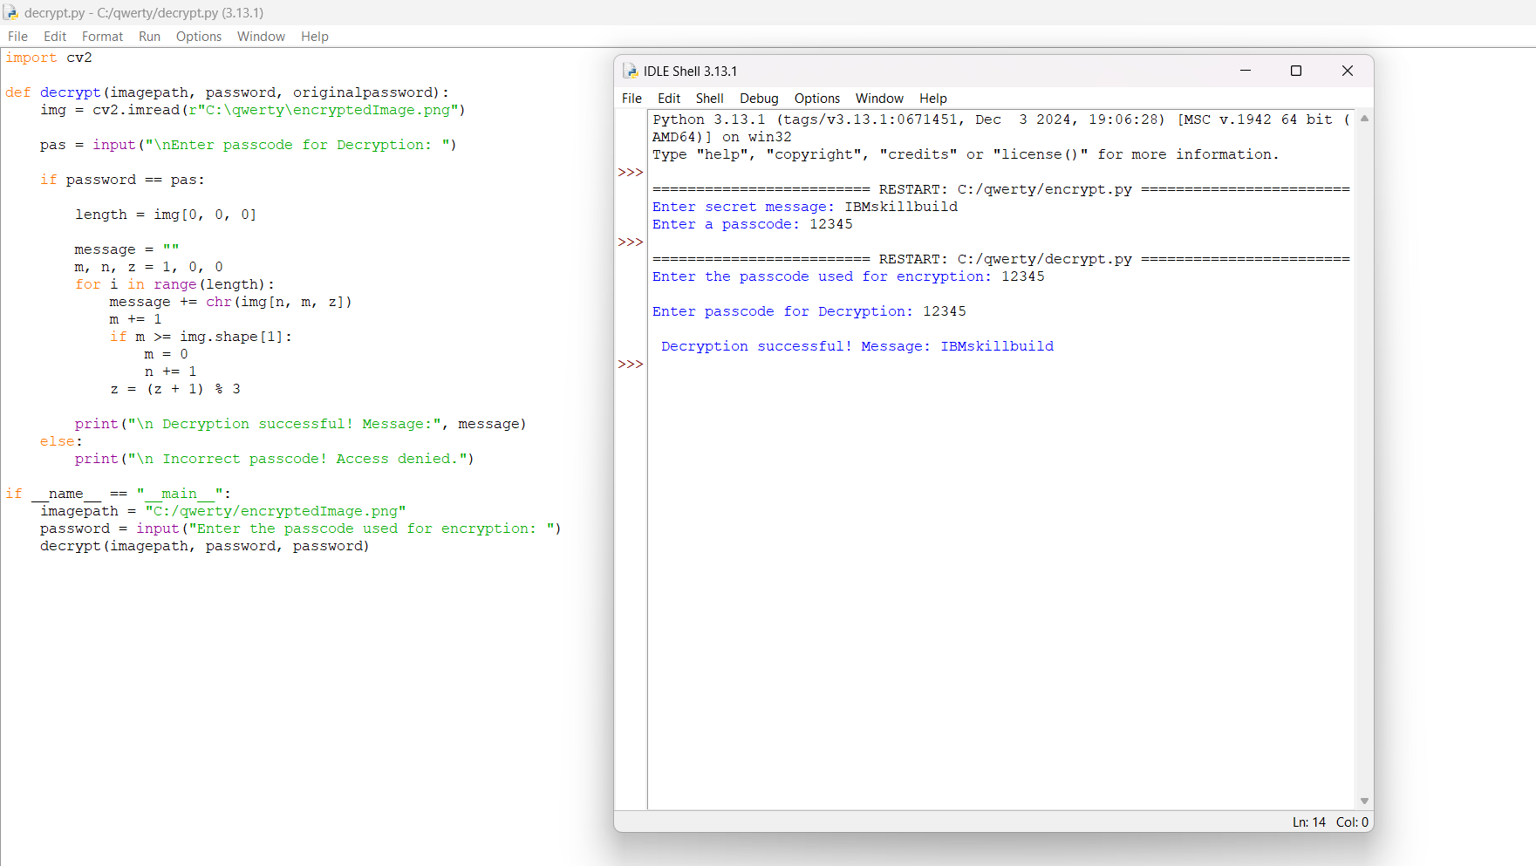
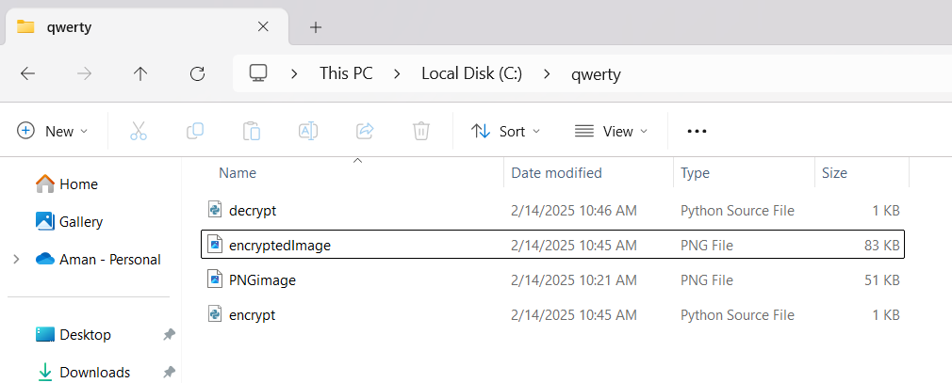
Results

Slide 8
Conclusion
Conclusion:-This project successfully implements image-based encryption using steganography. It ensures secure data concealment by embedding secret messages within image pixels, making them undetectable to unauthorized users. The technique enhances confidentiality and security, making it valuable for applications requiring hidden communication and data protection.

Slide 9
GitHub Link
Github Link : https://github.com/Ashraf-781/project_AICTE.git

Slide 10
THANK YOU

