Slide 1
STORED PROCEDURES
Ashraf Swaidan – Mahdi Dhaini

Slide 2
AGENDA
Introduction​
MANTASK Overview
Database Structure
A Stored Procedures Talk
​Conclusion​

Slide 3
Introduction
Originally intended to spotlight the creation of sophisticated stored procedures within a database, our journey took an innovative turn. Amidst our pursuits, we envisioned a practical application for these procedures, thus paving the way for 'Mantask.' While our primary goal was to exemplify the prowess of these procedures, Mantask organically emerged as a dynamic environment where we seamlessly blend their functionalities. This evolution encapsulates our commitment to not merely showcase technical expertise but also to create an immersive space where the power of stored procedures meets real-world utility.

Slide 4
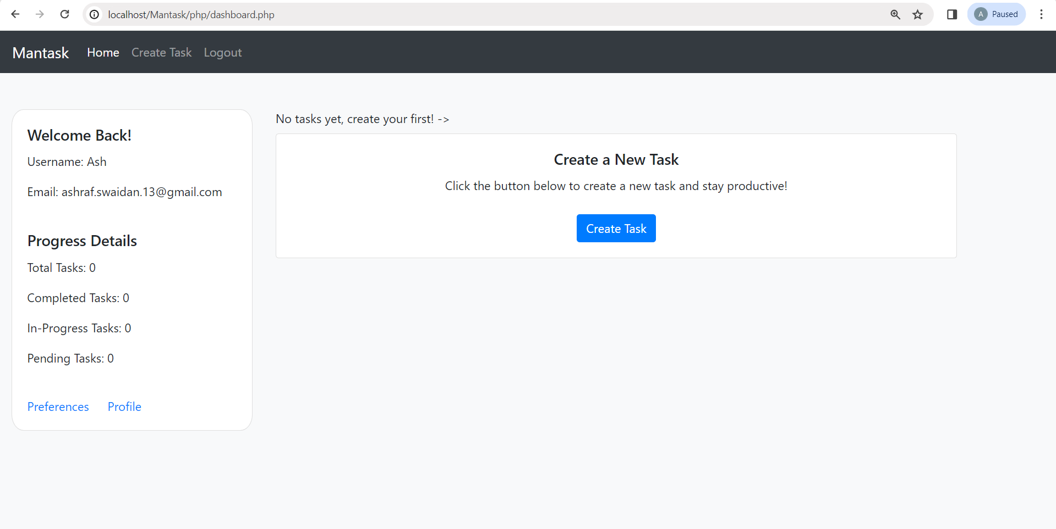
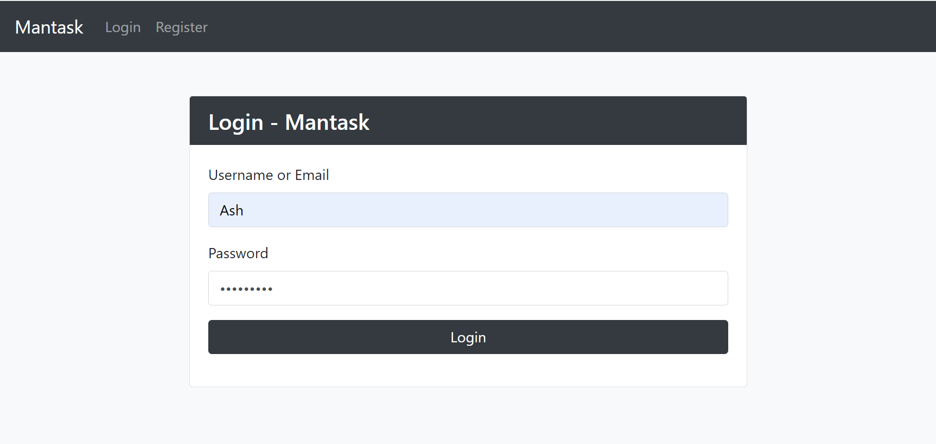
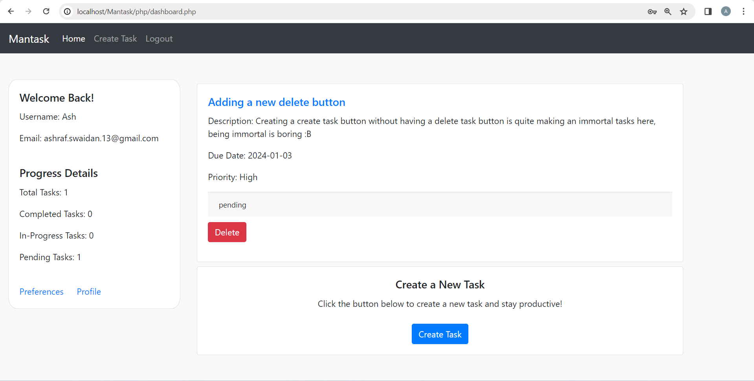
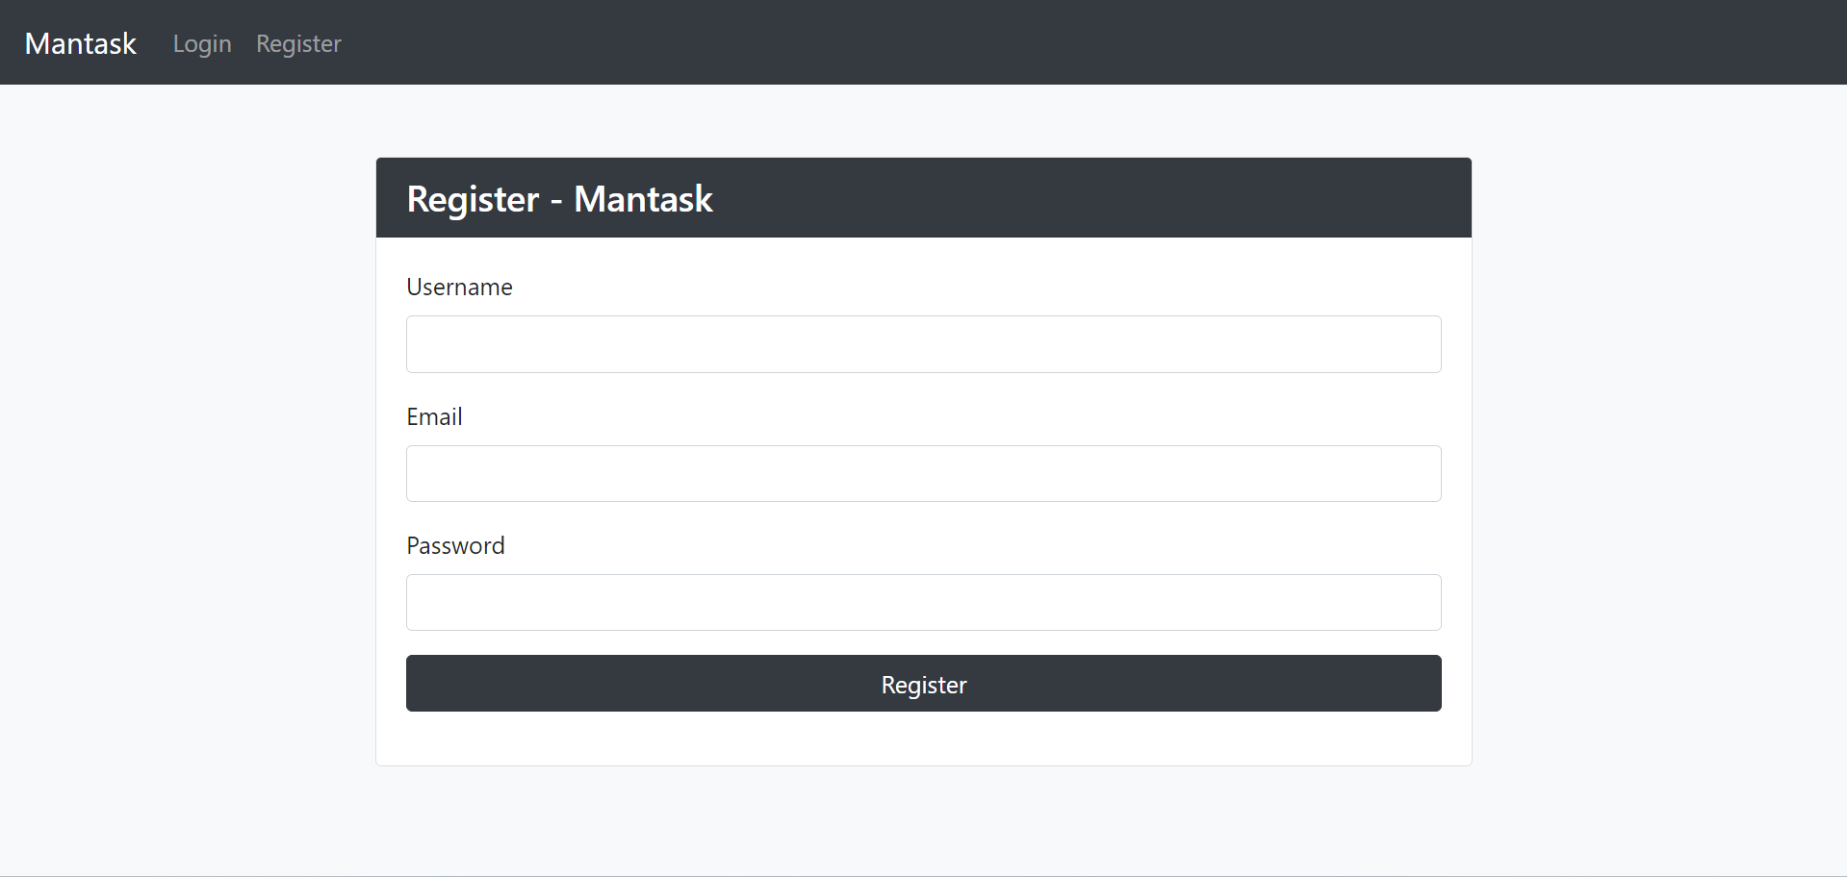
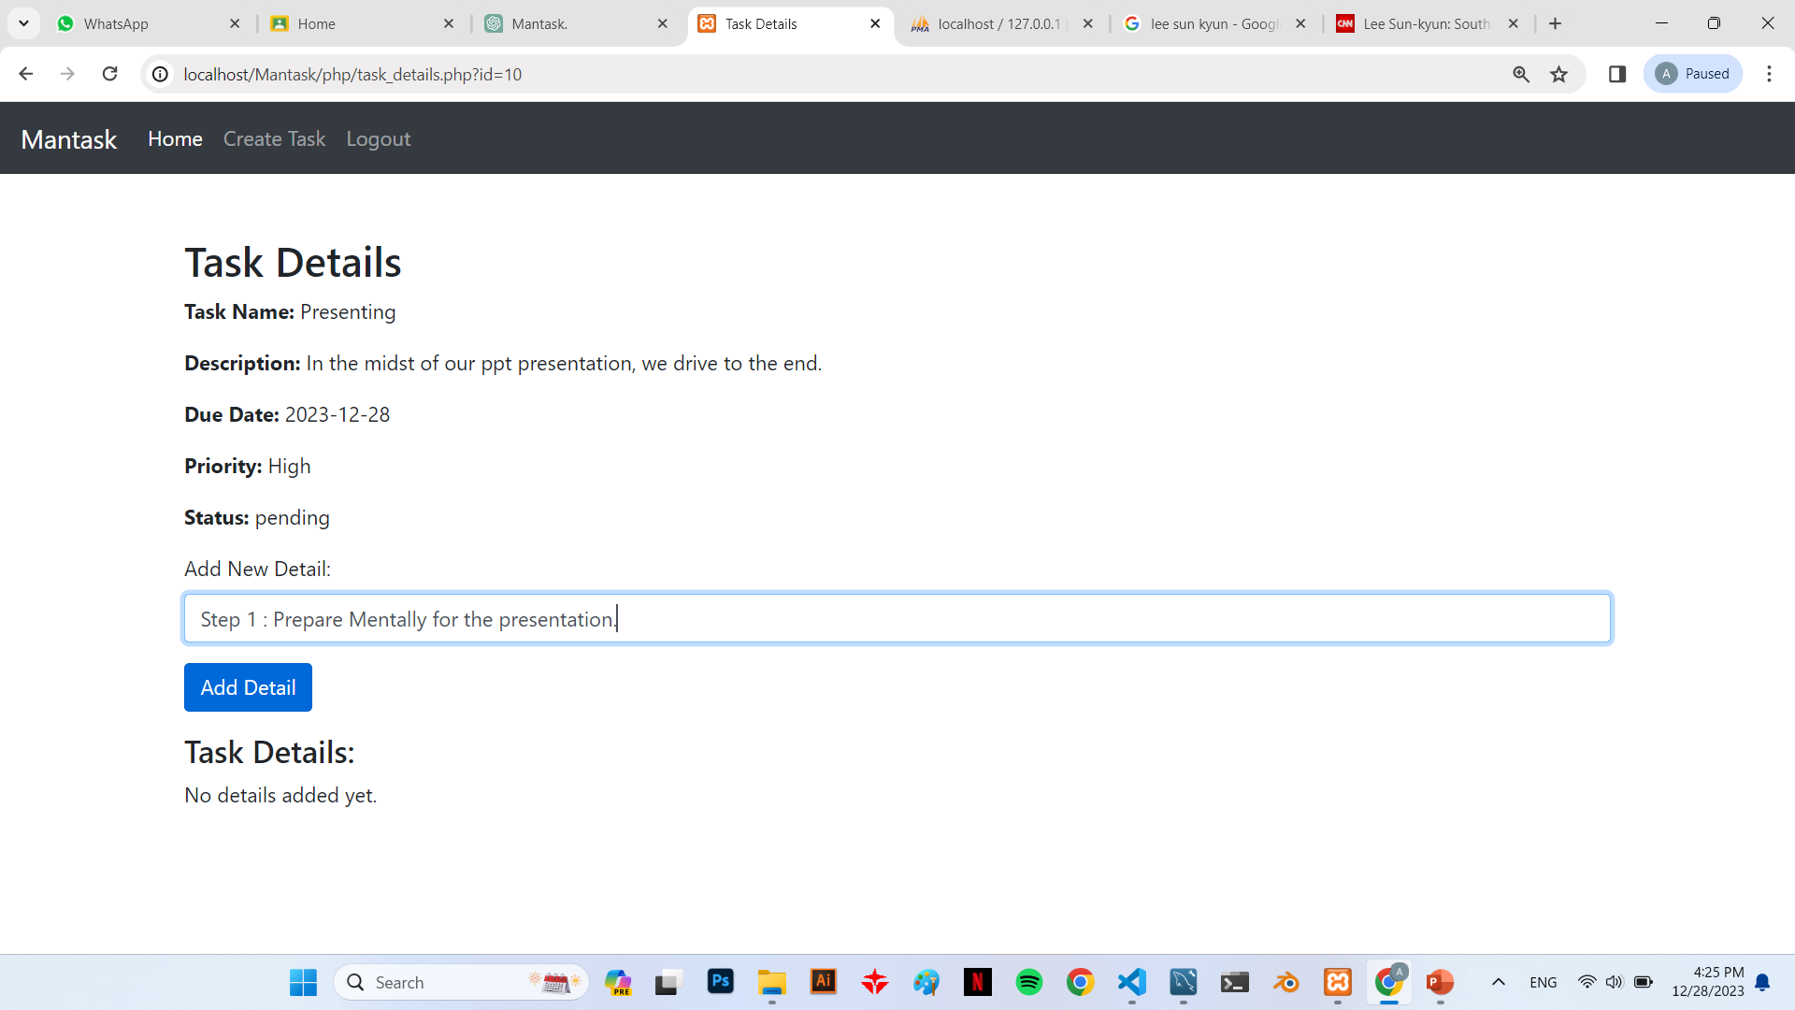
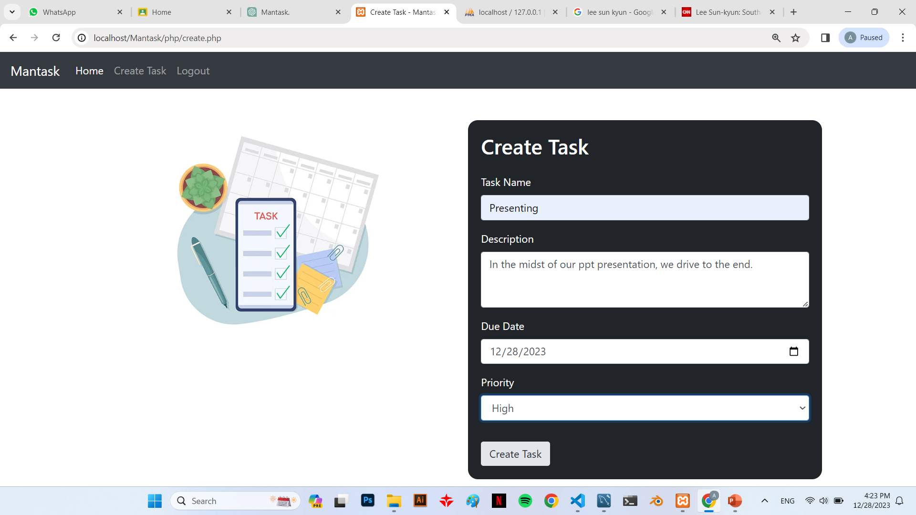
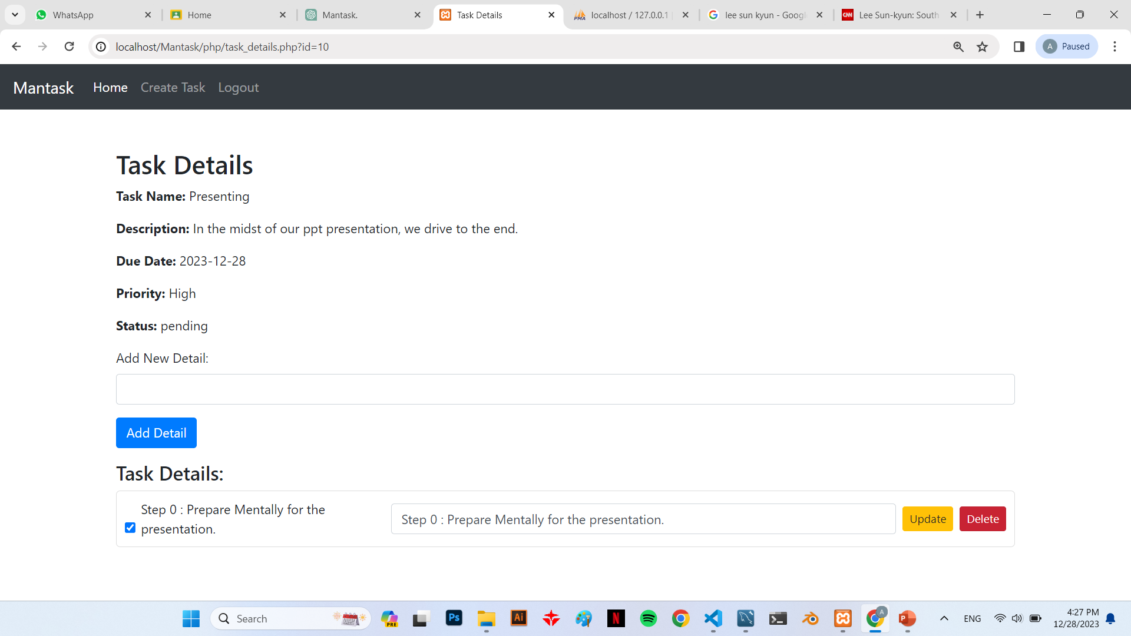
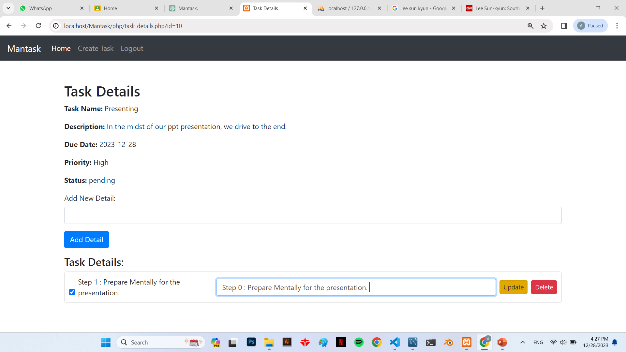
MANTASK PREVIEW
LOGIN VALIDATION
USER REGISTERATION
TASKS CREATION
Where our space took place
TASKS DELETION
TASKS INSIGHTS
Mantask is a comprehensive task management application designed to simplify and streamline the way users organize, track, and accomplish their tasks efficiently. This innovative platform offers a user-friendly interface with various features tailored to enhance productivity. Mantask allows users to create tasks, categorize them based on priority, set due dates, and track their progress. It also incorporates checklist functionality, enabling users to break down tasks into smaller, manageable steps.
TASK’S SUB-STEPS

Slide 5
MANTASK PREVIEW
LOGIN VALIDATION
Where our space took place
The login form is the gateway for registered users to access their accounts securely. Users can log in using their previously created credentials; A complete SECURE process.
USER REGISTERATION
Mantask's registration form allows new users to create accounts by providing essential information such as a unique username, email address, and password.
TASKS CREATION
TASKS DELETION
TASKS INSIGHTS
TASK’S SUB-STEPS

Slide 6
MANTASK PREVIEW
TASKS CREATION
Where our space took place
users effortlessly create tasks by inputting essential details such as task name, description, due date, and priority. These tasks are securely stored in the database, linked to unique user IDs for easy organization and retrieval.
TASKS INSIGHTS
Through the dashboard that views tasks created, Mantask's insights feature also provides valuable metrics, including the total number of tasks, completed tasks, pending tasks, and those in progress.
TASK’S SUB-STEPS
TASKS DELETION

Slide 7
MANTASK PREVIEW
TASK’S SUB-STEPS
Where our space took place
Users can efficiently organize their tasks by creating sub-steps within each task. This feature enables users to break down complex tasks into manageable subtasks for better planning and execution.
TASKS SUB-STEPS MANAGEMENT
A user can also edit any sub-step and either update it , or delete it entirely. All modifications are indeed connected to the database to maintain accurate connection between the frontend and the backend.

Slide 8
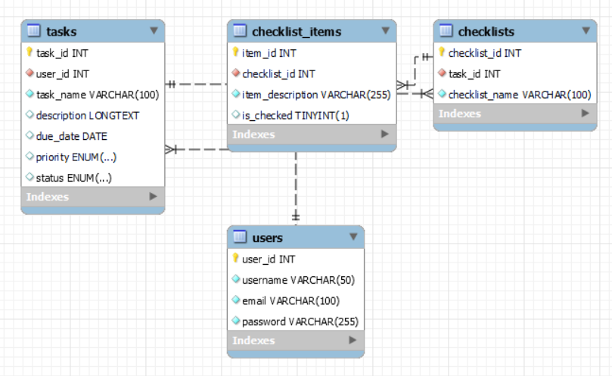
DATABASE EER DIAGRAM

Slide 9
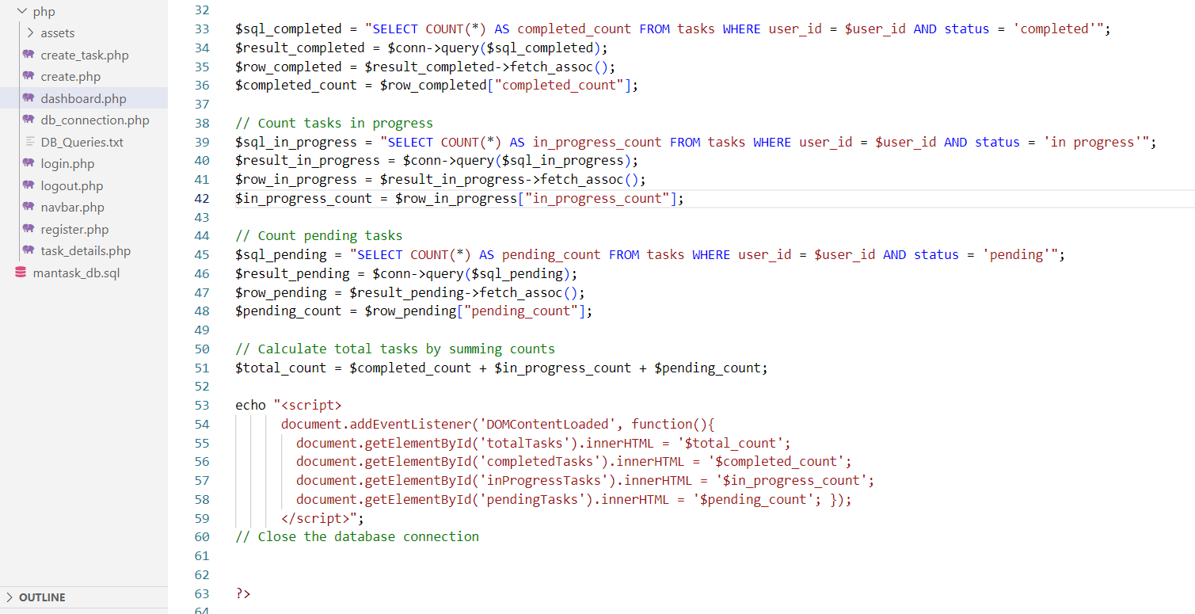
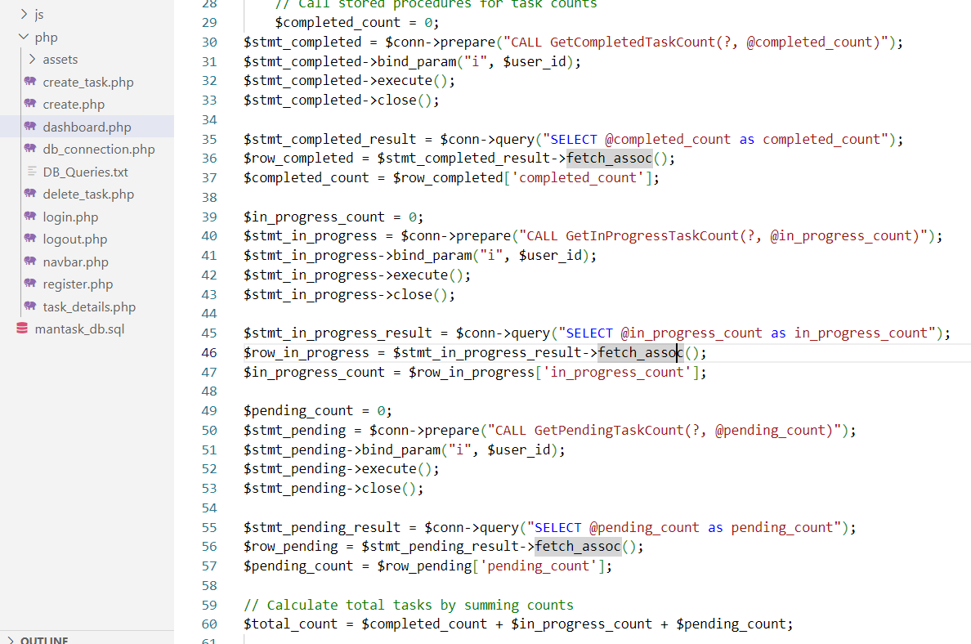
A Transition EXAMPLE; FROM RAW-PHP CODE INTO STORED PROCEDURES
“
”
This block of code is responsible for counting the number of tasks labelled as “pending” for now, using raw-php code and a direct implementation of query.
After transitioning into the use of stored procedures, here lies the result.
Yet, what happened behind the scenes ?

Slide 10
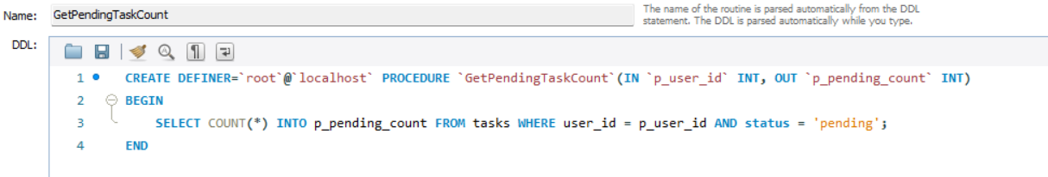
A Transition EXAMPLE; FROM RAW-PHP CODE INTO STORED PROCEDURES
“
”
Taking a look at the query, it got tired from being used directly through the code and chose to be a citizen in the state of stored procedure : GetPendingTaskCount, A True Secure State :D
The following stored procedure took user_id as an input, and pending count as an output, that which was used in the code.

Slide 11



Key Points in THE Transition
Security
MODULARITY
DATABASE ABSTRACTION
Stored procedures encapsulate SQL logic, reducing the risk of SQL injection attacks.
Transitioning to stored procedures offers several advantages, primarily in terms of security, performance, and code maintainability.
Stored procedures promote modularity by allowing the reuse of common database logic across multiple application components.
It ensures a more structured and secure approach to database operations, benefiting the Mantask project in the long run.
Separation of database logic into stored procedures abstracts the database structure from the application code, enhancing maintainability.

Slide 12
EXTENDED ADVANTAGES
Stored procedures are precompiled and optimized, resulting in faster execution times compared to raw SQL queries.
Reduces network traffic by executing code on the database server rather than sending multiple queries from the application.
Changes in the database structure can be localized within stored procedures without affecting application code.
Optimized database operations can handle larger volumes of data efficiently.
Reduces the load on the application server, enabling better scalability.
Enhances abstraction between the database layer and application code, facilitating easier maintenance and updates.
Allows better control over transactions within the database, ensuring data integrity and consistency.
Promotes standardized database access and operations across different parts of the application.
Optimized query execution leads to reduced server load and improved resource utilization.
Ensures consistency in database interactions, irrespective of changes in the application logic.

Slide 13
IN CONCLUSION
You made it this far , THANK YOU!
We hope you learned something :D
Transitioning to stored procedures in Mantask has been a significant learning experience. We gained insights into database optimization and security measures, understanding the importance of encapsulating logic within stored procedures. This process illuminated the significance of code modularity, reusability, and performance optimization in software development, enriching our understanding as students of creating robust and secure applications.

