Slide 1
EMBEDDED SYSTEMS PROJECTS

Slide 2

TEAM PRESENTATION:
PAMIDI MOHAMMAD ASHRAF
S20210020303
SANDEEP NIDAMANURI
S20210020300
PRAVEEN KUMAR
S20210020313
J MOHITH NAGA VARDHA GANESH
S20210020283

Slide 3
1
Wireless Stethoscope
Let’s start with the first set of slides

Slide 4
Most heart diseases are associated with and reflected by the sound that the heart produces, and one of the easiest and cheapest ways of diagnosing cardiac dysfunction is by Heart auscultation i.e. listening to the heart sound. Now if we are talking about traditional auscultation, that requires experience and good listening skills. That is why in this project we thought to build an electronic stethoscope that will be able to get the heart rate of the human body and we can display the data in a Bluetooth-based serial terminal window.
ABSTRACT:

Slide 5
BLOCK DIAGRAM:
LM393
Analog Comparators
Power Supply
AD8232
ECG Sensor
Node MCU
Stethoscope chest piece
ECG Lead Wires
App Interface

Slide 6
COMPONENTS:
HARDWARE | SOFTWARE
LM393 Analog Comparators Breadboard Stethoscope chest piece Medical grade tube Jumper Wires Node MCU AD8232 ECG Sensor ECG Lead Wires | Arduino IDE App Interface using MIT app inventory Web Interface (UBIDOTS) Firebase

Slide 7
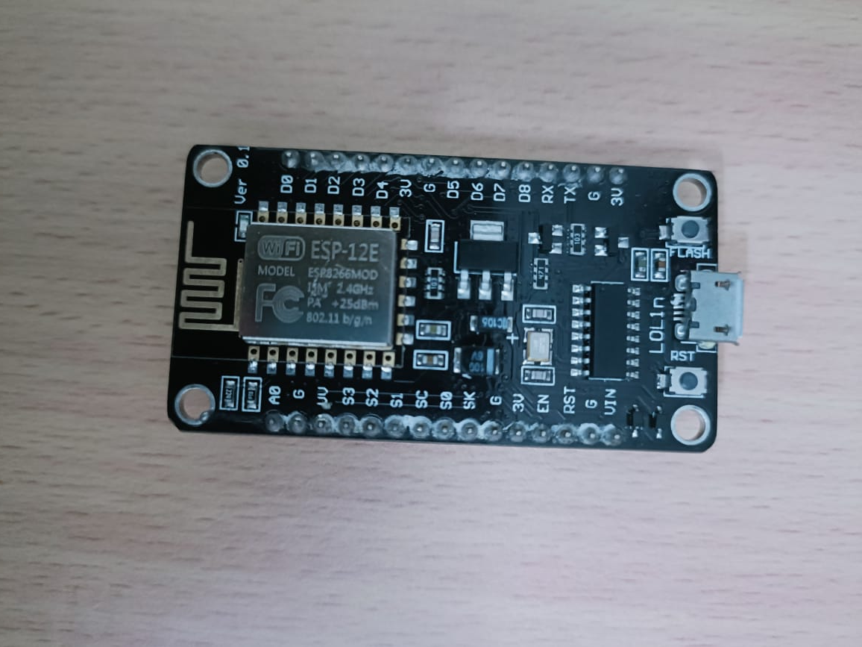
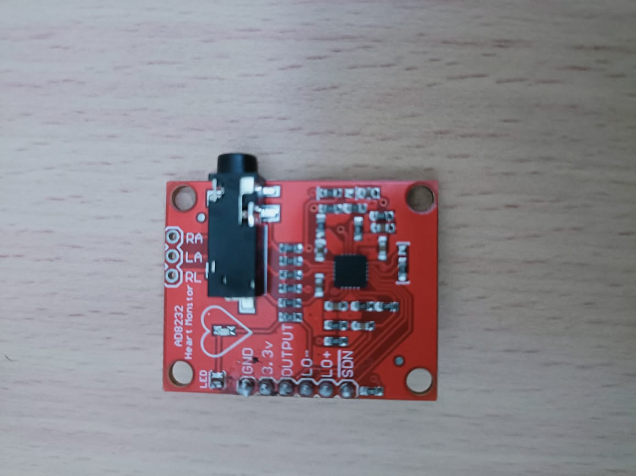
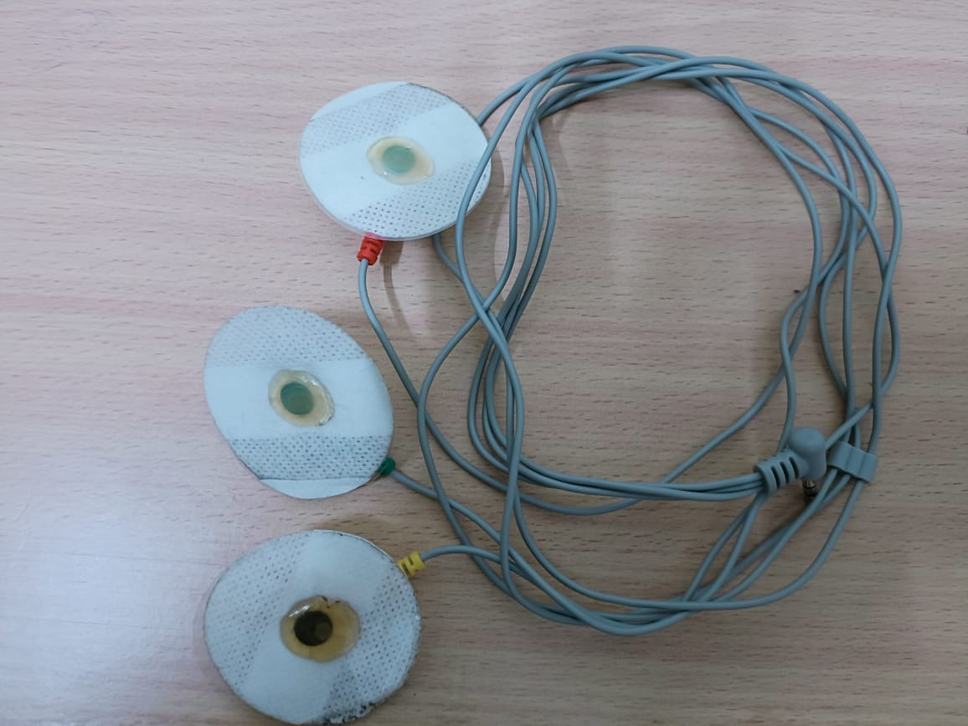
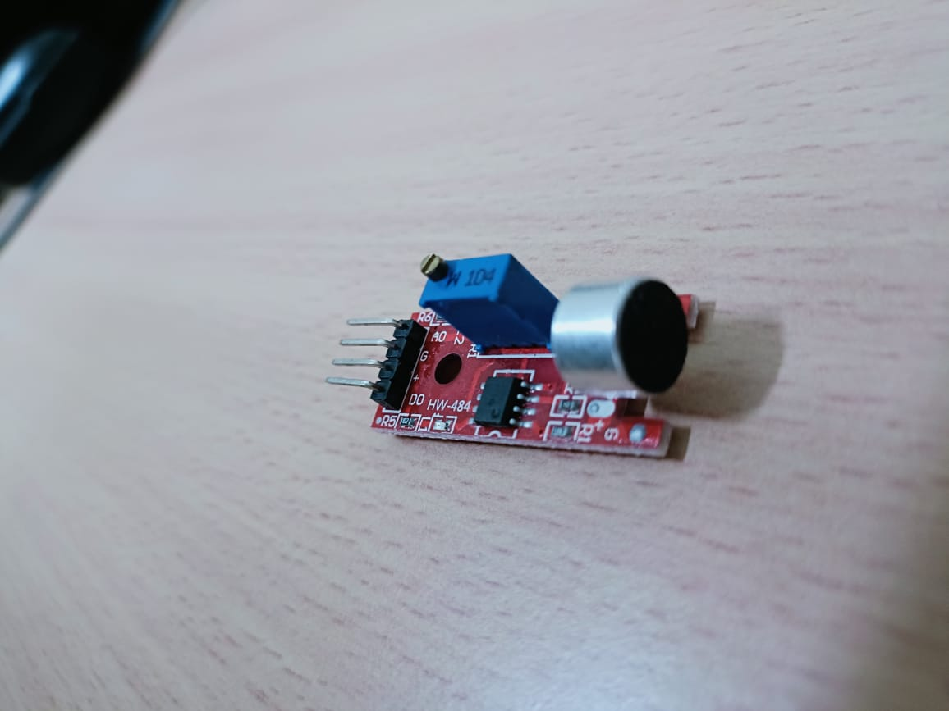
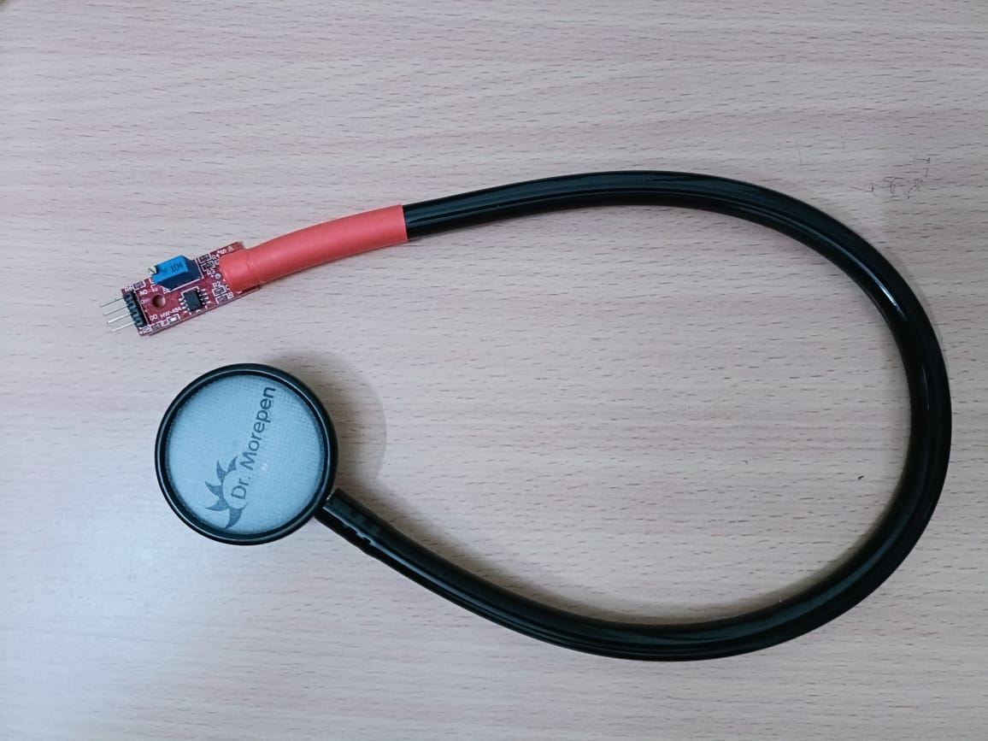
HARDWARE COMPONENTS
Node MCU
ECG Lead Wires
AD8232 ECG Sensor
LM393 Analog Comparators
Stethoscope chest piece

Slide 8
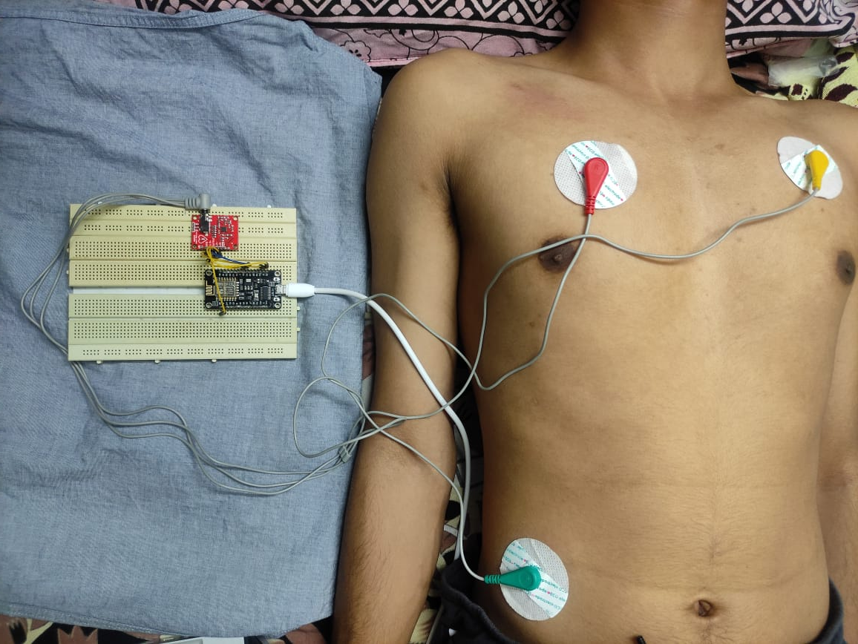
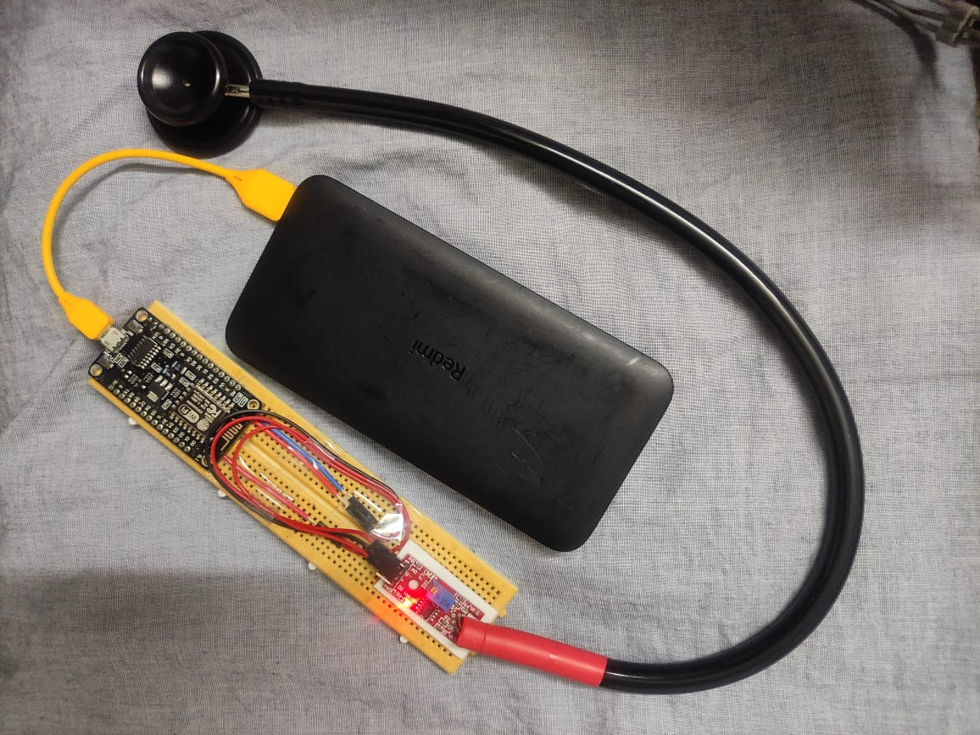
Project Models
Remote ECG
Remote Stethoscope

Slide 9
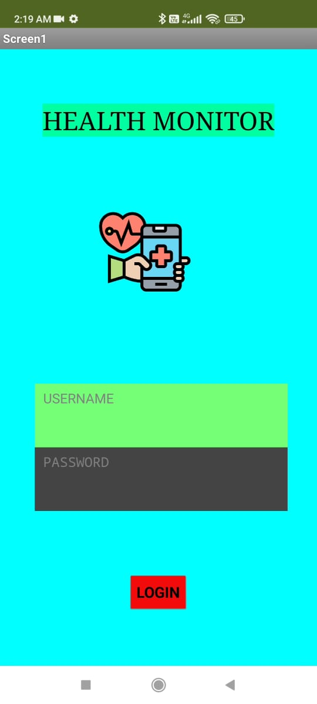
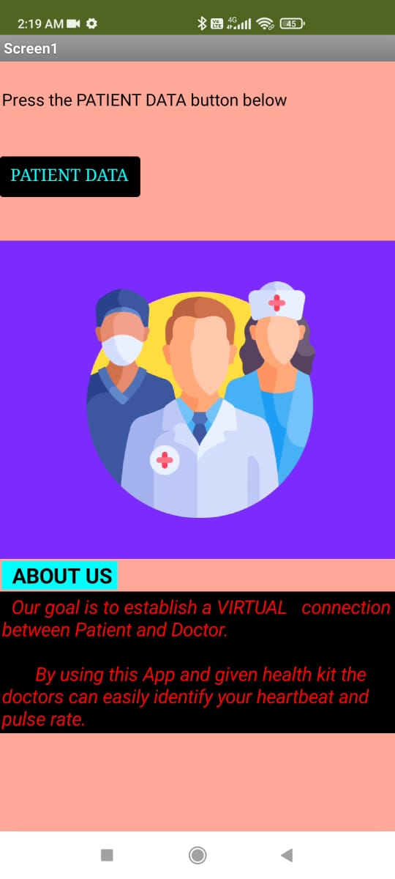
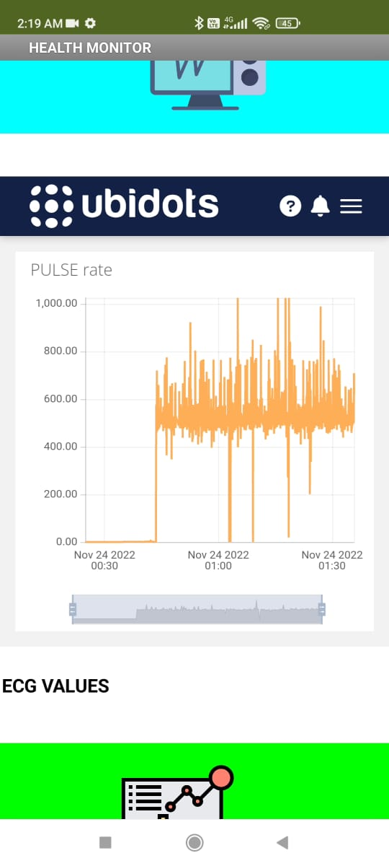
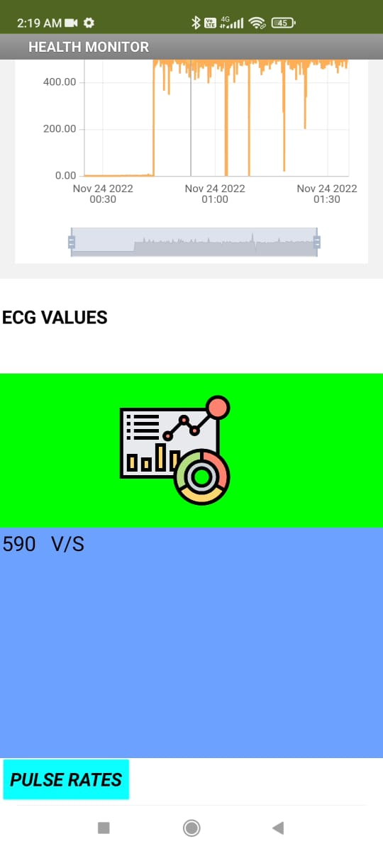
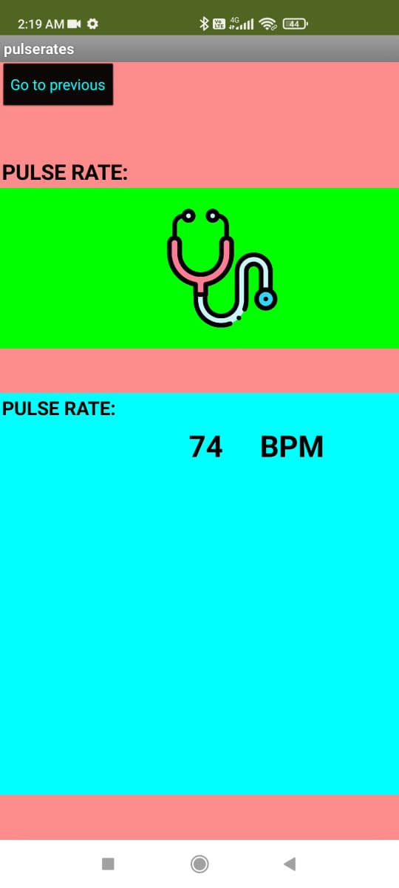
App Interface
Login Page
Introduction Page
ECG Graph
ECG Values
BPM Values

Slide 10
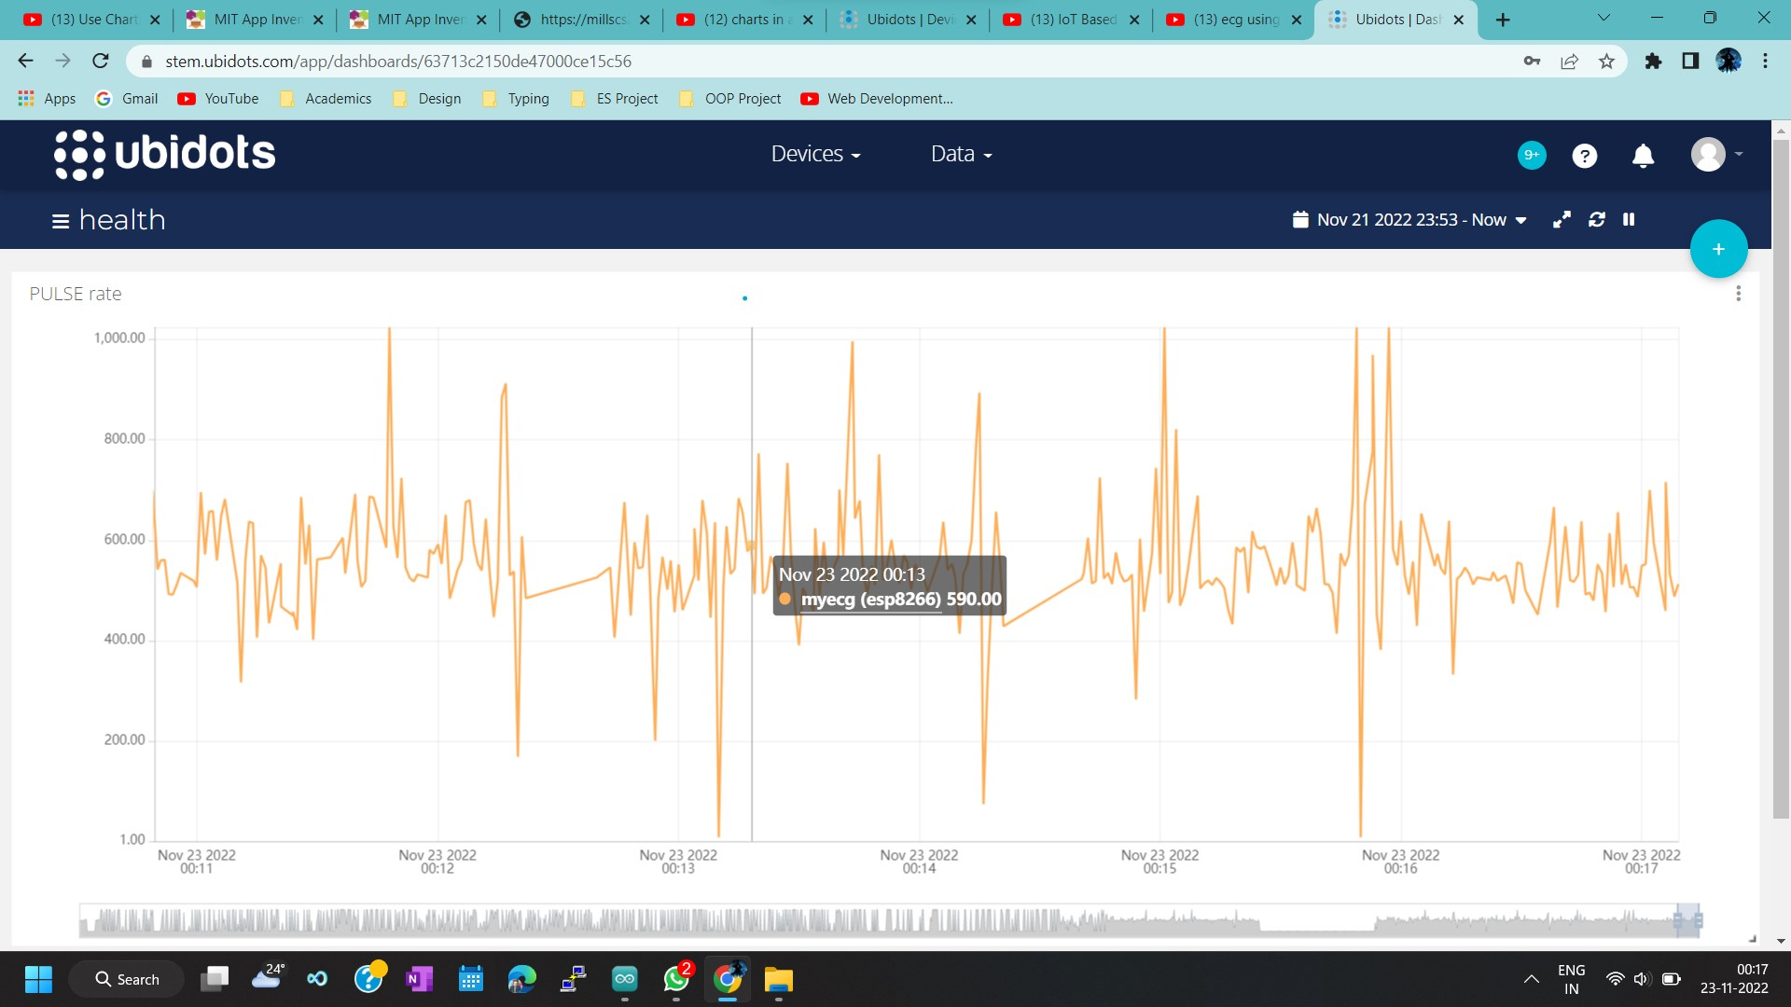
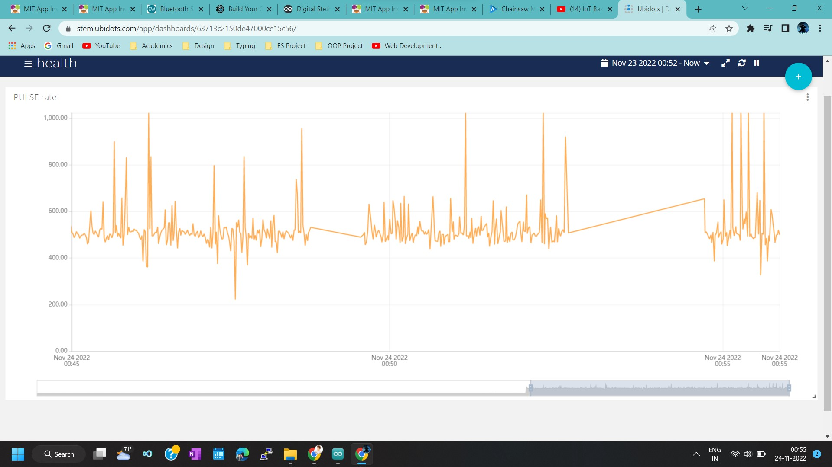
Achieved Outcomes
ECG of subject 1
ECG of subject 2

Slide 11
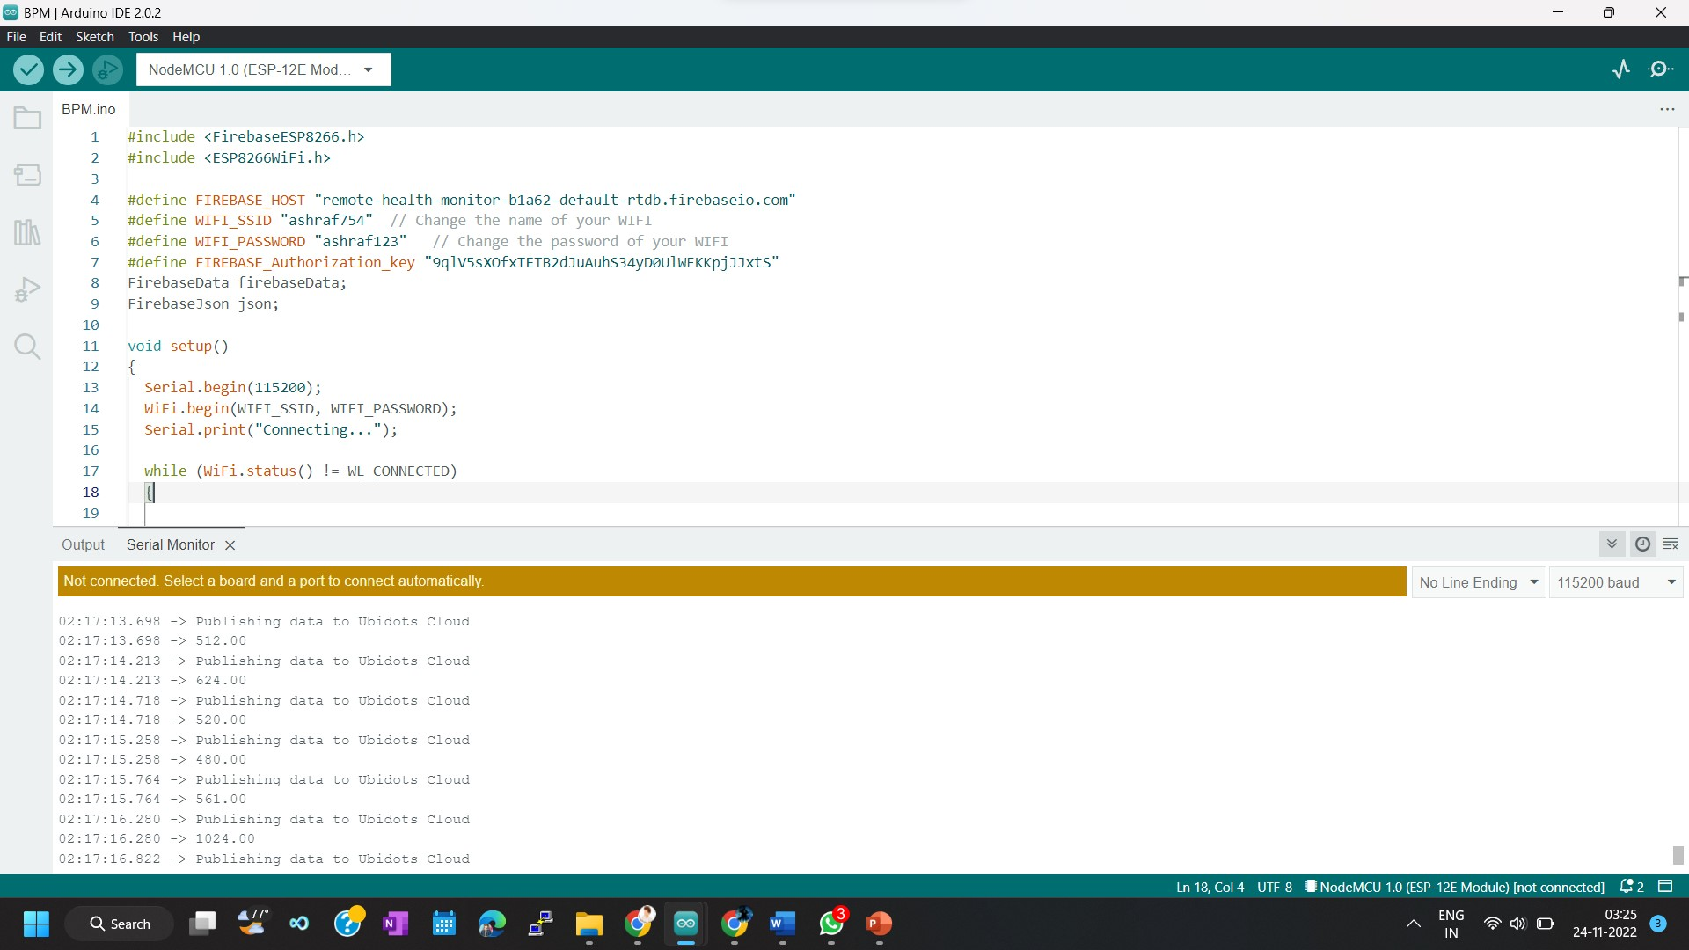
Achieved Outcomes
Pulse rate of the candidate

Slide 12
Phase Wise Implementation:
Phase-I: Outputs for pre-evaluation –
Implemented the ECG using web framework plotting the ECG graph of the subject.
Phase-II: Outputs for final evaluation –
Implemented the wireless stethoscope and that checks the ECG of the subject and stores it in the firebase.
Developed an app that communicates BPM (Beats per minutes) and ECG graph and storing in the firebase.
Displaying the UI in the MIT app inventory built.

