Slide 1




HUMAN STRESS DETECTION AND PREDICTION SYSTEM USING ANN
TEAM 3

Slide 2
INTRODUCTION
HUMAN STRESS DETECTION
Stress is a significant health issue that adversely affects both physical and mental well-being. To address this challenge, we propose the development of a Stress Monitoring and Prediction System designed to assess and analyze physiological data, such as sleep patterns, movement, and respiration rates. This system will utilize advanced sensors and data collection methods to continuously monitor individuals’ health metrics, enabling real-time detection of stress levels and patterns derived from various physiological indicators.
OBJECTIVE
The primary objective of this project is to create an Artificial Neural Network (ANN) model that accurately predicts individual stress levels based on the analysis of collected data. By recognizing correlations between physiological parameters and stress responses, the ANN will provide users with valuable insights into their stress triggers and levels. This proactive approach empowers individuals to implement effective stress management strategies, ultimately enhancing their overall well-being and resilience in the face of daily challenges.

Slide 3
TECHNOLOGIES USED
Programming Language: Python
Framework: Django
IDE: Visual Studio Code
Model Type: Artificial Neural Network (ANN)
Data Visualization: Matplotlib, Seaborn

Slide 4

PROJECT OVERVIEW
CREATE A NEW USER ACCOUNT to access the stress detection application.
LOGIN WITH YOUR USERNAME AND PASSWORD to secure your personalized dashboard.
INPUT HEALTH DATA including Snoring Rate, Respiratory Rate, Body Temperature, Limb Movement, and more.
RECEIVE STRESS PREDICTION RESULTS generated by the Artificial Neural Network (ANN) model to monitor and manage stress levels.
VIEW PAST PREDICTIONS and health data, providing insights into your stress patterns over time.

Slide 5
PROJECT MILESTONES
Milestone 01: Data Preprocessing
Data Cleaning and Preparation: Preprocessed and cleaned the data to ensure accurate analysis.
Visualizations: Utilized tools like bar charts, correlation matrices, and pair plots to explore relationships among variables.
Milestone 02: ANN Model Design
Model Structure: Designed the ANN model with specific layers tailored to the input parameters, enabling precise stress level predictions.
Performance Metrics: Visualized the training process using metrics such as accuracy and loss to monitor model performance.
Milestone 04: Model Deployment
Milestone 03: Model Training and Visualization
Training: Trained the model on the dataset, optimizing hyperparameters.
Integration: Deployed the ANN model within the Django application.
User Experience: Ensured a seamless user experience where predictions are generated in real-time based on user inputs.

Slide 6
MILESTONE –1 Data Preprocessing & Visualization

Slide 7
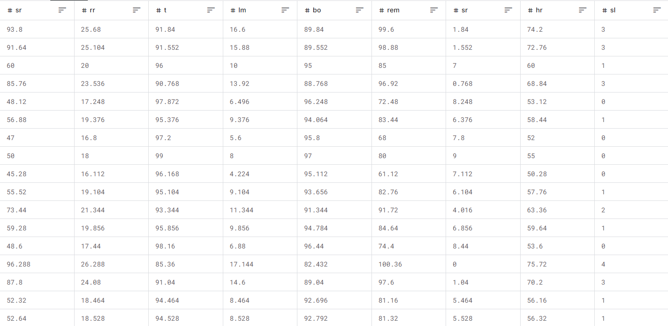
Data Preprocessing & Visualization
The dataset includes physiological data such as snoring rate, respiratory rate, body temperature, limb movement, and other health parameters to predict stress levels using an Artificial Neural Network (ANN) model. This comprehensive data helps in accurately monitoring and managing stress in real-time.

Slide 8
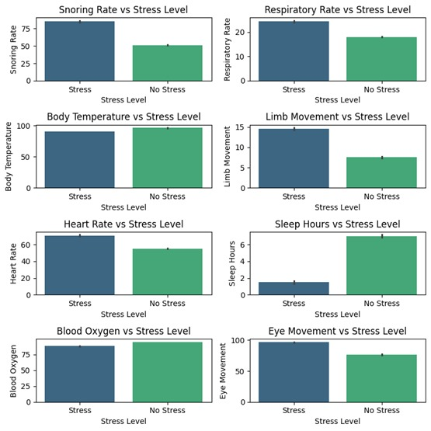
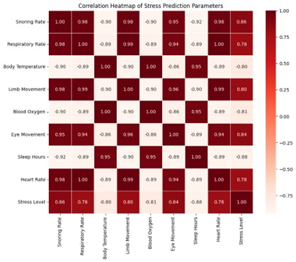
Data Preprocessing & Visualization
Bar Chart
Confusion Matrix

Slide 9
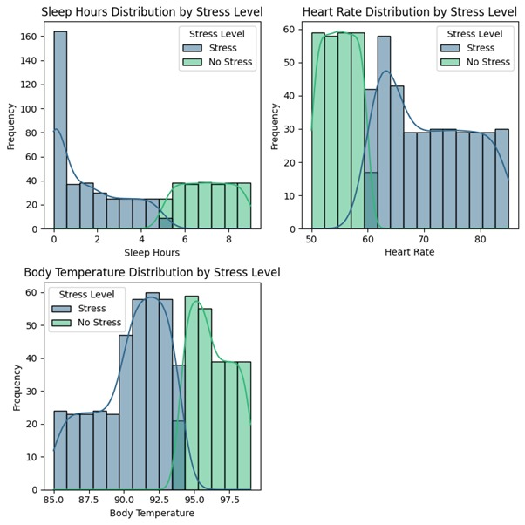
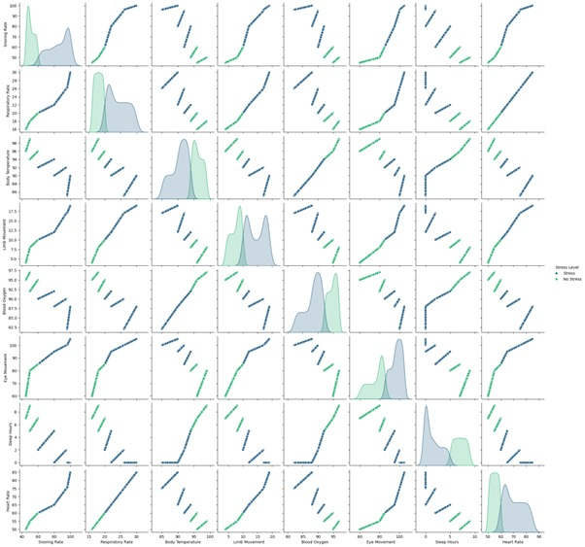
Data Preprocessing & Visualization
Histogram
Pair Plots

Slide 10
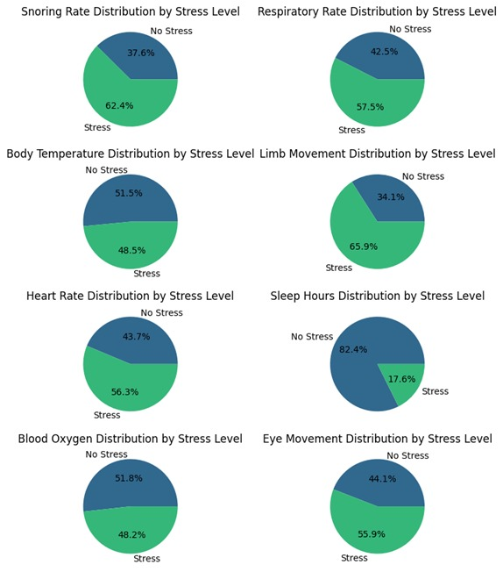
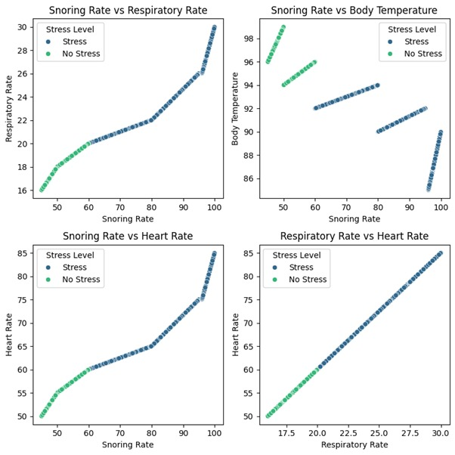
Data Preprocessing & Visualization
Pie Charts
Scatter Plots

Slide 11
MILESTONE – 2 ANN Model Design

Slide 12
ANN Model Design
Input Layer:
Accepts 8 numerical features derived from sleep data: Heart Rate, Body Movements, Respiratory Rate, EEG Data, Sleeping Hours, Blood Oxygen Level, Snoring Rate, and Limb Movement Rate.
Hidden Layers:
First Hidden Layer:
64 neurons with ReLU activation function for capturing complex patterns and relationships in the input data.
Second Hidden Layer:
32 neurons with ReLU activation, reducing the feature space while retaining significant patterns.
Output Layer:
A single neuron with a sigmoid activation function, designed for binary classification, outputting a probability of being stressed or not stressed.
Compilation:
Loss Function: Binary cross-entropy for evaluating the model's performance on a binary classification problem.

Slide 13
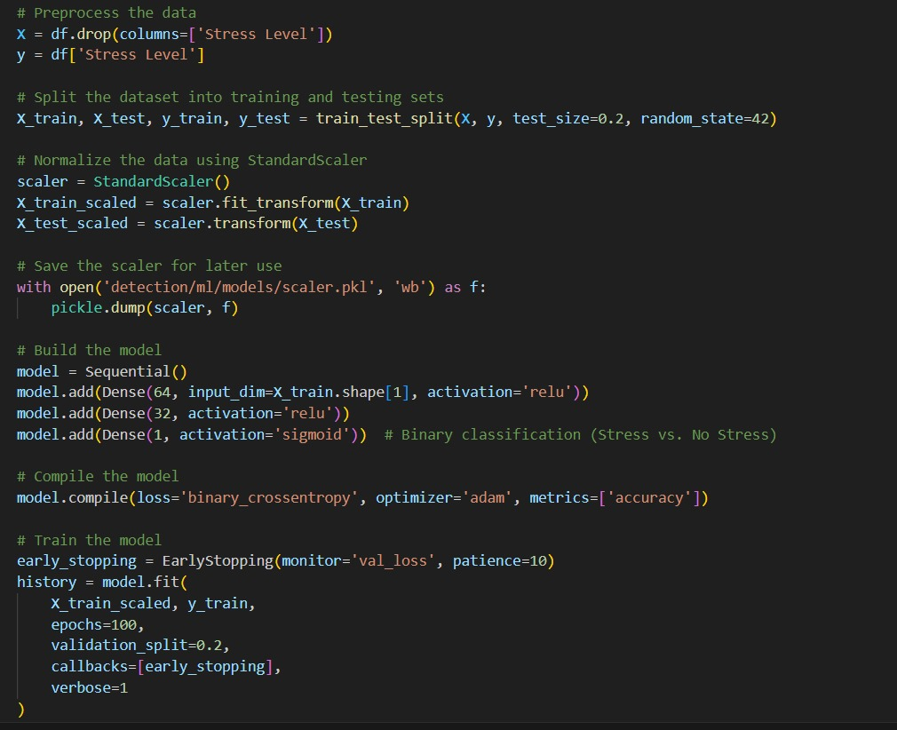
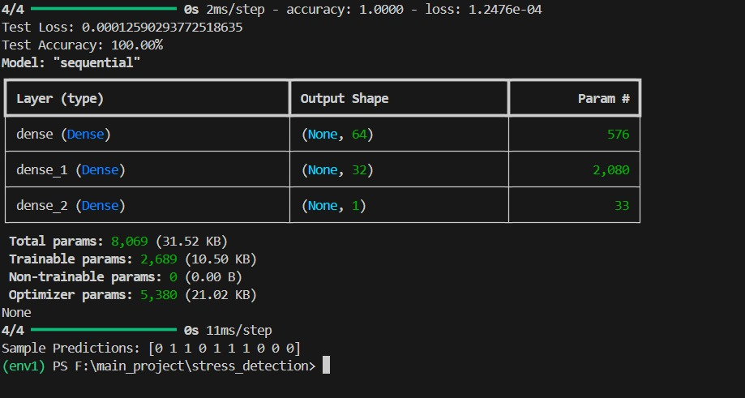
ANN Model Design

Slide 14
MILESTONE – 3 Model Training & Visualization

Slide 15
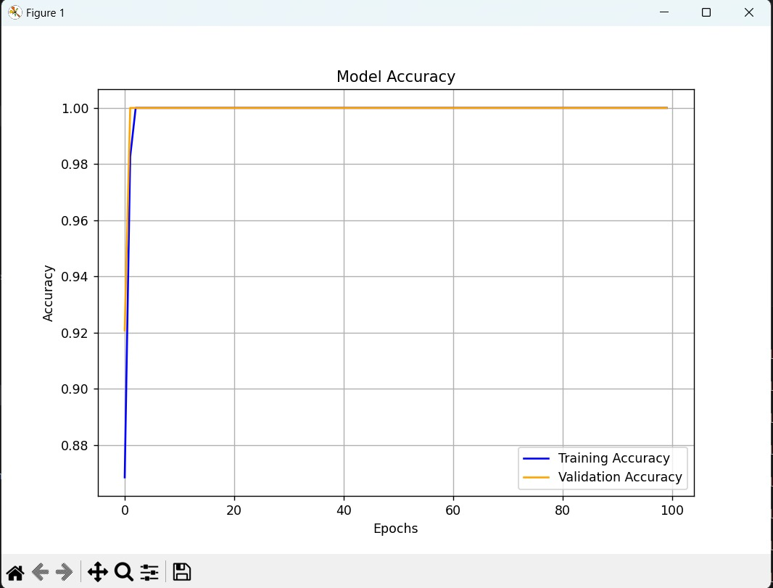
Model Training & Visualization
This graph shows the training and validation accuracy of the model over the course of 100 epochs. The training accuracy starts at around 0.89 and quickly reaches 1.0, indicating that the model is able to perfectly fit the training data. The validation accuracy also increases rapidly, reaching 1.0 by around 20 epochs and remaining there for the rest of the training process. This suggests that the model is able to generalize well to unseen data, and has achieved excellent classification performance.

Slide 16
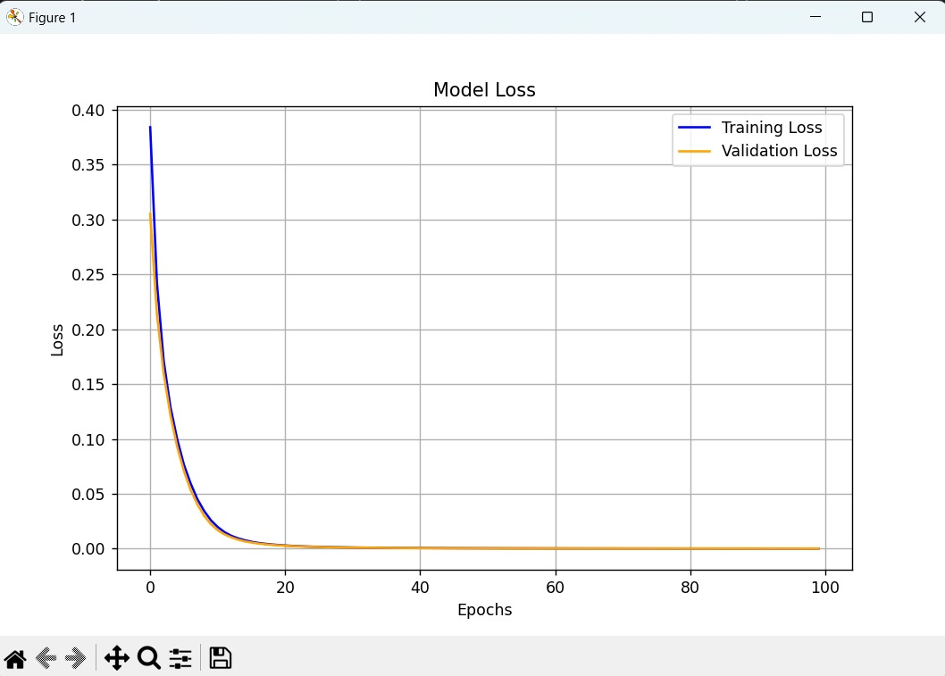
Model Training & Visualization
The graph displays the training and validation loss of the model over the 100 epochs. The training loss starts relatively high but decreases sharply, reaching a very low value of around 0.01 by the end of training. The validation loss follows a similar trajectory, decreasing steadily and reaching a final value of around 0.035. The close alignment between the training and validation loss curves indicates that the model is not overfitting, and is able to effectively minimize the loss on both the training and validation sets.

Slide 17
Model Training & Visualization

Slide 18
MILESTONE – 4 MODEL DEPLOYMENT & USER INTERFACE

Slide 19
Model Deployment :
Framework: Django
To deploy the trained model, I integrated it into a Django-based web application.
The web app provides a user-friendly interface where users can:
Log in securely
Input their physiological data
Instantly receive their stress prediction, along with insights into contributing factors
Leveraging the power of Django's web development framework, the application is able to efficiently process user inputs and generate accurate stress predictions in real-time.
Database: MySQL
For the database, I implemented MySQL to store all relevant user data, including:
User login information
User physiological data inputs
Stress prediction results
MySQL's robust and scalable features ensure the secure storage and retrieval of user data, enabling the web application to provide a reliable and trustworthy service.
By combining the capabilities of Django and MySQL, I was able to create a comprehensive and user-centric web application that seamlessly integrates the trained stress detection model.

Slide 20
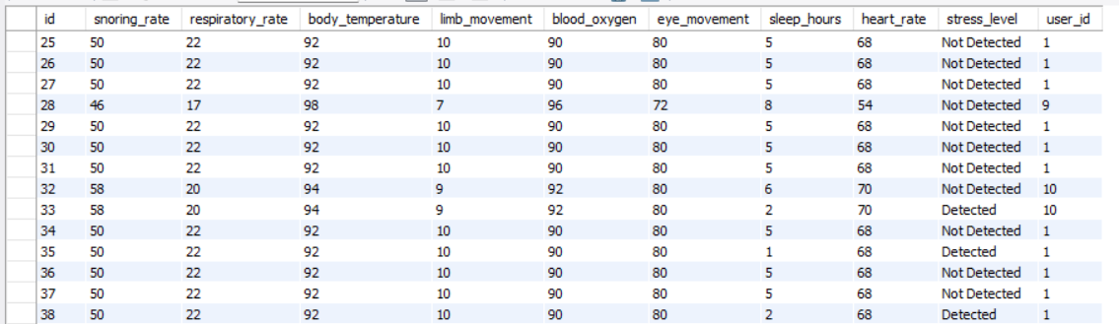
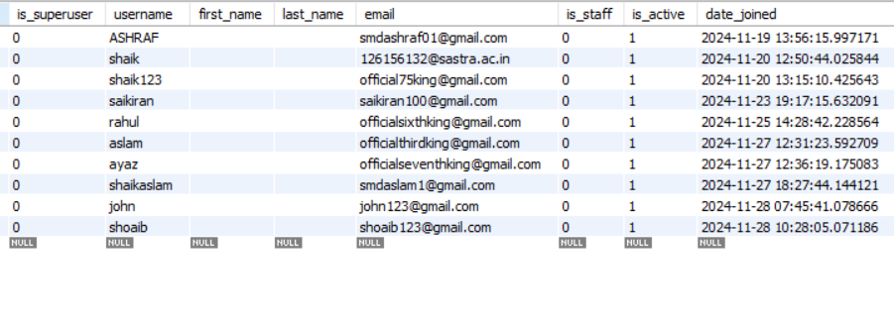

Slide 21
USER INTERFACE

Slide 22
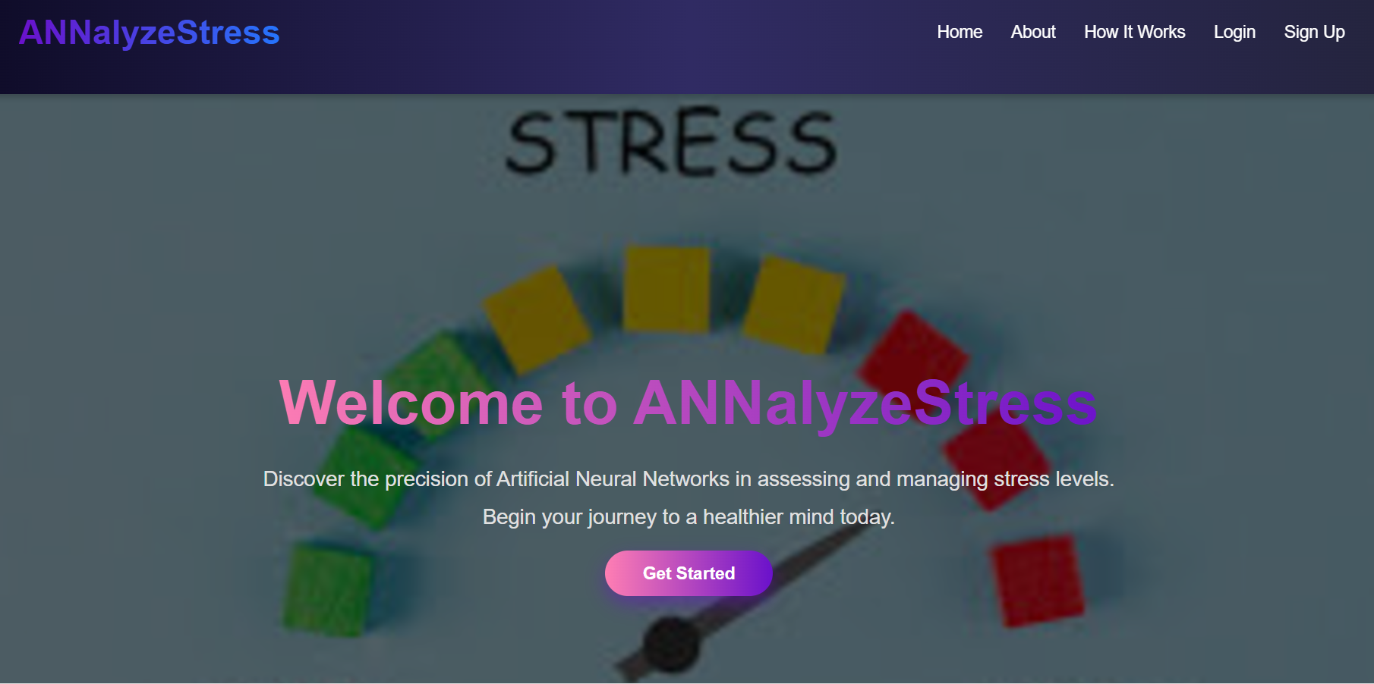
HOME PAGE
Analyze and monitor your stress levels with ease and accuracy! Log in or sign up to get personalized insights and take proactive steps towards better stress management. By pressing the "Sign Up" button, you'll create a new user account and gain access to the application. The "Log In" button allows existing users to enter their personalized dashboard.

Slide 23
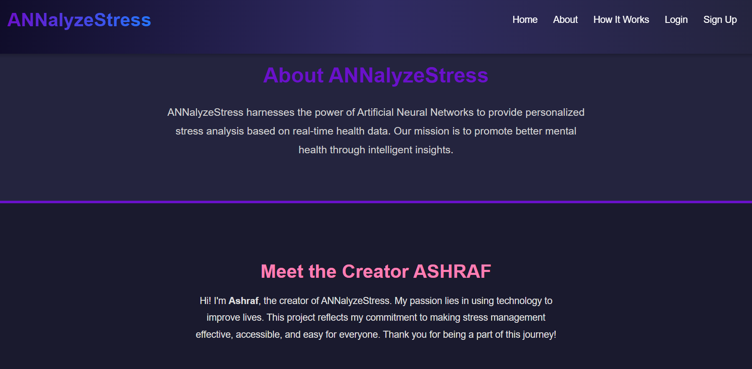
ABOUT PAGE

Slide 24
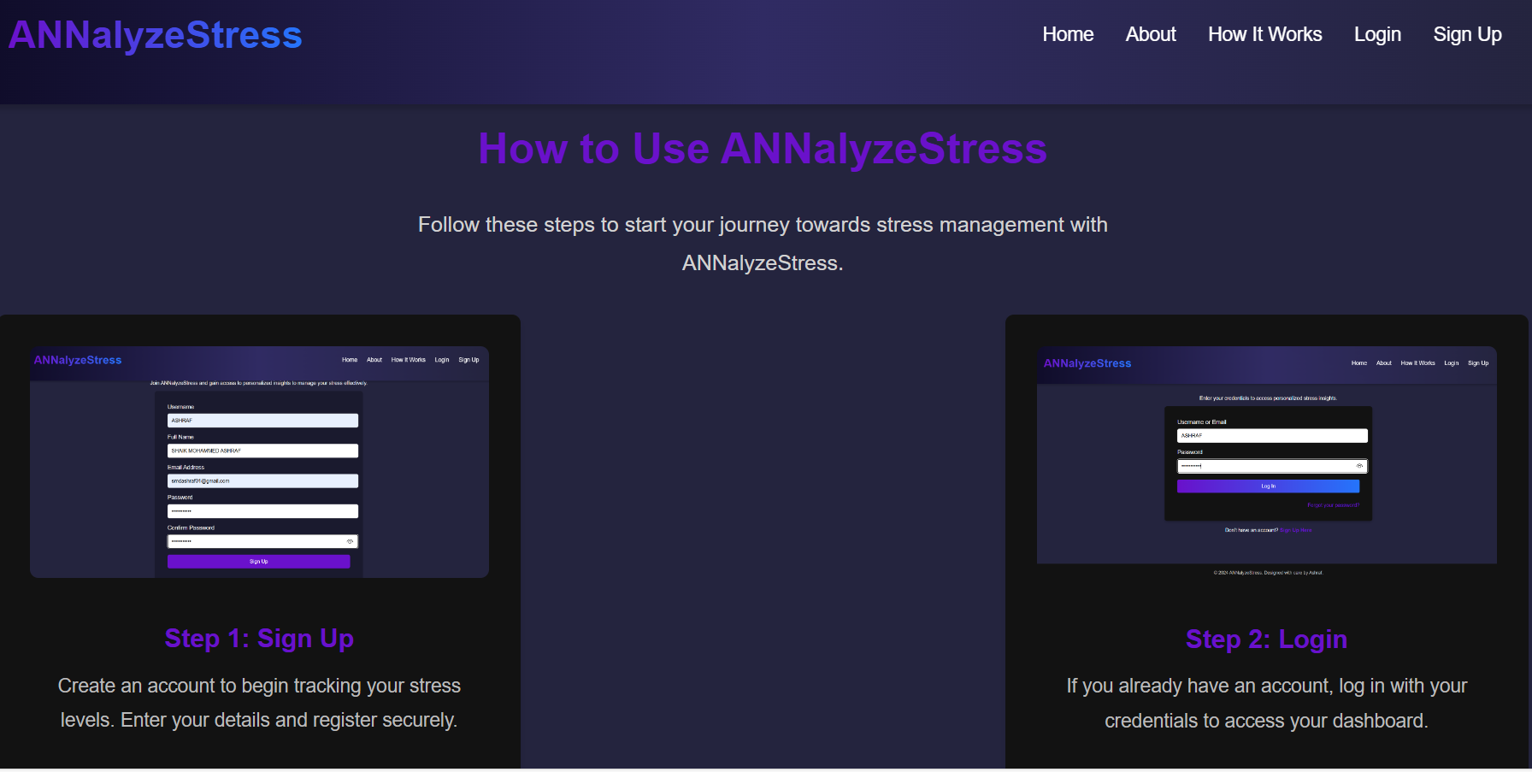
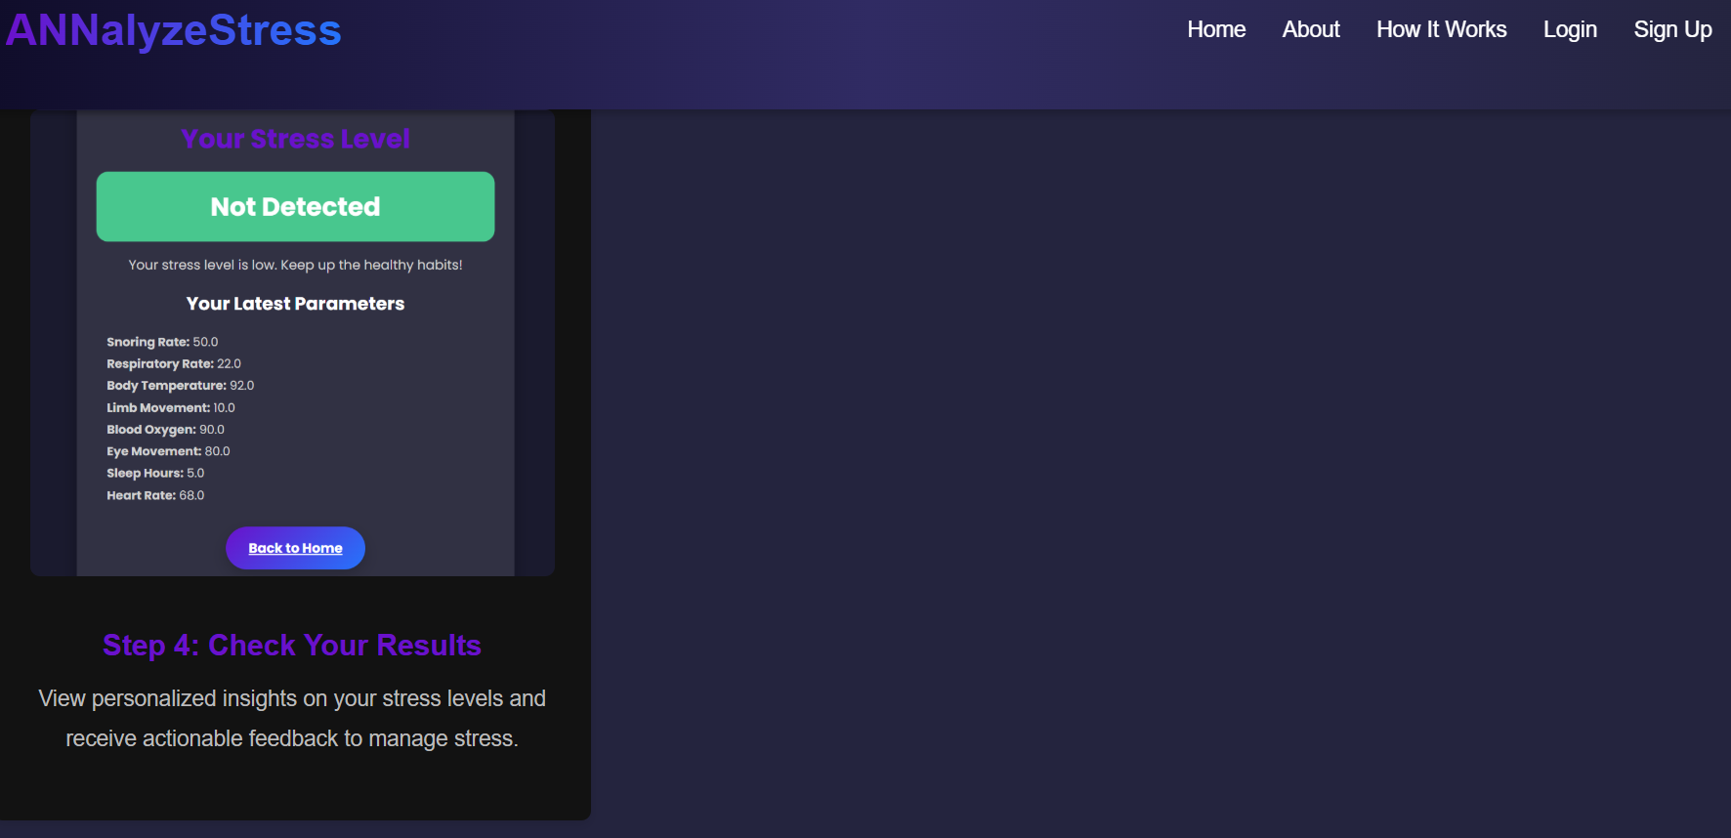
HOW IT WORKS

Slide 25
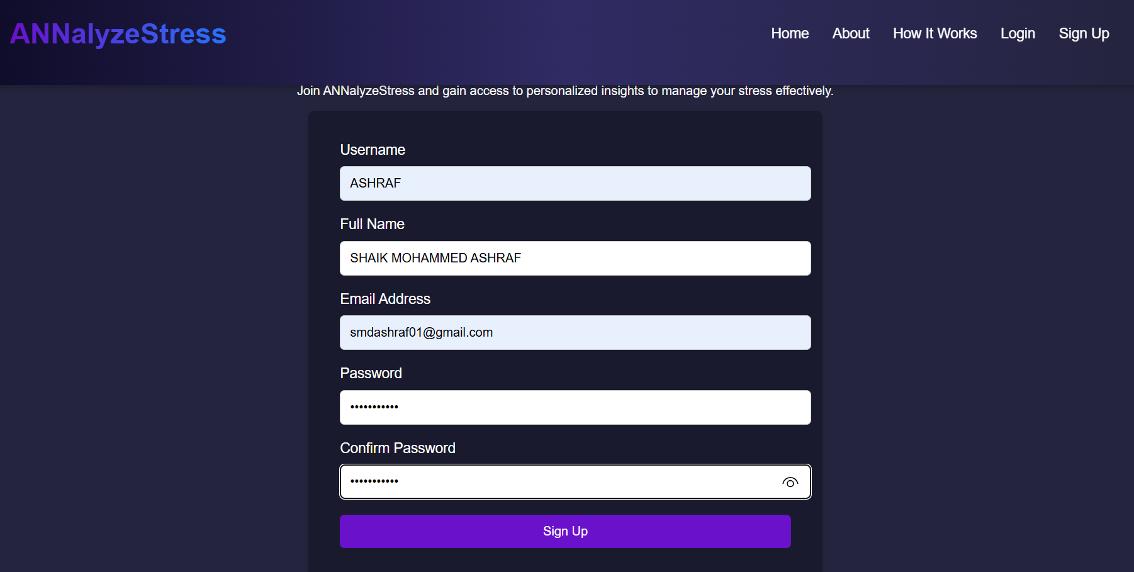
SIGNUP PAGE
User Registration Process:
If you are a new user on this website, you can sign up or register by clicking on the "Sign Up" button. This action will redirect you to the Sign-Up page, where you need to provide the required information to successfully create an account.

Slide 26
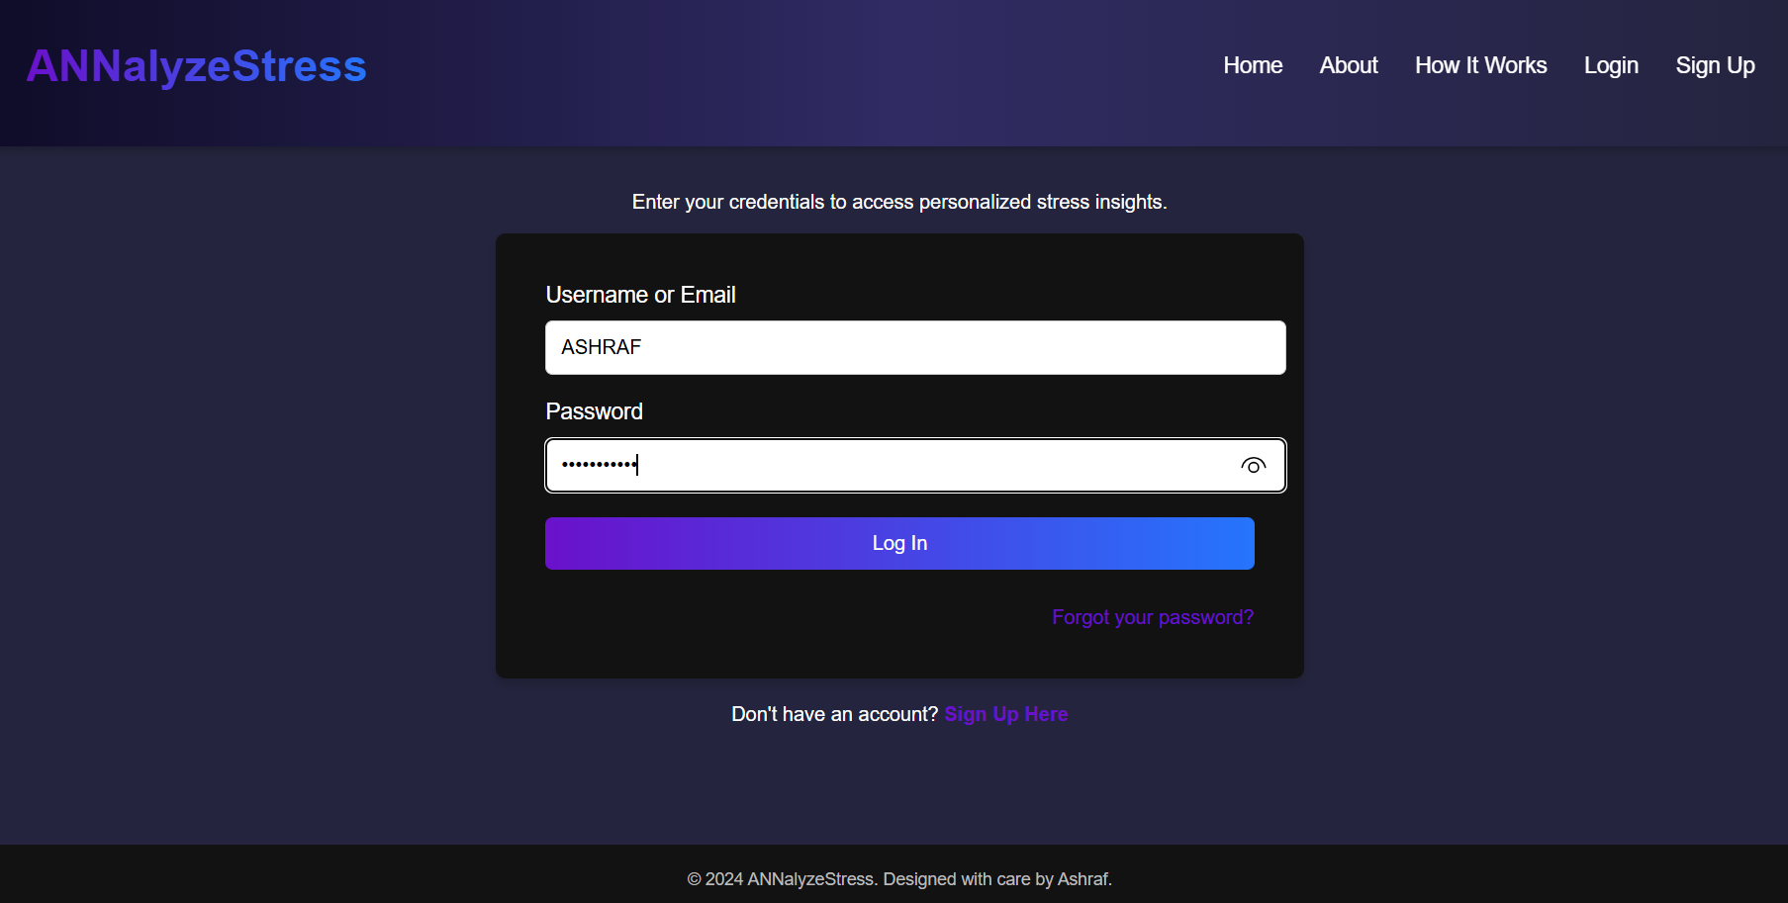
LOGIN PAGE
User Login Process
To access your account, simply enter your username and password in the provided fields and click on the "Login" button. If you don't have an account, click on the "Sign up" link at the bottom to create a new one.

Slide 27
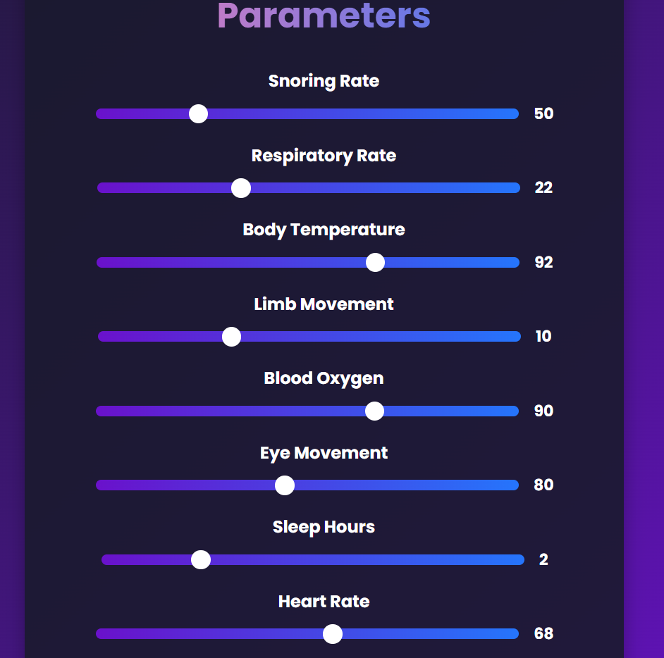
DATA ENTRY PAGE
To Check Your Health, Input Your Health Parameters data Like: Snoring Rate, Respiratory Rate, Body Temperature, etc. Then You have to just Click on "Submit" & You will redirect to your health result Dashboard

Slide 28
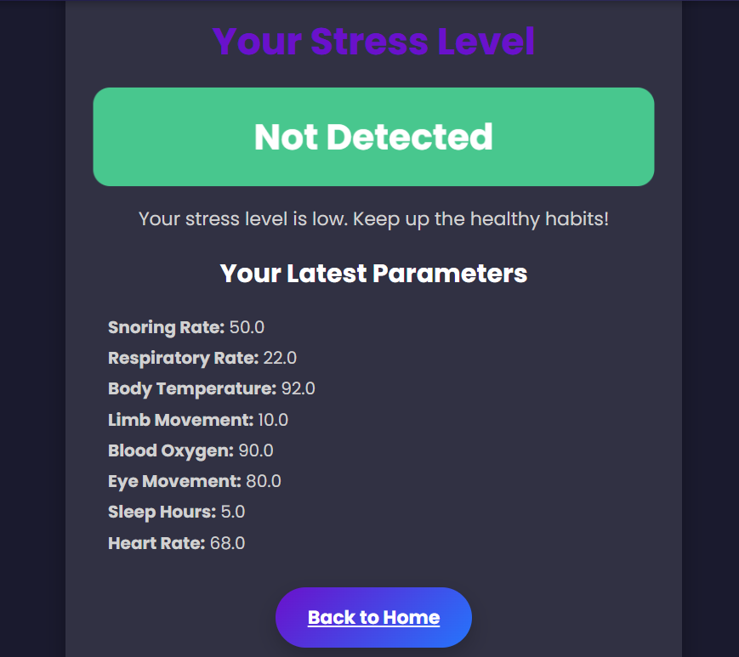
RESULT PAGE
After inputting data, if your stress level is "Not Detected": Then this interface will show along with Parameters readings. You can recheck your stress using the above "Back to Home" button.

Slide 29
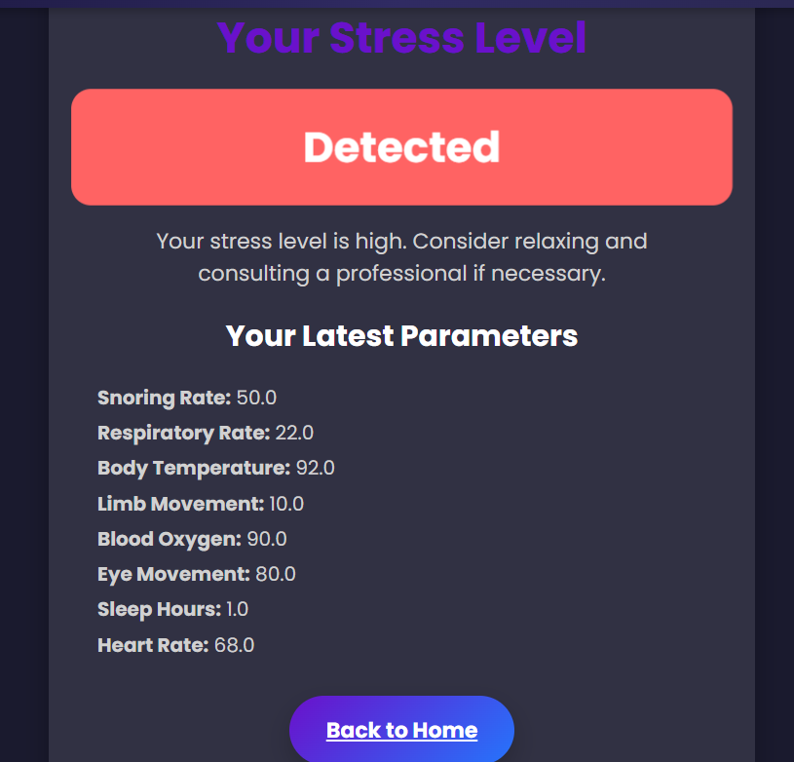
RESULT PAGE
After inputting data, if you are "Stressed," then this interface will show along with parameters information. You can recheck your stress using the above "Check Again" button.

Slide 30
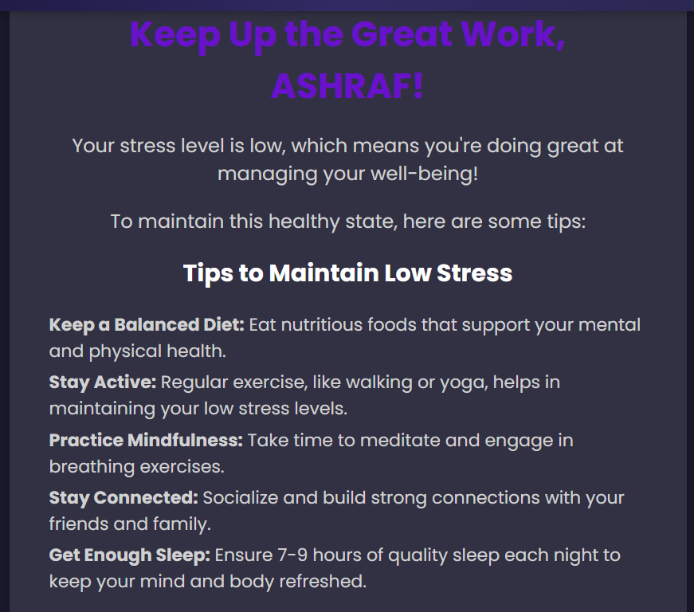
BASED ON THE RESULTS

Slide 31
CONCLUSION
In conclusion, this project has developed and deployed a highly accurate stress detection model integrated into a user-friendly Django-based web application. Leveraging the power of machine learning and the robust MySQL database, the web app allows users to securely input their data and receive instant stress predictions with personalized insights.
By bridging the gap between cutting-edge technology and practical application, this project empowers individuals to better understand and manage their stress levels, leading to improved overall well-being. Moving forward, we aim to continuously refine and expand the capabilities of this system, with the goal of making this technology widely accessible and integrated into various healthcare and wellness applications.

Slide 32
TEAM MEMBERS
Shaik Mohammed Ashraf
Swagat Kumar Behera
Shakthi Balasubramanian
Madipelly Mukesh
Gudala Lilly Grace
Kaustubh Desale

Slide 33
THANK YOU

