Slide 1

UK Road Accident Analysis
Presented by :- Mohammad Ashraf

Slide 2
CONTENTS
Aim
Brief Introduction About the project
Problem Statement
Our Approach Towards the Project
Aggregation on Different KPI’s
DASHBOARD
INSIGHTS

Slide 3

AIM
Preform EDA Analysis and Build a Machine Learning Model to Predict the accident Severity
and create a dynamic dashboard

Slide 4
Brief Introduction About the project
identify high-risk areas such as intersections, road segments, or specific regions with a higher concentration of accidents
Examining accident data across different seasons can reveal patterns and trends related to weather conditions, road surface conditions, and their impact on accident frequency and severity
Exploring the relationship between various factors, such as speed limits, road types, weather conditions, and accident severity
Studying vehicle types accident outcomes can help identify specific vehicle-related factors that contribute to accidents
Analyzing accident data from urban and rural areas separately can reveal differences in accident patterns, contributing factors, and severity
Build the Machine Learning Accident severity prediction Model Based on Various factor such as Weather condition , road type , vehicle type and region

Slide 5
Problem Statement
Main aim is to analyze the data of Uk road accident to extract the valuable insights that can help to control accident rate
These insights are helpful to impalement right road safety precaution on right place

Slide 6
OUR APPROACH FOR THE PROJECT
Data cleaning and null handing Using python
Preform EDA Analysis Using Python and Creating Interactive Dashboard using Excel
Build a ML Model to Predict the accident Severity

Slide 7
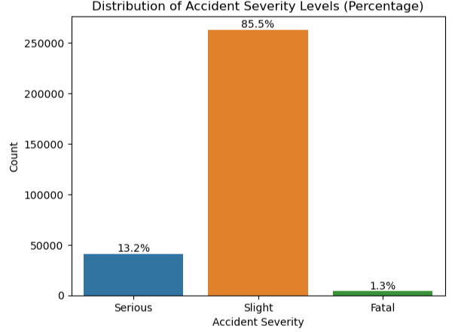
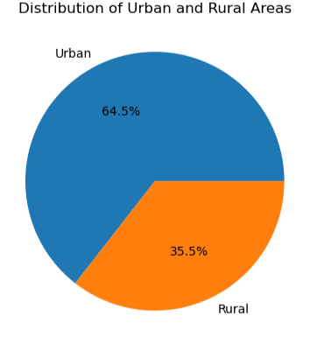
Distribution of Accident Severity Levels (Percentage)
Number of accident according to region(percentage)

Slide 8
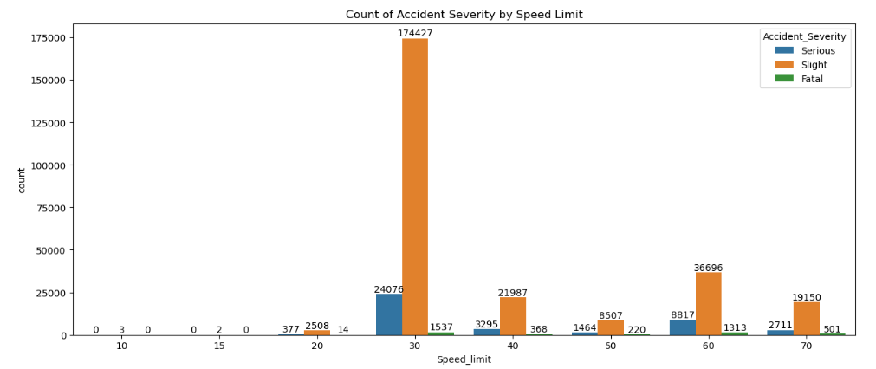
Number of accident severity according to speed limit

Slide 9
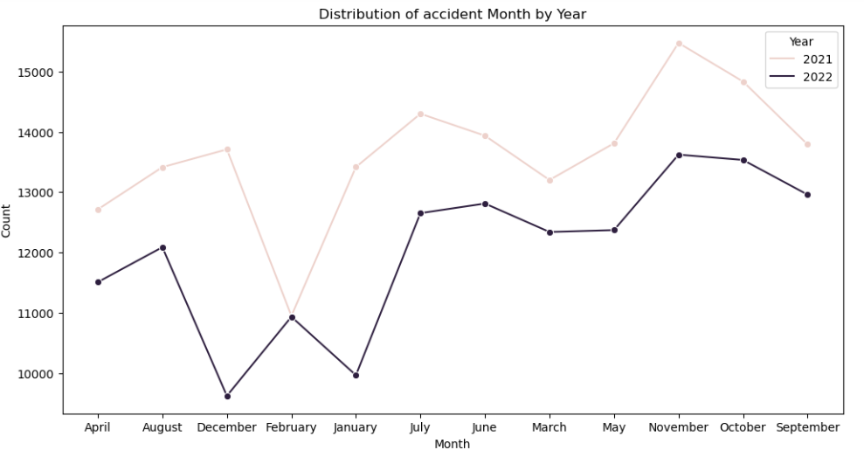
Number of accidents over different years

Slide 10
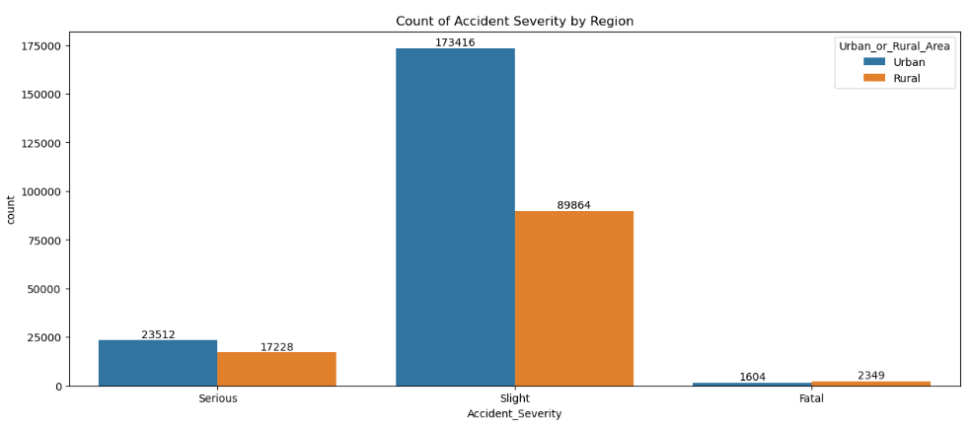
Number of Accident Severity by Region

Slide 11
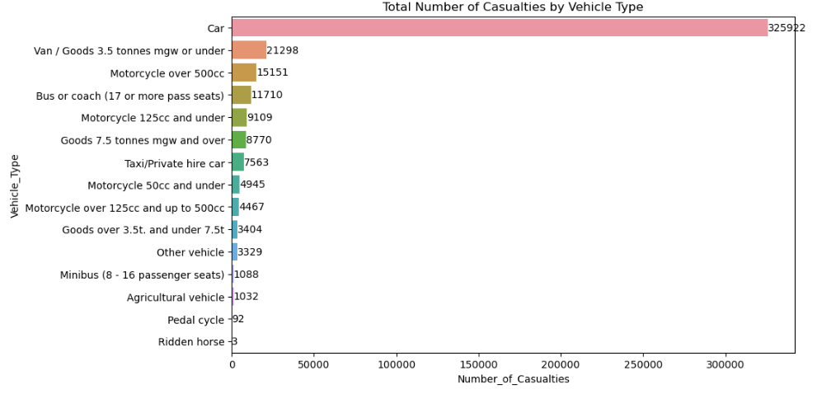
Total Number of Casualties by Vehicle Type

Slide 12
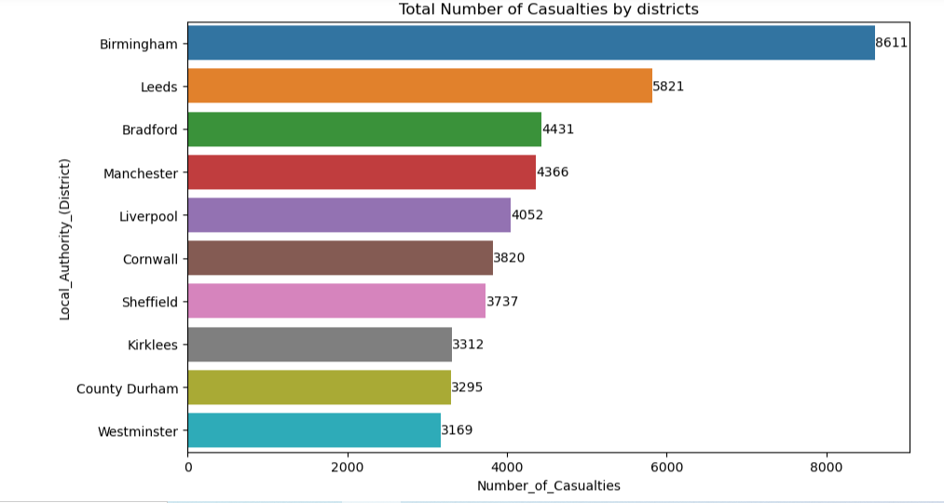
Number of Casualties vary across different local authorities (districts)

Slide 13
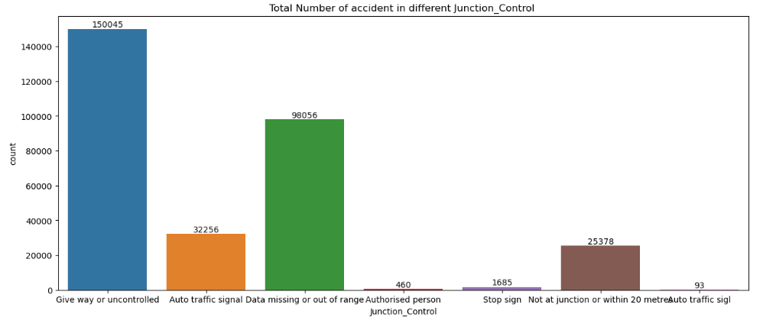
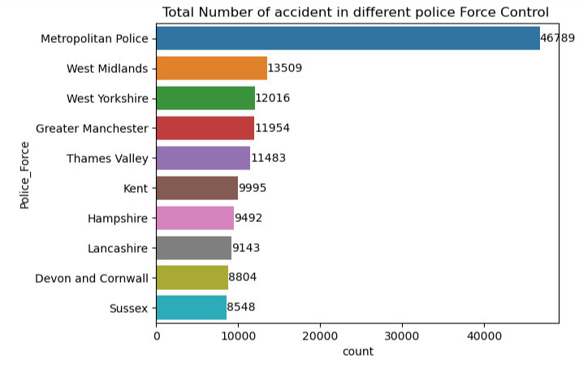
Total Number of accident in different Junction Control
Top 10 Total Number of accident in different police Force Control

Slide 14
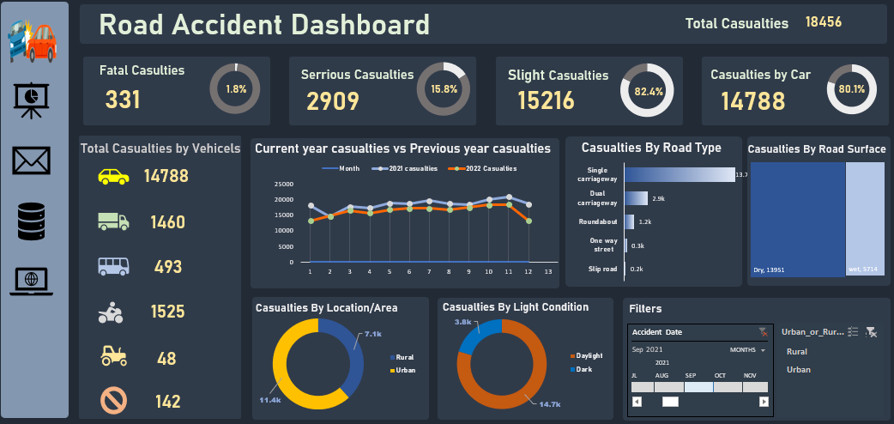

Slide 15
Insights
Number of Slight cases is very high approx. 85.5% and Fatal approx. 1.3%
Most number Fatal ,serious and slight cases are happened when speed limit is 30 and 60 KMPH
Urban Area is the greater Count of accident as compare to rural
Most of The Fatal Type of cases are happened in rural areas
In the vehicle type Car is the highest accident rate in count and Number_of_Casualties it’s approx. 25K
Dry type road condition is the highest accident rate approx. 21 K
And the Most of the accident are occur in the daylight time approx. 23K
Top 3 district in the accident rate are Birmingham ,Leeds and Bradford

