Slide 1
Portfolio Health Overview
Automated RAG assessment across 2 active implementations (2026-06-18 to 2026-07-02)
• Zycus - Titan S2P Implementation is AMBER with a composite health score of 60/100 (71% complete).
• Zycus - UniSan S2P Implementation is AMBER with a composite health score of 60/100 (44% complete).
• Resource coverage is the portfolio's weakest signal: 86% of Titan S2P Implementation active tasks are unassigned, 38% of UniSan S2P Implementation active tasks are unassigned.
• Combined, 280 active tasks across the portfolio have no owner, led by Zycus - Titan S2P Implementation.
• Both projects carry schedule slippage on in-flight phases that is compressing downstream UAT and Hypercare windows.
Zycus - Titan S2P Implementation
Overall Status: 🟡 AMBER (60/100) Completion: 71% Schedule Index (SPI): 1.25 Unassigned active tasks: 191 (86%) Data confidence: 92%
Zycus - UniSan S2P Implementation
Overall Status: 🟡 AMBER (60/100) Completion: 44% Schedule Index (SPI): 0.75 Unassigned active tasks: 89 (38%) Data confidence: 96%
Notes:
This slide summarizes the automated health assessment of the portfolio. Zycus - Titan S2P Implementation is AMBER with a composite health score of 60/100 (71% complete). Zycus - UniSan S2P Implementation is AMBER with a composite health score of 60/100 (44% complete).

Slide 2
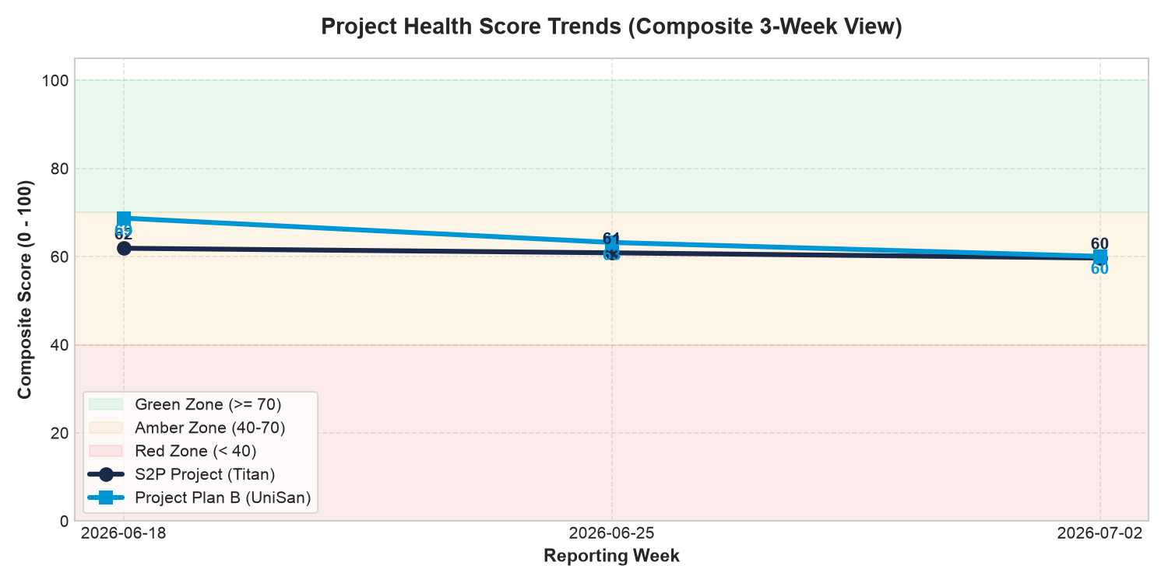
Portfolio Trajectory Trends
Composite health score movement across the reporting period
• Zycus - Titan S2P Implementation: composite score moved from 62 to 60 (-2.2 pts) over 2026-06-18 to 2026-07-02 — trajectory STABLE.
• Zycus - UniSan S2P Implementation: composite score moved from 69 to 60 (-8.7 pts) over 2026-06-18 to 2026-07-02 — trajectory DECLINING.
• Portfolio-average health changed -5.4 points over the period; overall trajectory is DECLINING.
• Score erosion is driven primarily by schedule performance and growing critical-path delays, not by task velocity.
Notes:
Trend view across the reporting weeks. Score erosion is driven primarily by schedule performance and growing critical-path delays, not by task velocity.

Slide 3
Critical Risk Matrix
Top risks ranked by signal severity and milestone slippage
• Risk 1: Titan S2P Implementation — Resource Coverage scored 15/100. Resource assignment coverage is 14.0%. 191 of 222 active tasks have no assigned owner.
• Risk 2: Titan S2P Implementation — Schedule Performance scored 30/100. SPI = 1.25. Project is 71.0% complete vs 56.9% elapsed timeline. Critical schedule slippage of…
• Risk 3: Titan S2P Implementation — milestone 'Phase 2 - P2P' is 81 days behind baseline.
• Risk 4: UniSan S2P Implementation — Schedule Performance scored 40/100. SPI = 0.75. Project is 44.0% complete vs 58.8% elapsed timeline. Max schedule slippage is 8…
• Risk 5: UniSan S2P Implementation — Task Completion Velocity scored 40/100. Task Completion Velocity Ratio: 0.75 (44.0% actual progress vs 58.8% elapsed timeline).
CRITICAL RISK HEATMAP
🔥 [HIGH IMPACT / HIGH LIKELIHOOD] - Titan S2P Implementation: Resource Coverage (15/100) - Titan S2P Implementation: Schedule Performance (30/100) - Titan S2P Implementation: Phase 2 - P2P (-81d) ⚡ [HIGH IMPACT / MED LIKELIHOOD] - UniSan S2P Implementation: Schedule Performance (40/100) - UniSan S2P Implementation: Task Completion Velocity (40/100) - UniSan S2P Implementation: Resource Coverage (40/100) ⚠️ [MED IMPACT / MED LIKELIHOOD] - Titan S2P Implementation: Blocker Density (60/100)
Notes:
Risks are ranked from the weakest computed signals and the largest milestone variances.

Slide 4
Schedule Performance Deep-Dive
Milestone slippage and schedule signal detail by project
• Titan S2P Implementation: schedule signal 30/100 — SPI = 1.25. Project is 71.0% complete vs 56.9% elapsed timeline. Critical schedule slippage of 81 days detected.
• Titan S2P Implementation: 'Phase 2 - P2P' running 81 days behind baseline (In Progress).
• Titan S2P Implementation: 'P2P Cutover' running 62 days behind baseline (Not Started).
• UniSan S2P Implementation: schedule signal 40/100 — SPI = 0.75. Project is 44.0% complete vs 58.8% elapsed timeline. Max schedule slippage is 8 days.
• UniSan S2P Implementation: 'Zycus - UniSan S2P Implementation' running 8 days behind baseline (In Progress).
Notes:
Detailed schedule breakdown, generated from baseline-versus-actual variance in the project plans.

Slide 5
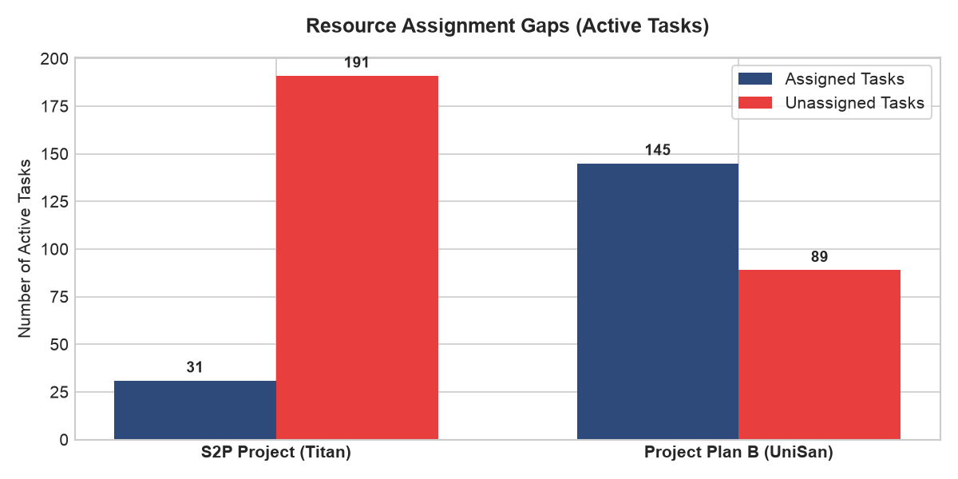
Resource Gaps & Dependency Analysis
Ownership coverage and critical-path exposure
• Titan S2P Implementation: 191 of 222 active tasks (86%) have no assigned owner; 3 tasks are On Hold.
• Titan S2P Implementation: dependency risk 70/100 — Dependency risk: 11 of 15 critical path tasks are delayed. 18 active tasks have low schedule float (<= 3…
• UniSan S2P Implementation: 89 of 234 active tasks (38%) have no assigned owner; 0 tasks are On Hold.
• UniSan S2P Implementation: dependency risk 70/100 — Dependency risk: 2 of 50 critical path tasks are delayed. 32 active tasks have low schedule float (<= 3…
Notes:
Resource coverage is the portfolio's most consistent weakness; the donut chart shows assigned versus unassigned active tasks.

Slide 6
Strategic Recommendations
Actions mapped to the weakest health signals
• Assign dedicated owners to all unassigned critical-path tasks within one week (Owner: Project Managers).
• Re-baseline milestones with material negative variance and publish a recovery plan (Owner: Delivery Leads).
• Escalate all 'On Hold' blockers to the executive sponsor for resolution this cycle (Owner: Sponsor).
• Governance: establish a weekly cross-project health review using this automated report.
Notes:
Each recommendation maps directly to a failing or weak signal in the RAG framework.

Slide 7
30-Day Outlook & Forecast
Trend-based projection with and without intervention
• Titan S2P Implementation: at the current trend (-1.1 pts/week), the composite score is projected at ~55/100 in 30 days.
• UniSan S2P Implementation: at the current trend (-4.3 pts/week), the composite score is projected at ~43/100 in 30 days.
• With intervention (owner assignment + blocker escalation), resource and blocker signals can recover within two reporting cycles.
• Decision required: lock resource assignments and approve re-baselined milestones at the next steering committee.
Notes:
Projection extrapolates the observed weekly score trend forward four weeks.

