Slide 1


Nile Crop
GRADUATION PROJECT
AI-Powered Crop Recommendation & Plant Disease Detection
(20%-40%)
of crops are lost
Model 01
(Crop Recommendation)
Model 02
(Disease Detection)
"According to FAO reports, 20–40% of global crop production is lost annually."
Algorithm: Random Forest Accuracy: Up to 99
Architecture: CNN (MobileNetV2)Dataset: Plant Village Accuracy: ~94–95
Supervised by: DR/ Eman Salah Salem Ahmed

Slide 2
Project Team
2 / 12
TEAM LEADER
NAME
ID
Ashraf Mohamed
EL Sayed
Ashraf Mohamed EL Sayed
4241391
ID: 4241391
Mostafa Hamdy Ahmed
4241362
Phone: 01001390299
Rofaida Islam Elsayed
4241635
SUPERVISOR
Ahmed Elsaed Mostafa
4241309
DR/ Eman Salah Salem Ahmed
Fares Ahmed Adel
4241131
Lina Mohamed Sayed
4241289
Sama Abdalla Elsaied
4241527
Mohamed Adel Elbaz
4241120
Mohamed Wael Abdel-Momen
4241341

Slide 3
Project Description
3 / 12
WHAT IS IT?
Crop Recommendation
NileCrop is a free, Arabic-first web application powered
by two AI models that help Egyptian farmers make
data-driven agricultural decisions —
without any hardware or sensors.
✔ A Progressive Web App (PWA)
✔ Designed for farmers in Egypt
✔ Key idea: Replace traditional guessing
→ Data-driven decisions
Recommends the best crop for any location
using real climate data from Open-Meteo and soil
data from SoilGrids (FAO) — Random Forest model,
99.55% accuracy.
Key idea: Replace traditional guessing → data-driven decisions
Disease Detection
How it works?
Farmer photographs a plant leaf — CNN model
(MobileNetV2) identifies the disease from 17 classes,
shows treatment and prevention steps.
94% classification accuracy
1
Farmer enters city name
2
System auto-fetches climate & soil data
3
AI model processes data in real-time
4
Returns crop recommendation or disease diagnosis

Slide 4
4 / 12
The Problem
No Guidance
30–40%
?
Farmers rely only on neighbors & tradition — no scientific basis for crop decisions.
of Egypt crops
lost every year
Late Diagnosis
!
Plant diseases spread before detected, causing massive losses each season.
Wrong irrigation decisions
Random fertilizer use
Late disease detection
Wasted Resources
$
Over-irrigation and excess fertilizers cost money and damage soil quality long-term.
No digital tools in Arabic

Slide 5
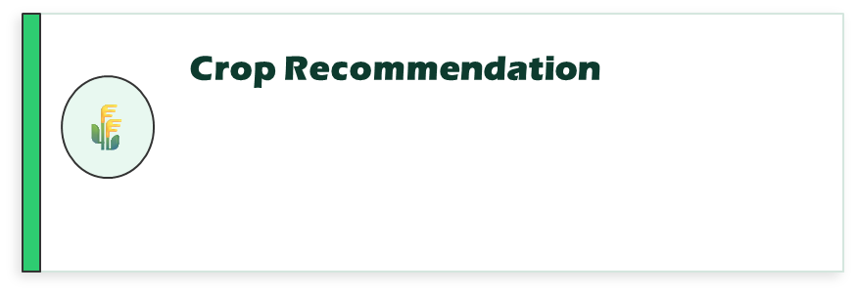
Our Solution
5 / 12
One Platform. Two AI Models. Real Data. 100% Software — No Hardware Needed.
What is NileCrop?
Farmer selects city → System auto-fetches real-time
weather & soil data → Random Forest model recommends
best crop + confidence %.
Accuracy: 99.55%
NileCrop is a free, bilingual (Arabic + English) Progressive
Web App that empowers Egyptian farmers to make smarter
agricultural decisions — using real-time AI, not guesswork.
The farmer only needs to:
🌾 Choose their city → Get crop recommendation
📷 Take a photo → Get disease diagnosis
Everything else is automatic.
Key Design Principle:
Replace traditional guessing with data-driven decisions.
Disease Detection
🔬
Farmer photographs a plant leaf → CNN model
(MobileNetV2) analyzes image → Returns disease
name in Arabic + treatment instructions.
Accuracy: ~94%

Slide 6

System Flow
6 / 12
Crop Path
[ Farmer ]
Disease Path
[ Enter Location ]
External APIs
[ Upload Image ]
Open-Meteo (Weather)
Soil Grids — FAO (Soil)
NASA POWER (Climate)
[ Fetch Weather & Soil ]
[ CNN — MobileNetV2 ]
[ RF Model ]
[ Classify Disease ]
[ Best Crop + Confidence % ]
[ Disease Result (AR) ]
Result delivered in Arabic + English | PWA — works on any mobile | No sensors required

Slide 7
AI Models
7 / 12
Crop Recommendation
Disease Detection
MODEL
1
Random Forest Algorithm
MODEL
2
CNN — MobileNetV2 (Transfer Learning)
2,200 labeled records
< 10,000 training images
7 features: N, P, K, Temp, Humidity, pH, Rainfall
PlantVillage Dataset (subset)
21 Egyptian-suitable crops
17 disease classes
99.55% accuracy achieved
17 plant species covered
Train / Test Split: 80% / 20%
94% classification accuracy

Slide 8
Research Foundation
8 / 12
Our project is built on peer-reviewed research from Frontiers in Plant Science & Springer LNNS
Frontiers in Plant Science · 2016
Using Deep Learning for Image-Based Plant Disease Detection
1
Mohanty, Hughes & Salathé
Trained CNN on PlantVillage dataset (54,306 images, 26 diseases) — achieved F1 score 0.9934 (99.35% accuracy). Foundation of our Disease Detection module.
Springer LNNS · 2025
Crop and Fertilizer Recommendation System Using Machine Learning
2
Paliwal & Upadhyay
Benchmarked 4 ML algorithms. Random Forest achieved 99.99% accuracy for crop recommendation using N, P, K, temperature, humidity & pH. Directly validates our Model 01.

Slide 9
Datasets
9 / 11
Crop Recommendation
PlantVillage
DATASET
DATASET
1
Source: Kaggle | Used for: Model 01 (Random Forest)
2
Source: Kaggle / Mendeley | Used for: Model 02 (MobileNetV2)
Original Dataset:
Original Dataset:
CROP
2,200 rows x 8 columns
DISEASE
54,306 images (healthy + diseased)
22 crop classes (100 samples each — balanced)
14 crop species
7 features: N, P, K, Temperature, Humidity, pH, Rainfall
26 diseases -> 38 total classes
Label: Crop name (target variable)
Healthy images included per species
Controlled background, high quality RGB
After NileCrop Modification:
Removed 4 non-Egyptian crops (mungbean, coconut, jute, coffee)
NileCrop Subset:
Added 4 Egyptian crops (wheat, potato, soybean, strawberry)
< 10,000 images — CPU-friendly subset
Final: 21 Egyptian-suitable crop classes
17 disease classes (matching our crops)
Balanced: diseased + healthy per class

Slide 10
Data Sources & APIs
WEATHER
Temperature, Humidity, Rainfall
Free — No API key required
SOIL
Soil Grids (FAO)
pH, Nitrogen, Phosphorus,
Potassium — Global Coverage
CLIMATE
NASA POWER API
Historical Climate Data
Free — No key required
Open – Meto API
CROPS
Kaggle Dataset
2,200 labeled records
Crop Recommendation training
PAPERS
Research Refs
Mohanty et al. (2016)
Paliwal & Upadhyay (2025)
DISEASE
Plant Village
54,306 disease images
CNN Model training data
8 / 11

Slide 11
Technology Stack
11 / 12
FRONTEND
BACKEND
AI / ML
DATABASE
DEVOPS
React.js
Python
Scikit-learn
PostgreSQL
Git / GitHub
Tailwind CSS
FastAPI
TensorFlow
Cities Table
Vercel
Chart.js
REST APIs
OpenCV
Request Logs
Render
PWA (Mobile)
JWT Auth
MobileNetV2
Caching
Postman

Slide 12
12 / 12
Why NileCrop
Stands Out🤔
1
2
3
Real Data, Not Simulation
Dual AI System
Built for Egypt
Live climate & soil from FAO and NASA APIs — not fake test data.
Two specialized models: crop recommendation + image disease detection.
Arabic UI, free to use, works on any mobile — designed for real farmers.
NileCrop | AI + Real Data + Arabic UX

Slide 13


