Slide 1
TEAM- CODERS
TEAM MEMBERS:
ASHRAF EQBAL(LEADER)
ASAF EQBAL(MEMBER)

Slide 2
TOPIC
“Healthcare accessibility isn’t a privilege to women
- It is a basic need and should be a priority”

Slide 3
IDEA:-
To develop a online shopping app specially designed for the needs and requirements of women .
To create a web app to provide hygiene to women and also better health to them.

Slide 4
Steps Which Can Be Taken
CREATE APP WHICH INCLUDE:-
NUTRITION SUPPLIMENTS
SEXUAL WELLNESS PRODUCTS
HEALTH AND MEDICAL DEVICES
Etc…

Slide 5
Creating a web app
Creating a web app here refers to design a webpage/website which can deal with the wellness products required by the women which can be provided to them without creating embarrassment in their lives due to the taboo in most parts of India. Web app will contain products and also medical facilities which can result in betterment in healthcare of womens.

Slide 6
Web App
App contains
Section for buying healthcare products
Section for online consultancies

Slide 7
Web App Designing
We will use HTML,CSS,JAVASCRIPT and PHP
Code required is given

Slide 8
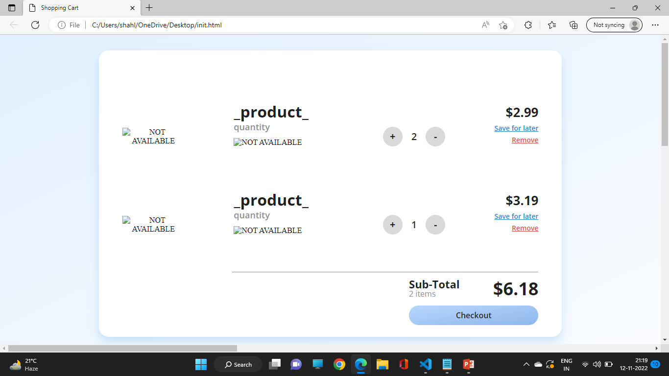
WEB APP(SCREEN)

Slide 9
THANK YOU

