Slide 1
POLARIS DC-1
AVIAPOLIS DATA CAMPUS, VANTAA
SITE LOGISTICS PLAN
22 Monthly Plans · March 2026 – December 2027
Pre-Start Meeting Issue · August 2026
Nordbuild Oy · PDC-LOG-002 Rev 0 · PDC-LOG-001 Rev C Compliant

Slide 2
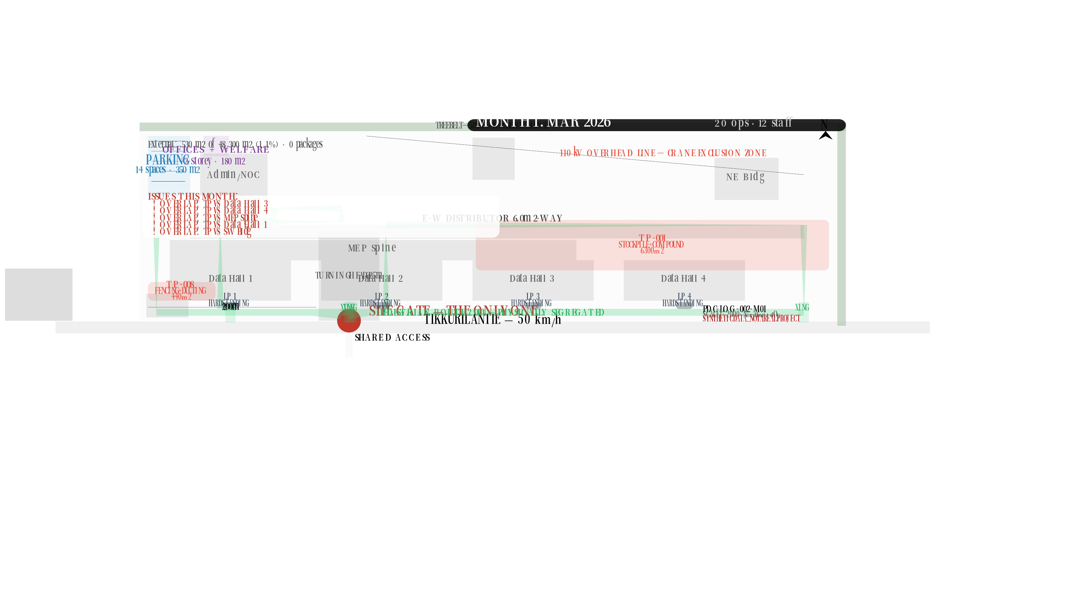

Slide 3
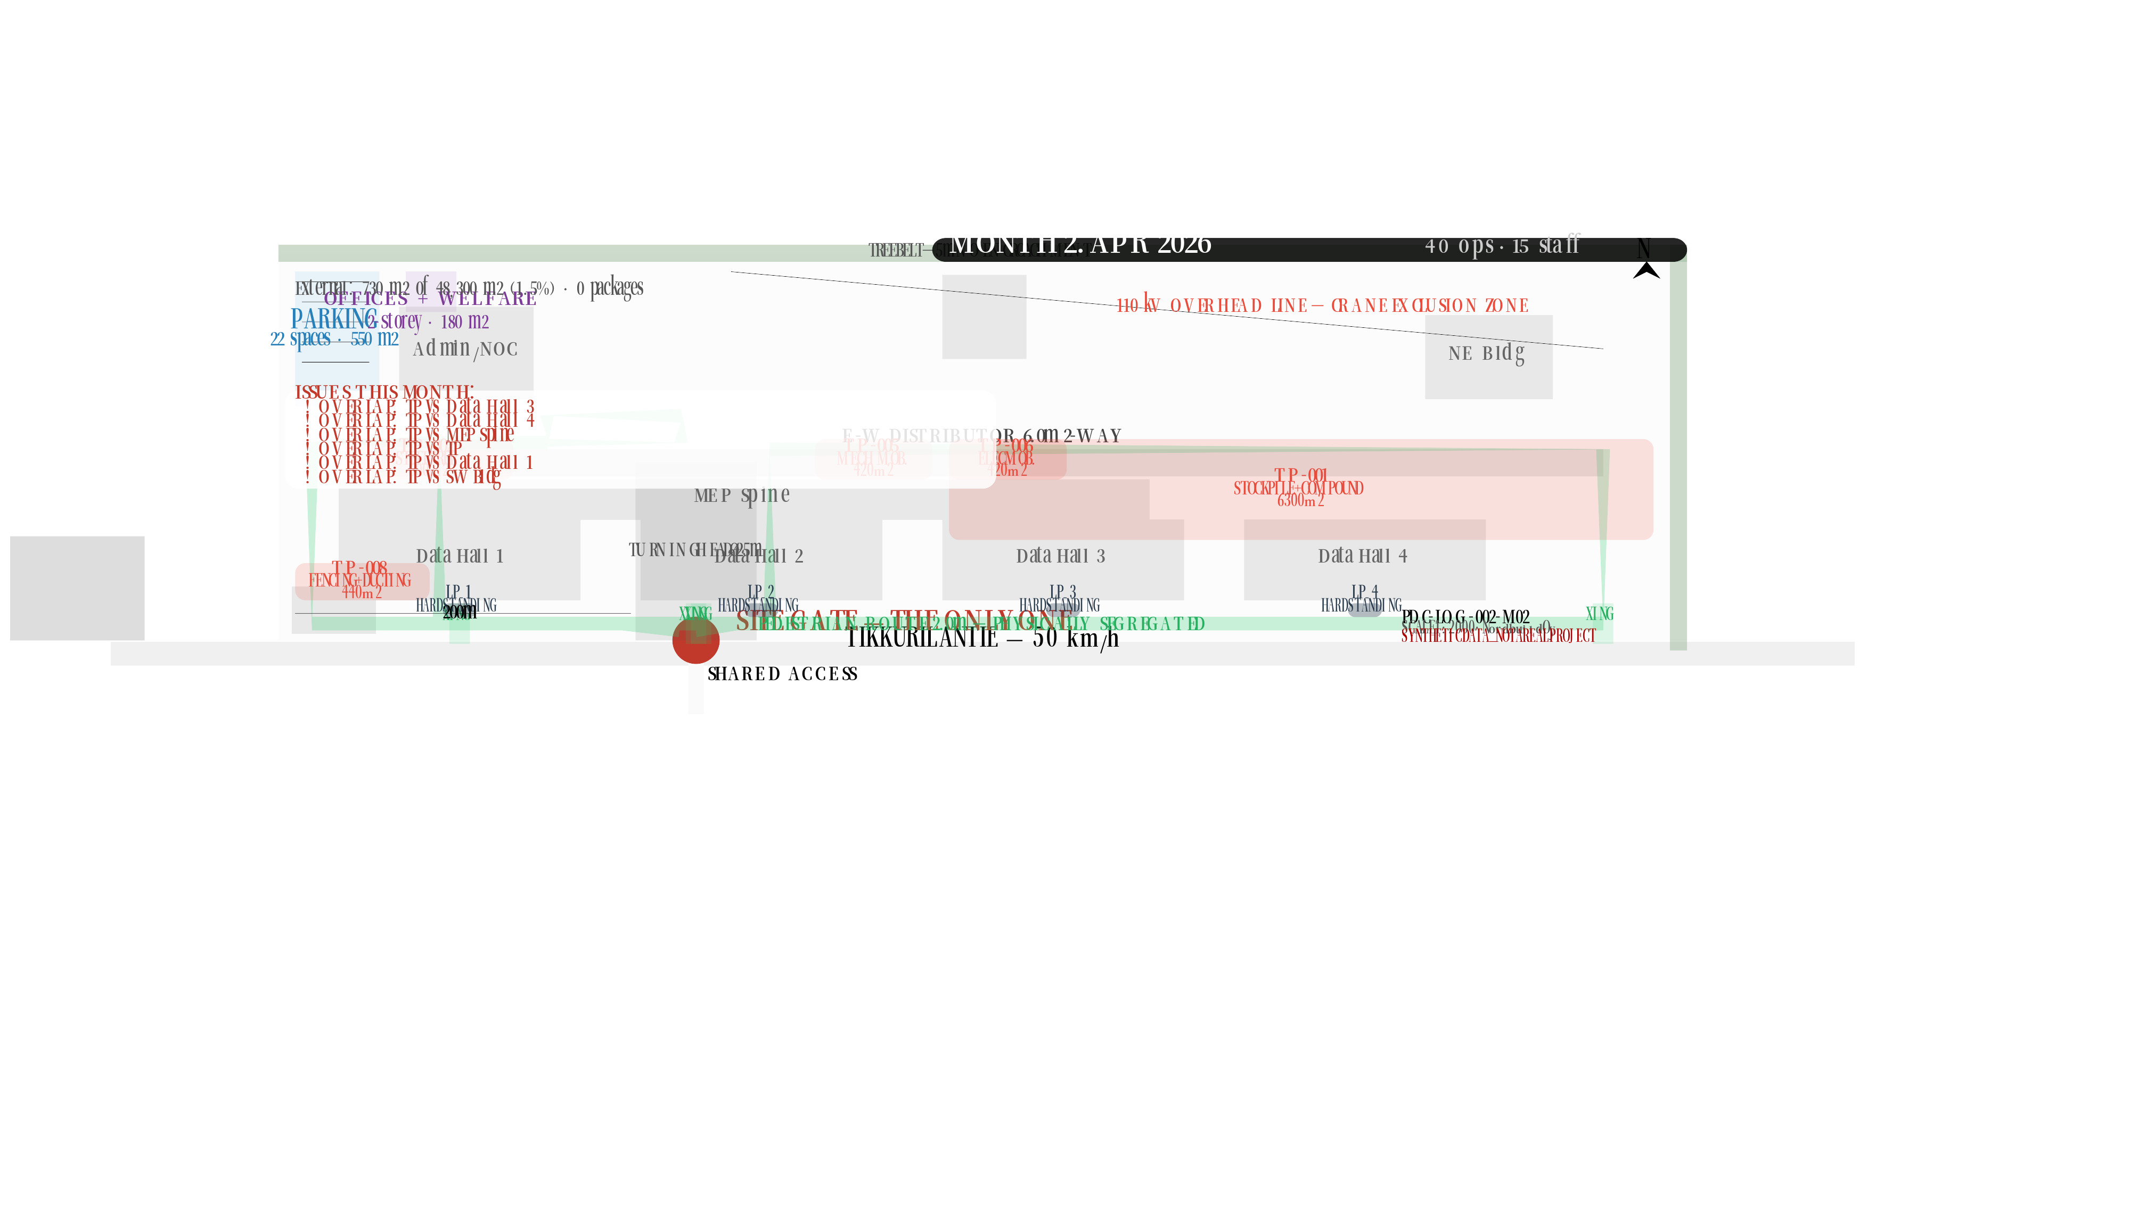

Slide 4


Slide 5
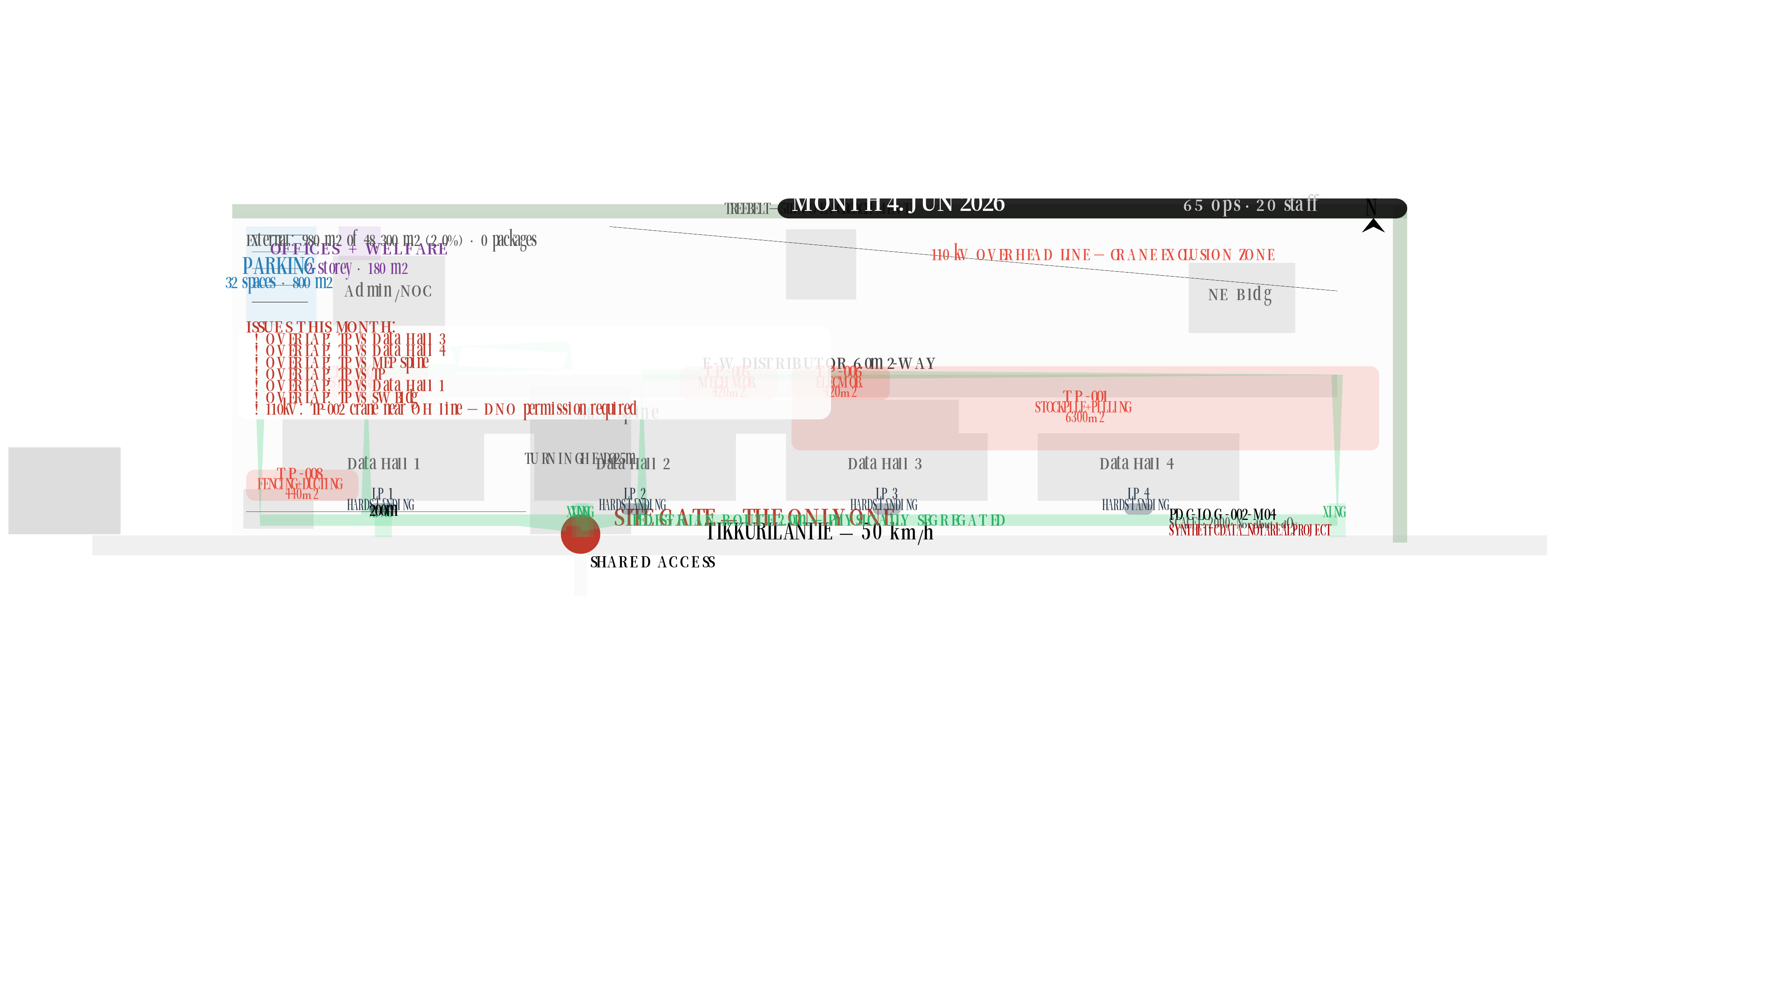

Slide 6


Slide 7
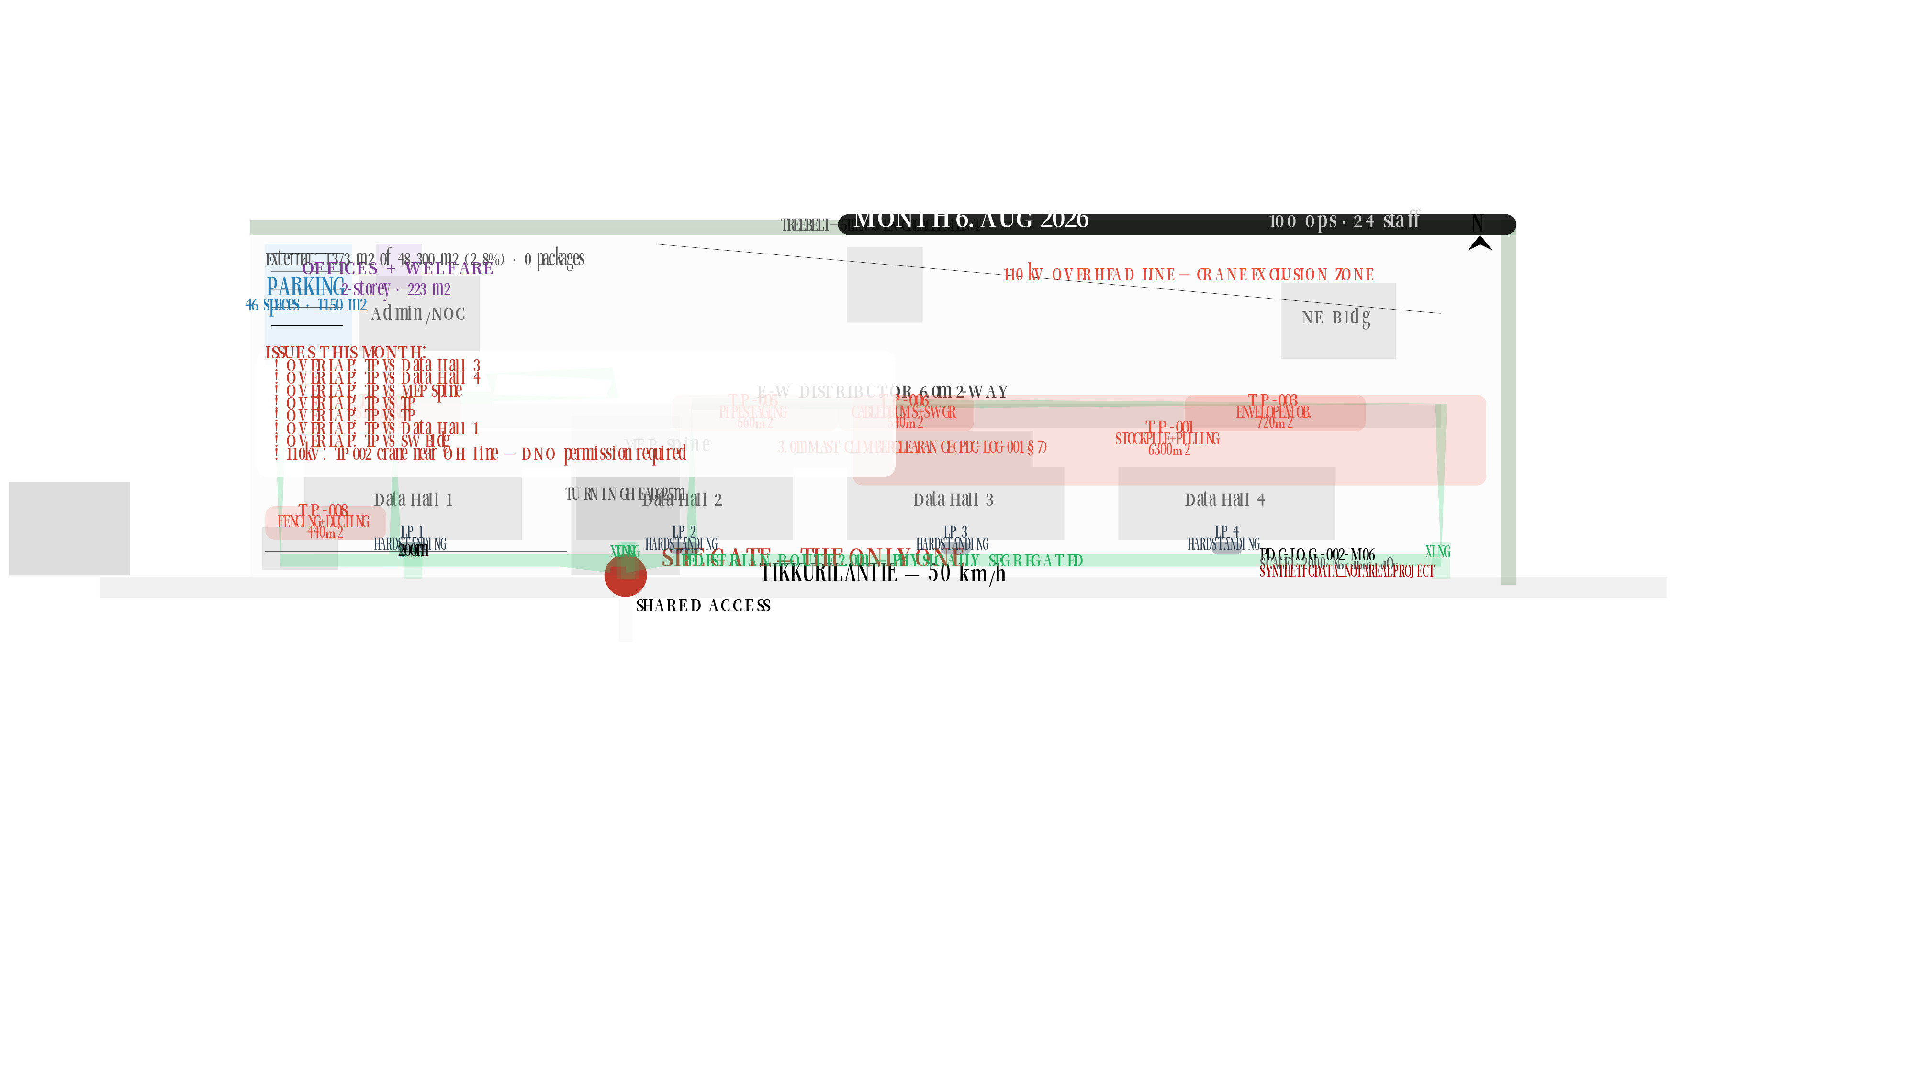

Slide 8
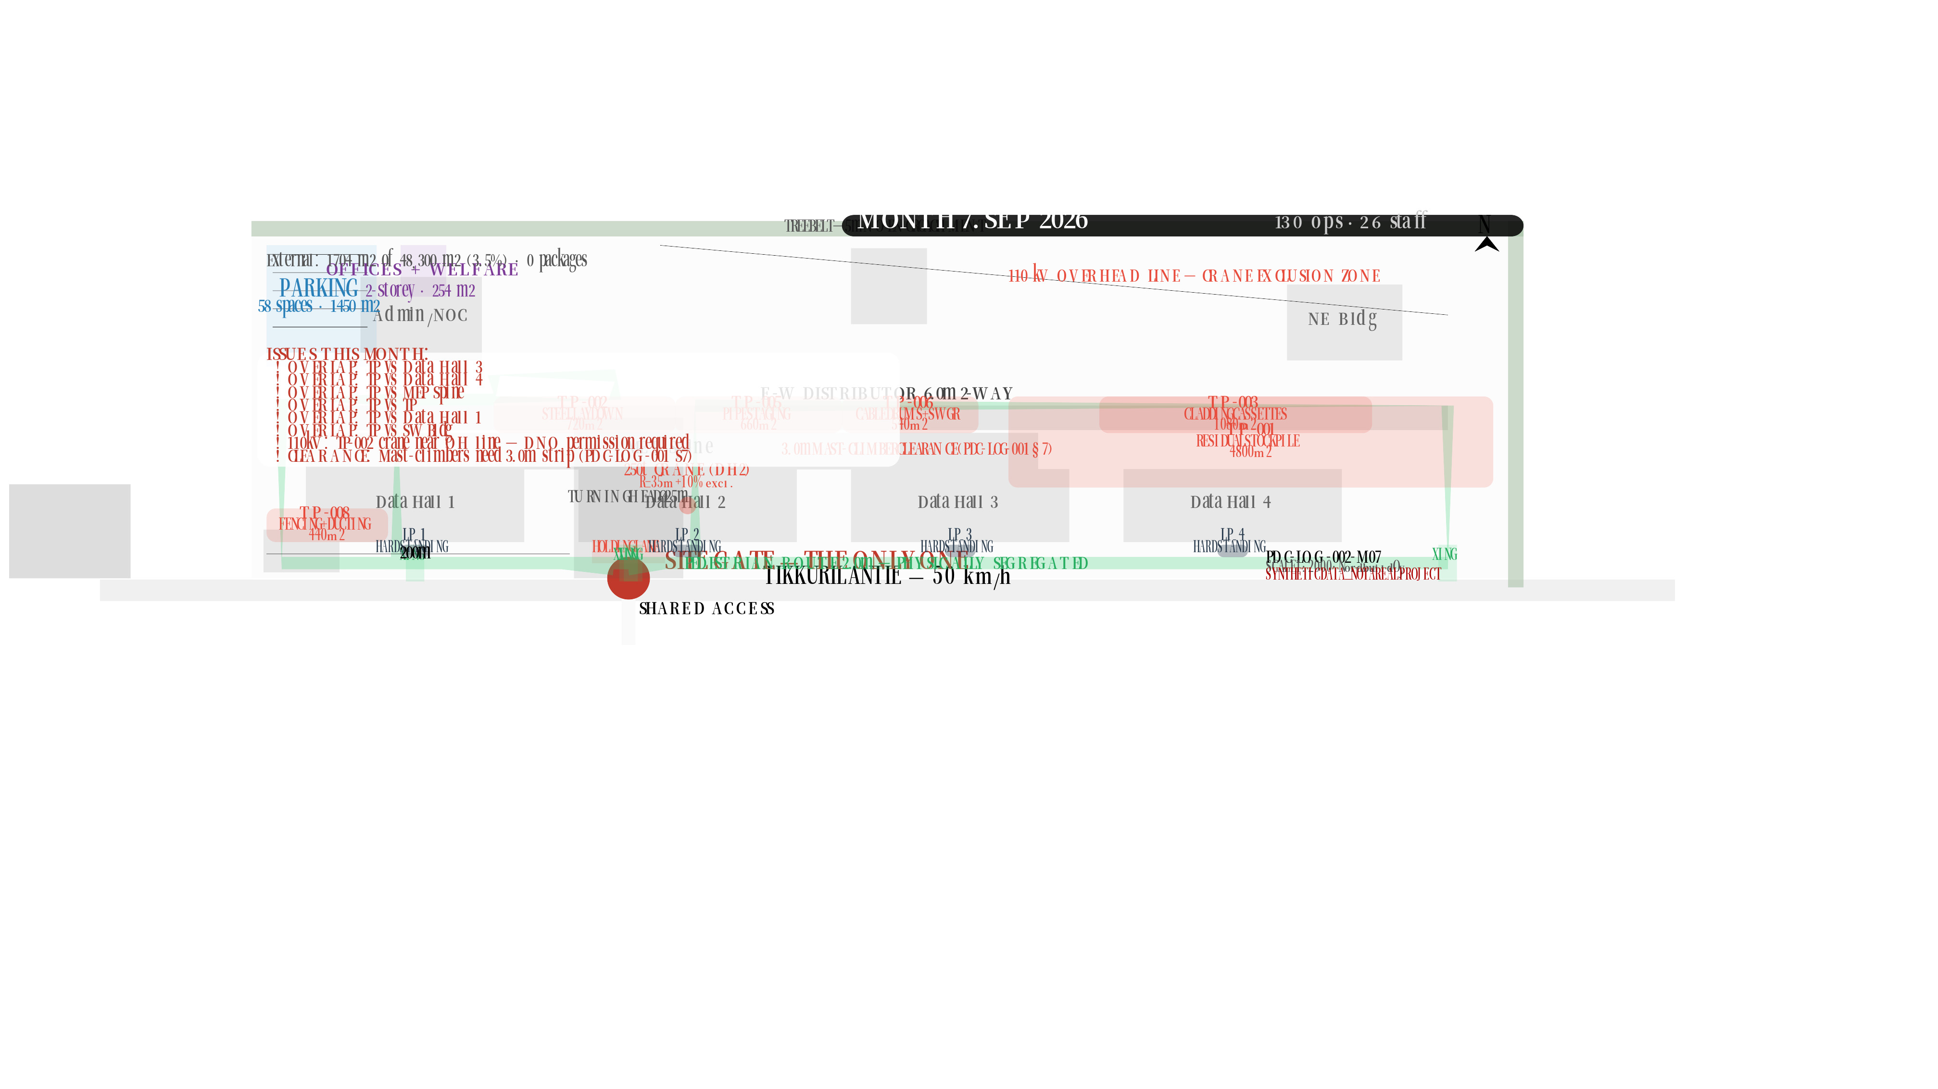

Slide 9
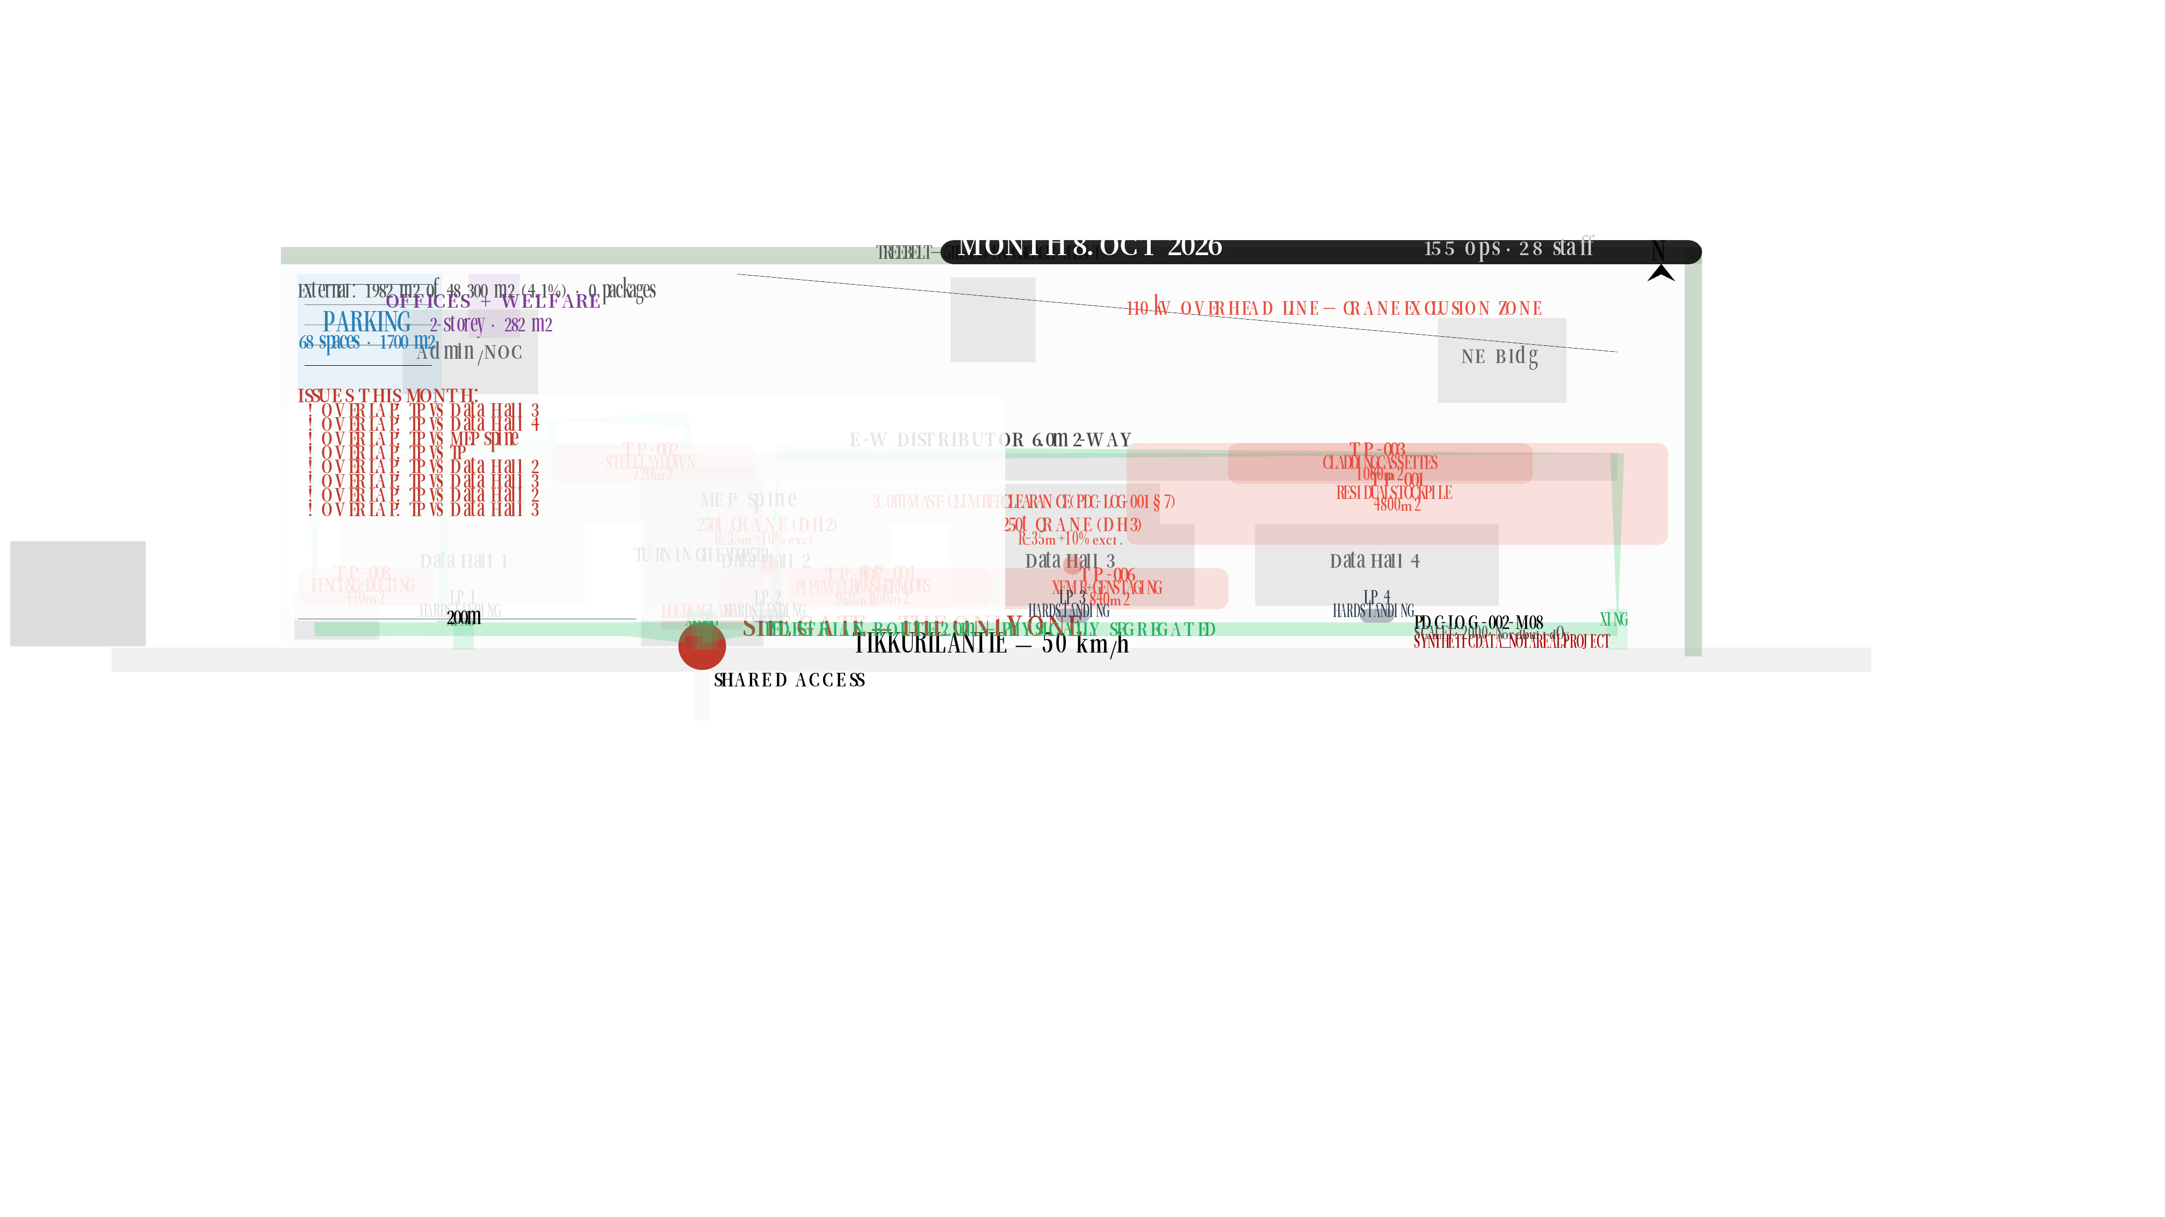

Slide 10
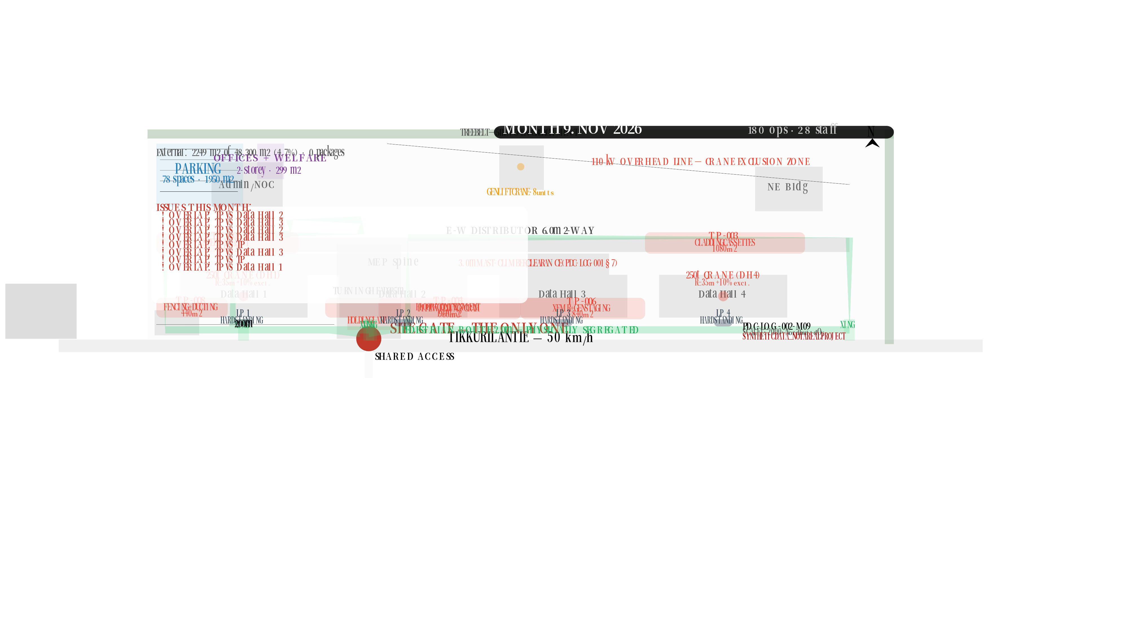

Slide 11
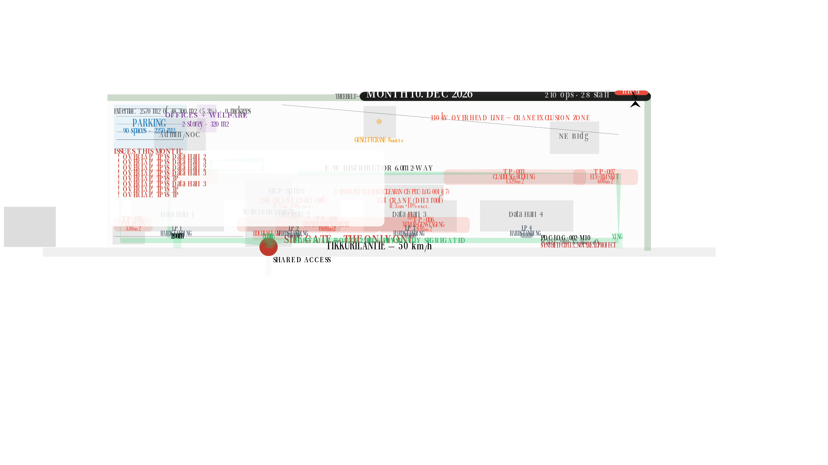

Slide 12
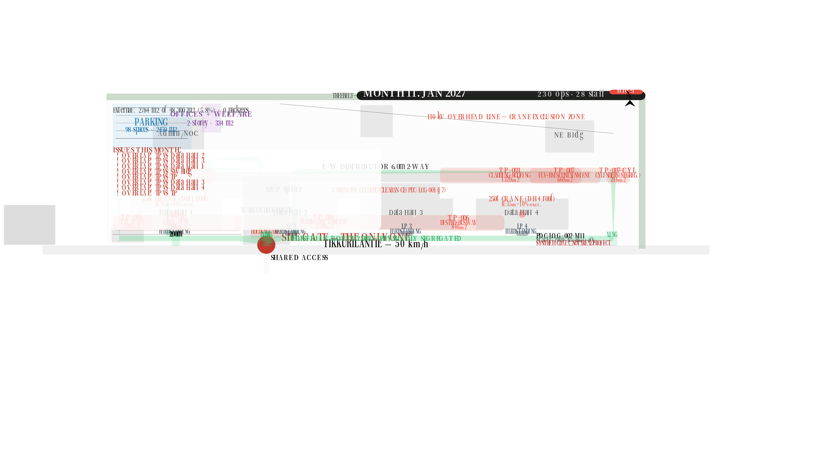

Slide 13
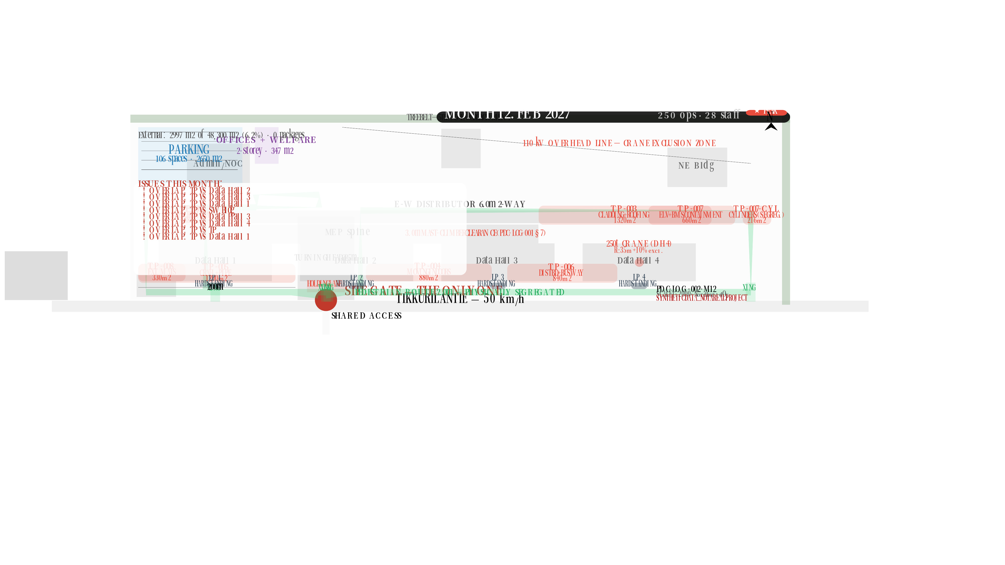

Slide 14
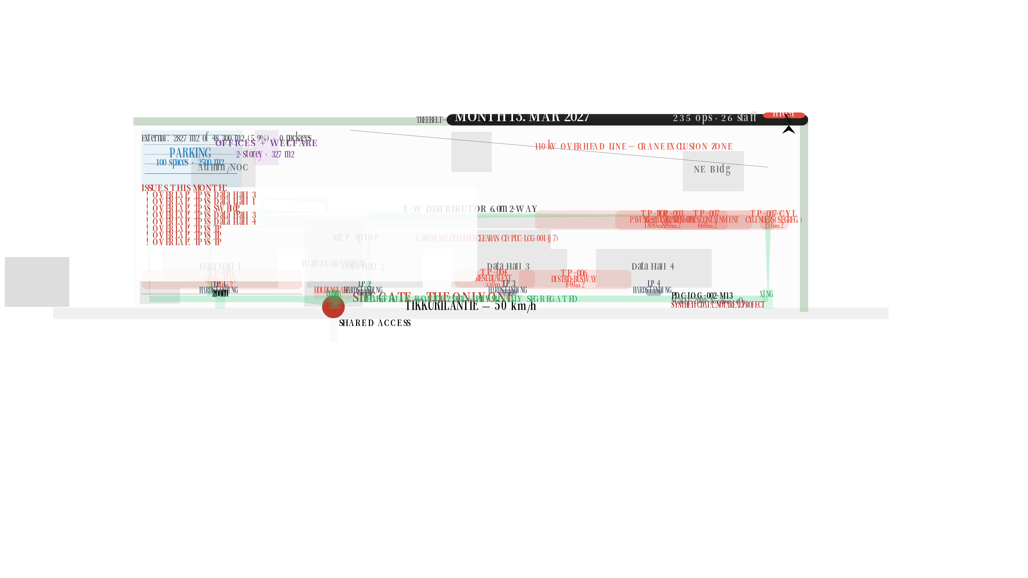

Slide 15
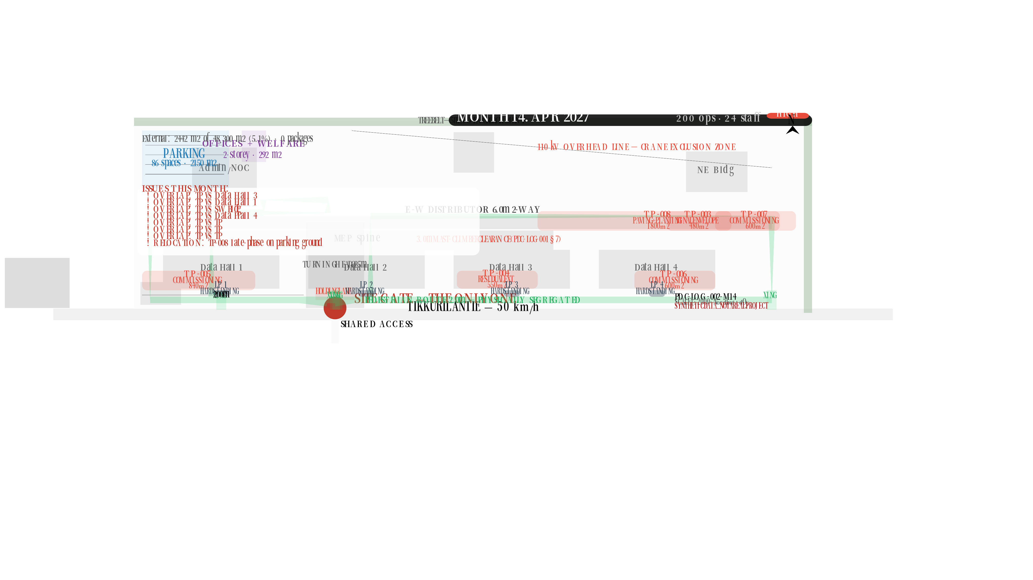

Slide 16
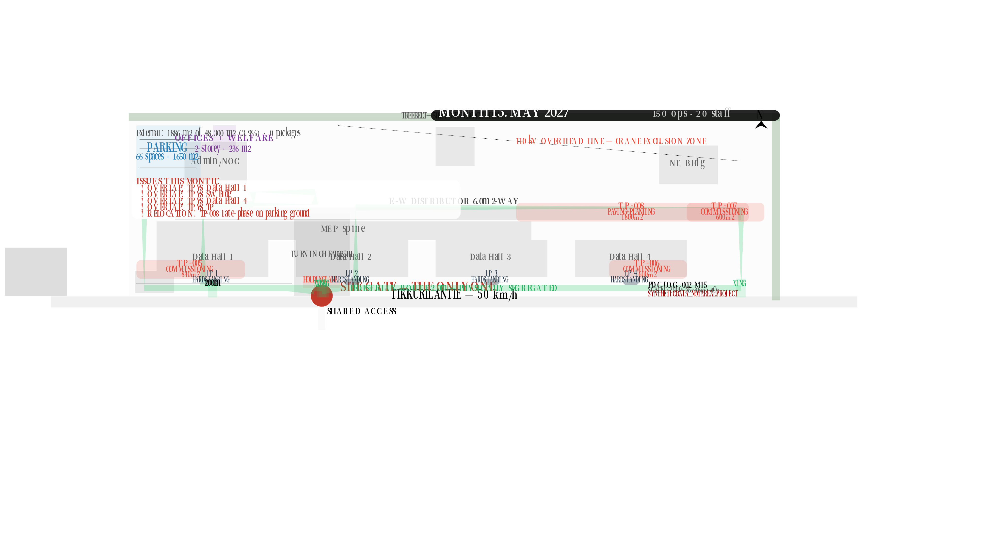

Slide 17
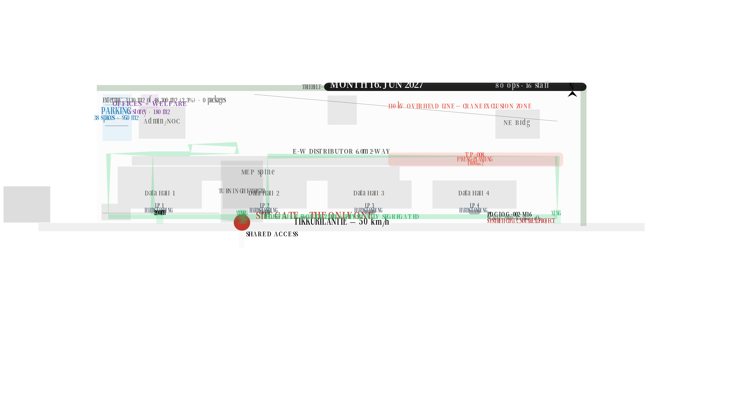

Slide 18


Slide 19
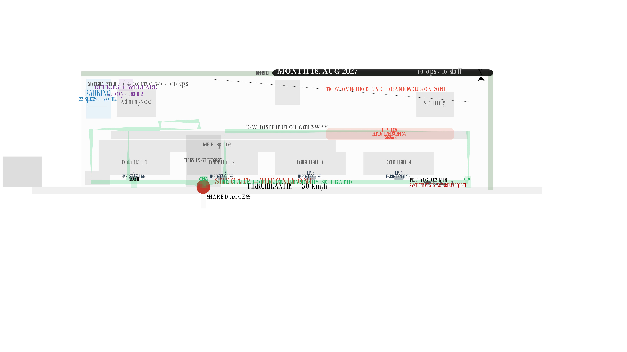

Slide 20


Slide 21


Slide 22
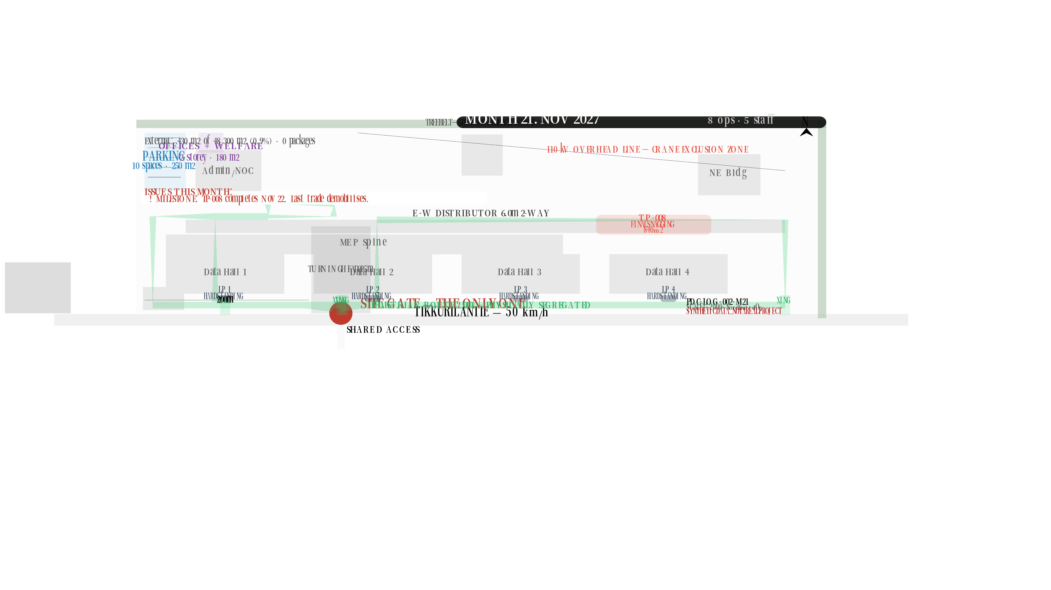

Slide 23
