Slide 1
POLARIS DC-1
SITE LOGISTICS PLAN
22 Months · Mar 2026 – Dec 2027
Split-Site Format per PDC-LOG-001 §3.1 — 2 sheets per month
Nordbuild Oy · PDC-LOG-002 Rev 0 · Pre-Start Meeting · August 2026

Slide 2
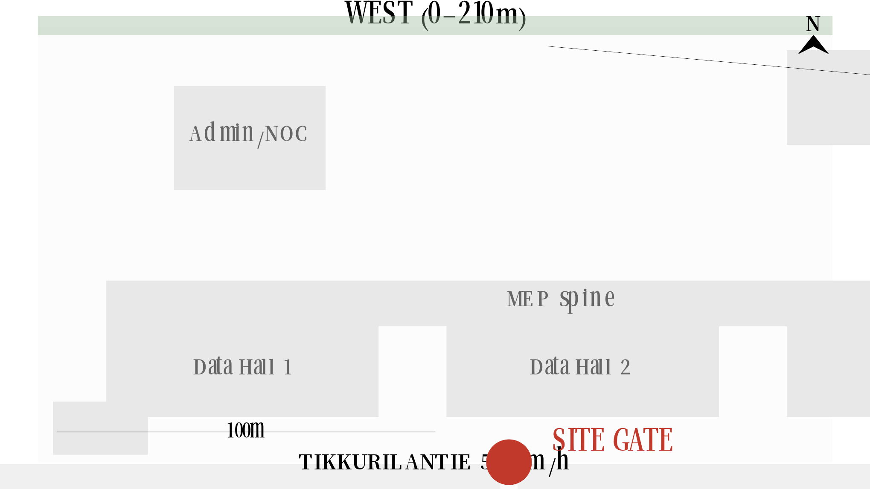
M1 MAR 2026 — WEST (0–210m)
20 ops · 12 staff
PARKING 14sps 350m2
OFFICES+WELFARE 180m2
TP STOCKPILE 6300m2
TP FENCING+DUCT 440m2
LP-1
LP-2

Slide 3
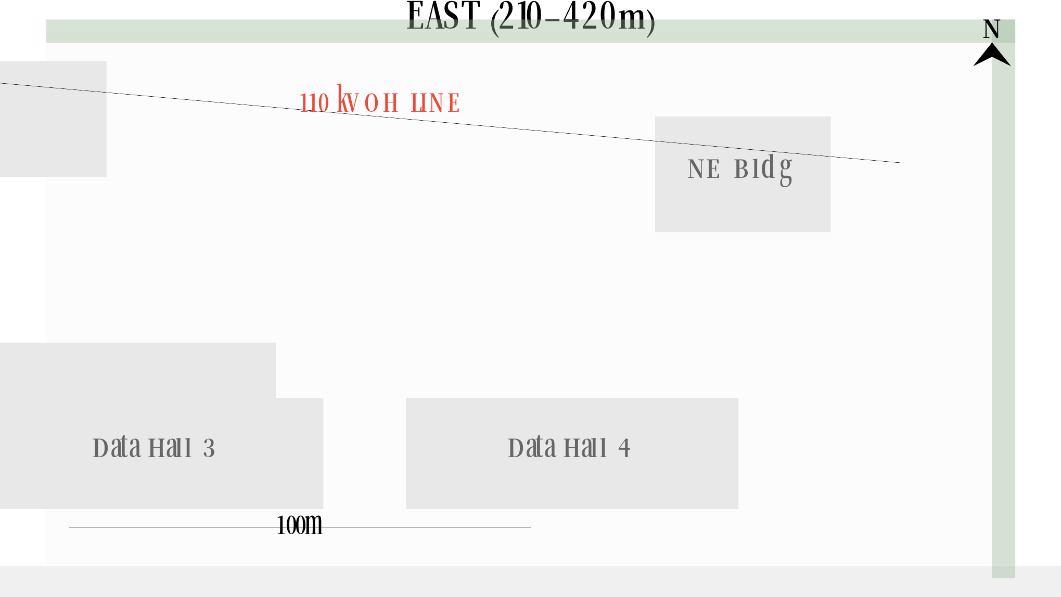
M1 MAR 2026 — EAST (210–420m)
20 ops · 12 staff
TP STOCKPILE 6300m2
LP-3
LP-4

Slide 4
M2 APR 2026 — WEST (0–210m)
40 ops · 15 staff
PARKING 22sps 550m2
OFFICES+WELFARE 180m2
TP STEEL PREP 600m2
TP MECH MOB. 420m2
TP STOCKPILE 6300m2
TP ELEC MOB. 420m2
TP FENCING+DUCT 440m2
LP-1
LP-2

Slide 5
M2 APR 2026 — EAST (210–420m)
40 ops · 15 staff
TP STOCKPILE 6300m2
TP ELEC MOB. 420m2
LP-3
LP-4

Slide 6
M3 MAY 2026 — WEST (0–210m)
50 ops · 18 staff
PARKING 26sps 650m2
OFFICES+WELFARE 180m2
TP STEEL PREP 600m2
TP MECH MOB. 420m2
TP STOCKPILE 6300m2
TP ELEC MOB. 420m2
TP FENCING+DUCT 440m2
LP-1
LP-2

Slide 7
M3 MAY 2026 — EAST (210–420m)
50 ops · 18 staff
TP STOCKPILE 6300m2
TP ELEC MOB. 420m2
LP-3
LP-4

Slide 8
M4 JUN 2026 — WEST (0–210m)
65 ops · 20 staff
PARKING 32sps 800m2
OFFICES+WELFARE 180m2
TP STEEL PREP 600m2
TP MECH MOB. 420m2
TP STOCKPILE+PILLING 6300m2
TP ELEC MOB. 420m2
TP FENCING+DUCT 440m2
LP-1
LP-2
110kV DNO permission for crane

Slide 9
M4 JUN 2026 — EAST (210–420m)
65 ops · 20 staff
TP STOCKPILE+PILLING 6300m2
TP ELEC MOB. 420m2
LP-3
LP-4
110kV DNO permission for crane

Slide 10
M5 JUL 2026 — WEST (0–210m)
85 ops · 22 staff
PARKING 40sps 1000m2
OFFICES+WELFARE 202m2
TP STEEL PREP 600m2
TP MECH MOB. 420m2
TP STOCKPILE+PILLING 6300m2
TP ELEC MOB. 420m2
TP FENCING+DUCT 440m2
LP-1
LP-2
110kV DNO permission for crane

Slide 11
M5 JUL 2026 — EAST (210–420m)
85 ops · 22 staff
TP STOCKPILE+PILLING 6300m2
TP ELEC MOB. 420m2
LP-3
LP-4
110kV DNO permission for crane

Slide 12
M6 AUG 2026 — WEST (0–210m)
100 ops · 24 staff
PARKING 46sps 1150m2
OFFICES+WELFARE 223m2
TP STEEL PREP 600m2
TP PIPE STAGING 660m2
TP CABLE+SWGR 540m2
TP STOCKPILE+PILLING 6300m2
TP FENCING+DUCT 440m2
LP-1
LP-2
110kV DNO permission for crane | Mast-climber 3.0m clearance (§7)

Slide 13
M6 AUG 2026 — EAST (210–420m)
100 ops · 24 staff
TP CABLE+SWGR 540m2
TP STOCKPILE+PILLING 6300m2
TP ENVELOPE MOB. 720m2
LP-3
LP-4
110kV DNO permission for crane | Mast-climber 3.0m clearance (§7)

Slide 14
M7 SEP 2026 — WEST (0–210m)
130 ops · 26 staff
PARKING 58sps 1450m2
OFFICES+WELFARE 254m2
250t CRANE
TP STEEL 720m2
TP PIPE STAGING 660m2
TP CABLE+SWGR 540m2
TP FENCING+DUCT 440m2
LP-1
LP-2
110kV DNO permission for crane | Mast-climber 3.0m clearance (§7)

Slide 15
M7 SEP 2026 — EAST (210–420m)
130 ops · 26 staff
TP CABLE+SWGR 540m2
TP RESIDUAL 4800m2
TP CLADDING 1080m2
LP-3
LP-4
110kV DNO permission for crane | Mast-climber 3.0m clearance (§7)

Slide 16
M8 OCT 2026 — WEST (0–210m)
155 ops · 28 staff
PARKING 68sps 1700m2
OFFICES+WELFARE 282m2
250t CRANE
TP STEEL 720m2
TP FENCING+DUCT 440m2
TP PIPE+CRAH 960m2
TP FLOORS 660m2
TP XFMR+GEN 840m2
LP-1
LP-2
110kV DNO permission for crane | Mast-climber 3.0m clearance (§7)

Slide 17
M8 OCT 2026 — EAST (210–420m)
155 ops · 28 staff
250t CRANE
TP RESIDUAL 4800m2
TP CLADDING 1080m2
TP PIPE+CRAH 960m2
TP FLOORS 660m2
TP XFMR+GEN 840m2
LP-3
LP-4
110kV DNO permission for crane | Mast-climber 3.0m clearance (§7)

Slide 18
M9 NOV 2026 — WEST (0–210m)
GEN CRANE
180 ops · 28 staff
PARKING 78sps 1950m2
OFFICES+WELFARE 299m2
250t CRANE
TP STEEL+PRECAST 960m2
TP FENCING+DUCT 440m2
TP FLOOR+CONTAIN. 1540m2
TP PIPE+CRAH 960m2
TP XFMR+GEN 840m2
LP-1
LP-2
110kV DNO permission for crane | Mast-climber 3.0m clearance (§7)

Slide 19
M9 NOV 2026 — EAST (210–420m)
180 ops · 28 staff
250t CRANE
TP CLADDING 1080m2
TP FLOOR+CONTAIN. 1540m2
TP PIPE+CRAH 960m2
TP XFMR+GEN 840m2
LP-3
LP-4
110kV DNO permission for crane | Mast-climber 3.0m clearance (§7)

Slide 20
M10 DEC 2026 — WEST (0–210m) ★ PEAK
GEN CRANE
210 ops · 28 staff
PARKING 90sps 2250m2
OFFICES+WELFARE 320m2
TP STEEL+PRECAST 960m2
250t CRANE
TP EXT.MATS 330m2
TP FLOOR+CONTAIN. 1540m2
TP PIPE+CRAH 960m2
TP XFMR+GEN 840m2
LP-1
LP-2
110kV DNO permission for crane | Mast-climber 3.0m clearance (§7)

Slide 21
M10 DEC 2026 — EAST (210–420m) ★ PEAK
210 ops · 28 staff
250t CRANE
TP CLADDING+ROOF 1320m2
TP ELV+BMS 600m2
TP FLOOR+CONTAIN. 1540m2
TP PIPE+CRAH 960m2
TP XFMR+GEN 840m2
LP-3
LP-4
110kV DNO permission for crane | Mast-climber 3.0m clearance (§7)

Slide 22
M11 JAN 2027 — WEST (0–210m) ★ PEAK
230 ops · 28 staff
PARKING 98sps 2450m2
OFFICES+WELFARE 334m2
250t CRANE
TP STEEL+PRECAST 960m2
TP CRAH+PIPE 1200m2
TP EXT.MATS 330m2
TP FLOOR+CONTAIN. 1540m2
LP-1
LP-2
110kV DNO permission for crane | Mast-climber 3.0m clearance (§7)

Slide 23
M11 JAN 2027 — EAST (210–420m) ★ PEAK
230 ops · 28 staff
250t CRANE
TP CLADDING+ROOF 1320m2
TP ELV+BMS 660m2
TP CYLINDERS 216m2
TP FLOOR+CONTAIN. 1540m2
TP DIST+BUSWAY 840m2
LP-3
LP-4
110kV DNO permission for crane | Mast-climber 3.0m clearance (§7)

Slide 24
M12 FEB 2027 — WEST (0–210m) ★ PEAK
250 ops · 28 staff
PARKING 106sps 2650m2
OFFICES+WELFARE 347m2
TP STEEL RESIDUAL 480m2
TP CRAH+PIPE 1200m2
TP EXT.MATS 330m2
TP MOVING INDOORS 880m2
LP-1
LP-2
110kV DNO permission for crane | Mast-climber 3.0m clearance (§7)

Slide 25
M12 FEB 2027 — EAST (210–420m) ★ PEAK
250 ops · 28 staff
250t CRANE
TP CLADDING+ROOF 1320m2
TP ELV+BMS 660m2
TP CYLINDERS 216m2
TP MOVING INDOORS 880m2
TP DIST+BUSWAY 840m2
LP-3
LP-4
110kV DNO permission for crane | Mast-climber 3.0m clearance (§7)

Slide 26
M13 MAR 2027 — WEST (0–210m) ★ PEAK
235 ops · 26 staff
PARKING 100sps 2500m2
OFFICES+WELFARE 327m2
TP CRAH+PIPE 1200m2
TP RESIDUAL 550m2
LP-1
LP-2
Mast-climber 3.0m clearance (§7) | TP-008 relocation: parking shifts

Slide 27
M13 MAR 2027 — EAST (210–420m) ★ PEAK
235 ops · 26 staff
TP PAVING+PLANT 1800m2
TP RESIDUAL ENV. 840m2
TP ELV+BMS 660m2
TP CYLINDERS 216m2
TP RESIDUAL 550m2
TP DIST+BUSWAY 840m2
LP-3
LP-4
Mast-climber 3.0m clearance (§7) | TP-008 relocation: parking shifts

Slide 28
M14 APR 2027 — WEST (0–210m) ★ PEAK
200 ops · 24 staff
PARKING 86sps 2150m2
OFFICES+WELFARE 292m2
TP COMMISSIONING 840m2
TP RESIDUAL 550m2
LP-1
LP-2
TP-008 relocation: parking shifts | Gate: booking system active (200 ops)

Slide 29
M14 APR 2027 — EAST (210–420m) ★ PEAK
200 ops · 24 staff
TP PAVING+PLANT 1800m2
TP FINAL ENV. 480m2
TP COMMISSIONING 600m2
TP RESIDUAL 550m2
TP COMMISSIONING 600m2
LP-3
LP-4
TP-008 relocation: parking shifts | Gate: booking system active (200 ops)

Slide 30
M15 MAY 2027 — WEST (0–210m)
150 ops · 20 staff
PARKING 66sps 1650m2
OFFICES+WELFARE 236m2
TP COMMISSIONING 840m2
LP-1
LP-2
TP-008 relocation: parking shifts

Slide 31
M15 MAY 2027 — EAST (210–420m)
150 ops · 20 staff
TP PAVING+PLANT 1800m2
TP COMMISSIONING 600m2
TP COMMISSIONING 600m2
LP-3
LP-4
TP-008 relocation: parking shifts

Slide 32
M16 JUN 2027 — WEST (0–210m)
80 ops · 16 staff
PARKING 38sps 950m2
OFFICES+WELFARE 180m2
LP-1
LP-2

Slide 33
M16 JUN 2027 — EAST (210–420m)
80 ops · 16 staff
TP PAVING+PLANT 1800m2
LP-3
LP-4

Slide 34
M17 JUL 2027 — WEST (0–210m)
60 ops · 12 staff
PARKING 30sps 750m2
OFFICES+WELFARE 180m2
TP FINAL COMM. 480m2
LP-1
LP-2
S1+S2+S3 COMPLETED

Slide 35
M17 JUL 2027 — EAST (210–420m)
60 ops · 12 staff
TP ROADS+PLANT 1560m2
TP FINAL COMM. 360m2
TP FINAL COMM. 480m2
LP-3
LP-4
S1+S2+S3 COMPLETED

Slide 36
M18 AUG 2027 — WEST (0–210m)
40 ops · 10 staff
PARKING 22sps 550m2
OFFICES+WELFARE 180m2
LP-1
LP-2

Slide 37
M18 AUG 2027 — EAST (210–420m)
40 ops · 10 staff
TP ROADS+PLANT 1560m2
LP-3
LP-4

Slide 38
M19 SEP 2027 — WEST (0–210m)
25 ops · 8 staff
PARKING 16sps 400m2
OFFICES+WELFARE 180m2
LP-1
LP-2
TP-006 (Oct 1) + TP-007 (Oct 7) complete

Slide 39
M19 SEP 2027 — EAST (210–420m)
25 ops · 8 staff
TP ROADS+PLANT 1320m2
LP-3
LP-4
TP-006 (Oct 1) + TP-007 (Oct 7) complete

Slide 40
M20 OCT 2027 — WEST (0–210m)
15 ops · 6 staff
PARKING 12sps 300m2
OFFICES+WELFARE 180m2
LP-1
LP-2
TP-005 completes Oct 27

Slide 41
M20 OCT 2027 — EAST (210–420m)
15 ops · 6 staff
TP SNAGGING 1080m2
LP-3
LP-4
TP-005 completes Oct 27

Slide 42
M21 NOV 2027 — WEST (0–210m)
8 ops · 5 staff
PARKING 10sps 250m2
OFFICES+WELFARE 180m2
LP-1
LP-2
TP-008 completes Nov 22 — last trade

Slide 43
M21 NOV 2027 — EAST (210–420m)
8 ops · 5 staff
TP FINAL SNAG 840m2
LP-3
LP-4
TP-008 completes Nov 22 — last trade

Slide 44
M22 DEC 2027 — WEST (0–210m)
5 ops · 4 staff
PARKING 8sps 200m2
OFFICES+WELFARE 180m2
LP-1
LP-2
S4 sectional completion Jan 2 2028

Slide 45
M22 DEC 2027 — EAST (210–420m)
5 ops · 4 staff
LP-3
LP-4
S4 sectional completion Jan 2 2028

