Slide 1
POLARIS DC-1
SITE LOGISTICS PLAN
22 Months · Two Months per Slide · Mar 2026 – Dec 2027
Nordbuild Oy · PDC-LOG-002 Rev 0 · PDC-LOG-001 §3.1 Compliant
Pre-Start Meeting · August 2026

Slide 2
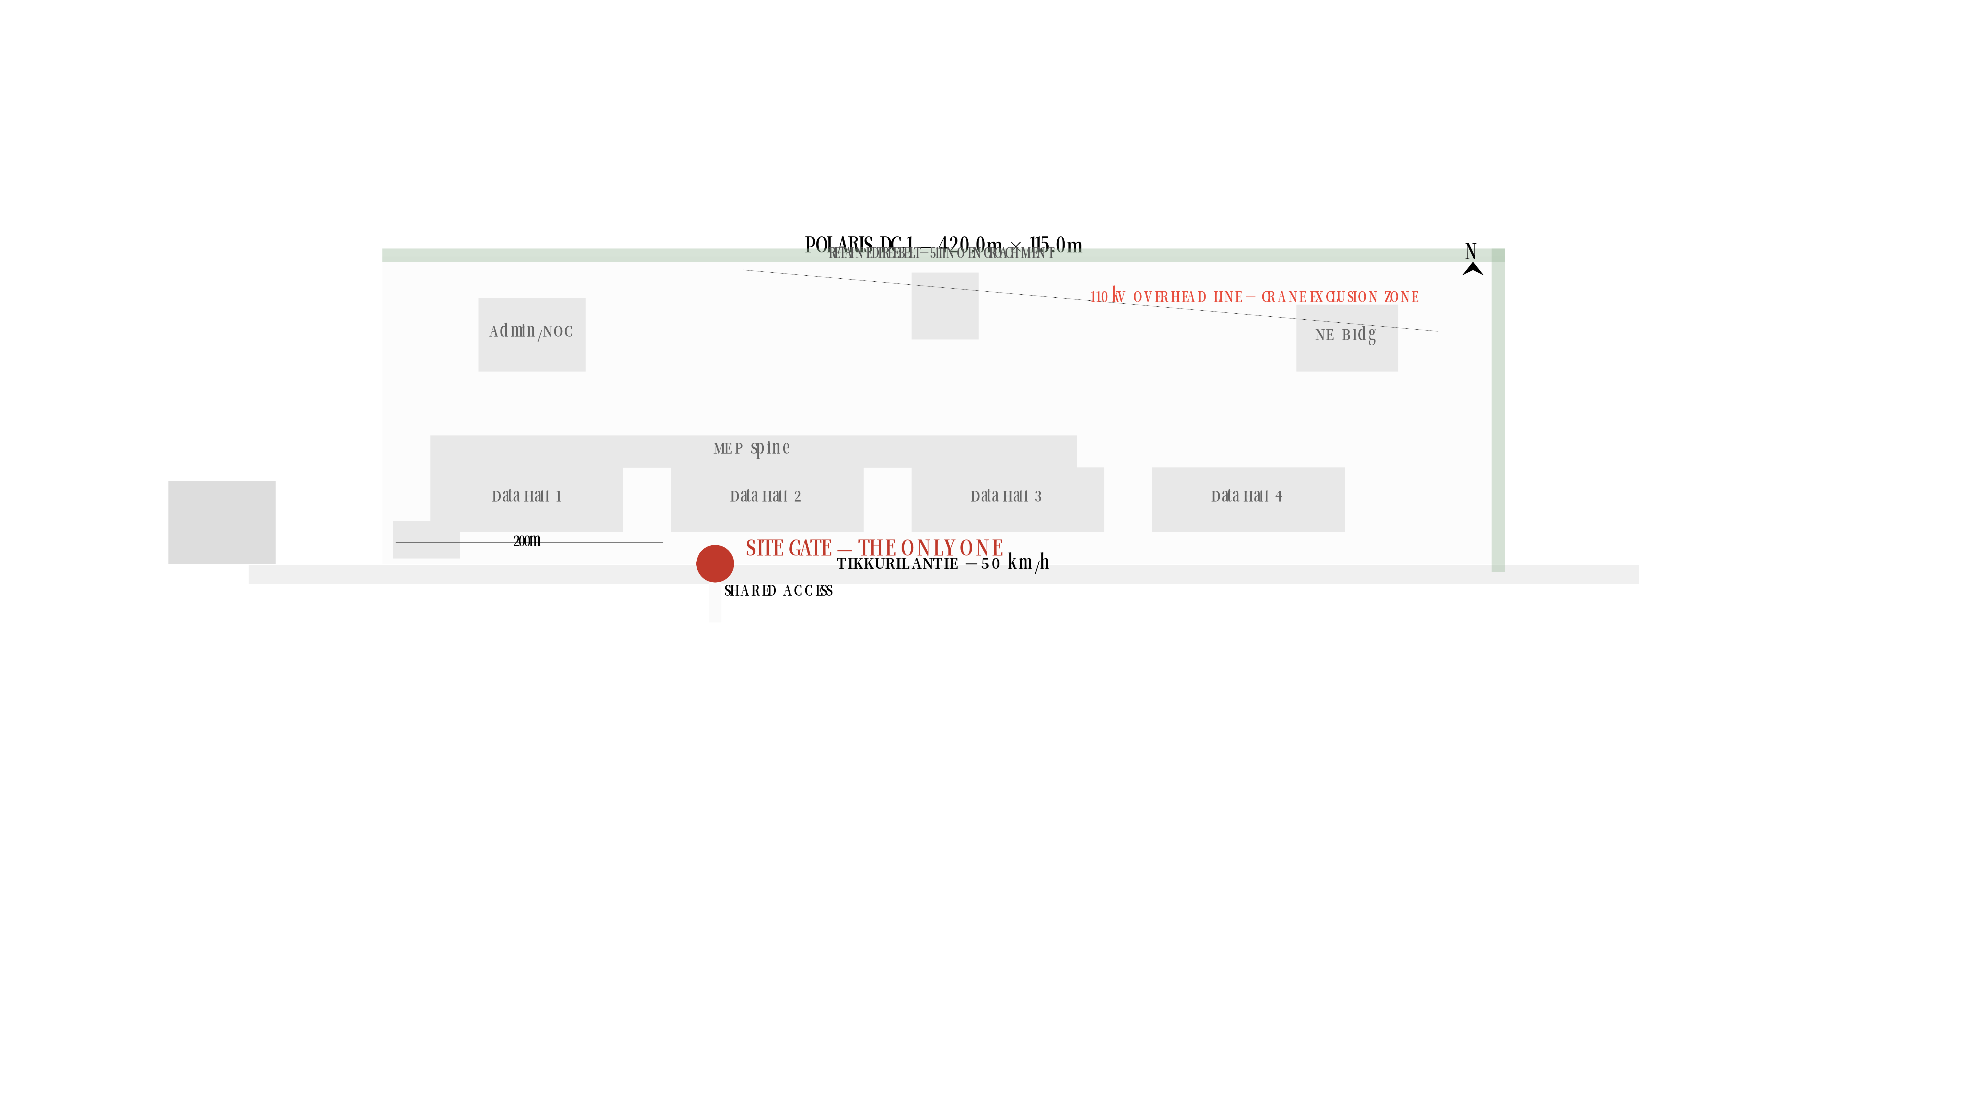
M1 MAR 2026 — 20 ops · 12 staff
PARKING 14sps 350m2
WELFARE 180m2
TP STOCKPILE 6300m2
TP FENCING+DUCT 440m2
LP-1
LP-2
LP-3
LP-4
M2 APR 2026 — 40 ops · 15 staff
PARKING 22sps 550m2
WELFARE 180m2
TP STEEL PREP 600m2
TP MECH MOB. 420m2
TP STOCKPILE 6300m2
TP ELEC MOB. 420m2
TP FENCING+DUCT 440m2
LP-1
LP-2
LP-3
LP-4

Slide 3
M3 MAY 2026 — 50 ops · 18 staff
PARKING 26sps 650m2
WELFARE 180m2
TP STEEL PREP 600m2
TP MECH MOB. 420m2
TP STOCKPILE 6300m2
TP ELEC MOB. 420m2
TP FENCING+DUCT 440m2
LP-1
LP-2
LP-3
LP-4
M4 JUN 2026 — 65 ops · 20 staff
110kV DNO permission
PARKING 32sps 800m2
WELFARE 180m2
TP STEEL PREP 600m2
TP MECH MOB. 420m2
TP STKPL+PILLING 6300m2
TP ELEC MOB. 420m2
TP FENCING+DUCT 440m2
LP-1
LP-2
LP-3
LP-4

Slide 4
M5 JUL 2026 — 85 ops · 22 staff
110kV DNO permission
PARKING 40sps 1000m2
WELFARE 202m2
TP STEEL PREP 600m2
TP MECH MOB. 420m2
TP STKPL+PILLING 6300m2
TP ELEC MOB. 420m2
TP FENCING+DUCT 440m2
LP-1
LP-2
LP-3
LP-4
M6 AUG 2026 — 100 ops · 24 staff
110kV DNO permission | Mast-climber 3m strip §7
PARKING 46sps 1150m2
WELFARE 223m2
TP STEEL PREP 600m2
TP PIPE STAGING 660m2
TP CABLE+SWGR 540m2
TP STKPL+PILLING 6300m2
TP ENVELOPE 720m2
TP FENCING+DUCT 440m2
LP-1
LP-2
LP-3
LP-4

Slide 5
M7 SEP 2026 — 130 ops · 26 staff
110kV DNO permission | Mast-climber 3m strip §7
PARKING 58sps 1450m2
WELFARE 254m2
250t CRANE
TP STEEL 720m2
TP PIPE STAGING 660m2
TP CABLE+SWGR 540m2
TP RESIDUAL 4800m2
TP CLADDING 1080m2
TP FENCING+DUCT 440m2
LP-1
LP-2
LP-3
LP-4
M8 OCT 2026 — 155 ops · 28 staff
110kV DNO permission | Mast-climber 3m strip §7
PARKING 68sps 1700m2
WELFARE 282m2
250t CRANE
250t CRANE
TP STEEL 720m2
TP RESIDUAL 4800m2
TP CLADDING 1080m2
TP FENCING+DUCT 440m2
TP PIPE+CRAH 960m2
TP FLOORS 660m2
TP XFMR+GEN 840m2
LP-1
LP-2
LP-3
LP-4

Slide 6
GEN CRANE
M9 NOV 2026 — 180 ops · 28 staff
110kV DNO permission | Mast-climber 3m strip §7
PARKING 78sps 1950m2
WELFARE 299m2
250t CRANE
250t CRANE
TP STEEL+PRECAST 960m2
TP CLADDING 1080m2
TP FENCING+DUCT 440m2
TP FLOOR+CONTAIN. 1540m2
TP PIPE+CRAH 960m2
TP XFMR+GEN 840m2
LP-1
LP-2
LP-3
LP-4
GEN CRANE
M10 DEC 2026 ★ PEAK — 210 ops · 28 staff
110kV DNO permission | Mast-climber 3m strip §7
PARKING 90sps 2250m2
WELFARE 320m2
TP STEEL+PRECAST 960m2
250t CRANE
250t CRANE
TP CLADDING+ROOF 1320m2
TP ELV+BMS 600m2
TP EXT.MATS 330m2
TP FLOOR+CONTAIN. 1540m2
TP PIPE+CRAH 960m2
TP XFMR+GEN 840m2
LP-1
LP-2
LP-3
LP-4

Slide 7
M11 JAN 2027 ★ PEAK — 230 ops · 28 staff
110kV DNO permission | Mast-climber 3m strip §7
PARKING 98sps 2450m2
WELFARE 334m2
250t CRANE
250t CRANE
TP STEEL+PRECAST 960m2
TP CLADDING+ROOF 1320m2
TP ELV+BMS 660m2
TP CYLINDERS 216m2
TP CRAH+PIPE 1200m2
TP EXT.MATS 330m2
TP FLOOR+CONTAIN. 1540m2
TP DIST+BUSWAY 840m2
LP-1
LP-2
LP-3
LP-4
M12 FEB 2027 ★ PEAK — 250 ops · 28 staff
110kV DNO permission | Mast-climber 3m strip §7
PARKING 106sps 2650m2
WELFARE 347m2
TP STEEL RESID. 480m2
250t CRANE
TP CLADDING+ROOF 1320m2
TP ELV+BMS 660m2
TP CYLINDERS 216m2
TP CRAH+PIPE 1200m2
TP EXT.MATS 330m2
TP MOVING INDOORS 880m2
TP DIST+BUSWAY 840m2
LP-1
LP-2
LP-3
LP-4

Slide 8
M13 MAR 2027 ★ PEAK — 235 ops · 26 staff
Mast-climber 3m strip §7 | TP-008 relocation
PARKING 100sps 2500m2
WELFARE 327m2
TP PAVING+PLANT 1800m2
TP RESIDUAL ENV. 840m2
TP ELV+BMS 660m2
TP CYLINDERS 216m2
TP CRAH+PIPE 1200m2
TP RESIDUAL 550m2
TP DIST+BUSWAY 840m2
LP-1
LP-2
LP-3
LP-4
M14 APR 2027 ★ PEAK — 200 ops · 24 staff
TP-008 relocation | Gate booking system active
PARKING 86sps 2150m2
WELFARE 292m2
TP PAVING+PLANT 1800m2
TP FINAL ENV. 480m2
TP COMMISSIONING 600m2
TP COMMISSIONING 840m2
TP RESIDUAL 550m2
TP COMMISSIONING 600m2
LP-1
LP-2
LP-3
LP-4

Slide 9
M15 MAY 2027 — 150 ops · 20 staff
TP-008 relocation
PARKING 66sps 1650m2
WELFARE 236m2
TP PAVING+PLANT 1800m2
TP COMMISSIONING 600m2
TP COMMISSIONING 840m2
TP COMMISSIONING 600m2
LP-1
LP-2
LP-3
LP-4
M16 JUN 2027 — 80 ops · 16 staff
PARKING 38sps 950m2
WELFARE 180m2
TP PAVING+PLANT 1800m2
LP-1
LP-2
LP-3
LP-4

Slide 10
M17 JUL 2027 — 60 ops · 12 staff
S1+S2+S3 COMPLETED
PARKING 30sps 750m2
WELFARE 180m2
TP ROADS+PLANT 1560m2
TP FINAL COMM. 360m2
TP FINAL COMM. 480m2
TP FINAL COMM. 480m2
LP-1
LP-2
LP-3
LP-4
M18 AUG 2027 — 40 ops · 10 staff
PARKING 22sps 550m2
WELFARE 180m2
TP ROADS+PLANT 1560m2
LP-1
LP-2
LP-3
LP-4

Slide 11
M19 SEP 2027 — 25 ops · 8 staff
TP-006 Oct 1 + TP-007 Oct 7 done
PARKING 16sps 400m2
WELFARE 180m2
TP ROADS+PLANT 1320m2
LP-1
LP-2
LP-3
LP-4
M20 OCT 2027 — 15 ops · 6 staff
TP-005 completes Oct 27
PARKING 12sps 300m2
WELFARE 180m2
TP SNAGGING 1080m2
LP-1
LP-2
LP-3
LP-4

Slide 12
M21 NOV 2027 — 8 ops · 5 staff
TP-008 completes Nov 22 — last trade
PARKING 10sps 250m2
WELFARE 180m2
TP FINAL SNAG 840m2
LP-1
LP-2
LP-3
LP-4
M22 DEC 2027 — 5 ops · 4 staff
S4 sectional completion Jan 2 2028
PARKING 8sps 200m2
WELFARE 180m2
LP-1
LP-2
LP-3
LP-4

