Slide 1
Polaris DC-1
Mobilisation Pack — Board Approval
Aviapolis Data Campus, Vantaa · Phase 1
8 August 2026 · FIDIC Yellow Book 2017 D&B lump sum
Contract Sum €92,400,000 · Time for Completion 22 months · Four Sections
PDC-PR-001 Rev 0

Slide 2
The board is asked to approve three things
Mobilisation gate · week +1 Thursday
1
Pre-Commencement procurement of LT-01 transformers
110/20 kV, 16 MVA, 52-week lead
Order-by 16 Jan 2026 — already past on Commencement 2 Mar 2026
Without this, Section 1 (TfC 2 May 2027) cannot be achieved.
2
Sectional completion framework
S1 14mo (2 May 27) · S2 16mo (2 Jul 27)
S3 19mo (2 Oct 27) · S4 22mo (2 Jan 28)
Endorse the four TfCs as the delivery thesis.
3
Advance + performance security
Advance: €9.24M (10% of contract sum)
Performance security: €9.24M (10% bank guarantee)
Approve execution in line with PC RevC.
Item 1 is time-critical: without pre-Commencement procurement authorisation by 2 March 2026, LT-01 cannot be ordered in time.

Slide 3
Project at a glance
What we're building, who it's for, when it's done
4
4
22 mo
data halls
Sections
build period
DH1 → DH4
TfC 14/16/19/22 mo
Mar 2026 → Jan 2028
€92.4M
€9.24M
+€4.26M
contract sum
max LD exposure
minimum cash buffer
BOQ PDC-BOQ-001 Rev A
10% aggregate cap
May 2027 — base case needs NO facility
Employer: Polaris Digital Infrastructure Oy · Contractor: NordBuild Oy · Engineer: Norvia Consulting Oy · Contract: FIDIC YB 2017 D&B

Slide 4
Phasing — sectional completion
Four TfCs, four Delay Damages rates, aggregate cap 10%
S1 · 14mo · 2 May 2027 · €18,000/day
S2 · 16mo · 2 Jul 2027 · €12,000/day
S3 · 19mo · 2 Oct 2027 · €12,000/day
S4 · 22mo · 2 Jan 2028 · €10,000/day
M0
M3
M6
M9
M12
M15
M18
M21
Aggregate LD cap: 10% of contract sum = €9,240,000 (cumulative, concurrent accrual subject to cap).
Section 1 carries the highest daily LD (€18,000) because it is the critical-path section — substation, generators, shared cooling spine, gatehouse.

Slide 5
Sequence and package interfaces
Eight tender packages + main-contract commissioning
Per-hall build pattern (DH1 → DH4)
Critical interfaces
• TP-001 Earthworks & Substructure → TP-002 Steel frame → TP-003 Envelope
• Shared cooling spine (Section 1) sized for full 10 MW — must complete before DH2 commissioning
• TP-006 Electrical rough-in (transformers, busway, switchgear)
• 110 kV grid energisation (MS-09, 12 Mar 2027) gates Section 1 TOC
• TP-005 Mechanical rough-in (chillers, dry coolers, CRAH)
• TP-004 Finishes & data-hall containment (raised access, partitions)
• Tenant fit-out access (MS-10, Month 12) overlaps Section 1 commissioning — interface risk R-15
• TP-007 ELV / BMS / suppression / fire detection
• Waste-heat 72h test (MS-17, heating season only Oct–Apr) — miss waits for next season
• L1–L5 Commissioning (MS-11 to MS-13 for Section 1)
• Permanent car park (Sep–Oct 2027) sits on temporary compound footprint — sequence compound move first (R-04)
Section 1 is the binding constraint
Everything the other halls depend on lives in Section 1: the primary substation, the 8 × 2.5 MVA standby generators, the shared cooling spine sized for the full 10 MW, the gatehouse. The L1–L5 commissioning sequence for DH1 (MS-11 L4 integrated systems testing in Month 13; MS-12 L5 24 h load-bank in Month 14) is what closes Section 1 — and Section 1's TOC is what earns the first half of the 5% retention release.

Slide 6
Long-lead procurement — LT-01 is the binding constraint
15 long-lead items, one carries NEGATIVE FLOAT
⚠ LT-01 — 110/20 kV transformers (2 nr, 16 MVA) — 52-week lead
Need on site 15 Jan 2027 · Order by 16 Jan 2026 · Float −6.4 weeks · TP-006 (Electrical)
Order date is BEFORE the Commencement Date (2 Mar 2026). Without a pre-Commencement order under letter of intent, or a formal advance procurement instruction, Section 1 (TfC 2 May 2027) cannot be achieved.
Other long-lead items (float in weeks)
Ref | Package | Equipment | Float (wks)
LT-02 | TP-006 | 20 kV switchgear + protection | +9.6
LT-03 | TP-006 | Standby generators (8 × 2.5 MVA) | +9.6
LT-04 | TP-006 | UPS modules (16 × 1000 kVA) | +21.6
LT-07 | TP-005 | Chillers (4 nr) | +22.6
LT-08 | TP-005 | Dry coolers / adiabatic (10 nr) | +28.6
LT-09 | TP-005 | CRAH units (28 nr) | +32.6
LT-10 | TP-005 | Waste-heat recovery plant (4 MW) | +30.6
LT-11 | TP-002 | Structural steel fabrication | +5.6
LT-15 | TP-007 | Suppression system (data halls) | +35.6

Slide 7
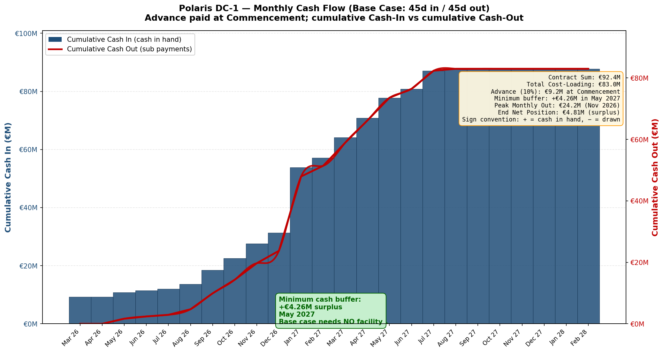
Cash flow — base case needs NO working-capital facility
Same chart as in the workbook (Cash Flow sheet)
Headline: base case (45d in / 45d out, advance paid at Commencement per PC RevC SP-11) requires NO working-capital facility. Minimum cash buffer +€4.26M SURPLUS in May 2027 — the cumulative net stays positive throughout the build. End-of-project net position +€4.81M; peak monthly cash-out €24.18M in November 2026.

Slide 8
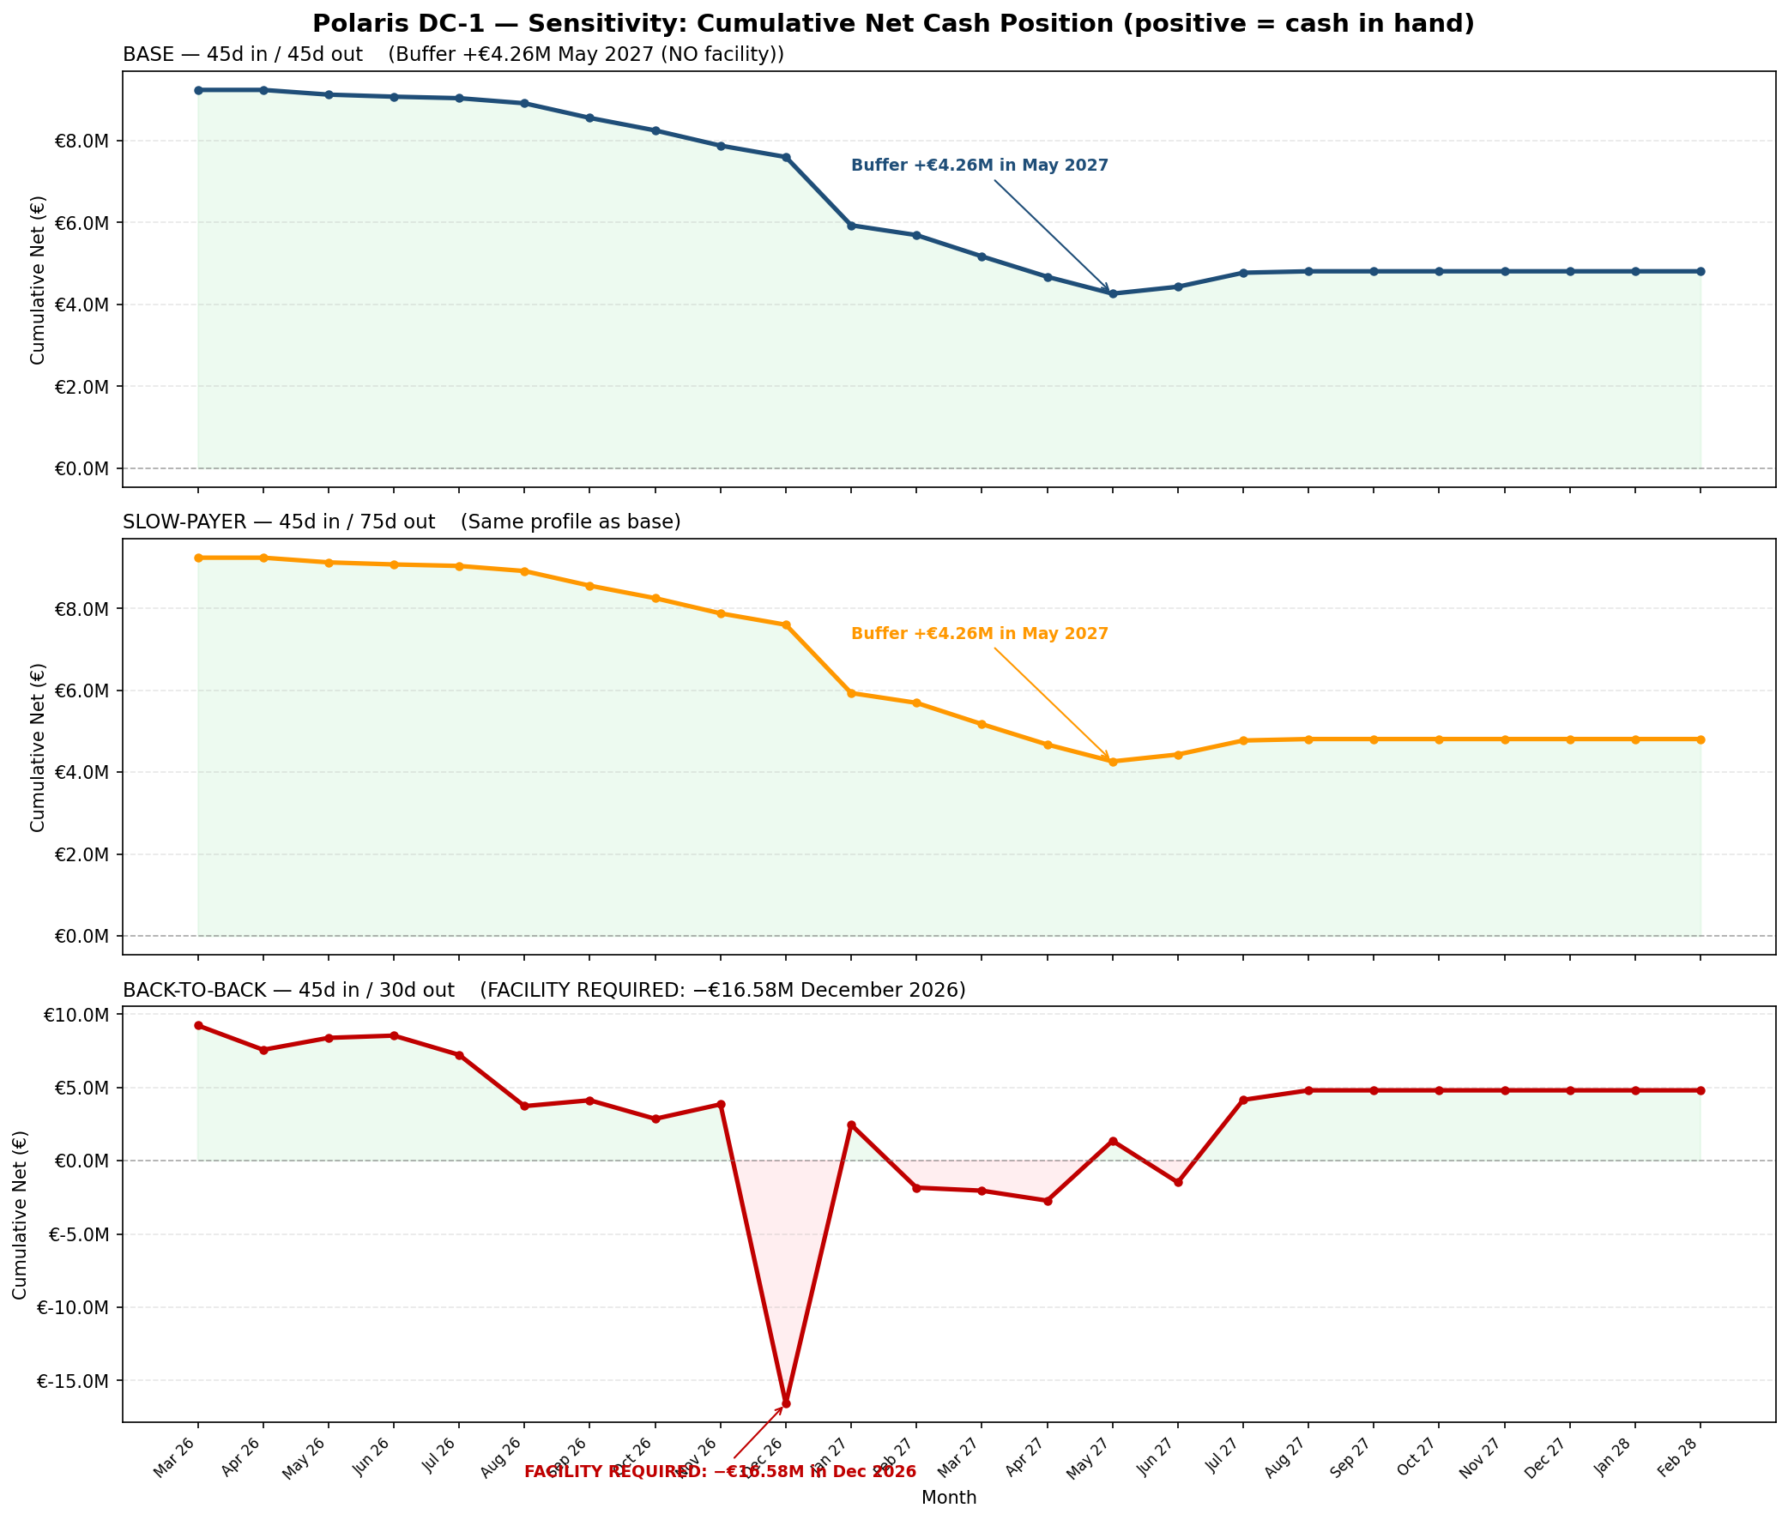
Sensitivity — back-to-back IS the facility case
45/30 scenario: working-capital line required
BASE (45/45): minimum buffer +€4.26M in May 2027 — NO facility required. SLOW-PAYER (45/75): same profile. BACK-TO-BACK (45/30): facility required −€16.58M in DECEMBER 2026 — a working-capital line of ~€17–18M would be needed if subs press for shorter payment terms.

Slide 9
Reconciliation — BOQ €92.4M vs cost loading €82.97M
€9.43M gap is a structural shift, not a missing line
§ | Description | Cost Load €M | BOQ €M | Diff €M
A | Preliminaries & General Requirements | 2.5 | 6.0 | +3.5
B | Earthworks, Blasting, Piling & Substructure | 9.4 | 6.5 | -2.9
C | Structure — Structural Steel & Precast Concre | 7.3 | 8.8 | +1.5
D | Envelope — Cladding, Roofing & Louvres | 5.6 | 5.5 | -0.1
E | Architectural Finishes & Data Hall Containmen | 4.2 | 4.6 | +0.4
F | Mechanical — Chillers, Dry Coolers, CRAH & Pi | 30.2 | 22.2 | -8.0
G | Electrical — HV/MV, Transformers, UPS & Gener | 10.7 | 27.7 | +17.0
H | ELV, BMS/DCIM, Fire Detection & Suppression | 2.6 | 5.1 | +2.5
I | External Works, Security & Fibre Entry | 2.3 | 3.7 | +1.4
J | Commissioning & Handover (L1-L5) | 8.2 | 2.3 | -5.9
 | TOTAL | 82.97 | 92.40 | +9.43
Why the gap exists
• Cost loading is a labour + install view (Resource Groups are crews).
• BOQ is a supply + install view — full equipment prices in F, G, H.
• Section G: BOQ carries €17.0M of equipment supply (transformers, switchgear, generators, UPS, busway) not in cost loading.
• Section A: BOQ carries insurance, performance bond, statutory supervisors, design/risk allowance (€3.5M).
• Offsetting: cost-loaded Mech (F) and Commissioning (J) carry install and L1–L5 labour heavier than BOQ does.
• All 10 sections account for the gap — sums reconcile to €9.43M exactly. Row-level audit in workbook (Audit — Cost Loading sheet).
For the cash flow: cash-IN uses BOQ; cash-OUT uses cost-loaded timing mapped to BOQ work; the €9.43M gap is implicit in the Advance Procurement line and the prelims.

Slide 10
Risk summary — top 7 by residual score (16 risks in workbook)
Includes R-16 (commencement-date conflict) and R-08 (back-to-back facility)
Risk ID | Risk | R-Score | Owner | Status
R-01 | LT-01 transformers, −6.4 wks float; Section 1 at risk | 8 | PM + Procurement | Active — board approval required
R-05 | Grid energisation MS-09 (12 Mar 2027) gates Section 1 TOC | 8 | PM + Engineering Mgr | Active — DNO engagement
R-03 | 110 kV overhead line — DNO consent before substation precast | 6 | Engineering Manager | Active — submit early
R-06 | Rock blasting — vibration, neighbour, archaeology trigger | 6 | Site Manager + H&S | Mitigated
R-15 | Tenant acceptance dependencies on Sectional Completion | 6 | PM + Commercial Mgr | Active — engage
R-07 | Subcontract back-to-back risk — 7 packages not yet let | 6 | Commercial Manager | Active — standardise
R-16 | Commencement-date conflict (PC 2 Mar vs baseline 1 Mar) | 4 | PM + Planner | Active — align baseline
Score = L × I (1–5 each). Residual after mitigation. Full register: 16 risks, scored and owned, in workbook Risk Register sheet.

Slide 11
Asks of the board
Three decisions for mobilisation approval
1
Pre-Commencement procurement of LT-01 transformers
Issue letter of intent / advance procurement instruction within 7 days so the order is placed on the 16 January 2026 cut-off.
Critical: without this, Section 1 (TfC 2 May 2027) is unachievable. LD exposure €18k/day from that date.
2
Endorse the sectional completion framework
Confirm the four TfCs (14/16/19/22 months from 2 March 2026) as the delivery thesis, with sectional LD rates and 10% aggregate cap.
Aligns contractual structure with the cash flow, the risk register, and the procurement plan. No contract change required.
3
Approve advance payment + performance security execution
Release the 10% advance payment (€9.24M) at Commencement against advance payment guarantee; issue the 10% on-demand bank guarantee for performance security.
Both are per PC RevC SP-11 and Part A Item 4.2. Without these, mobilisation cannot start.

