Slide 1
Polaris DC-1 — Period 07 Board Update (P07 cycle 5)
Data date 30 September 2026 · Operative PC: PDC-PC-001 RevC (FINAL, 24.02.2026)
Full BAC basis (EUR 92.4M)
Activity subset basis (EUR 8.34M)
CPI 0.902
CPI 0.697
EAC EUR 102.4M vs BAC EUR 92.4M
EAC EUR 11.97M vs BAC EUR 8.34M
Both bases flag the Kallio cost over-run. Activity subset shows the concentration; full BAC smooths it.
What is going well
What the board needs to know
• DH1 piling complete on programme 11.09
• DH2 piling complete on programme 15.09
• Section 1 date unchanged: 02.05.2027
• R-09 TMP compound closed 14.09 (no claim)
• SPI 1.020 (full BAC) / 0.998 (activity subset)
• Kallio cost overrun concentrated
• 110 kV letter: 14-day window closed 11.09 — 19 days ago; hold-harmless drafted
• PDC-PC-001 RevC SP-7 apportionment regime (not bar); Cost bar retained
• 110 kV slip event: 28-day notice clock expired 25.09.2026; 20.2.2 reinstated
• DH2 waterproofing: KMO-QC-0219 UNWITNESSED — cert not worth the paper
• IL-1400: derived 67 wd to Section 1 (NOT a quoted baseline float)
• Critical-path float 0 — 110 kV now on the chain
1 of 12

Slide 2
EVM KPI — Period 07 — BOTH bases
Cumulative to 30.09.2026
Activity subset basis (working)
Full BAC basis (comparable to P05/P06)
SPI
CPI
EAC
VAC
SPI
CPI
EAC
VAC
0.998
0.697
€11.97M
€−3.63M
1.020
0.902
€102.4M
€−10M
Metric | Activity subset (BAC 8.34M) | Full BAC (BAC 92.4M) | Source
BAC | €8,342,800 | €92,400,000 | Activity Progress / P05-P06 workbooks
PV to date | €5,418,050 | €6,861,932 | Activity Progress / P06 + 1 mths
EV to date | €5,406,850 | €7,000,000 | Activity Progress / P06 + 1 mths
AC to date (cum) | €7,757,800 | €7,757,800 | PDC-CVR-P07
SV | €−11,200 | €+138,068 | Computed
CV | €−2,350,950 | €−757,800 | Computed
TCPI | 5.019 | 1.011 | Computed
Both bases use the same AC (EUR 7,757,800). Activity subset shows Kallio cost concentration; full BAC smooths it.
2 of 12

Slide 3
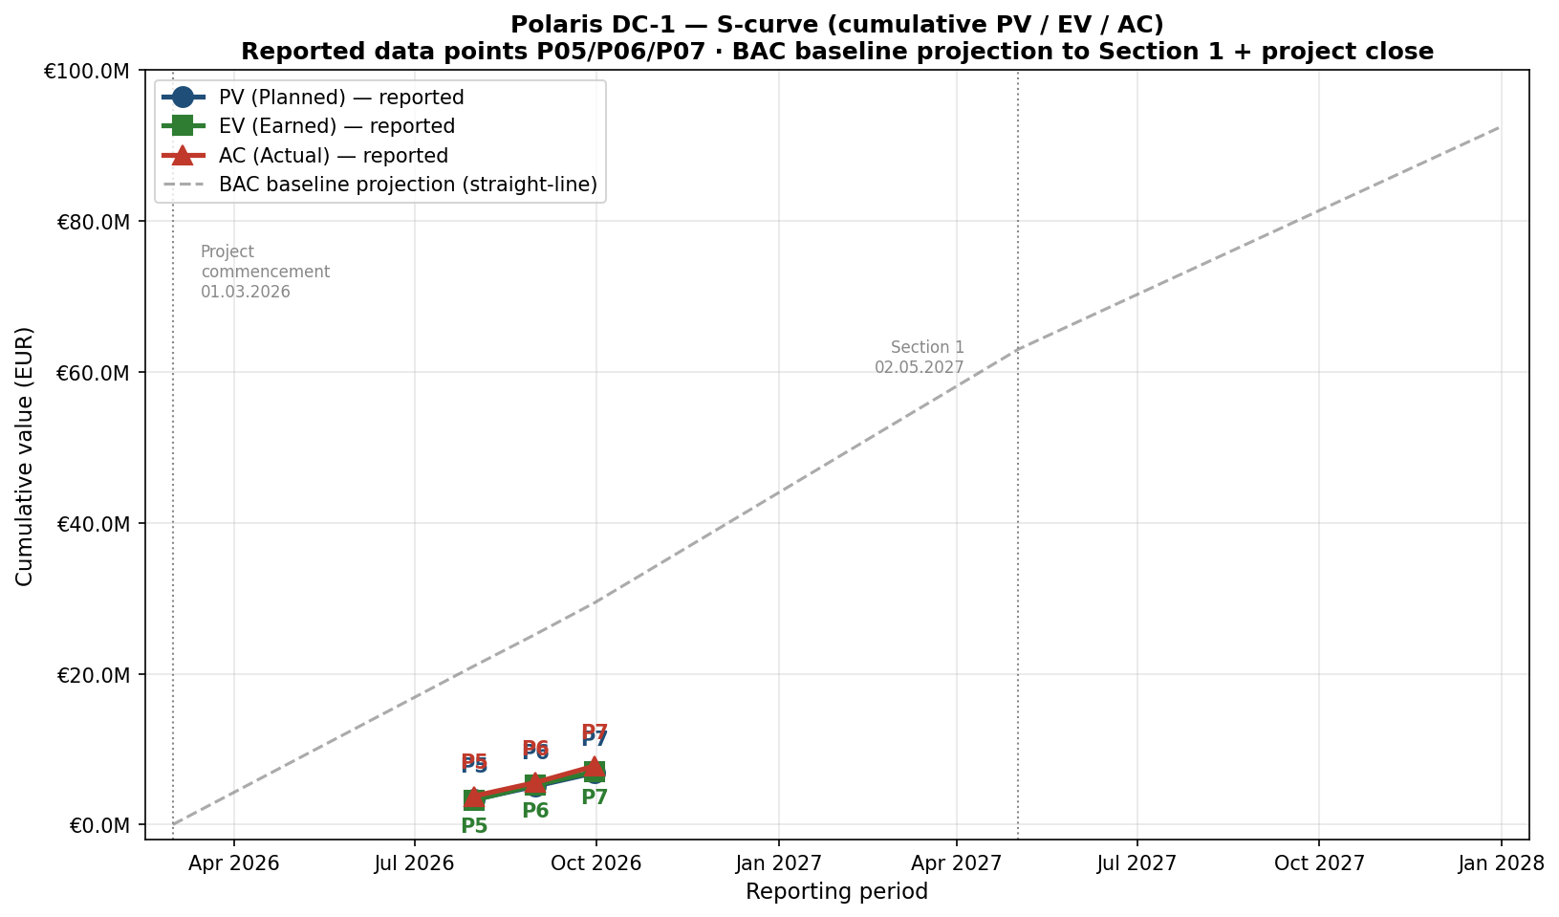
S-curve — Cumulative PV / EV / AC (from project commencement)
Reported data points P05/P06/P07 · BAC baseline projection to Section 1 + project close
BAC EUR 92,400,000. P07 EV EUR 7.0M is ahead of P07 PV EUR 6.86M (SPI 1.020). P07 AC EUR 7.76M is above EV (CPI 0.902). The Kallio cost over-run is concentrated in the active earthworks / substructure packages. Earlier months (Mar–Jun 2026) carry no reported data — the P06 S-curve sheet contains 'ESTIMATED earlier-period ramp' figures which have been excluded per the no-back-fill rule.
3 of 12

Slide 4
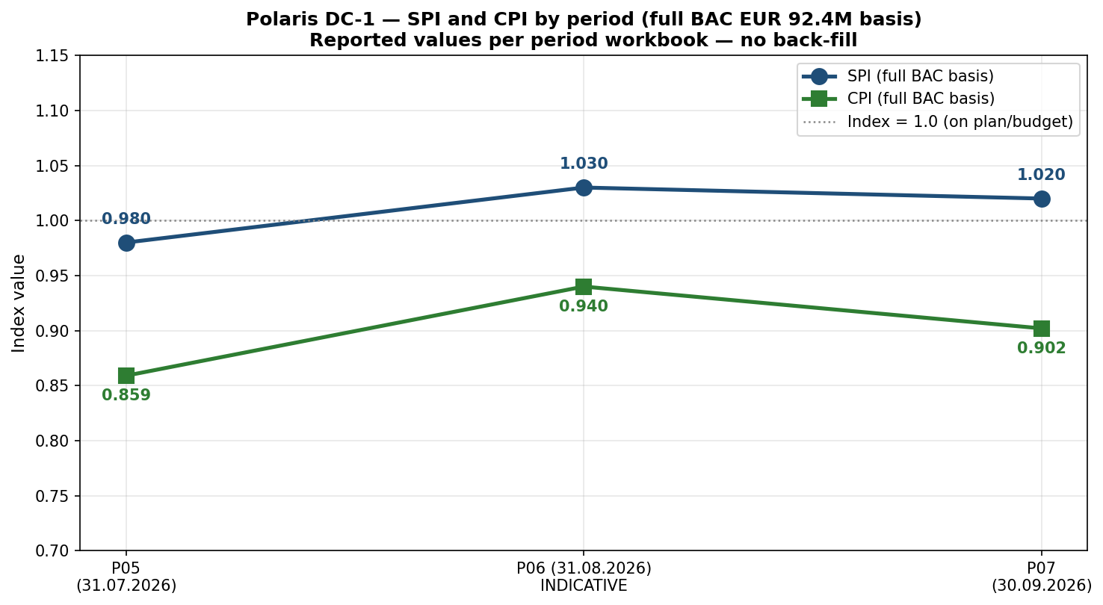
SPI and CPI by period (full BAC EUR 92.4M basis)
Reported values per period workbook — no back-fill
P05: SPI 0.98 / CPI 0.859. P06: SPI 1.03 / CPI 0.94 (INDICATIVE per P06 workbook). P07: SPI 1.020 / CPI 0.902. CPI has structurally lagged BAC throughout. Activity subset basis shows CPI 0.697 (Kallio concentration).
4 of 12

Slide 5
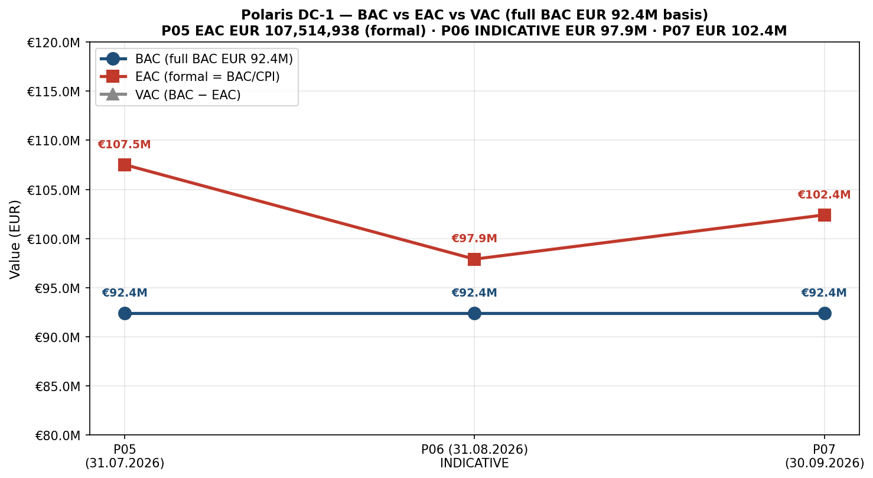
BAC vs EAC vs VAC by period (full BAC EUR 92.4M basis)
Reported EAC values per period workbook — no back-fill
BAC stable at EUR 92.4M throughout. EAC walked EUR 107,514,938 (P05) → EUR 97,900,000 (P06 indicative) → EUR 102,402,960 (P07). The EAC deterioration P06 → P07 reflects the P07 step-up in cost variance. VAC EUR −15.1M (P05) → EUR −5.5M (P06 indicative) → EUR −10.0M (P07).
5 of 12

Slide 6
SV and CV by period — reported values only
P05 reported · P06 and P07 not reported in their workbooks
Per the no-back-fill rule: SV and CV were reported only in the P05 workbook (SV EUR -65,681, CV EUR -529,413). P06 and P07 workbooks did not include variance metrics. The cells are empty rather than back-filled.
Period | SV (EUR) | CV (EUR) | Source
P05 (31.07.2026) | −65,681 | −529,413 | P05 EVM Summary — reported
P06 (31.08.2026) | Not reported | Not reported | P06 EVM_Disclosure does not include variance metrics
P07 (30.09.2026) | Not reported | Not reported | P07 workbook does not include variance metrics — derived in this workbook
Derived: P07 (full BAC) | +138,068 | −757,800 | Computed from EV EUR 7.0M − PV EUR 6.86M, EV EUR 7.0M − AC EUR 7.76M
Recommendation: P08 should report SV and CV explicitly. The P07 workbook carries the derived values on the EVM Summary sheet (basis B) — but a reported SV/CV is the standard. Note also that ETC (Estimate to Complete) was not reported in P05/P06/P07 workbooks; this is the third standard EVM metric missing from the project reporting set.
6 of 12

Slide 7
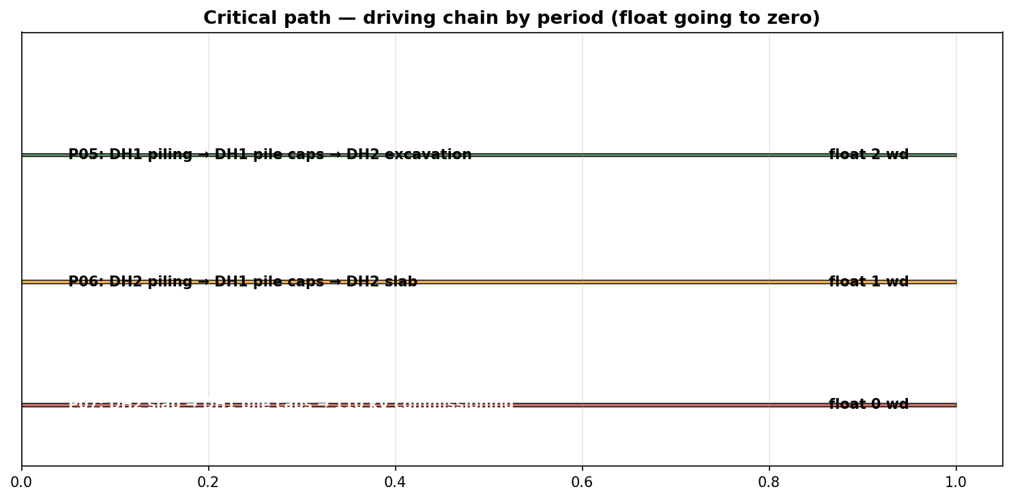
Critical path — driving chain has shifted
Float 2 → 1 → 0 working days across P05–P06–P07
Period | Driving chain | Float (wd) | Section 1 date
P05 (Jul 2026) | DH1 piling → DH1 pile caps → DH2 excavation | 2 | 02.05.2027
P06 (Aug 2026) | DH2 piling → DH1 pile caps → DH2 slab | 1 | 02.05.2027
P07 (Sep 2026) | DH2 slab → DH1 pile caps → 110 kV commissioning | 0 | 02.05.2027
The 110 kV leg is now on the chain. IL-1400 has derived 67 wd to Section 1 (see slide 8).
7 of 12

Slide 8
IL-1400 — baseline figures (PDC-SCH-005 Rev2) and derived float
The 67 wd figure is a derivation, NOT a quoted baseline float
67 working days (DERIVED)
IL-1400 to Section 1 date (02.05.2027) — DERIVATION from baseline dates
Element | Value | Source
Baseline duration | 70 working days | PDC-SCH-005 Rev2
Baseline start | 2026-06-15 | PDC-SCH-005 Rev2
Baseline finish | 2026-10-12 | PDC-SCH-005 Rev2
Predecessor (IL-1311) | COMPLETE (diary 21.09.2026) | PDC-SCH-005 Rev2 + site diary
Float column on Rev2 | NOT REPORTED (Rev2 has no float column) | PDC-SCH-005 Rev2 — Dur / Start / Finish / Predecessor / Notes only
Successor on critical path (IL-1510) | Chiller installation — 20 wd, 2027-01-29 → 2027-02-25 (predecessors IL-1210 + IL-1400) | PDC-SCH-005 Rev2
DERIVED — IL-1400 finish to IL-1510 finish | predecessor link per baseline | PDC-SCH-005 Rev2
DERIVED — IL-1510 finish to Section 1 (2027-05-02) | 66 cal days = 47 wd | Calendar arithmetic
DERIVED — commissioning/access/finishing buffer | 20 wd | Main contract Sections L+M
DERIVED — IL-1400 float to Section 1 | AT LEAST 67 WD (DERIVATION, NOT QUOTED) | Computed; baseline has no float column
Position on critical path | NOT on Section 1 critical path | PDC-MIN-P07 §4 (TL)
8 of 12

Slide 9
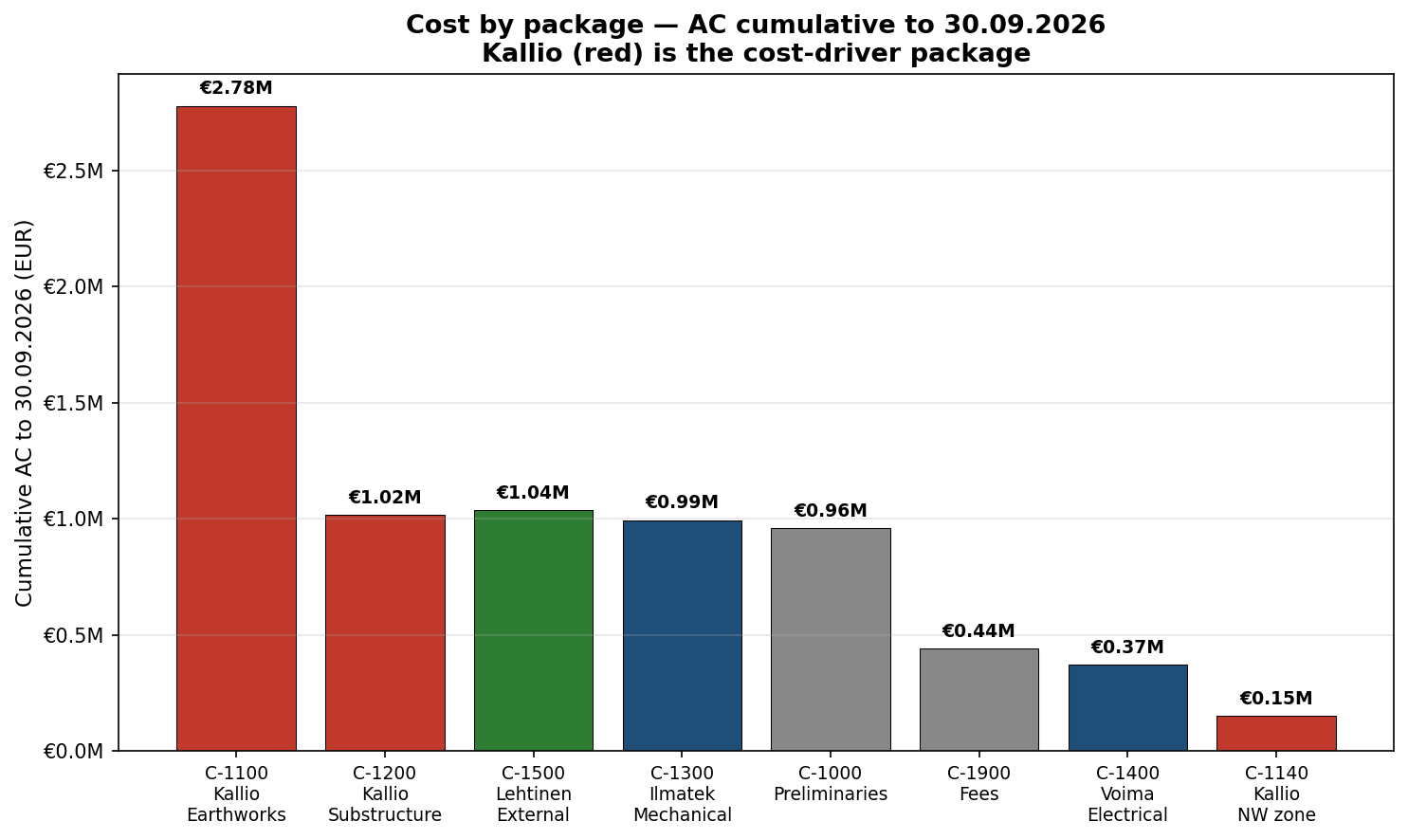
Cost by package — Kallio is the cost driver
Cumulative AC to 30.09.2026 (per PDC-CVR-P07)
Reading
TP-001 Kallio accounts for €3.95M of the €7.76M cumulative AC (51%). C-1100 (Earthworks + piling) is the principal driver at €2.78M, with C-1200 (Substructure) growing fast at €1.02M. A07-07 (cost recovery mechanism review) is the action.
9 of 12

Slide 10
Source-conflict log — the agreements and disagreements
CORRECTED P07 cycle 5 — operative PC PDC-PC-001 RevC
Item | Sub-return | Site / QS | Governing | Action
IL-1400 cooling spine % | Ilmatek 48% | QS 46% | QS 46% | Pay at 46%
DH2 waterproofing (C-1180) | Kallio 100% (KMO-QC-0219) | QS 90% | QS 90% | NCR; A07-01 by 07.10
KMO-QC-0219 cert | Kallio 100% signed | UNWITNESSED | Not worth the paper | NCR; rely on QS 90%
ILM-NOT-003 EoT (22 WD) | Ilmatek 22 WD | No entitlement | Deny under Cl. 1.3 + 4.1 + 4.2 (RevC SP-7 apportionment) | A07-04 by 13.10
Kallio PDC-SCH-001 Rev1 | Accept as programme | 12-item review | Do not accept | A07-03 (closed in report)
110 kV revised date | ER 24.04.2027 | No response issued | Hold-harmless + RevC SP-15 28-day notice + 20.2.2 | A07-05 by 06.10
C-1140 (NW zone) cost | Kallio €214,600 [CORRECTED from €178,400] | Incurred €152,800 | Reconcile | A07-02 by 14.10
Four live tensions this period. Three are defensible; the fourth (110 kV) is material and the Contractor owns it.
• DH2 waterproofing: KMO-QC-0219 UNWITNESSED — cert not worth the paper; pay 90% per QS.
• ILM-NOT-003: reasoned deny under PDC-SUB-005 Rev1 Cl. 1.3 / 4.1 / 4.2; PDC-PC-001 RevC SP-7 apportionment regime; derived 67 wd to Section 1.
• Kallio PDC-SCH-001 Rev1: 12-item field-by-field (4 REJECT / 4 ACCEPT / 4 NOTE) — do not accept.
• 110 kV: RevC SP-15 28-day notice + 20.2.2 reinstated; SP-7 apportionment regime.
10 of 12

Slide 11
Open actions — what is owed to whom
P07 cycle 5 — A07-03 closed; operative PC corrected to RevC
Action | Owner | Due | Status
A07-01 Complete bay W4 DH2 waterproofing upstands | PK / Kallio | 07.10.2026 | New
A07-02 C-1140 reconciliation (Kallio €214,600 vs incurred €152,800) | PK / Kallio + commercial | 14.10.2026 | New
A07-03 Kallio PDC-SCH-001 Rev1 review (field-by-field) | TL | 13.10.2026 | Closed in P07 cycle 2
A07-04 Respond to ILM-NOT-003 | TL / contracts | 13.10.2026 | New
A07-05 Issue hold-harmless response to PDC-LTR-PMC-014 | Contracts | 06.10.2026 | New
A07-06 EI-005 quotation (PDC-PC-001 RevC SP-9 / Cl. 13.3.1) | JV / PMC | 20.10.2026 | New
A07-07 Cost recovery mechanism review (BAC vs CPI) | Commercial / PMC | 20.10.2026 | New
A07-08 P08 to report SV / CV / ETC explicitly | PMC (planning) | 13.10.2026 | New
A07-09 Confirm operative PC for P08 onwards (RevC) | PD / PMC | 13.10.2026 | New
A06-05 EI-004 L2 quotation | JV / PMC | 15.09.2026 | Open (carry)
A05-05 Ilmatek recovery schedule | Ilmatek / TL | 31.08.2026 | Open (carry)
Critical this week: A07-05 (hold-harmless letter) — overdue, goes first. Next: A07-04 (response to ILM-NOT-003) by 13.10. A07-07 (cost recovery) is material to the board's position.
11 of 12

Slide 12
Asks of the board — Period 08
What needs decision this period (P07 cycle 5)
1
Authorise the immediate issue of the hold-harmless letter (PDC-LTR-001-021)
14-day window closed 11.09. Letter drafted on RevC terms. 28-day notice clock for 110 kV slip expired 25.09.2026; 20.2.2 reinstated.
2
Authorise A07-07 — cost recovery mechanism review
Activity subset CPI 0.697 / EAC EUR 11.97M. Full BAC CPI 0.902 / EAC EUR 102.4M. C-1100 and C-1200 are Kallio.
3
Confirm the DH2 waterproofing position (pay 90%, complete W4 upstands)
NCR PDC-NCR-001 drafted. KMO-QC-0219 UNWITNESSED — cert not worth the paper.
4
Approve the response to ILM-NOT-003 (reasoned deny under Cl. 1.3 / 4.1 / 4.2)
PDC-SUB-005 Rev1. PDC-PC-001 RevC SP-7 apportionment regime; Cost bar retained. Derived 67 wd to Section 1 — baseline has no float column. Deny on cost and time.
5
Back the field-by-field review of Kallio PDC-SCH-001 Rev1 (do not accept)
12-item review: 4 REJECT, 4 ACCEPT, 4 NOTE. Principal REJECT: waterproofing + Act 63 MEP spine not Kallio's scope.
6
Note R-20 (110 kV) — substance owed by 31.10.2026 — RevC SP-7 apportionment + SP-15 28-day notice + 20.2.2
110 kV slip event: 28-day notice clock expired 25.09.2026. 20.2.2 reinstated in full. Slab commencement 21.09.2026 gives a separate, still-open 28-day window (expires 19.10.2026) for any EoT application related to that event.
7
Note the P07 cycle 5 operative-PC correction
Operative PC is PDC-PC-001 RevC (FINAL, 24.02.2026), not RevB. SP-7 apportionment regime (not bar); SP-15 28-day notice + 20.2.2 reinstated; SP-9 interim valuation; SP-12 set-off limited; SP-5 / SP-2 / SP-3 / SP-6 / SP-13 reinstated.
12 of 12

