Slide 1
START HERE
A few words, in everyday language
The rest of the deck uses the names the field team uses. Here is what they mean.
Doctor (HCP)
Hospital, clinic, pharmacy
Rep
A physician or other clinician the company visits.
The places those visits happen. A hospital is sometimes called an HCO.
The person who goes out and sees customers.
Visit, or call
Plan
Class, A1 to C3
One of those meetings, written up in Salesforce. If it is not written up, it did not happen.
How many visits each customer should receive this month.
How important a customer is. A is seen most often. C is seen least often.
Time off territory
Business unit
Next best customer
A day the rep is not out visiting: leave, training, or sick. Short name: TOT.
A product team, such as diabetes, heart, or dermatology.
Who to see next, because they are behind on the plan.
For anyone new to pharmaceutical field teams
Salesforce for Pharmaceuticals

Slide 2
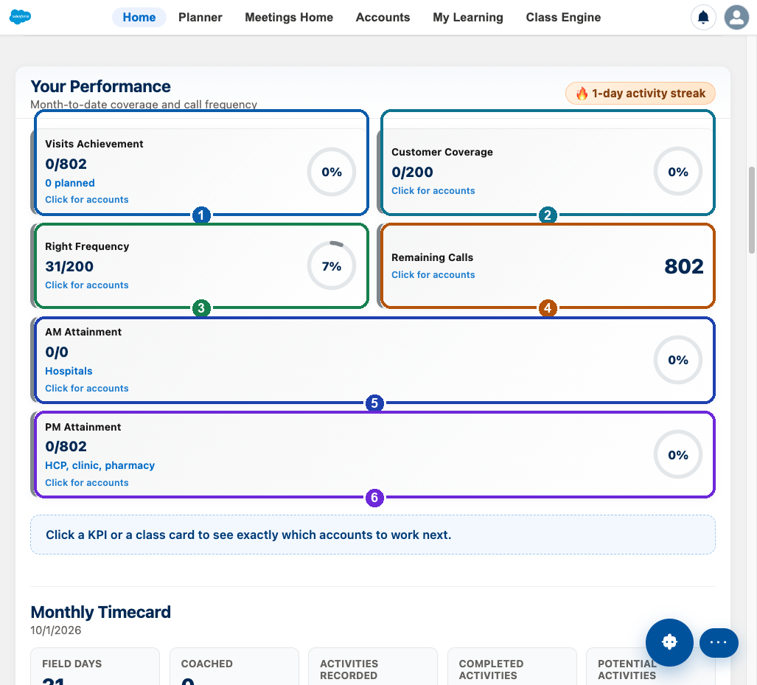
FIELD CO-PILOT · OFFLINE APP
What the six home numbers mean
Click any number to see the customers behind it
1 Visits done, out of the visits this month's plan expects.
2 Customers seen at least once, so nobody on the list is skipped.
3 Customers visited as often as their class requires. A is seen more than C.
4 Visits still left. Open it to see who to book next.
5 Hospital visits. This is the morning hospital round.
6 Doctors, clinics, and pharmacies — everyone who is not a hospital.
Field Co-pilot home, Salesforce offline app
Salesforce for Pharmaceuticals

Slide 3
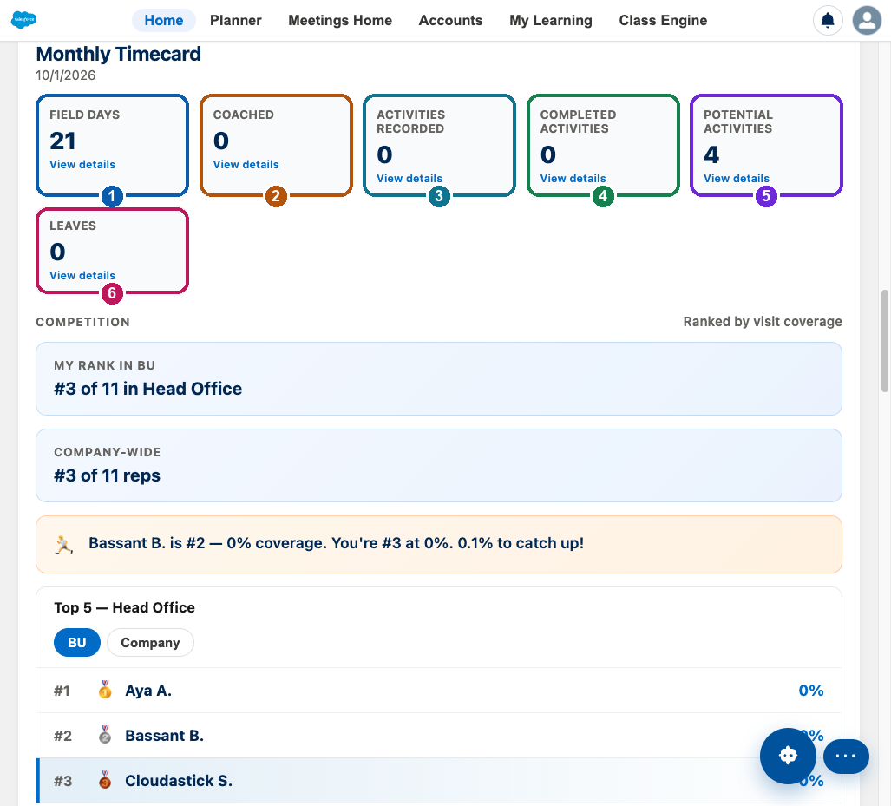
FIELD CO-PILOT · OFFLINE APP
The monthly timecard
These tiles explain the month, not just today's calls
1 Field days — weekdays minus holidays and approved leave.
2 Coached — days a manager rode along.
3 Activities recorded — days with at least one finished visit.
4 Completed activities — visits and meetings that actually happened.
5 Potential activities — visits and meetings still on the calendar.
6 Leaves — approved and pending days away. These are not missed visits.
Field Co-pilot home, Salesforce offline app
Salesforce for Pharmaceuticals

Slide 4
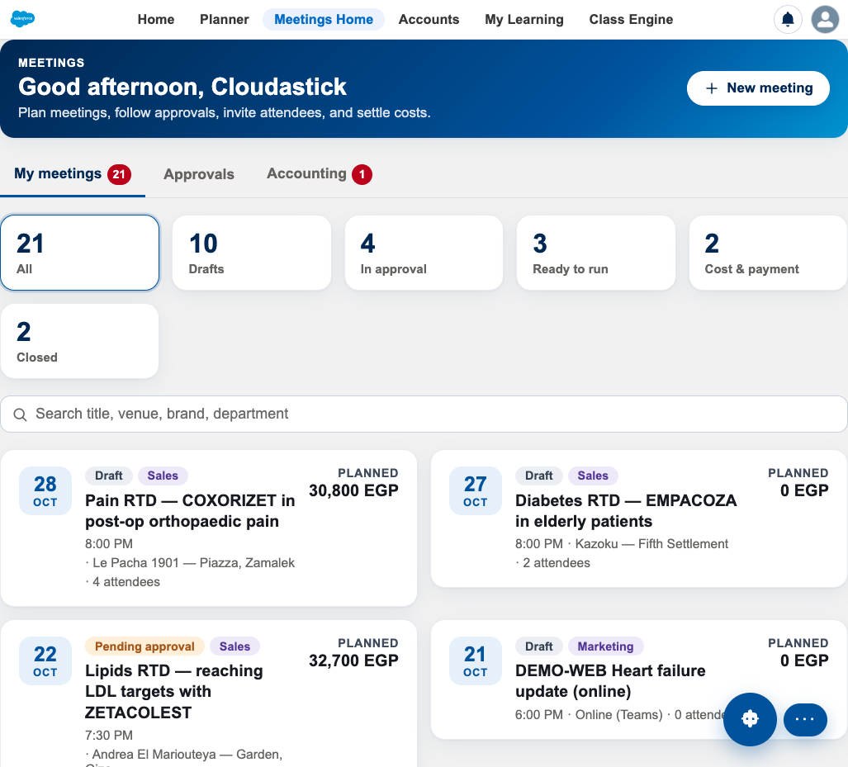
FIELD CO-PILOT · OFFLINE APP
A meeting is a group event, not a clinic visit
What you are looking at
A round table, speaker evening, training, or webinar. Doctors are invited. There is a venue and a budget.
The colored counts are the life of an event: still a draft, waiting for a manager, ready to run, costs being settled, or closed.
Each card is one event: date, place, how many people, and the planned cost in Egyptian pounds.
A manager approves the spend before invitations go out. After the event, the real cost is compared with the plan.
Meetings Home, Salesforce offline app
Salesforce for Pharmaceuticals

Slide 5
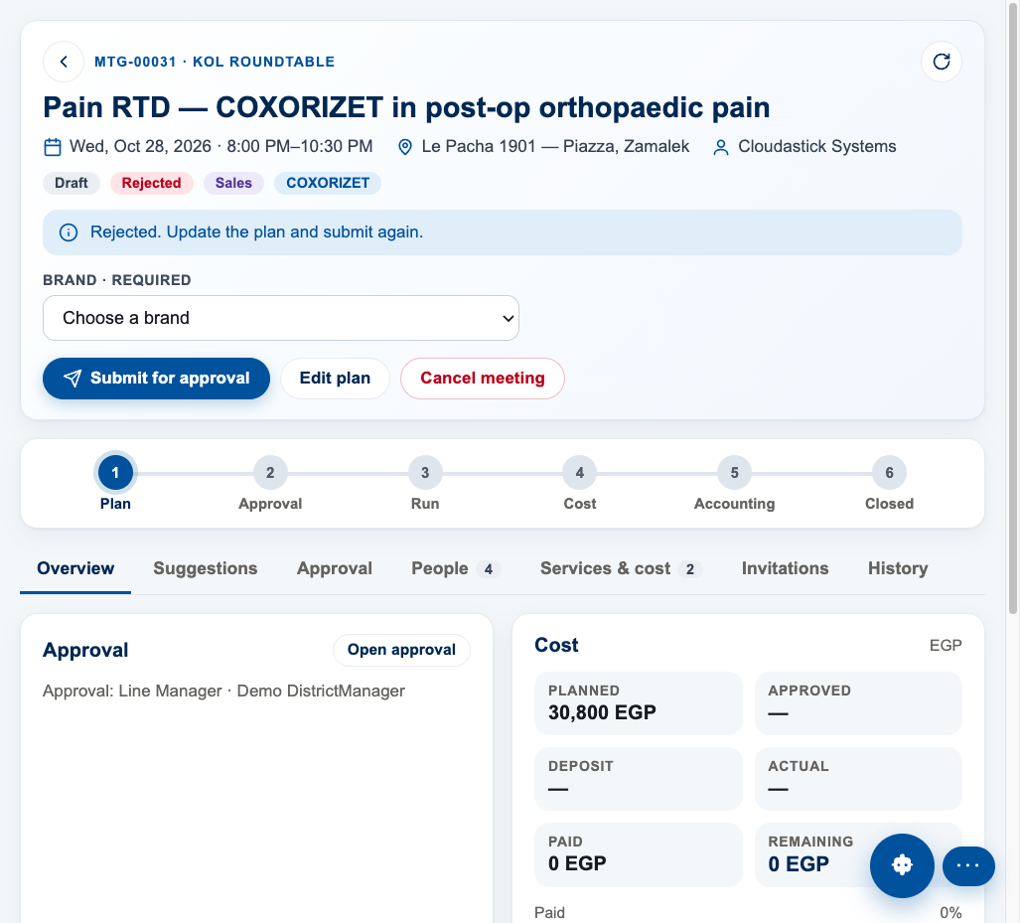
MEETINGS · OFFLINE APP
Plan, approve, run, then settle the cost
The six steps
1. Plan — date, place, topic, guests, and a cost estimate.
2. Approval — the right managers say yes, or send it back. This example was sent back because catering was above the allowed amount per person.
3. Run — the event happens. Doctors check in.
4. Cost — what was actually spent.
5. Accounting — finance pays what was approved.
6. Closed — the record is finished and can be audited.
One meeting, Salesforce offline app
Salesforce for Pharmaceuticals

Slide 6
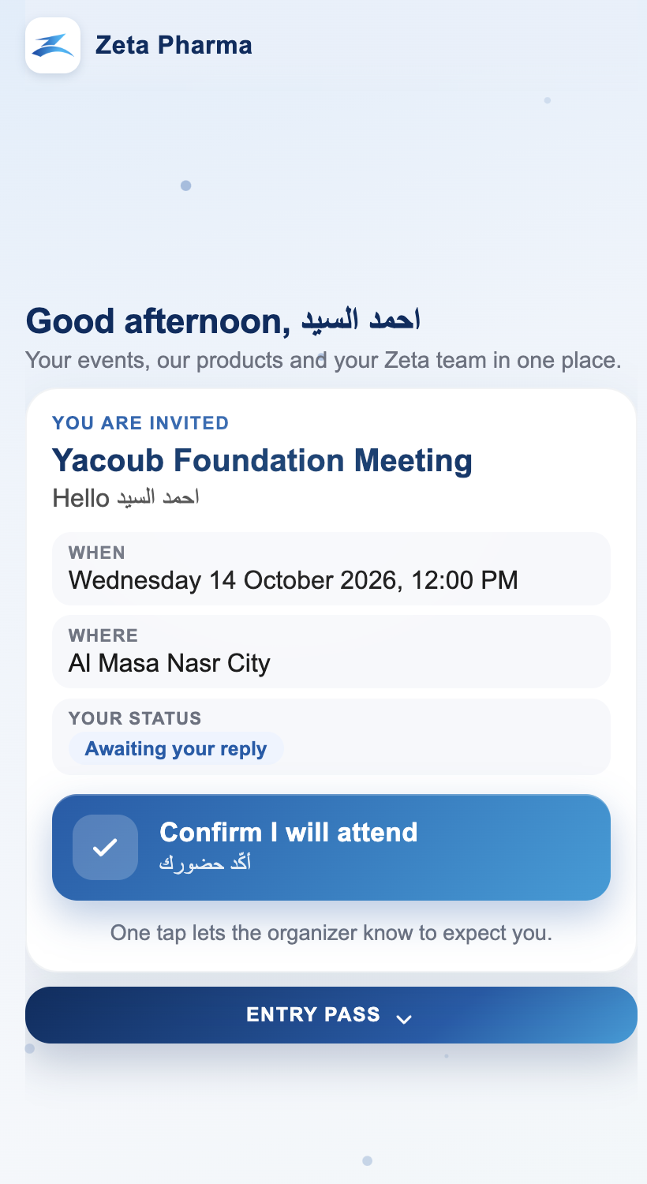
MEETINGS · THE DOCTOR'S VIEW
The doctor never logs into Salesforce
What the doctor sees on their phone
They receive a personal link by WhatsApp or email. Opening it shows this invitation.
They see when, where, and whether they have replied. One tap confirms they will attend.
On the day they show a live entry pass at the door. The code changes every minute, so a screenshot of the pass cannot be reused.
The same small app lets them ask for samples, request a visit, ask Medical a question, or report a side effect.
The company sees who was invited, who confirmed, and who actually walked in.
HCP view of the Yacoub Foundation Meeting
Salesforce for Pharmaceuticals

Slide 7
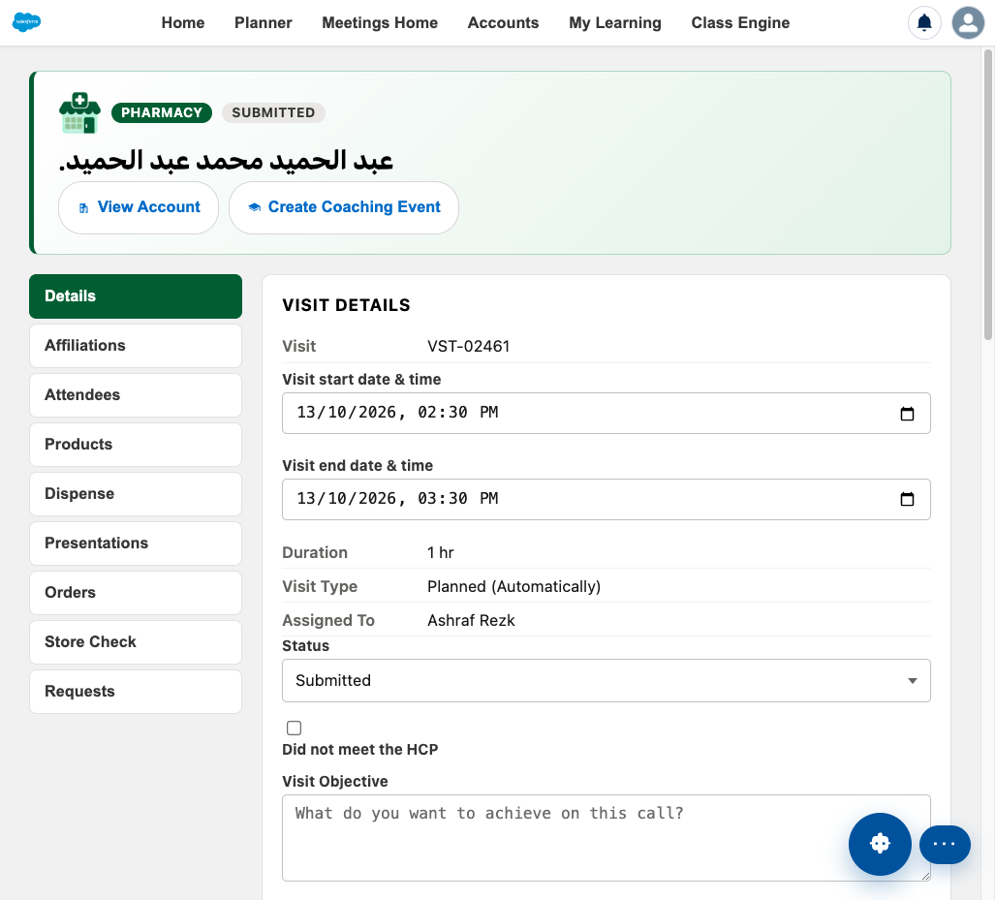
FIELD CO-PILOT · OFFLINE APP
Writing up one customer call
This is visit execution
The rep opens the visit during or just after the call and records what happened.
Details: when it started and ended, the purpose, and whether they actually met the person.
The other tabs cover who was there, which products were discussed, samples left behind, slides shown, orders, and a store check.
Submitting the visit updates the home-page numbers the same day.
A submitted pharmacy visit, Salesforce offline app
Salesforce for Pharmaceuticals

Slide 8
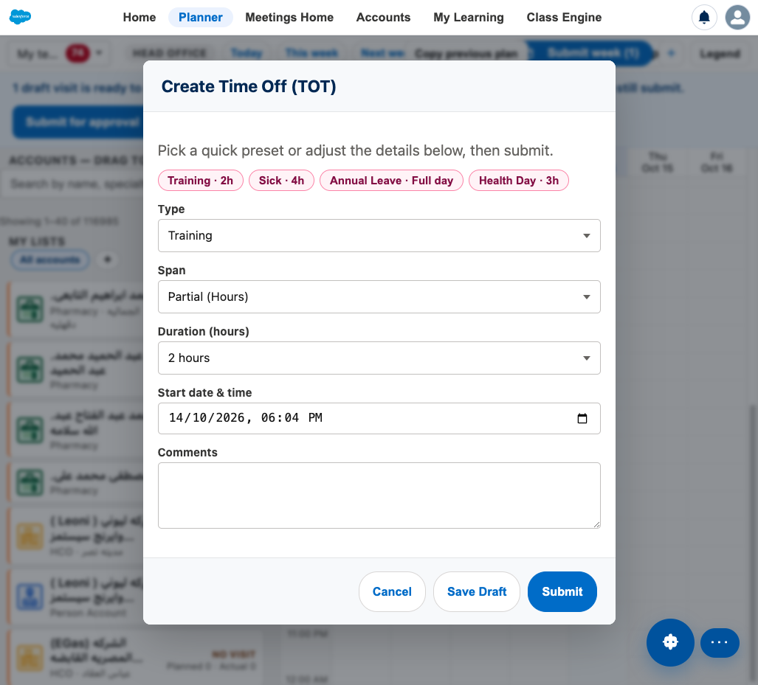
FIELD CO-PILOT · OFFLINE APP
Time off territory — a day not spent visiting
How a rep records it
From the weekly planner, the rep adds time off the same way they add a visit.
Presets cover the common cases: a short training, a few hours sick, a full day of annual leave, or a health day.
Custom covers anything else: the reason, how long, the start time, and a comment.
Save a draft or submit. The manager approves or rejects it on their phone.
Approved days come out of the visit target. A vacation does not look like the rep skipped their customers.
Create Time Off, from the offline planner
Salesforce for Pharmaceuticals

Slide 9
FIELD CO-PILOT
The rest of the rep's day, in plain words
Home office messages
Be in the know
Today's plan
Notes from headquarters: a new campaign, a rule, or a reminder. Read them before leaving the house.
Short news from medicine, the drug industry, and technology, so the rep is not surprised in the clinic.
Who is on today's route, in order, on a map. This is the driving list.
Top 5 next customers
Accounts
Planner
The five people most worth seeing next, because they are behind on visits. One tap books them.
The book of doctors, pharmacies, and hospitals: who they are, who they work with, and how the relationship is going.
The week. Drag a customer onto a time to book a visit. Meetings and time off sit on the same calendar.
Learning
Class engine
Expenses
Short courses and certificates between calls, so product knowledge stays current.
The grid that turns importance into A1–C3. That class decides how often the customer must be seen.
Money spent on the road, submitted by the rep and reviewed for repayment.
Each of these already has a screen later in the main deck
Salesforce for Pharmaceuticals

Slide 10
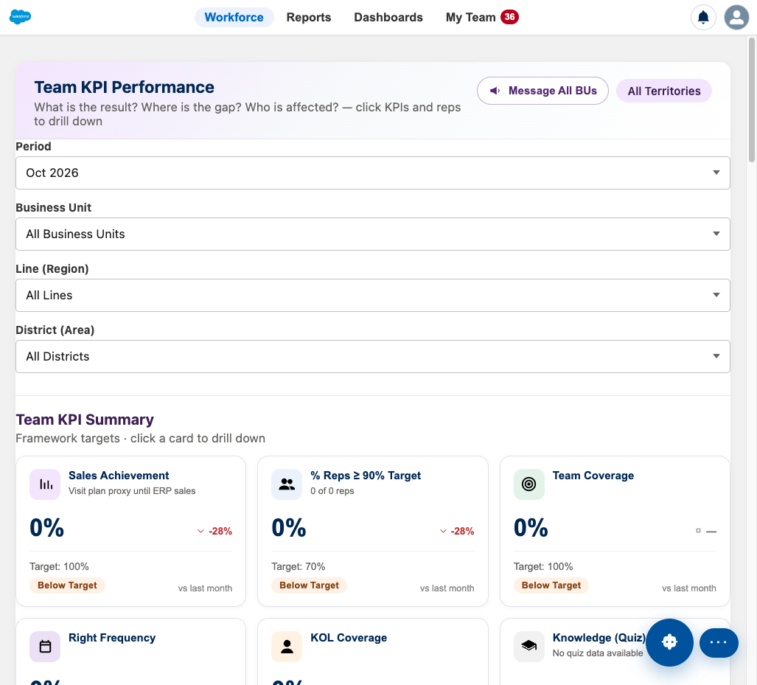
LEAD CO-PILOT · OFFLINE APP
The same month, seen across the team
Workforce
Managers open this instead of one rep's home page.
Filter by month, product team, region, and district.
Each card is a team result: sales, coverage, visit frequency, and coaching.
Click a card to see which reps are behind, and which customers are the gap.
My Team is where time off, meetings, and expenses wait for a yes or a no.
Lead Co-pilot, Salesforce offline app
Salesforce for Pharmaceuticals

Slide 11
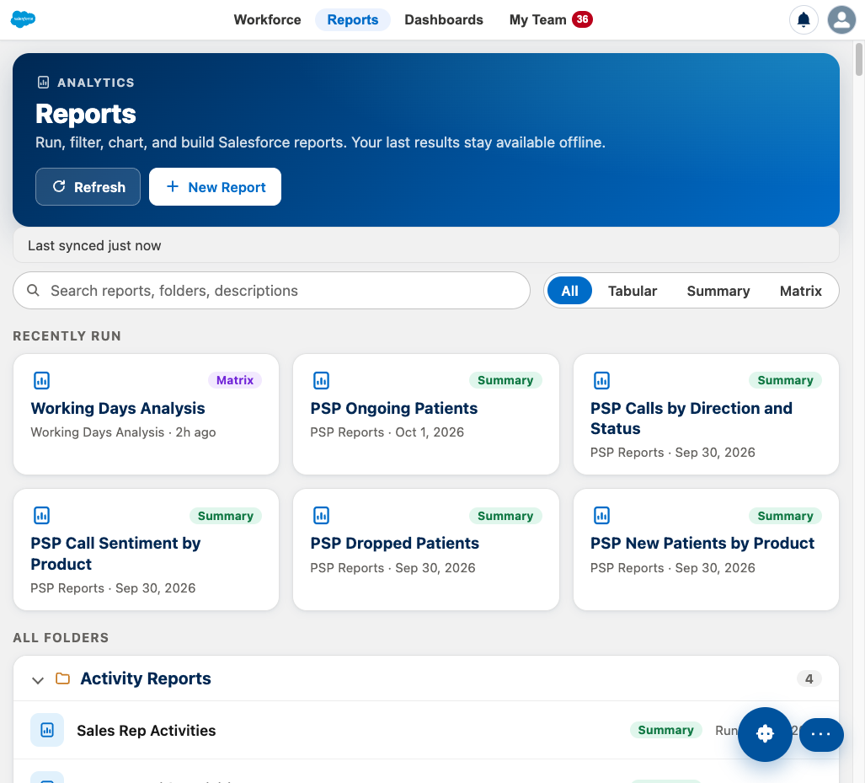
LEAD CO-PILOT · OFFLINE APP
Reports the team can run without a spreadsheet
Reports
Working days, visits, and coverage, already built.
The last result stays on the device, so a manager can open it with no signal.
New Report is for a question the standard set does not answer yet.
Lead Co-pilot, Salesforce offline app
Salesforce for Pharmaceuticals

Slide 12
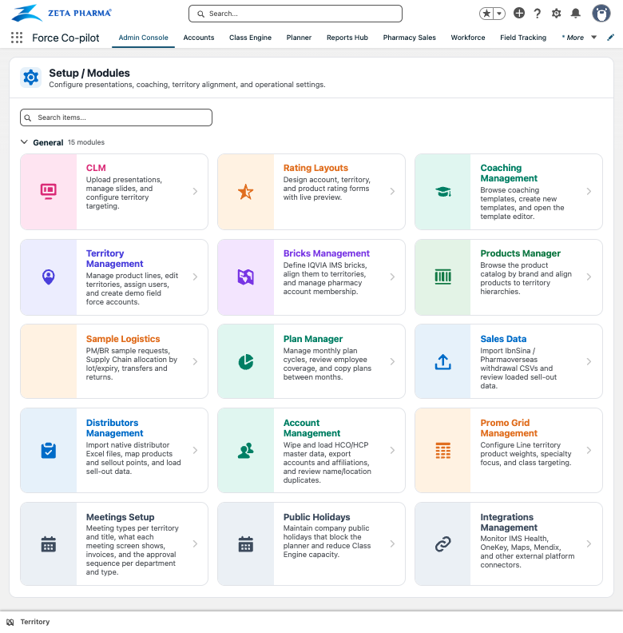
FORCE CO-PILOT · SALESFORCE
Where the company sets the rules
Sales force excellence
This app is for the people who set up the field, not the people out on visits.
Territories, products, bricks, and who is allowed to see which doctor.
How often each class of customer must be visited, and which holidays come out of the plan.
Meeting types, coaching forms, samples, and the data that arrives from distributors.
Reps and managers use the offline apps. This setup stays in Salesforce.
Force Co-pilot Admin Console, Salesforce Lightning
Salesforce for Pharmaceuticals

Slide 13
CARE COACH
The people who support patients
This is not the sales visit
Nurses and coordinators follow a patient over time: the journey, planned calls, and orders.
Calls can be recorded and summarized, so the next person knows what was said.
The drug company can look at the same program with names hidden: initials, age, and gender only.
Care Coach Co-pilot
Salesforce for Pharmaceuticals

